Slide 1
Statistical Literacy:
Bayesian Significance
Milo Schield
Fellow, ASA; New College of Florida
www.MiloSchield.com www.StatLit.org
ASA JSM: August 4, 2026:
Slides, paper and video on the web:
www.statlit.org/pdf/2026-Schield-ASA-Slides.pdf
www.StatLit.org/pdf/2026-Schield-ASA.pdf
www.StatLit.org/V/2026-Schield-ASA.mp4

Slide 2
Non-Repeatable Studies:
Statistically-Significant
Elderly priming: (Bargh et all, 1996)
Participants who unconsciously saw old-age words (bingo) walked more slowly afterward.
Precognition (Bem, 2011)
Future events influenced present behavior.
Power posing (Carney, Cuddy & Yap, 2010)
Expansive body postures increased testosterone, decreased cortisol, and improved risk-taking.

Slide 3

Statistical Significance (SS): Problems and Solutions
If $p<0.05$, you can reject the null hypothesis
Problems: Fixed cutoff:
is misunderstood and ignores important factors
is not theoretically justified. Can vs must.
Solutions:
“Don’t say” (Wasserstein et al, 2019)
Use a lower value (Benjamin 2018)
Attach labels to levels: weak, moderate, strong

Slide 4
Statistical Literacy:
Two Uses of Statistics
Statistical literacy studies statistics used as evidence.
Statistics are used as evidence in two ways:
Scientific research: Evidence is accumulated
Acceptance testing: A decision must be made
Wasserstein focused on statistics in scientific research
Quality control and journal editors use acceptance testing. Accept or reject. Safety regulators and courts use modified acceptance testing: reject vs. fail to reject or guilty vs. not-guilty. These need a statistical cutoff.

Slide 5


Using a single fixed p-value as a cutoff violates ECREE
ECREE: Extraordinary Claims
Require Extraordinary Evidence.
Need
P-value
as a
function of
the
Base Rate
Notes:
ig

Slide 6
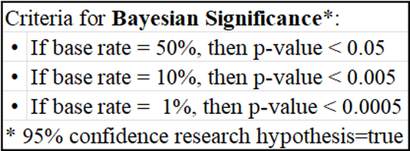
P-value (Base Rate):
Selected Results
Bayesian significance:
95% confidence that the Research hypothesis (H₁) is true given a statistically-significant result

Slide 7
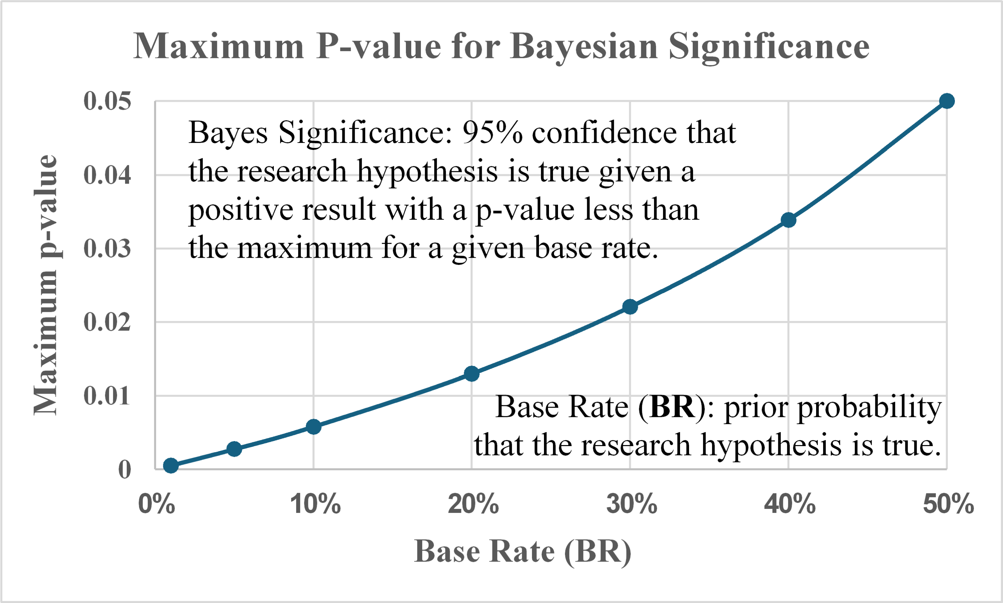
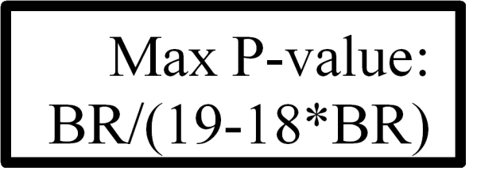
P-value (Base Rate):
Formula for the Results
.
Notes:
Talked with George Cobb about this.
He said, that makes sense. Fisher was looking for higher yields in his crops.

Slide 8
Derive p-value (base rate):
Two Approaches
Two approaches:
Symbolic is better and quicker for teachers or math students
Count tables are better for students who are not used to symbolic notation.
Here are both approaches:

Slide 9

Symbolic Proof:
Pvalue = P(BR)/(19-18*BR)
Start with Bayes rule involving the data (D), the Null (H_{o}) and the research hypothesis (H₁).
Five variables. Let’s eliminate three!
P(H₁ | D) = 0.95 Bayesian significance.
P(H_{o}) = 1 – P(H₁) = 1 – Base Rate = 1 - BR
P(D | H₁) = 1 – P(D | H_{o}) = 1 - Pvalue. Heroic!

Slide 10
Count Table Approach:
SIMPLE MODEL: Five Steps
Start with a medical test: standard 2x2.
Use Simple test: S=Sensitivity=Specificity.
Error rate=ER =Type 2 = Type 1 = 1- S
Introduce Bayes Significance: PPV = 0.95
Replace Disease Status with Research Hypothesis (RH). Introduce formula.
Replace RH(false) with Null Hypothesis(true)
Set p-value = Error Rate: PV= ER.

Slide 11
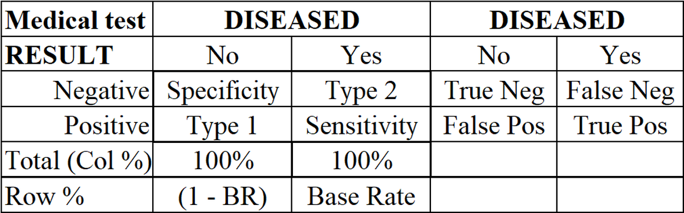
Modelling Acceptance:
1) Medical Tests:
Specificity = P(True Neg | No)
Sensitivity = P(True Pos | Yes)

Slide 12
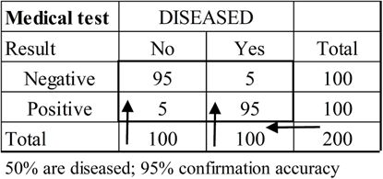
SIMPLE Medical Test:
2) S = Sensitivity=Specificity
If Sensitivity = Specificity, then Type1 = Type2.
PPV = Positive Predictive Value = P(Yes|Pos)
If disease prevalence = 50% and S = 95%
(ER = Type1% = 5%), then PPV = 95%.

Slide 13
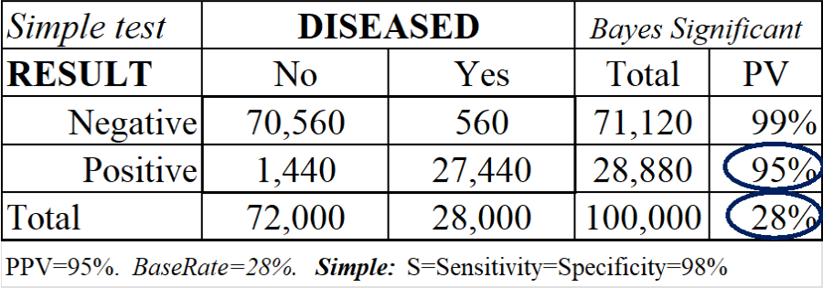
SIMPLE Medical Test:
3) Bayesian Significance
If PPV = 95%, then the result is Bayes Significant
If PPV = 95% and base rate = BR = 28%,
then S must be 98% (Error rate = ER = 2%).
As BaseRate ↓, S must ↑ (ER must ↓).

Slide 14
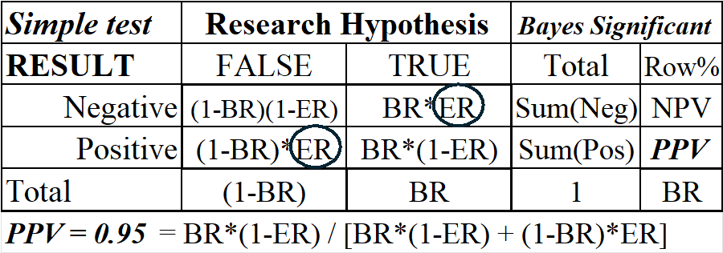
4) Simple Test: Introduce
Research Hypothesis
ER = Error Rate. BR = chance (RH is true).
Problem: No p-value. No Null Hypothesis.
Can’t connect Error Rate to P-value.
Notes:
Where is the statistical test result? Where is the result statistically significant? Where is the null hypothesis: true or false?

Slide 15
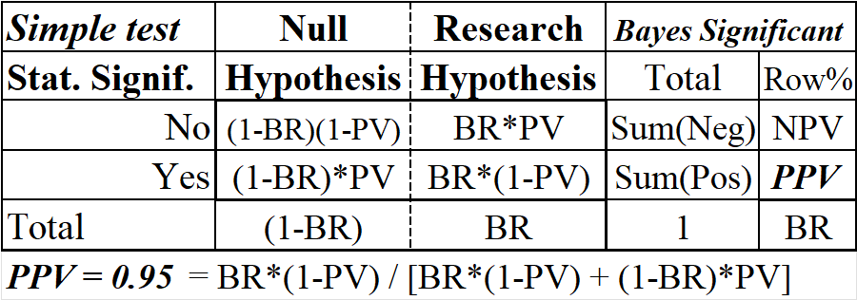
5) Introduce Null Hypothesis, P-value & Stat. Significance
Null hypothesis (True) = Research hypothesis (False).
P-value = Error Rate; PV = ER.
Solve for P-value as a function of Base Rate: PV(BR).

Slide 16
Recommendations for Journal Editors
Editors of statistically-based journals should require Bayesian significance. Editors could presume:
PV = 0.05 (BR = 50%) for plausible experiments.
PV = 0.005 (BR = 10%) for longitudinal observational studies or implausible experiments.
PV=0.0005 (BR = 1%) for cross-sectional studies, implausible longitudinal studies or very unlikely experiments.
Authors or researchers need to argue for a higher base rate to justify a higher p-value.

Slide 17
Bayes Significance:
Can and Should be Taught!
Introduce Bayesian significance.
95% confident that Research Hypothesis is true provided the p-value is below a certain value.
Derive p-value for Bayesian significance.
Derivation can be taught in 30 minutes.
Results can be taught in 2 or 3 minutes.
Results make intuitive sense.
Results are better than existing alternatives.

Slide 18
Social Benefit of
Bayesian Significance
Students: Our students think Bayesian. They expect statistics to derive a formula for Bayes significance. Seeing how the p-value supports Bayesian Significance may help them see the value of studying statistics.
Quantitative Disciplines. Many studies that can not be replicated used p < 0.05 when the research hypothesis was unlikely. Introducing this variable P-value standard may improve the quality of research in the social sciences and minimize BS: Bad Statistics.

Slide 19
Statistical Educators have a Choice
Stop teaching statistical significance in accordance with the 2019 ASA recommendation – even though acceptance testing needs statistical significance.
Continue teaching p < 0.05 for statistical significance – even though it violates Carl Sagan’s ECREE: extraordinary claims require extraordinary evidence.
Support Bayesian significance and a variable p-value based on the plausibility of the research hypothesis.
Present statistical significance including the base rate: 10% statistically-significant. Smaller is better.

Slide 20
Bibliography
ASA (2016) Wasserstein, R. L., & Lazar, N. A. The ASA's statement on
p-values: Context, process, and purpose. The American Statistician, 70(2), 129–133. https://doi.org/10.1080/00031305.2016.1154108
Bargh et all, (1996). Automaticity of social behavior: Direct effects of trait construct and stereotype activation on action. Journal of Personality and Social Psychology, 71(2), 230–244. https://doi.org/10.1037/0022-3514.71.2.230
Bem, D. J. (2011). Feeling the future: Experimental evidence for anomalous retroactive influences on cognition and affect. Journal of Personality and Social Psychology, 100(3), 407–425. https://doi.org/10.1037/a0021524
Benjamin et al. (2018). Redefine Statistical Significance. Nature Human Behaviour, vol. 2, no. 1, 2018, pp. 6–10, https://doi.org/10.1038/s41562-017-0189-z.

Slide 21
Bibliography
Carney, D. R., Cuddy, A. J. C., & Yap, A. J. (2010). Power posing: Brief nonverbal displays affect neuroendocrine levels and risk tolerance. Psychological Science, 21(10), 1363–1368. https://doi.org/10.1177/0956797610383437
Fisher, R.A. (1925). Statistical Methods for Research Workers.
Johnson, V.E. (2019). “Raise the Bar Rather that Retire Significance,” 567 Nature 461 (2019).
Mayo, D. G. (2019). The 2019 ASA Guide to P-values and Statistical Significance: Don’t Say What You Don’t Mean (Some Recommendations) (ii),blog post on Error Statistics Philosophy Blog,
https://errorstatistics.com/2019/06/17
Schachtman, N. (2019). Has the American Statistical Association Gone Post-Modern? https://schachtmanlaw.com/2019/03/24/has-the-american-statistical-association-gone-post-modern/

Slide 22
Bibliography
Sherry et all. (2025). Reproducibility of statistically significant phase III oncology trials: An In Silico meta-epsidemiological analysis. European Journal of Cancer, 226, 115596. https://doi.org/10.1016/j.ejca.2025.115596
Schield, M. (2024). Statistical Literacy: A New Course. ISLP IDSL.
Copy at www.StatLit.org/pdf/2024-Schield-ISLP.pdf
Schield, M. (2023). Statistical Literacy: Critical Thinking about Everyday Statistics. Kendall-Hunt. https://he.kendallhunt.com/product/
statistical-literacy-2023-critical-thinking-about-everyday-statistics
Schield, M. (1996). Using Bayesian Inference in Classical Hypothesis Testing. ASA Section on Statistical Education. Copy at http://www.statlit.org/pdf/1996SchieldASA.pdf
Wasserstein, R. L., Schirm. A. L., & Lazar, N. A. (2019). “Editorial: Moving to a World Beyond ‘p < 0.05’,” 73 Am. Statistician S1, S2 (2019).

Slide 23
JSM Birds of a Feather:
Discuss Bayes Significance
Agenda:_https://docs.google.com/document/d/1CiZCqaNCKAJomHHpF4F2HwoPIA1lhM5_xAXVHJo_-Yk/edit?tab=t.0
Discuss Bayesian Significance.
Wednesday (8/5/2026) 4:00-5:00 pm EDT.
In person: meet at StatEd booth.
Zoom Thurs (8/13/2026) 4:00-5:00 pm EDT
Zoom: https:/augsburg.zoom.us/j/5404394478?
pwd=cy94UlZUTEV5VnFZV1pKRU44Vk1vUT09

Slide 24
Concerns:
Birds of a Feather
Does a ‘statistically-significant result’ have meaning
for a research hypothesis?
Can we justify setting Type2 error rate = Type1?
Can we justify treating (Null Hypothesis = True) the same as (Research Hypothesis = False)?
Can we include the base rate in this modified statistical significance? 10% statistically significant?
Can we justify converting continuous distributions into binary categories? See Schield (1996).

