Slide 1
Statistical Literacy Textbook:
Highlights: Chapters 1-4
Statistical Literacy:
Critical Thinking about Everyday Statistics
Kendall-Hunt 2023
Milo Schield
ASA Fellow
Emeritus: Augsburg University
Visiting Professor: New College of Florida
www.StatLit.org/
pdf/2023-Schield-StatLit-Highlights-Slides.pdf
V/2023-Schield-StatLit-Highlights-Slides.mp4
Notes:
Model Trendline Linear 2Y1X using Excel 2013
11/24/2013 V0a
www.StatLit.org/pdf/Model-Trendline-Linear-2Y1X-Excel2013-6up.pdf
1
Analyzing Numbers in the News
15 May 2008
2008SchieldNNN6up.pdf
1
1

Slide 2
Table of Contents
2
Ch Pg Title
1 3 The Story Behind the Statistics
2 59 Comparisons and CARE Solutions
3 116 Understanding Measurements
4 177 Describing Ratios: Percent & Percentage
--------
5 217 Describing Ratios: Rate & Chance
6 234 Comparing Ratios
7 270 Interpreting Confusing Ratios
8 321 Randomness
Notes:
Model Trendline Linear 2Y1X using Excel 2013
11/24/2013 V0a
www.StatLit.org/pdf/Model-Trendline-Linear-2Y1X-Excel2013-6up.pdf
2
Analyzing Numbers in the News
15 May 2008
2008SchieldNNN6up.pdf
2
2

Slide 3
Chapter 1: Critical Thinking and Statistical Literacy
P 3
3
1.1 3 Learning outcomes
1.2 4 Introduction
1.3 12 Critical Thinking Issues
1.4 21 Statistical Literacy Issues
1.5 42 Stories
1.6 45 Chapter summary
1.7 46 Optional/advanced
Notes:
Model Trendline Linear 2Y1X using Excel 2013
11/24/2013 V0a
www.StatLit.org/pdf/Model-Trendline-Linear-2Y1X-Excel2013-6up.pdf
3
Analyzing Numbers in the News
15 May 2008
2008SchieldNNN6up.pdf
3
3

Slide 4
# Statistics are Different % from Numbers!!!
P 6
4
Statistics are different from numbers! 100 is a number.
Statistics have units – where the units matter.
‘100 malnourished white workers’ is a statistic.
Numbers: 1 plus 1 is always 2!
Stats: 1 bunny and 1 bunny?
More than 2 bunnies?
Stats: 1 ice cube and 1 ice cube?
Less than 2 ice cubes?
Statistics are socially constructed by people.
Statistics can be influenced or manipulated.
Notes:
Model Trendline Linear 2Y1X using Excel 2013
11/24/2013 V0a
www.StatLit.org/pdf/Model-Trendline-Linear-2Y1X-Excel2013-6up.pdf
4
Analyzing Numbers in the News
15 May 2008
2008SchieldNNN6up.pdf
4
4

Slide 5
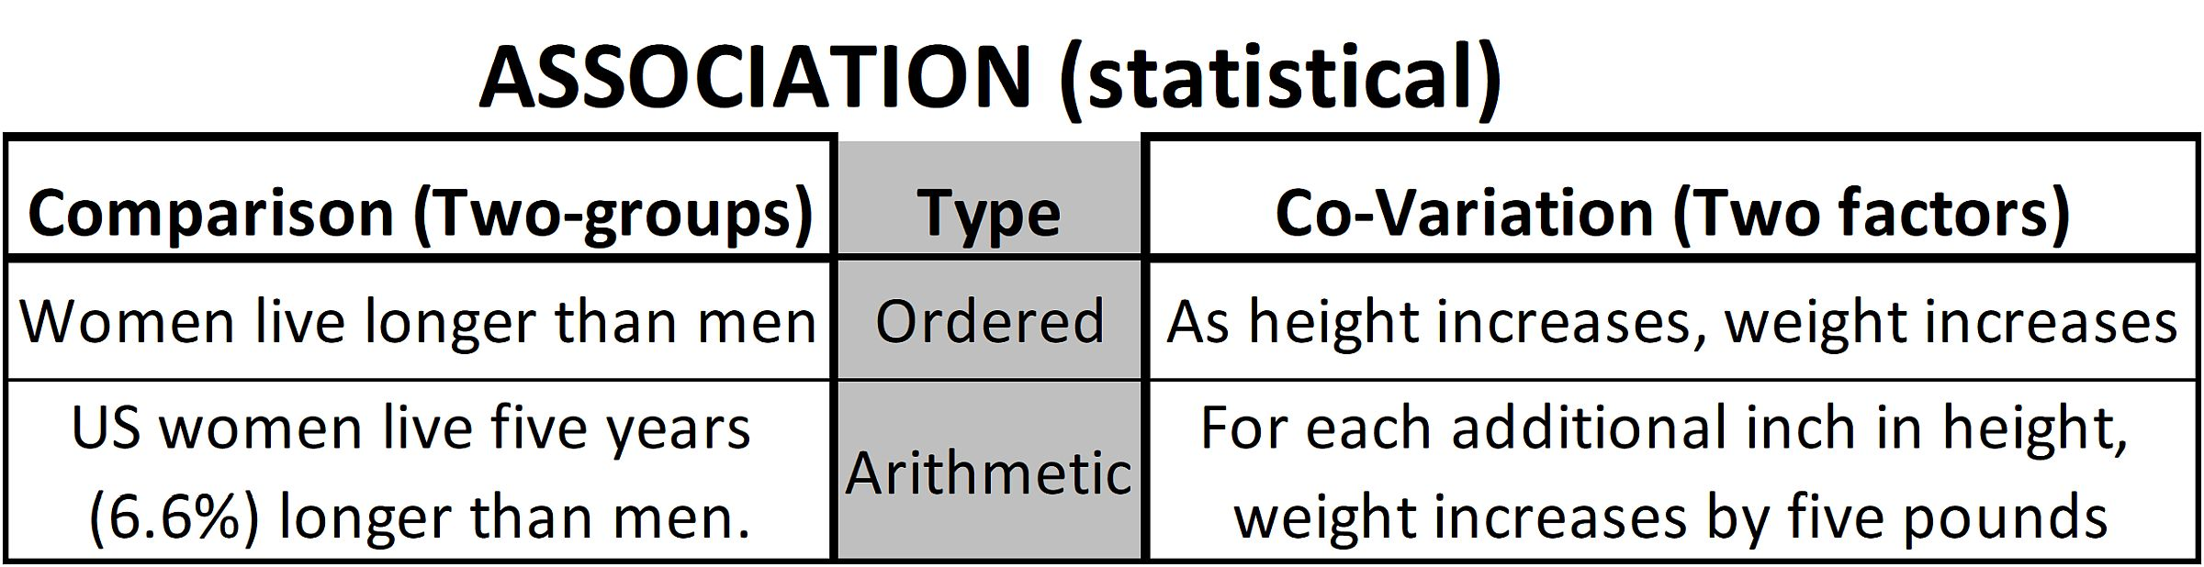
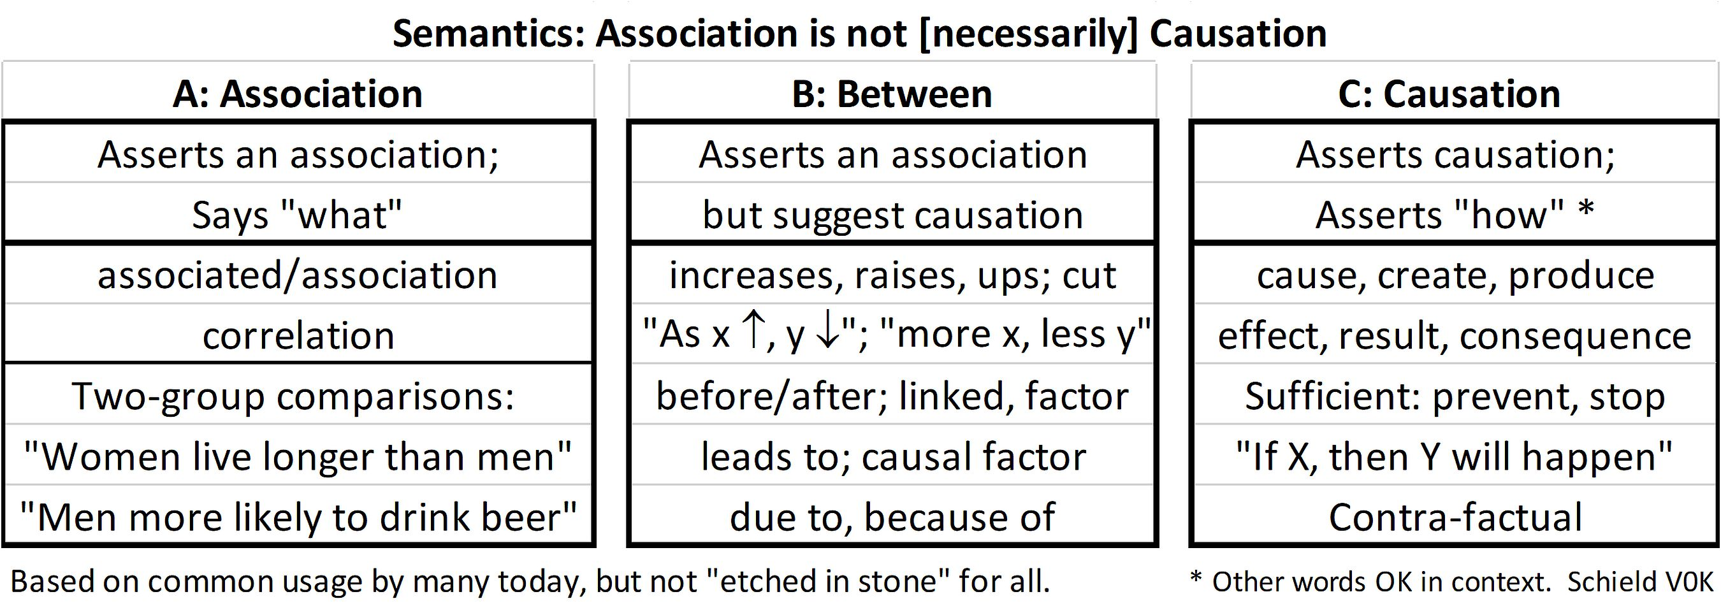
Association: Two Kinds.
Association vs. Causation
.
5
P 12+16
.
Notes:
Model Trendline Linear 2Y1X using Excel 2013
11/24/2013 V0a
www.StatLit.org/pdf/Model-Trendline-Linear-2Y1X-Excel2013-6up.pdf
5
Analyzing Numbers in the News
15 May 2008
2008SchieldNNN6up.pdf
5
5

Slide 6
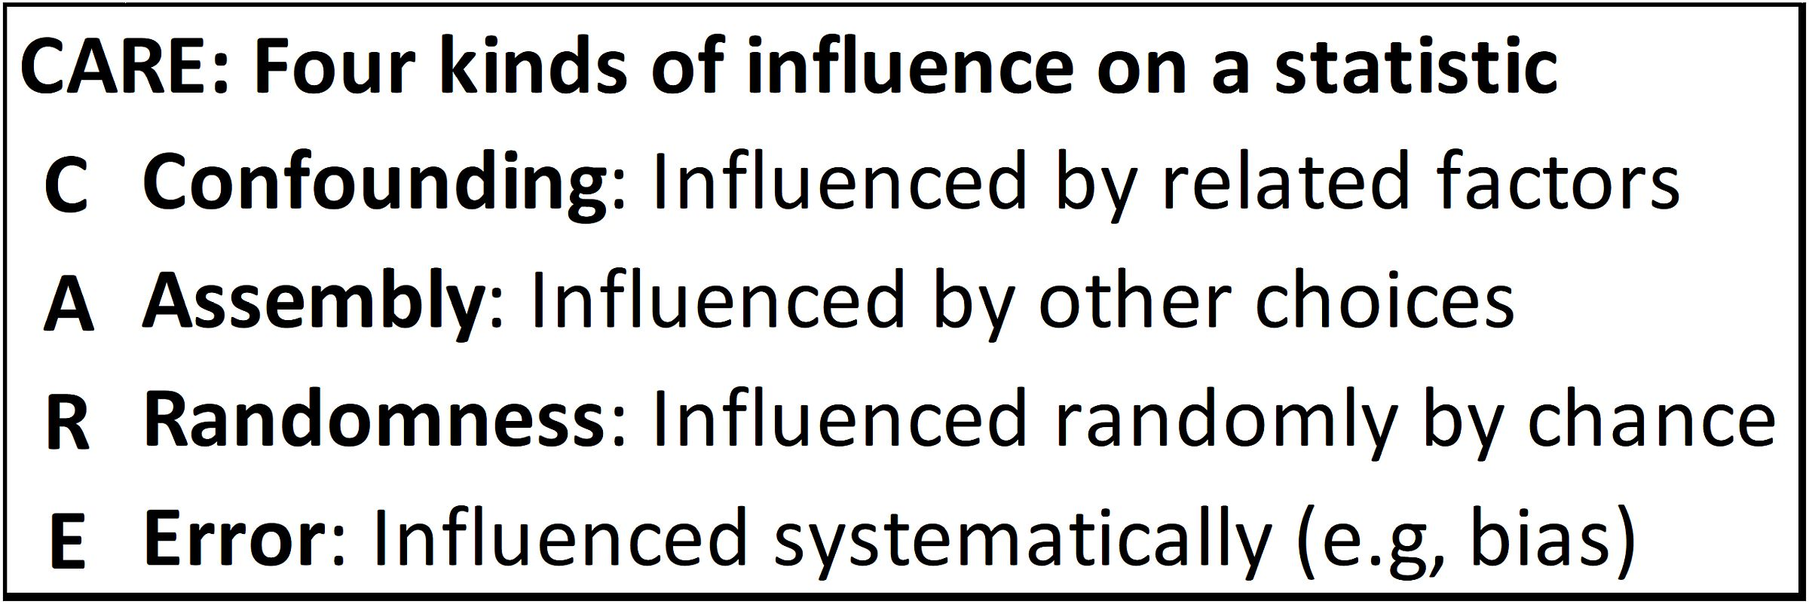
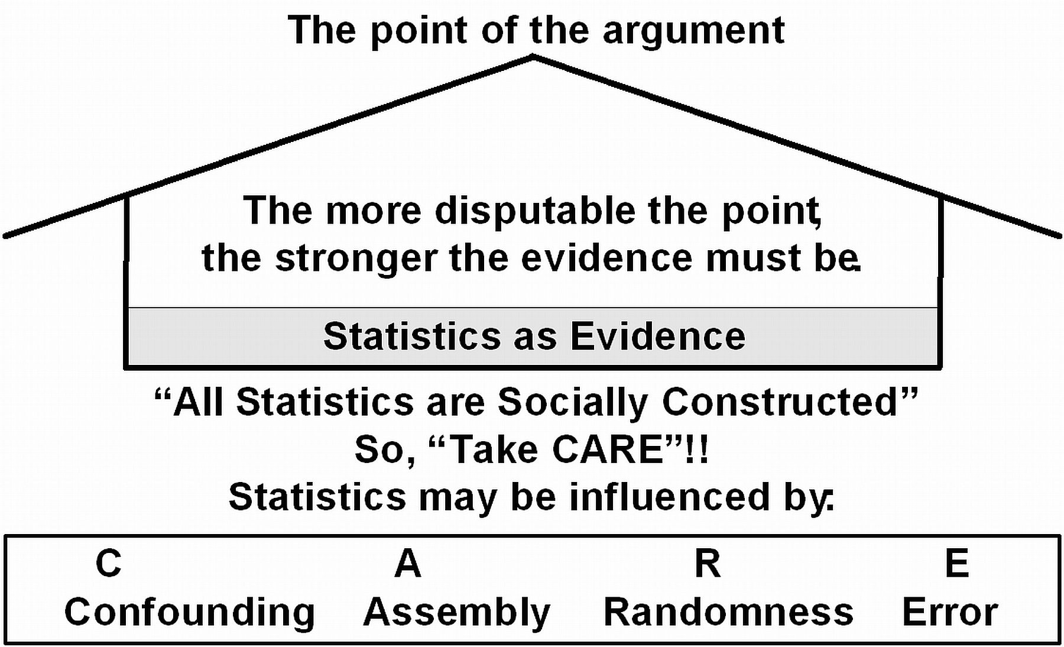
Statistics can be influenced:
So, take CARE!
P 11
6
.
Notes:
Model Trendline Linear 2Y1X using Excel 2013
11/24/2013 V0a
www.StatLit.org/pdf/Model-Trendline-Linear-2Y1X-Excel2013-6up.pdf
6
Analyzing Numbers in the News
15 May 2008
2008SchieldNNN6up.pdf
6
6

Slide 7
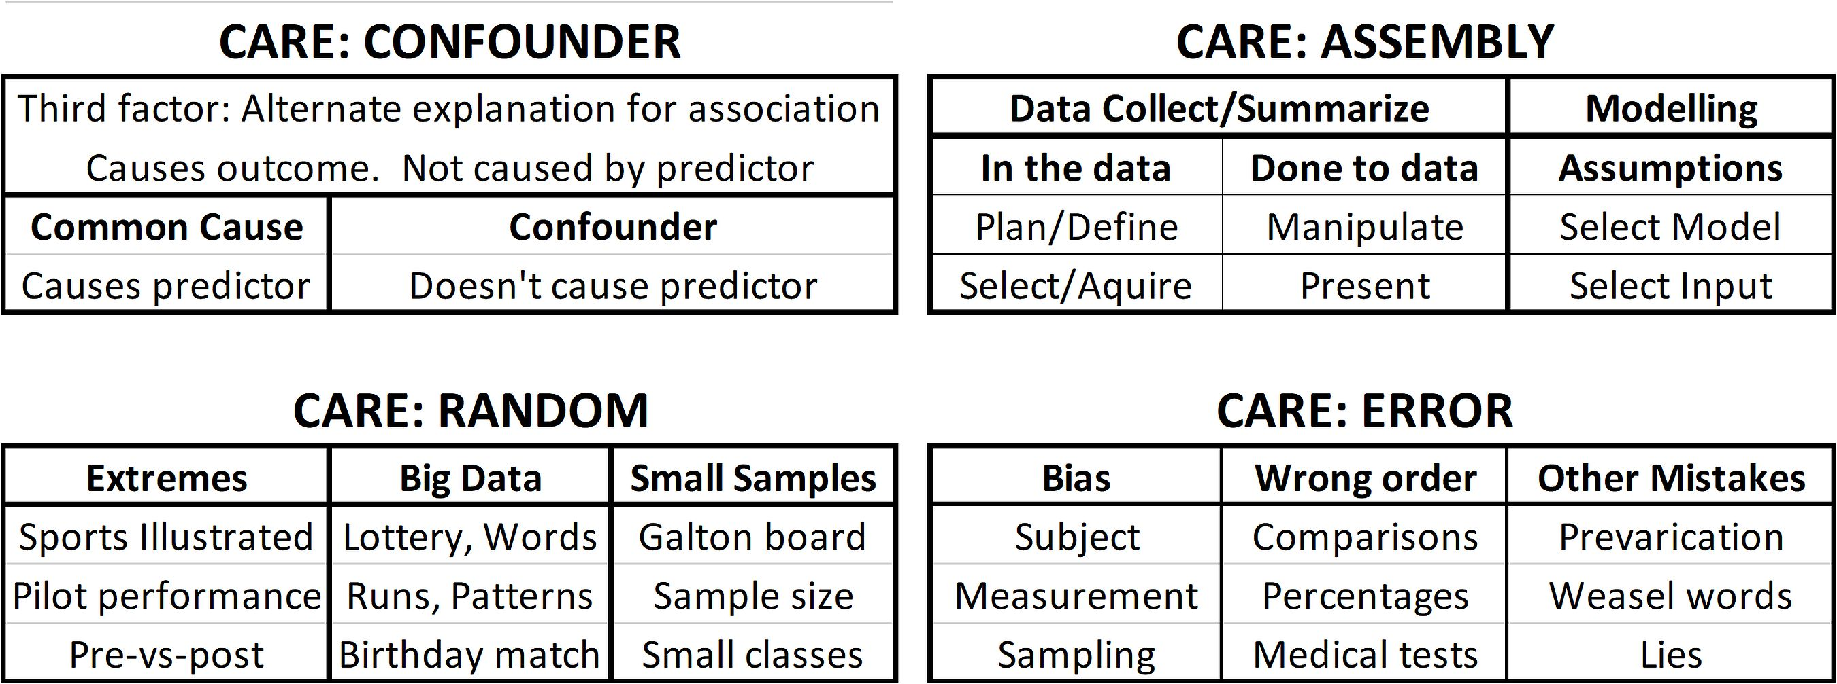
Statistics can be Influenced:
Four Kinds of Influences
P 45
7
Best advice in dealing with statistics: Take CARE!
The influences on a statistic are classified into four groups:
* Confounding, Assembly, Randomness and Error/bias
Notes:
Model Trendline Linear 2Y1X using Excel 2013
11/24/2013 V0a
www.StatLit.org/pdf/Model-Trendline-Linear-2Y1X-Excel2013-6up.pdf
7
Analyzing Numbers in the News
15 May 2008
2008SchieldNNN6up.pdf
7
7

Slide 8
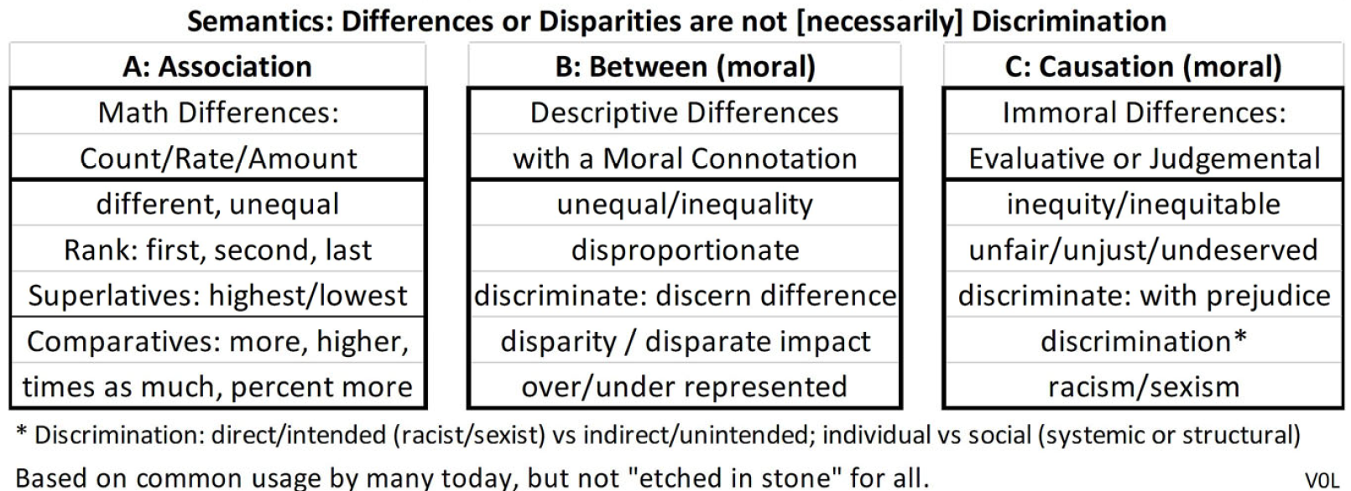
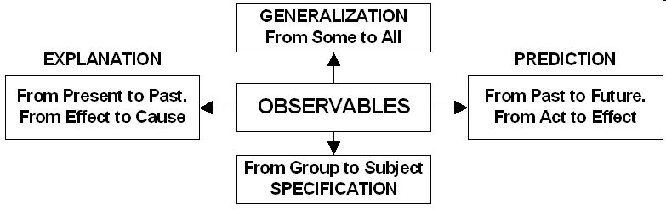
Association vs Moral Causation
Statistical Inference
P 47+54
8
.
Notes:
Model Trendline Linear 2Y1X using Excel 2013
11/24/2013 V0a
www.StatLit.org/pdf/Model-Trendline-Linear-2Y1X-Excel2013-6up.pdf
8
Analyzing Numbers in the News
15 May 2008
2008SchieldNNN6up.pdf
8
8

Slide 9
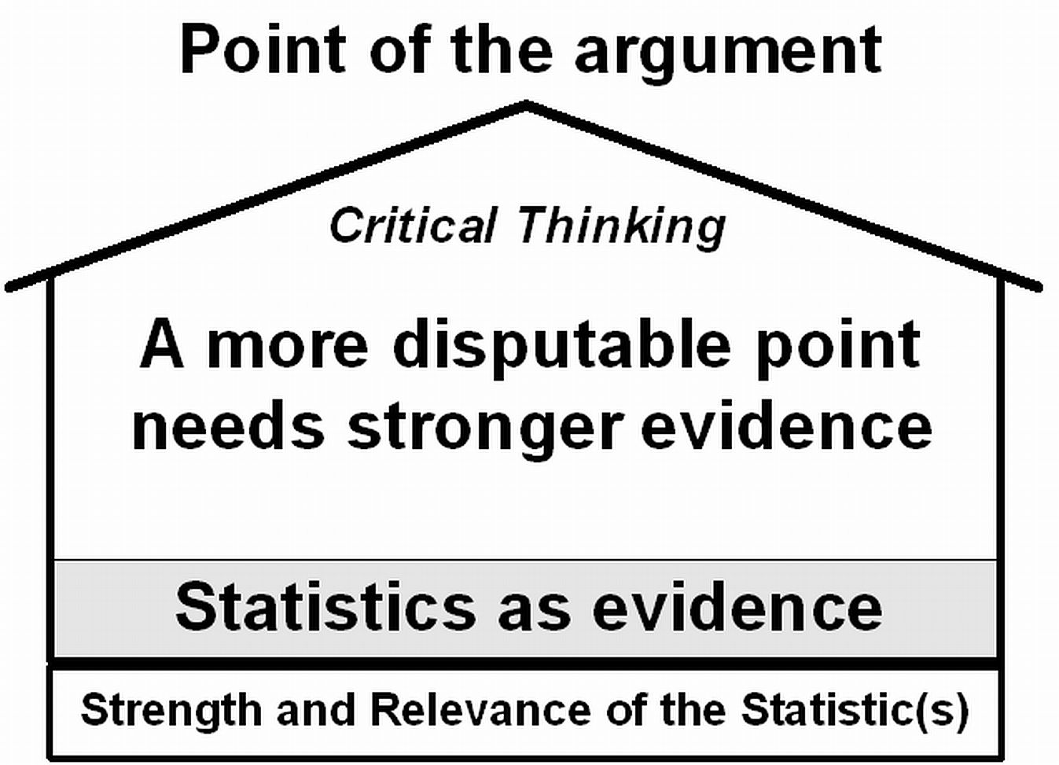
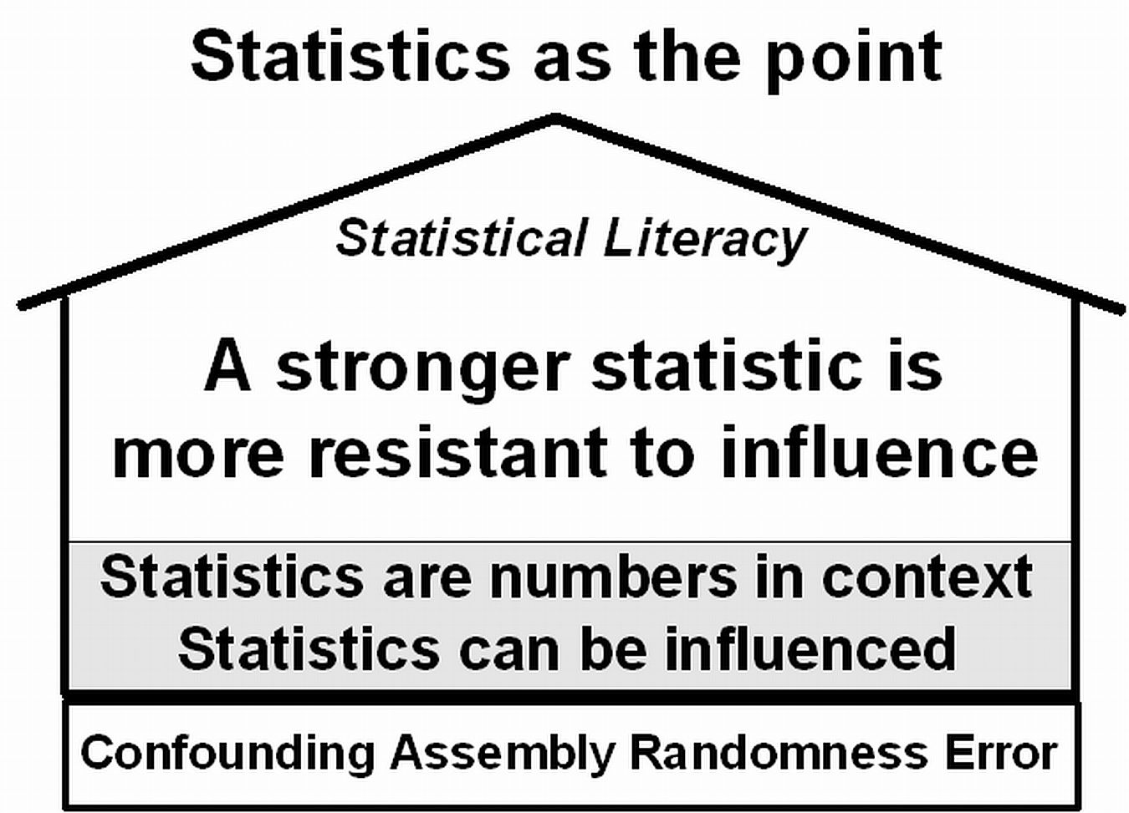
Statistics are typically found in arguments
P 51
9
The focus is on arguments: inductive arguments.
.
Statistics as a reason Statistics as the conclusion
Notes:
Model Trendline Linear 2Y1X using Excel 2013
11/24/2013 V0a
www.StatLit.org/pdf/Model-Trendline-Linear-2Y1X-Excel2013-6up.pdf
9
Analyzing Numbers in the News
15 May 2008
2008SchieldNNN6up.pdf
9
9

Slide 10
Chapter 2:
CARE Solutions
.
10
P 59
2.1 p 60 Learning Outcomes
2.2 p 60 Review
2.3 p 60 Association (two-group and two-factor)
2.4 p 68 Confounder Solutions
2.5 p 86 Assembly Solutions
2.6 p 90 Randomness Solutions
2.7 p 97 Error/Bias Solutions
2.8 p 100 Analyzing Stories
2.9 p 104 Chapter Summary
2.10 p 105 Advanced/Optional
Notes:
Model Trendline Linear 2Y1X using Excel 2013
11/24/2013 V0a
www.StatLit.org/pdf/Model-Trendline-Linear-2Y1X-Excel2013-6up.pdf
10
Analyzing Numbers in the News
15 May 2008
2008SchieldNNN6up.pdf
10
10

Slide 11
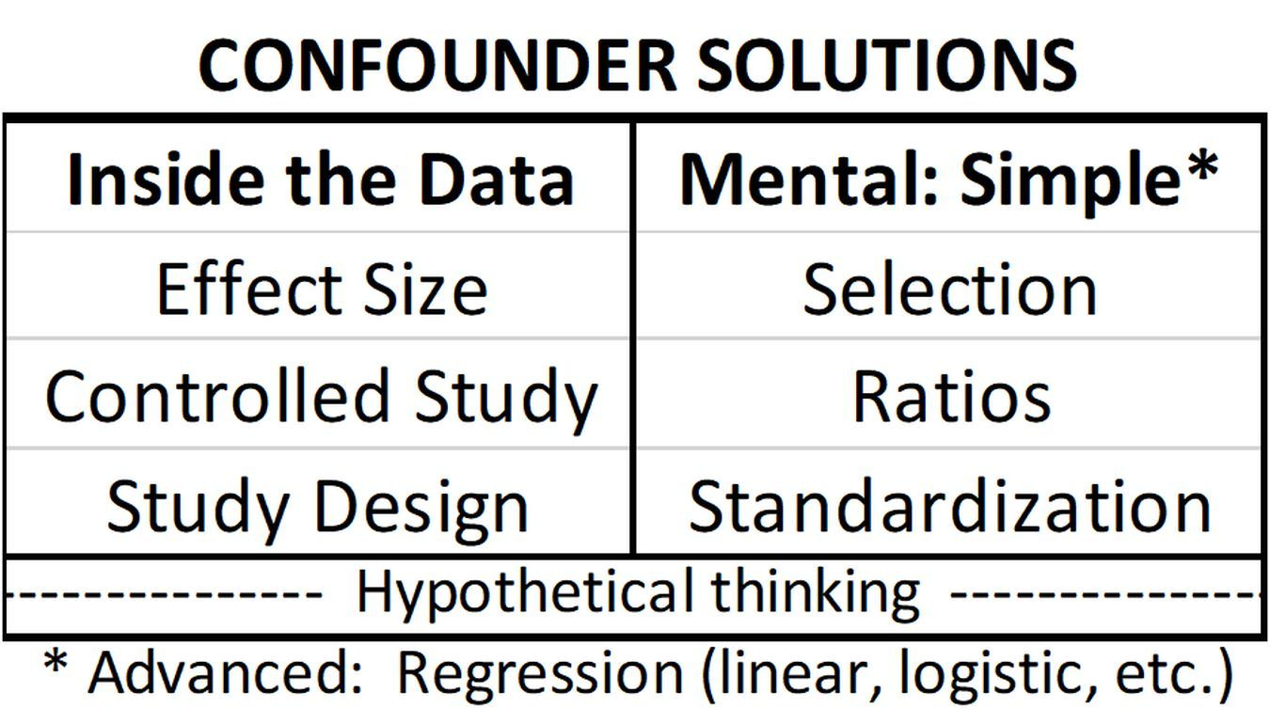
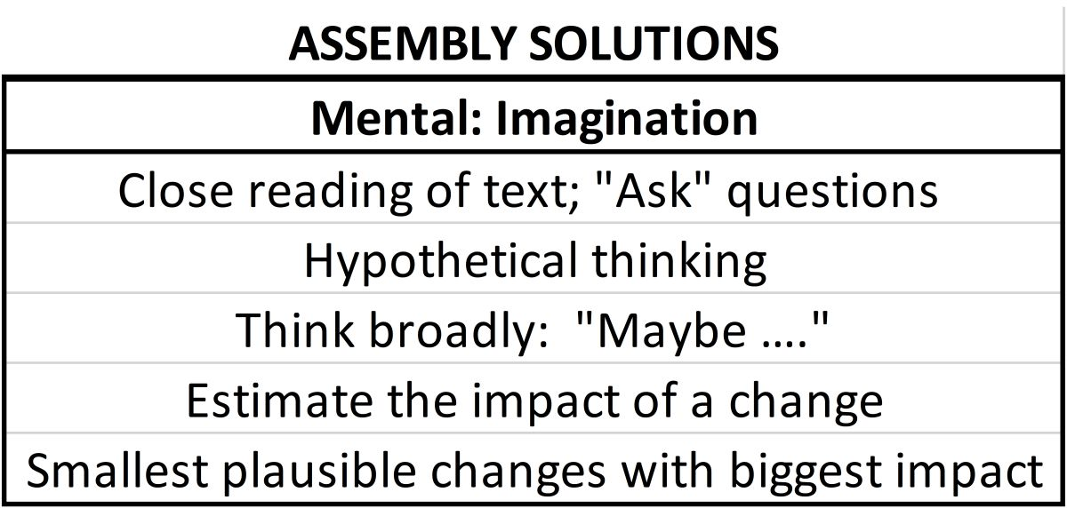
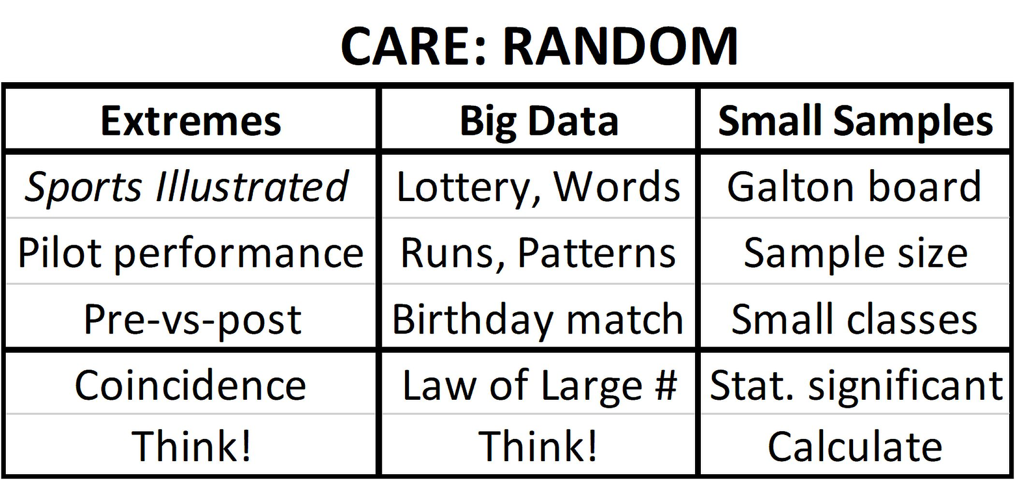
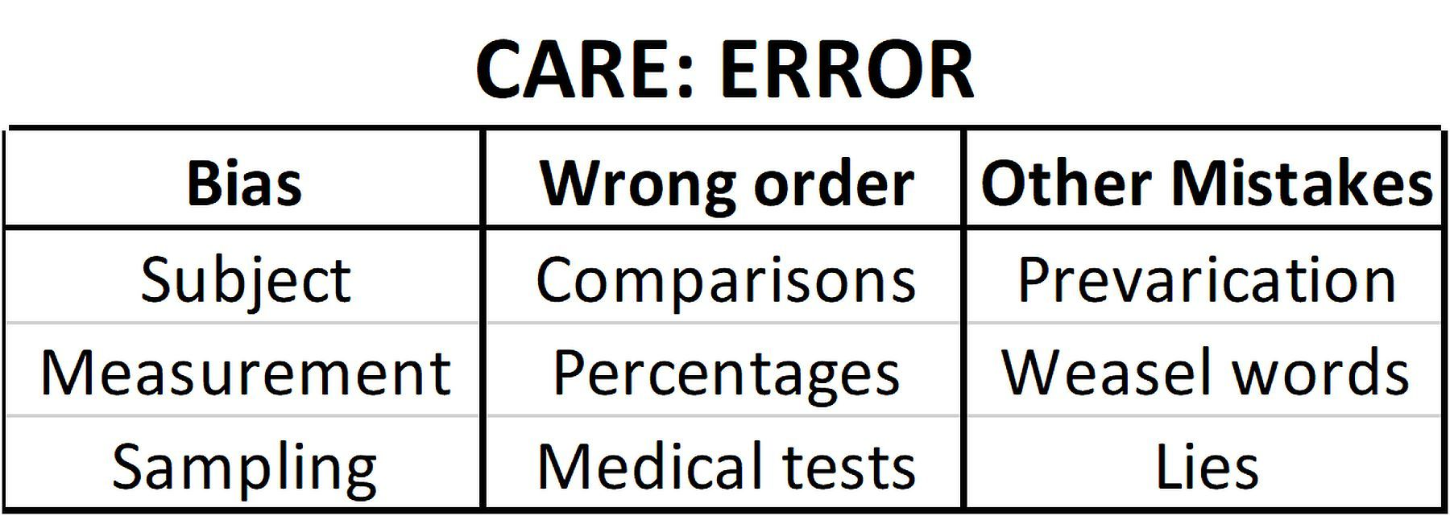
Chapter 2
The CARE Solutions
.
11
P 67+85
See below Think! Think!
*Bias: Single blind, double blind, random selection
*
Notes:
Model Trendline Linear 2Y1X using Excel 2013
11/24/2013 V0a
www.StatLit.org/pdf/Model-Trendline-Linear-2Y1X-Excel2013-6up.pdf
11
Analyzing Numbers in the News
15 May 2008
2008SchieldNNN6up.pdf
11
11

Slide 12
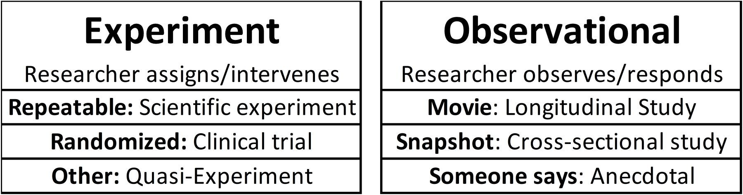
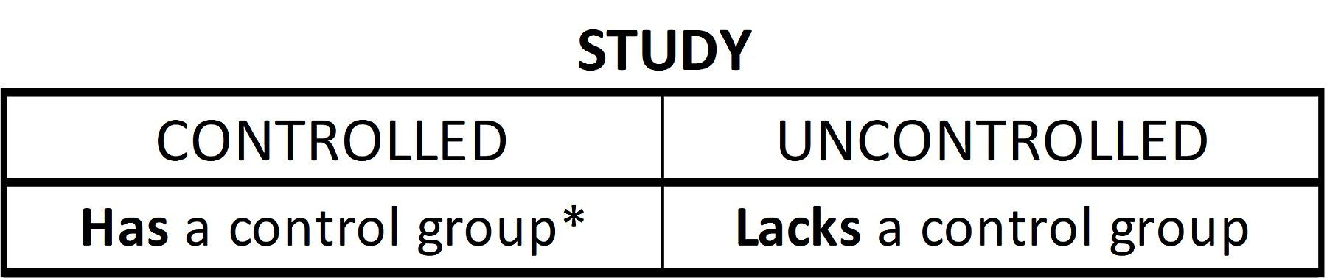
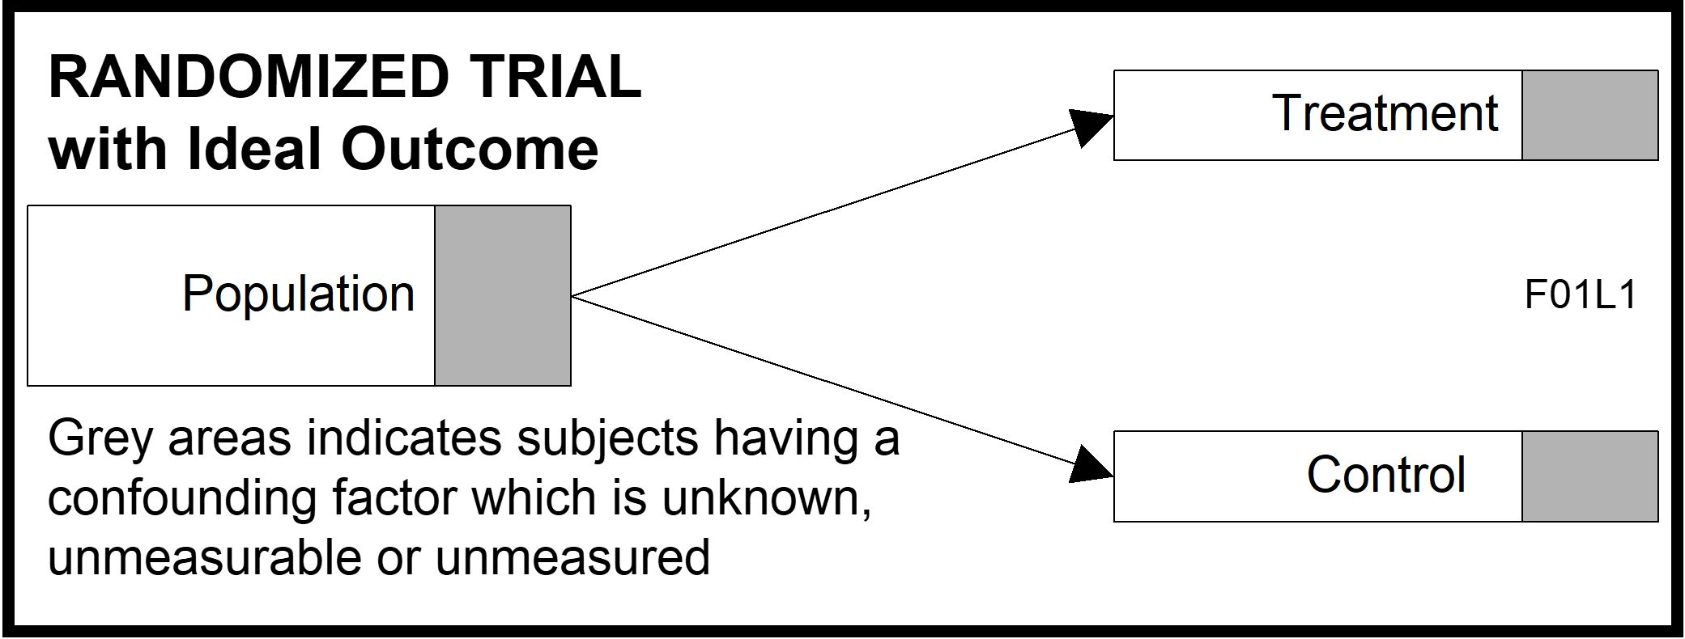
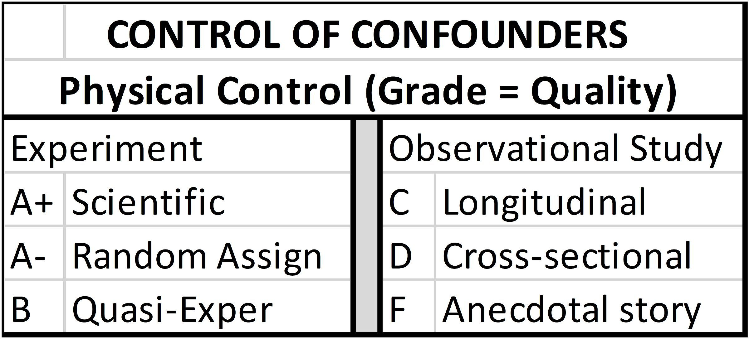
Confounder Solutions:
Study Design
.
12
P 69+70+72
Hard Science Soft Science
.
Notes:
Model Trendline Linear 2Y1X using Excel 2013
11/24/2013 V0a
www.StatLit.org/pdf/Model-Trendline-Linear-2Y1X-Excel2013-6up.pdf
12
Analyzing Numbers in the News
15 May 2008
2008SchieldNNN6up.pdf
12
12

Slide 13
Randomness: Solutions
P 90
13
Extremes: If due to chance, extremes seldom repeat
C.f., the Sports Illustrated jinx
Law of Big Data
The unlikely is almost certain given enough tries.
Expect unlikely events in big data.
Small-sample randomness.
If two 95% confidence intervals don’t overlap,
their difference is statistically significant.
Notes:
Model Trendline Linear 2Y1X using Excel 2013
11/24/2013 V0a
www.StatLit.org/pdf/Model-Trendline-Linear-2Y1X-Excel2013-6up.pdf
13
Analyzing Numbers in the News
15 May 2008
2008SchieldNNN6up.pdf
13
13

Slide 14
Chapter 3:
Understanding Measurements
P 116
14
3.1 p 116 Learning Outcomes
3.2 p 117 Review
3.3 p 117 Data and Data Distributions
3.4 p 121 Measures of Location
3.5 p 125 Measures of Center
3.6 p 134 Assembly on Measures of Center
3.7 p 137 Confounder Solutions: Standardizing
3.8 p 157 The Essentials
3.9 p 160 Chapter Summary
3.10 p 160 Advanced/Optional
Notes:
Model Trendline Linear 2Y1X using Excel 2013
11/24/2013 V0a
www.StatLit.org/pdf/Model-Trendline-Linear-2Y1X-Excel2013-6up.pdf
14
Analyzing Numbers in the News
15 May 2008
2008SchieldNNN6up.pdf
14
14

Slide 15
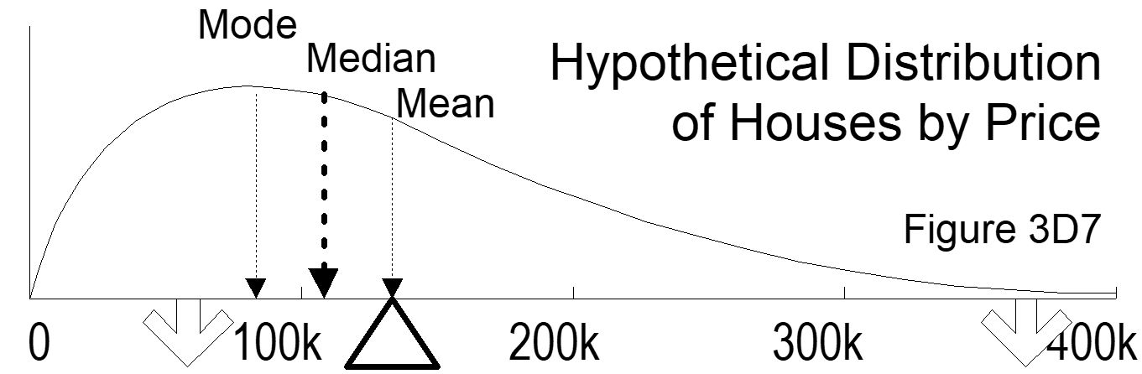
Assembly:
Choice of Summary Statistic
3.5.3: P 127
15
Assembly involves choices in defining, counting measuring, summarizing and presenting.
Mean, median and mode are three ways of summarizing.
If skewed, order is alphabetical. Mean is most extreme.
Notes:
Model Trendline Linear 2Y1X using Excel 2013
11/24/2013 V0a
www.StatLit.org/pdf/Model-Trendline-Linear-2Y1X-Excel2013-6up.pdf
15
Analyzing Numbers in the News
15 May 2008
2008SchieldNNN6up.pdf
15
15

Slide 16
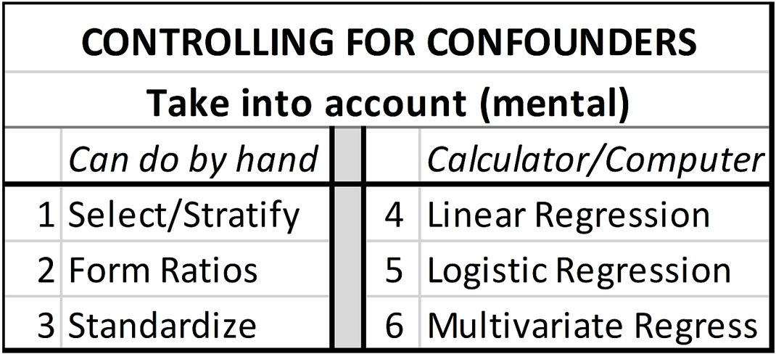
C: Confounding
Mental Solutions
Ch 3.2: P 117
16
Other classes focus on what can be done using computers.
This class focuses on what can be done mentally (by hand)
This chapter introduces ‘standardization’.
Notes:
Model Trendline Linear 2Y1X using Excel 2013
11/24/2013 V0a
www.StatLit.org/pdf/Model-Trendline-Linear-2Y1X-Excel2013-6up.pdf
16
Analyzing Numbers in the News
15 May 2008
2008SchieldNNN6up.pdf
16
16

Slide 17
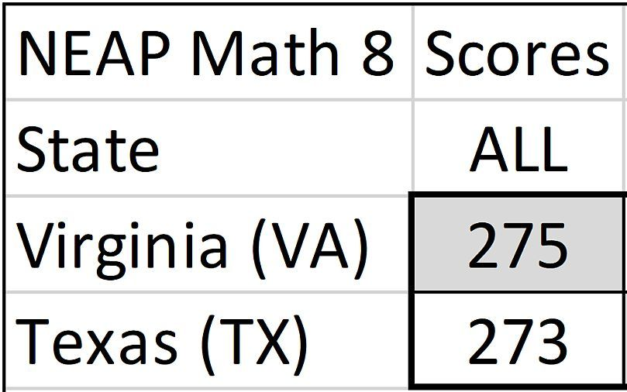
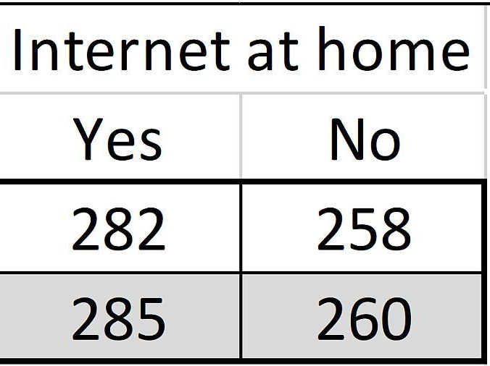
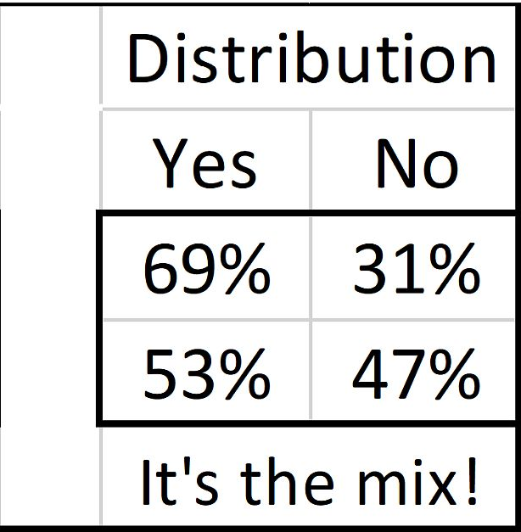
Simpson’s Paradox:
It’s the mix!
Ch 3.7.4: P 145
17
ALL: Virginia (275) higher than Texas (273).
Texas wins 1st half and 2nd half. But Texas loses the game.
Impossible with counts; not with ratios!
Why? It’s the mix!
Selection: If both had the same mix, Texas would win!
Notes:
Model Trendline Linear 2Y1X using Excel 2013
11/24/2013 V0a
www.StatLit.org/pdf/Model-Trendline-Linear-2Y1X-Excel2013-6up.pdf
17
Analyzing Numbers in the News
15 May 2008
2008SchieldNNN6up.pdf
17
17

Slide 18
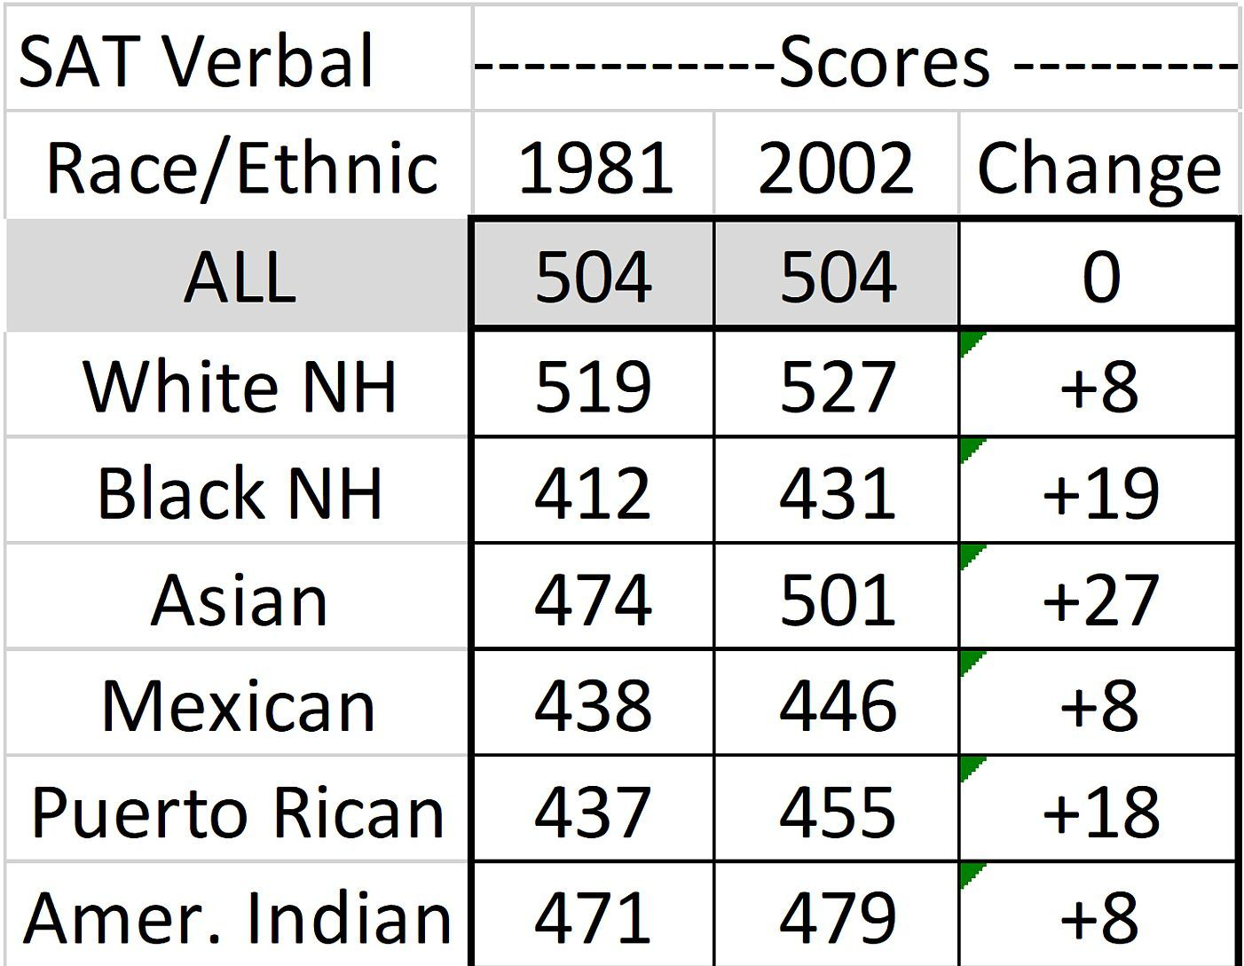
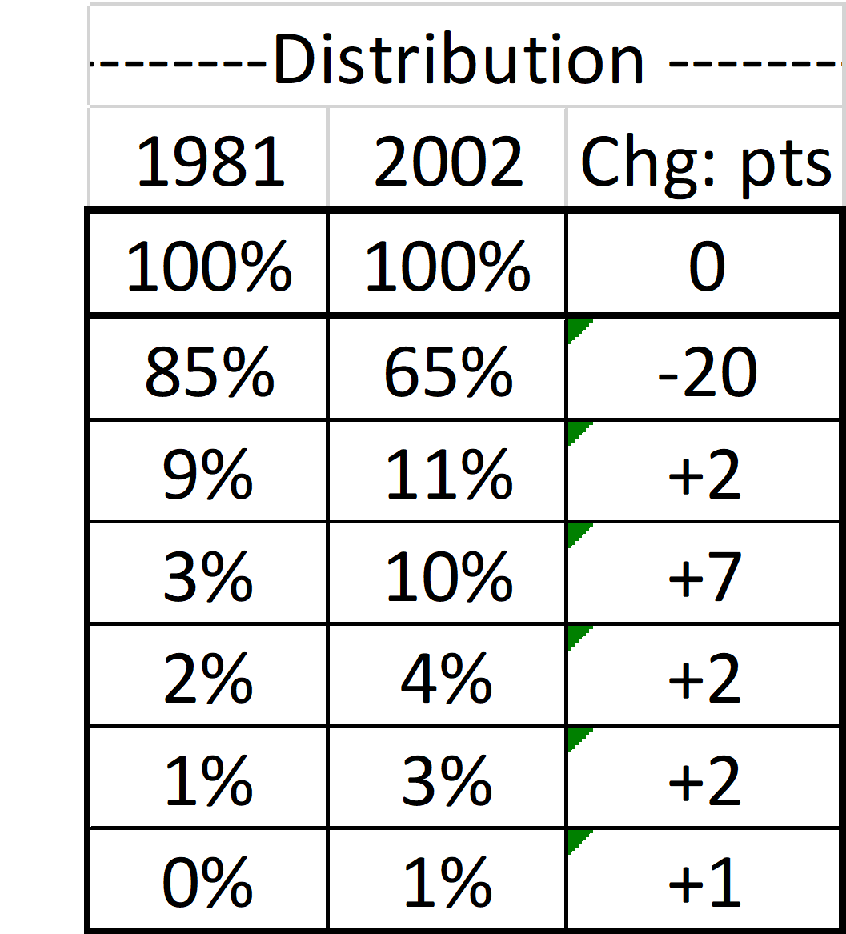
SAT Scores Over Time:
It’s the mix!
Ch 3.7.4: P 145
18
How can the average score stay the same
when each group’s score got better?
Notes:
Model Trendline Linear 2Y1X using Excel 2013
11/24/2013 V0a
www.StatLit.org/pdf/Model-Trendline-Linear-2Y1X-Excel2013-6up.pdf
18
Analyzing Numbers in the News
15 May 2008
2008SchieldNNN6up.pdf
18
18

Slide 19
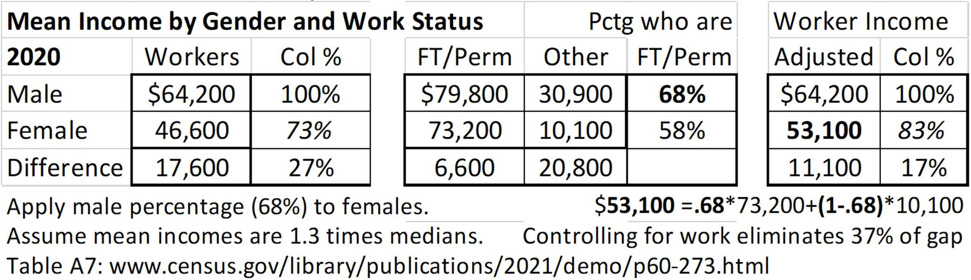
Standardizing Arithmetically:
Male-Female Income Gap
Ch 3.7.4: P 145
19
Crude Compare: Women make 73 cents for every dollar a man makes.
Adjusted: After taking into account work status, women make 83¢ for every dollar a man makes.
Notes:
Model Trendline Linear 2Y1X using Excel 2013
11/24/2013 V0a
www.StatLit.org/pdf/Model-Trendline-Linear-2Y1X-Excel2013-6up.pdf
19
Analyzing Numbers in the News
15 May 2008
2008SchieldNNN6up.pdf
19
19

Slide 20
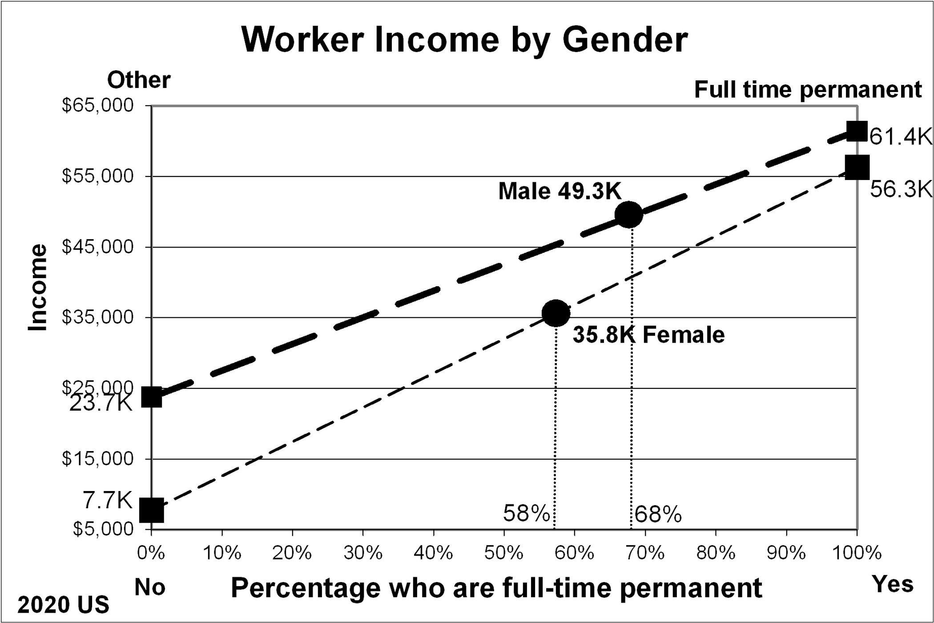
Male-Female Income Gap:
Crude Comparison
Ch 3.7.5.1: P 153
20
Women make 73 cents for each dollar a man makes.
Notes:
Model Trendline Linear 2Y1X using Excel 2013
11/24/2013 V0a
www.StatLit.org/pdf/Model-Trendline-Linear-2Y1X-Excel2013-6up.pdf
20
Analyzing Numbers in the News
15 May 2008
2008SchieldNNN6up.pdf
20
20

Slide 21
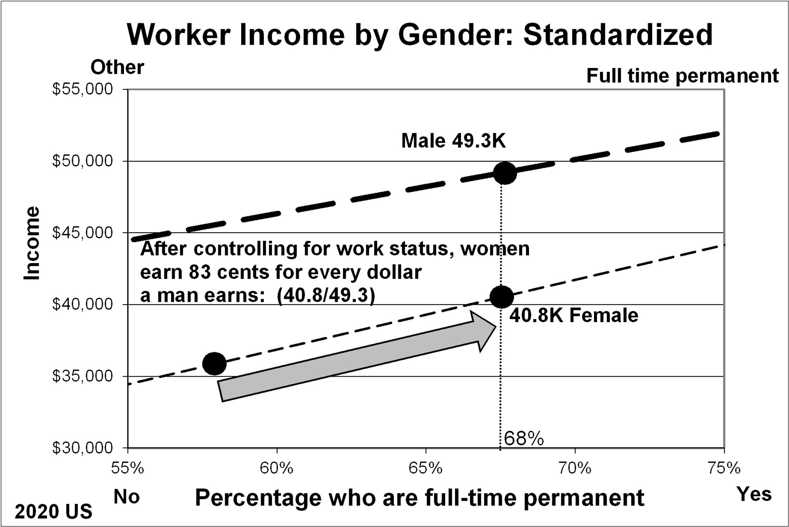
Male-Female Income Gap:
Adjusted Comparison
Ch 3.7.5 P 144
21
After taking into account work status,
women make 83¢ for every dollar a man makes.
Controlling for work status cuts 40% of the gap.
Notes:
Model Trendline Linear 2Y1X using Excel 2013
11/24/2013 V0a
www.StatLit.org/pdf/Model-Trendline-Linear-2Y1X-Excel2013-6up.pdf
21
Analyzing Numbers in the News
15 May 2008
2008SchieldNNN6up.pdf
21
21

Slide 22
Cornfield Conditions
P 172
22
After learning how easily everyday statistics can be influenced, a student decided never to trust a statistic.
This is not a undesirable outcome. Cynicism
isn’t much better than naivete (being clueless).
Cornfield proved: confounder must be bigger
than a predictor to reverse an association.
Cornfield conditions are necessary – not sufficient
Notes:
Model Trendline Linear 2Y1X using Excel 2013
11/24/2013 V0a
www.StatLit.org/pdf/Model-Trendline-Linear-2Y1X-Excel2013-6up.pdf
22
Analyzing Numbers in the News
15 May 2008
2008SchieldNNN6up.pdf
22
22

Slide 23
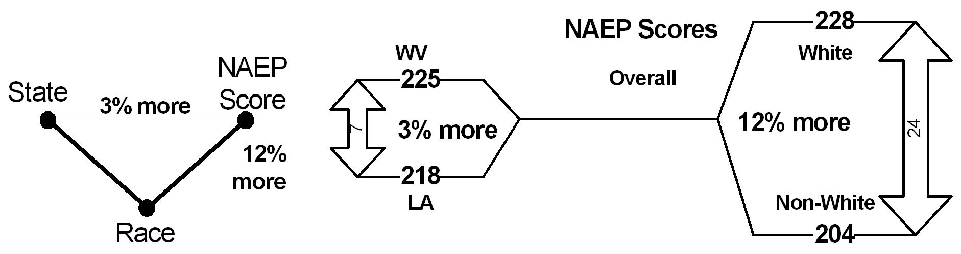
Cornfield Conditions:
4th Grade Math: White vs. Black
P 172
23
To reverse, confounder must be bigger than predictor
Racial gap (24 points) > State gap (7 points)
Will standardizing reverse? Not necessarily!
Notes:
Model Trendline Linear 2Y1X using Excel 2013
11/24/2013 V0a
www.StatLit.org/pdf/Model-Trendline-Linear-2Y1X-Excel2013-6up.pdf
23
Analyzing Numbers in the News
15 May 2008
2008SchieldNNN6up.pdf
23
23

Slide 24
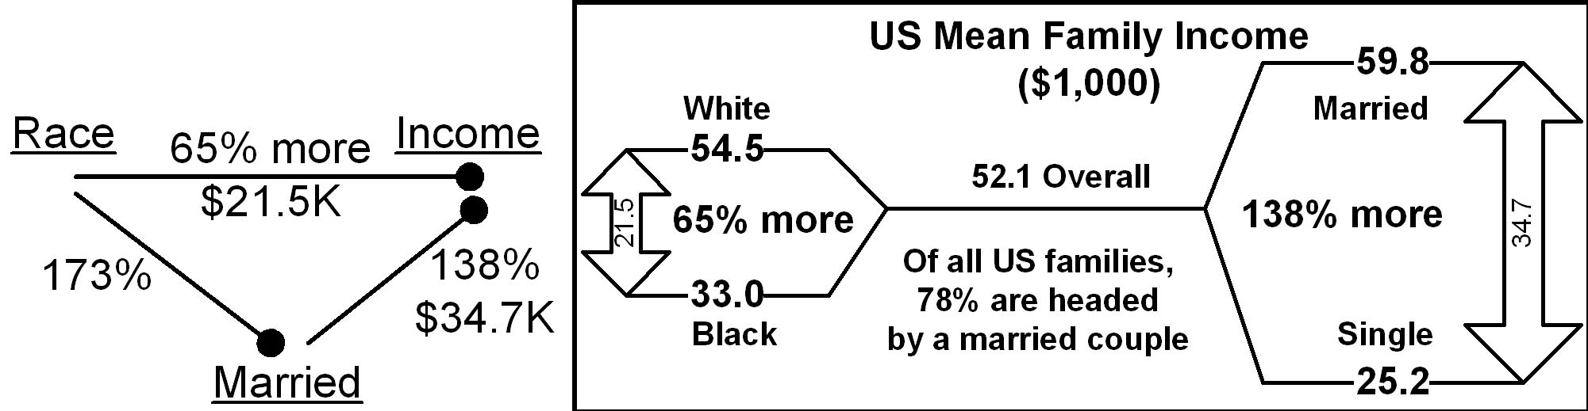
Cornfield Conditions:
Family Income: White vs. Black
P 173
24
To reverse, confounder must be bigger than predictor.
This is a necessary condition.
Marital status gap (35K) > Race gap (22K)
Will standardizing reverse? Not necessarily!
Notes:
Model Trendline Linear 2Y1X using Excel 2013
11/24/2013 V0a
www.StatLit.org/pdf/Model-Trendline-Linear-2Y1X-Excel2013-6up.pdf
24
Analyzing Numbers in the News
15 May 2008
2008SchieldNNN6up.pdf
24
24

Slide 25
Chapter 4 Ratios of Counts:
Describe Percentages; Read Tables
P 177
25
4.1 p 177 Learning Outcomes
4.2 p 178 Review
4.3 p 178 Part-Whole Ratios
4.4 p 182 Percent Grammar Statements
4.5 p 193 Percentage Grammar Statements
4.6 p 199 Count Tables (Percent or Percentage)
4.7 p 200 Distribution Grammar: Discrete Data
4.8 p 201 Half-Tables of Percentages
4.9 p 210 Chapter Summary
Notes:
Model Trendline Linear 2Y1X using Excel 2013
11/24/2013 V0a
www.StatLit.org/pdf/Model-Trendline-Linear-2Y1X-Excel2013-6up.pdf
25
Analyzing Numbers in the News
15 May 2008
2008SchieldNNN6up.pdf
25
25

Slide 26
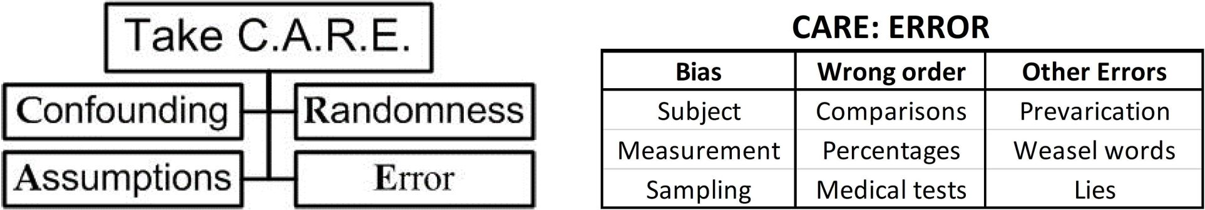
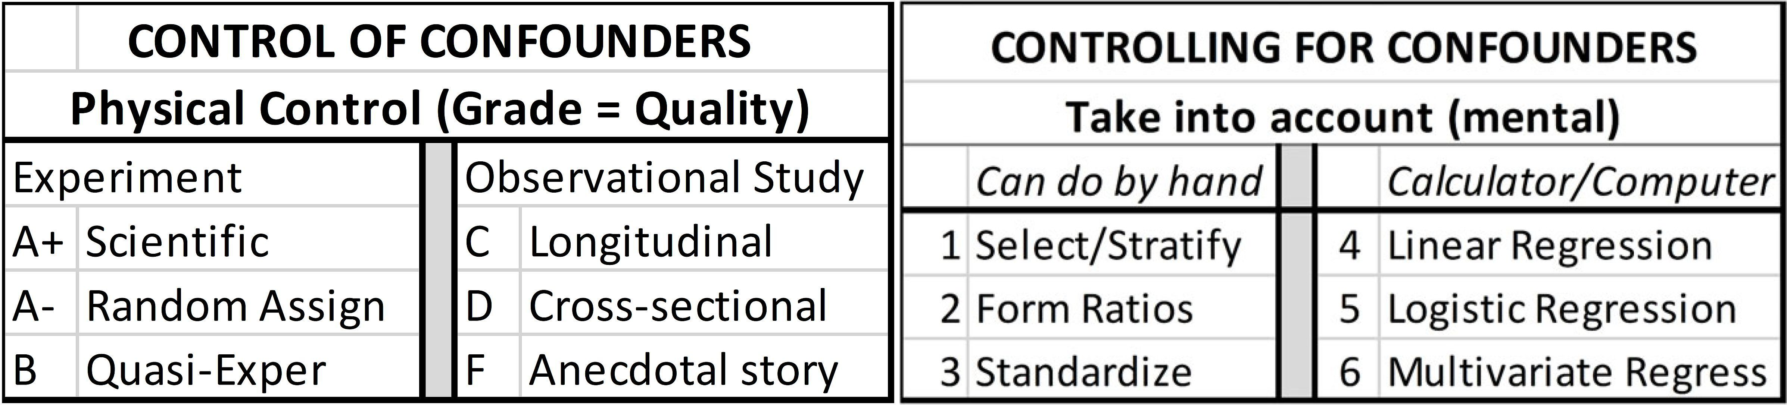
Chapter 4 Review
Chapter 1 (CARE); Chapter 2 (Control)
Ch 4.2, P 178
26
.
Percent & percentage grammar
Notes:
Model Trendline Linear 2Y1X using Excel 2013
11/24/2013 V0a
www.StatLit.org/pdf/Model-Trendline-Linear-2Y1X-Excel2013-6up.pdf
26
Analyzing Numbers in the News
15 May 2008
2008SchieldNNN6up.pdf
26
26

Slide 27
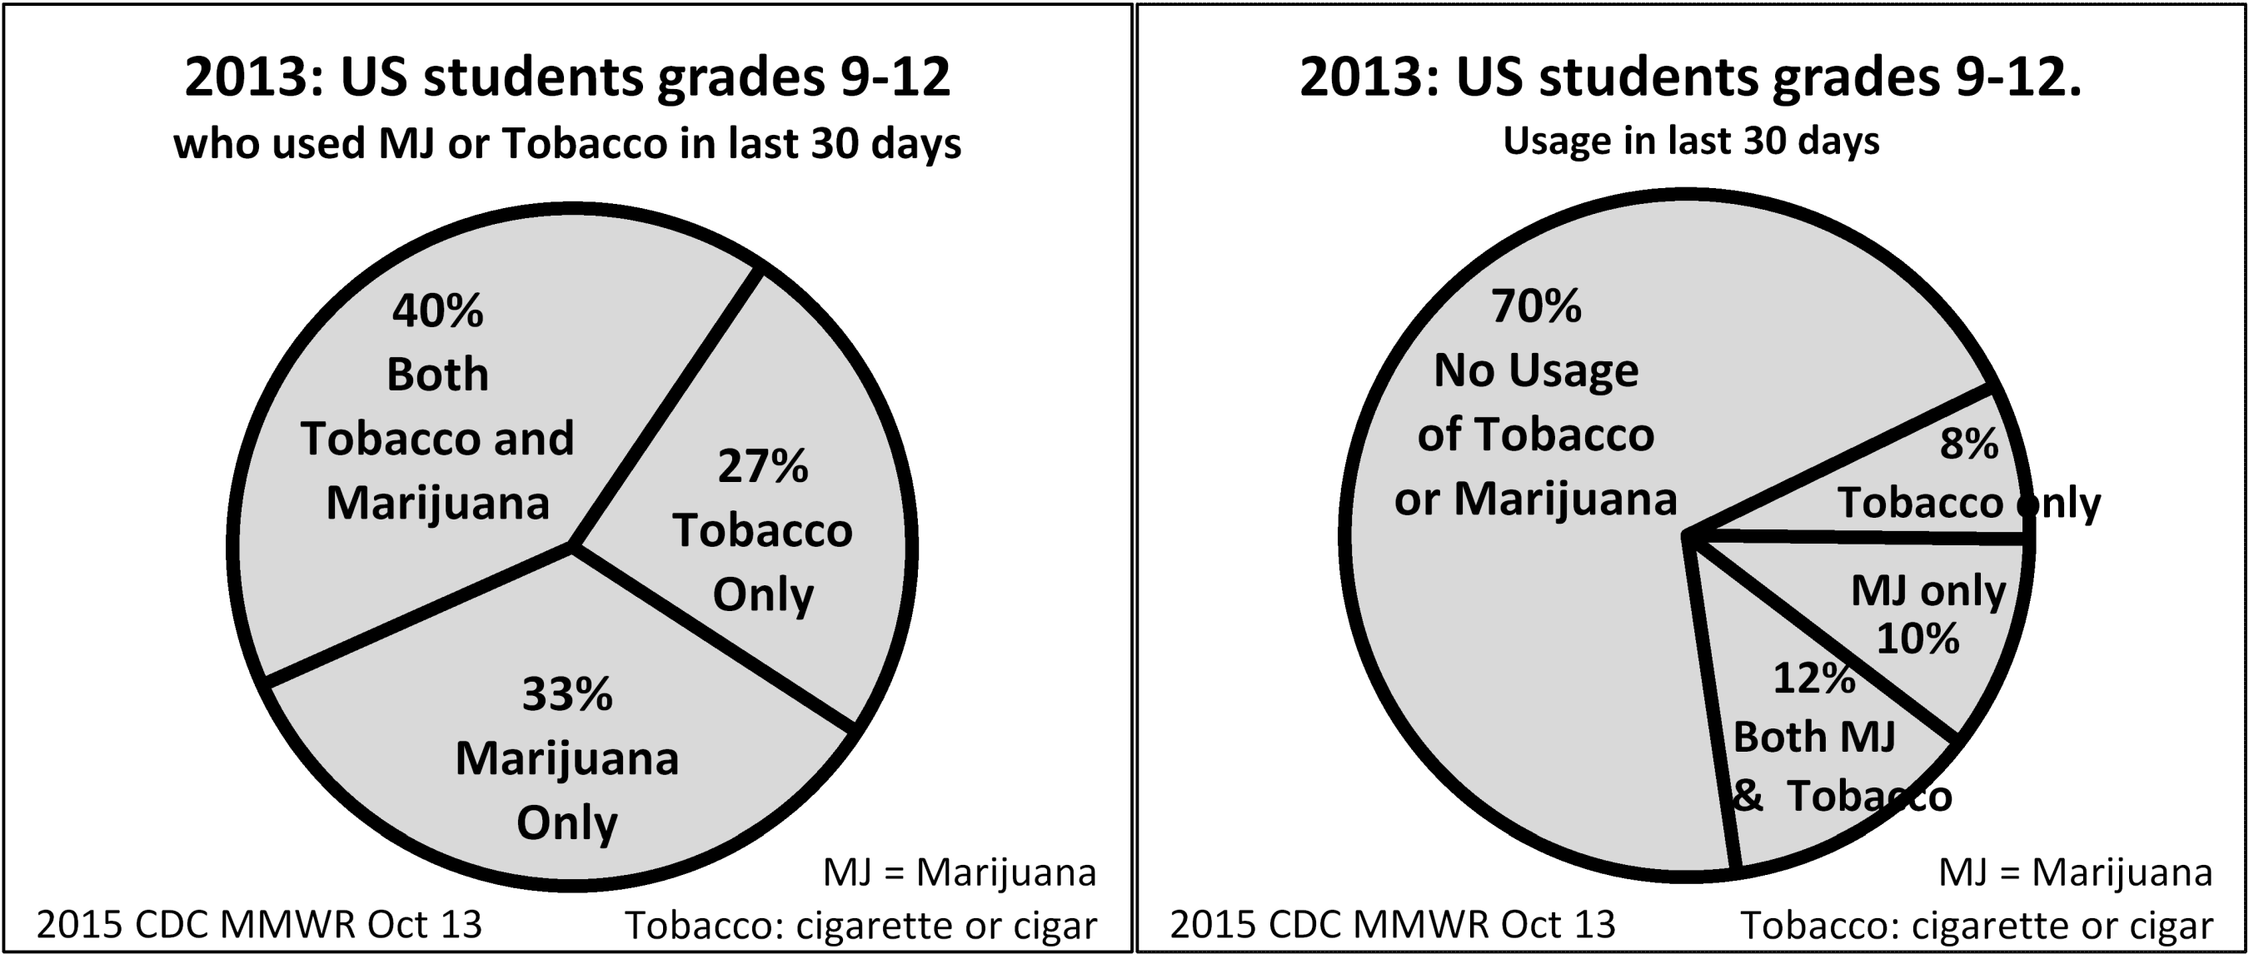
Pie Charts:
Close Reading is Critical!
Ch 4.3; P 181
27
In 2013, of US students grades 9-12,
27% smoked tobacco only in last 30 days.
8% smoked tobacco only in last 30 days.
Notes:
Model Trendline Linear 2Y1X using Excel 2013
11/24/2013 V0a
www.StatLit.org/pdf/Model-Trendline-Linear-2Y1X-Excel2013-6up.pdf
27
Analyzing Numbers in the News
15 May 2008
2008SchieldNNN6up.pdf
27
27

Slide 28
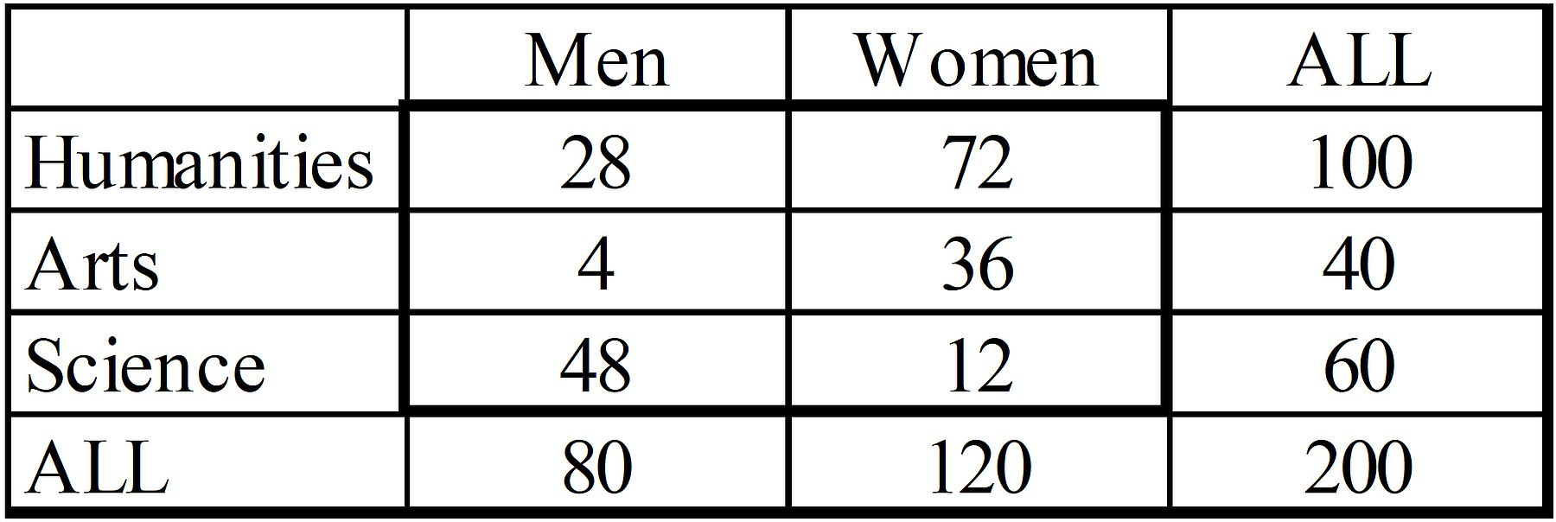
Count Tables:
Two Kinds of Questions
Ch 4.6; P 199
28
How many men are art majors?
How many art majors are men?
How many students are male art majors?
Order does not matter
What percentage of men are art majors?
What fraction of art majors are men?
What proportion of students are male art majors?
Order matters!
Notes:
Model Trendline Linear 2Y1X using Excel 2013
11/24/2013 V0a
www.StatLit.org/pdf/Model-Trendline-Linear-2Y1X-Excel2013-6up.pdf
28
Analyzing Numbers in the News
15 May 2008
2008SchieldNNN6up.pdf
28
28

Slide 29
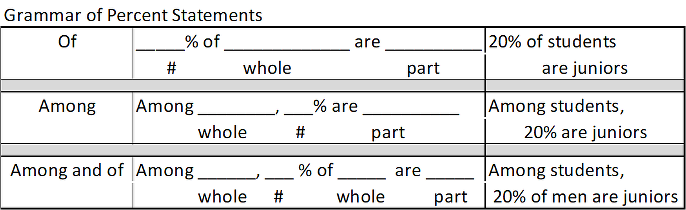
Percent Grammar:
Statement Template
Ch 4.4; P 183
29
‘Among’ and ‘of’ introduce the whole.
Main verb separates the part and whole.
Notes:
Model Trendline Linear 2Y1X using Excel 2013
11/24/2013 V0a
www.StatLit.org/pdf/Model-Trendline-Linear-2Y1X-Excel2013-6up.pdf
29
Analyzing Numbers in the News
15 May 2008
2008SchieldNNN6up.pdf
29
29

Slide 30
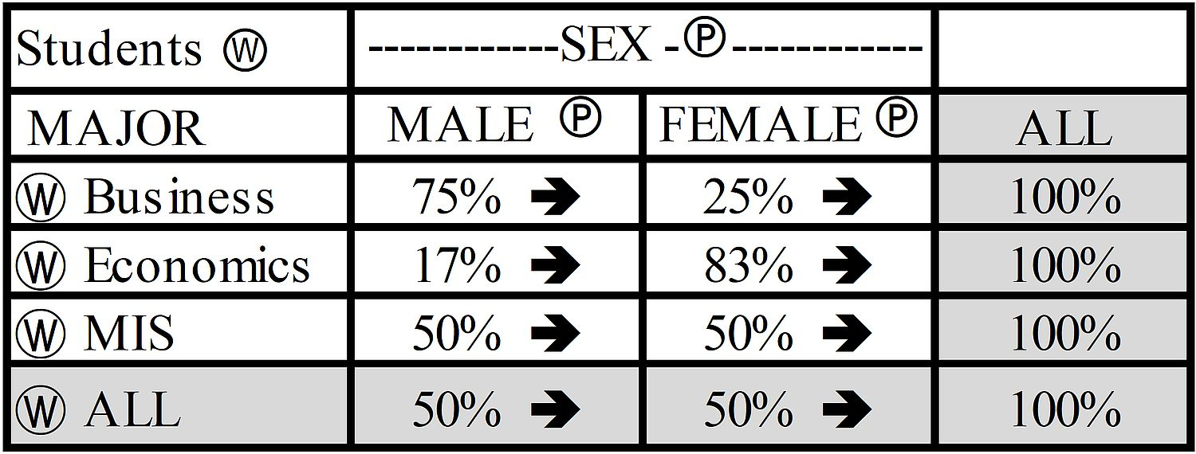
Percent Grammar:
100% Row Tables
Ch 4.4; P 186
30
Describe the 75% in the top row left column:
1) Row: 76% of business majors are men [OK]
2) Column: Among men, 75% are business majors
3) Table: Of students, 75% are male business majors
Notes:
Model Trendline Linear 2Y1X using Excel 2013
11/24/2013 V0a
www.StatLit.org/pdf/Model-Trendline-Linear-2Y1X-Excel2013-6up.pdf
30
Analyzing Numbers in the News
15 May 2008
2008SchieldNNN6up.pdf
30
30

Slide 31
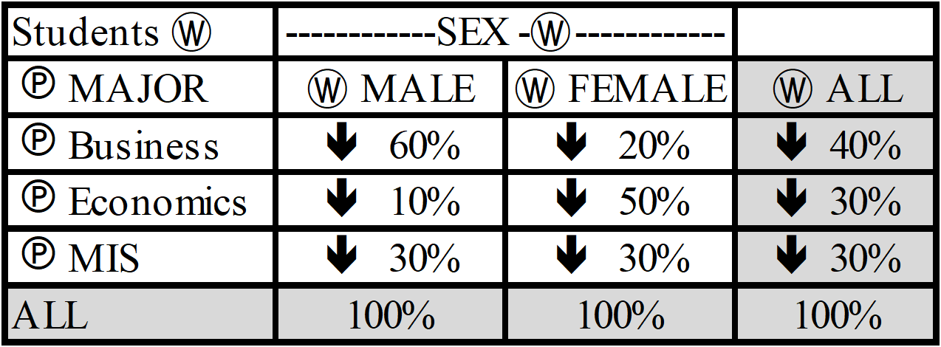
Percent Grammar:
100% Column Tables
Ch 4.4; P 186
31
Describe the 60% in the top row left column:
1) Row: 60% of business majors are men
2) Column: Among men, 60% are business majors [OK]
3) Table: Of students, 60% are male business majors
Notes:
Model Trendline Linear 2Y1X using Excel 2013
11/24/2013 V0a
www.StatLit.org/pdf/Model-Trendline-Linear-2Y1X-Excel2013-6up.pdf
31
Analyzing Numbers in the News
15 May 2008
2008SchieldNNN6up.pdf
31
31

Slide 32
Percent Grammar:
Confusion of the Inverse
Ch 4.4; P 186
32
Sometimes the confusion is obvious:
  90% of those in prison are men
  90% of men are in prison [False]
Sometimes the confusion is not obvious:
  30% of men smoke
  30% of smokers are men. [??]
Sometimes both may be true:
  50% of blacks in poverty are in one-parent families
  50% of one-parent families in poverty are black.
Notes:
Model Trendline Linear 2Y1X using Excel 2013
11/24/2013 V0a
www.StatLit.org/pdf/Model-Trendline-Linear-2Y1X-Excel2013-6up.pdf
32
Analyzing Numbers in the News
15 May 2008
2008SchieldNNN6up.pdf
32
32

Slide 33
Percent Grammar:
Confusing Statements
Ch 4.4.5; P 191
33
Misplaced phrases:
10% of Americans died from a lightening strike.
60% of Americans own a gun for safety.
39% of children run away during the summer.
Sports grammar: Part and whole in single phrase.
Natural whole:
  Percentage of completed passes (of passes completed)
  Percentage of passes that are completed. [Pass is whole]
  No natural whole:
  Percentage of male seniors (of senior males). [Bad]
  Cannot determine which is part and which is whole.
Notes:
Model Trendline Linear 2Y1X using Excel 2013
11/24/2013 V0a
www.StatLit.org/pdf/Model-Trendline-Linear-2Y1X-Excel2013-6up.pdf
33
Analyzing Numbers in the News
15 May 2008
2008SchieldNNN6up.pdf
33
33

Slide 34
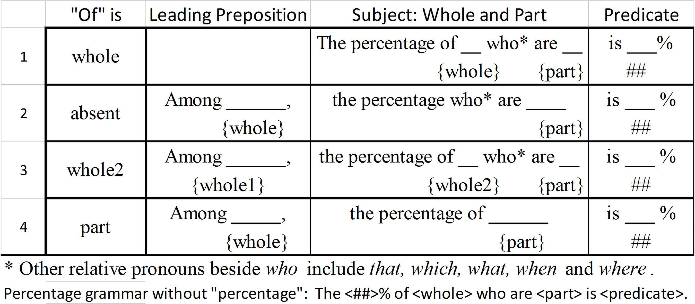
Percentage Grammar:
Statement Template
Ch 4.5; P 193
34
#4 is tricky! Are the following the same or different?
The percentage of men who run.
The percentage of men among runners. (#4)
(#1)
Notes:
Model Trendline Linear 2Y1X using Excel 2013
11/24/2013 V0a
www.StatLit.org/pdf/Model-Trendline-Linear-2Y1X-Excel2013-6up.pdf
34
Analyzing Numbers in the News
15 May 2008
2008SchieldNNN6up.pdf
34
34

Slide 35
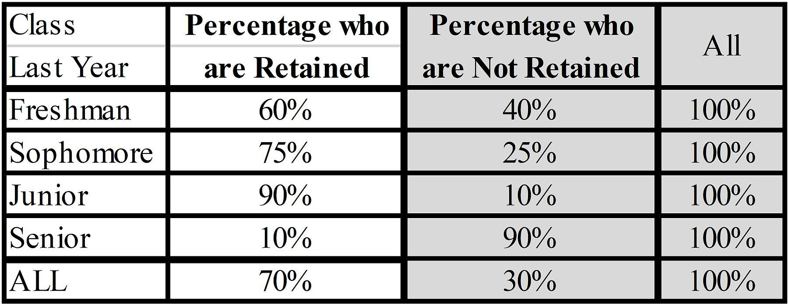
Percentage Tables:
Half Tables
Ch 4.6; P 199
35
Retained: Returned the next year.
Right half is arithmetically redundant. Omit.
Benefit: Save space. Cost: Loose 100%.
Need a new way to identify part and whole.
Is column ALL a sum (whole) or average (part)?
Notes:
Model Trendline Linear 2Y1X using Excel 2013
11/24/2013 V0a
www.StatLit.org/pdf/Model-Trendline-Linear-2Y1X-Excel2013-6up.pdf
35
Analyzing Numbers in the News
15 May 2008
2008SchieldNNN6up.pdf
35
35

Slide 36
Other Topics
Different
36
Std. Confounder distribution: = EXP(-RR/2)
Percentage attributable; cases attributable
Bayes reversal: P(B|A)/P(B) = P(A|B)/P(A)
Diabolical Denominator
Scanlan Paradox: As compare of big % improve,
compare of small complements tends to worsen.
Bayesian view of statistical significance:
If P(RH=True, Prior)>50% and p-value < 5%,
then P(RH=True, posterior) > 95%. Schield (2026)
Notes:
Model Trendline Linear 2Y1X using Excel 2013
11/24/2013 V0a
www.StatLit.org/pdf/Model-Trendline-Linear-2Y1X-Excel2013-6up.pdf
36
Analyzing Numbers in the News
15 May 2008
2008SchieldNNN6up.pdf
36
36

Slide 37
Highlights Conclusion
37
Focus on ideas and the use of ordinary English.
More 2-group compare than 2-factor compare
More induction (strength) than deduction (valid)
Focus on mixed-fruit (crude) comparison
More on soft science than hard science
More on confounding than on randomness
Students work backward (induction):
from results to choices (from effects to causes)
from seen to unseen (association to causation)
Notes:
Model Trendline Linear 2Y1X using Excel 2013
11/24/2013 V0a
www.StatLit.org/pdf/Model-Trendline-Linear-2Y1X-Excel2013-6up.pdf
37
Analyzing Numbers in the News
15 May 2008
2008SchieldNNN6up.pdf
37
37

Slide 38
Conclusion
38
Prepare students to ‘argue with statistics’
Introduce students
to close-reading and importance of grammar
Small changes in wording (syntax) can
create a big difference in meaning (semantics)
key distinctions (big ideas). College prep!
This course is accessible (no math phobia)
Students can perceive and appreciate value
Students can apply these ideas in everyday life
Notes:
Model Trendline Linear 2Y1X using Excel 2013
11/24/2013 V0a
www.StatLit.org/pdf/Model-Trendline-Linear-2Y1X-Excel2013-6up.pdf
38
Analyzing Numbers in the News
15 May 2008
2008SchieldNNN6up.pdf
38
38

Slide 39
References
39
Course introduction for teachers (pdf):
www.statlit.org/pdf/2025-Schield-StatLit-Intro-for-Teachers.pdf
Textbook Design (pdf and 1-hour video):
www.StatLit.org/pdf/2023-Schield-Textbook Design-Slides.pdf
www.StatLit.org/v/2023-Schield-Textbook Design-Slides.mp4
Student course evaluations:
New College: www.statlit.org/NCF.htm
UNM: www.statlit.org/pdf/2022-Schield-ASA.pdf
See highlights, chapter slides and slide videos: www.StatLit.org/Textbook.htm
Notes:
Model Trendline Linear 2Y1X using Excel 2013
11/24/2013 V0a
www.StatLit.org/pdf/Model-Trendline-Linear-2Y1X-Excel2013-6up.pdf
39
Analyzing Numbers in the News
15 May 2008
2008SchieldNNN6up.pdf
39
39

