Slide 1
Statistical Literacy Textbook:
Chapter 8 Slides
Statistical Literacy:
Critical Thinking about Everyday Statistics
Kendall-Hunt 2023
Milo Schield
ASA Fellow
Adjunct: University of New Mexico
Visiting Professor: New College of Florida
www.StatLit.org/pdf/
2023-Schield-StatLit-Ch8-Slides.pdf
Notes:
Model Trendline Linear 2Y1X using Excel 2013
11/24/2013 V0a
www.StatLit.org/pdf/Model-Trendline-Linear-2Y1X-Excel2013-6up.pdf
1
Analyzing Numbers in the News
15 May 2008
2008SchieldNNN6up.pdf
1
1

Slide 2
Randomness
Chapter 8: Table of Contents
8.0, P 323
2
8.1 p 321 Learning Outcomes
8.2 p 322 Review
8.3 p 322 Idea of Statistical Significance
8.4 p 324 Influencing Statistical Significance
8.5 p 329 Hypothesis Tests and Criminal Trials
8.6 p 331 Political Polls
8.7 p 333 Sampling: Random and Nonrandom
8.8 p 339 Statistical Significance Stories
8.9 p 340 Statistical Significance: Applicability
8.10 p 341 Common Misunderstandings
Notes:
Model Trendline Linear 2Y1X using Excel 2013
11/24/2013 V0a
www.StatLit.org/pdf/Model-Trendline-Linear-2Y1X-Excel2013-6up.pdf
2
Analyzing Numbers in the News
15 May 2008
2008SchieldNNN6up.pdf
2
2

Slide 3
Randomness
Chapter 8: Learning Outcomes
8.0, P 323
3
Understand the good and bad of statistical significance
Recognize how statistical significance can be influenced – from significance to insignificance or vice versa – by confounding, assembly, randomness and bias
Compare hypothesis tests to criminal trials: type 1 and type 2 error
Distinguish polls from surveys. Polls predict; surveys summarize.
Estimate size of population using capture-recapture
Identify common misunderstanding involving chance
Notes:
Model Trendline Linear 2Y1X using Excel 2013
11/24/2013 V0a
www.StatLit.org/pdf/Model-Trendline-Linear-2Y1X-Excel2013-6up.pdf
3
Analyzing Numbers in the News
15 May 2008
2008SchieldNNN6up.pdf
3
3

Slide 4
Statistical Significance:
The Idea (very abstract)
8.3, P 322, 324
4
Statistically significant: statistically unlikely. The less likely the chance, the more ‘significant’ the result.
Examples:
Dog that didn’t bark. Sherlock Holmes, Silver Blaze
Goldfinger meets Bond 3 times, 3 different places
Five heads in five flips of a fair coin.
Statistically significant:
Not necessarily important
is arbitrary (< 1 chance in 20) but not unreasonable
can be influenced
Notes:
Model Trendline Linear 2Y1X using Excel 2013
11/24/2013 V0a
www.StatLit.org/pdf/Model-Trendline-Linear-2Y1X-Excel2013-6up.pdf
4
Analyzing Numbers in the News
15 May 2008
2008SchieldNNN6up.pdf
4
4

Slide 5
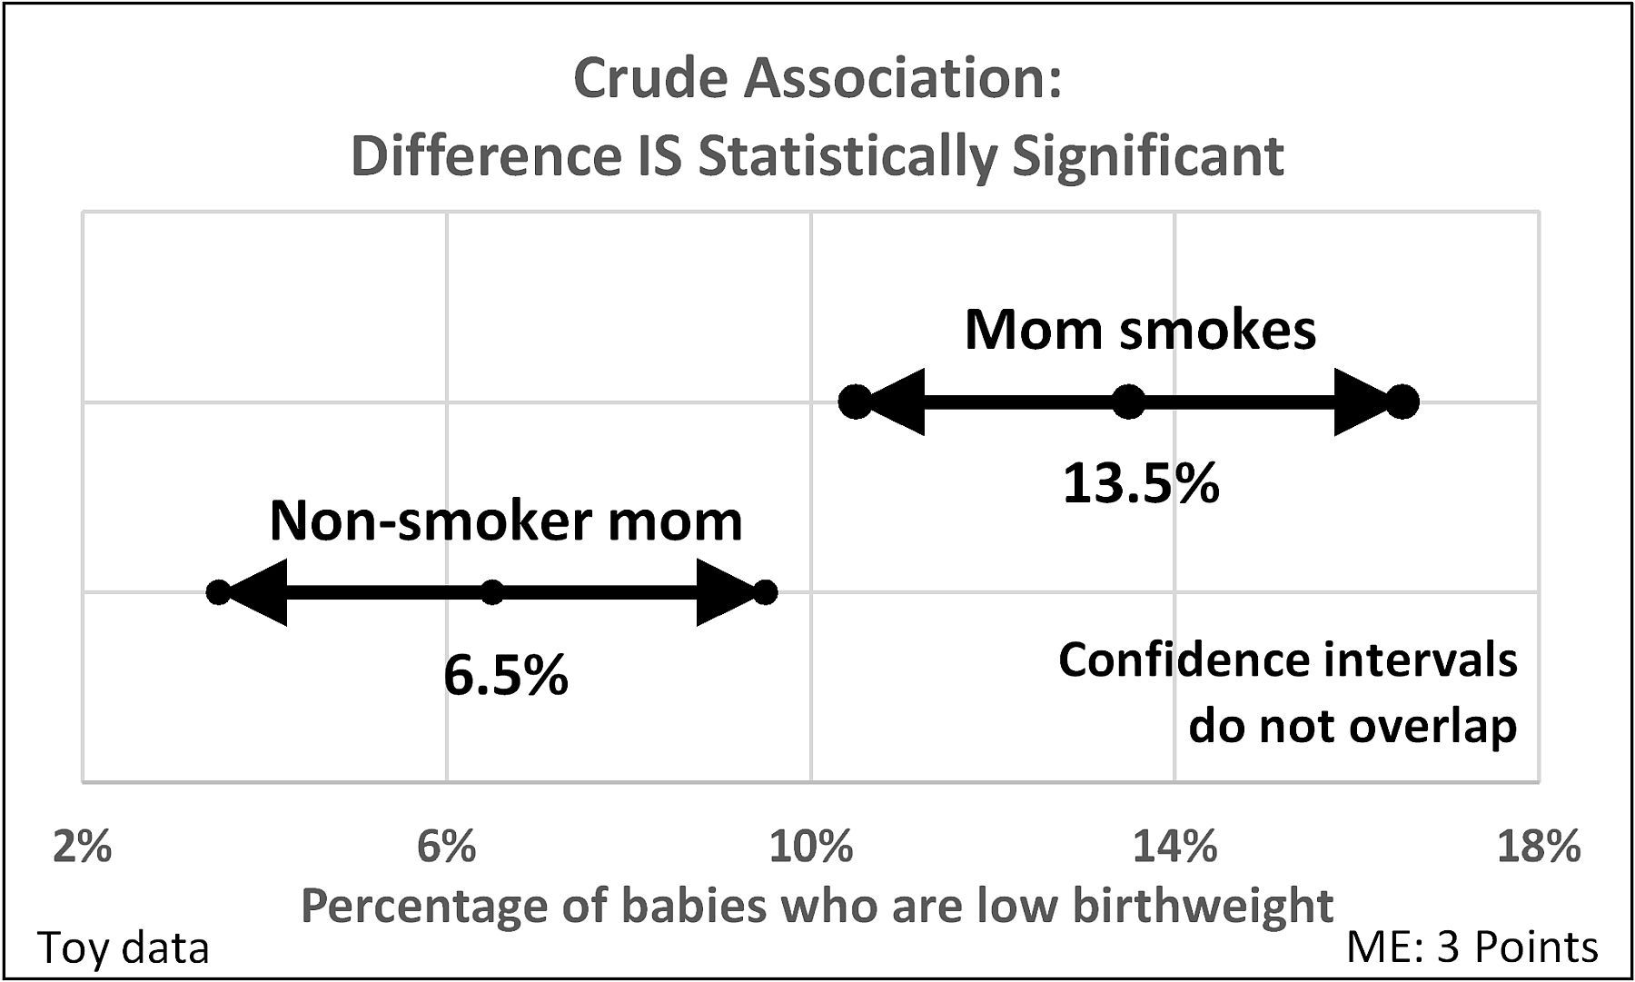
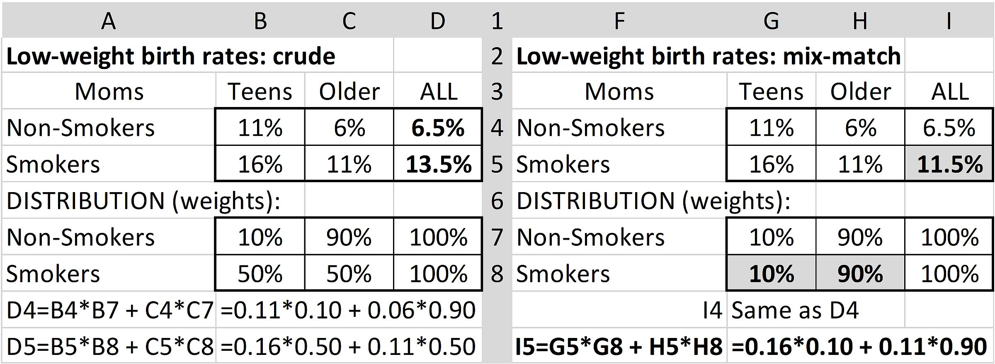
Statistical Significance:
Influenced by Confounding
8.4.1: P 324, 325
5
Crude: Difference is
statistically significant
Young moms: smokers 50%;
non-smokers 10%.
Adjust for mom’s age:
Notes:
Model Trendline Linear 2Y1X using Excel 2013
11/24/2013 V0a
www.StatLit.org/pdf/Model-Trendline-Linear-2Y1X-Excel2013-6up.pdf
5
Analyzing Numbers in the News
15 May 2008
2008SchieldNNN6up.pdf
5
5

Slide 6
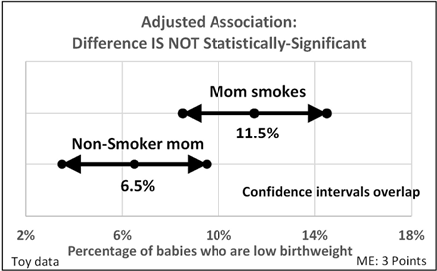

Statistical Significance:
Influenced by Confounding
8.4.1: P 326
6
Crude Association: Difference statistically significant
Adjusted: Difference is not statistically significant.
Notes:
Model Trendline Linear 2Y1X using Excel 2013
11/24/2013 V0a
www.StatLit.org/pdf/Model-Trendline-Linear-2Y1X-Excel2013-6up.pdf
6
Analyzing Numbers in the News
15 May 2008
2008SchieldNNN6up.pdf
6
6

Slide 7
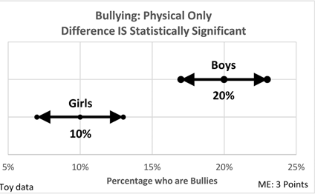
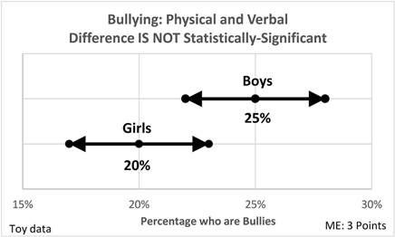
Statistical Significance:
Influenced by Assembly
8.4.2; P 326
7
Bullying #1: physical only.
Bullying #2: physical or verbal.
Change in definition (assembly) changes
statistically-significant into statistically insignificant
Notes:
Model Trendline Linear 2Y1X using Excel 2013
11/24/2013 V0a
www.StatLit.org/pdf/Model-Trendline-Linear-2Y1X-Excel2013-6up.pdf
7
Analyzing Numbers in the News
15 May 2008
2008SchieldNNN6up.pdf
7
7

Slide 8
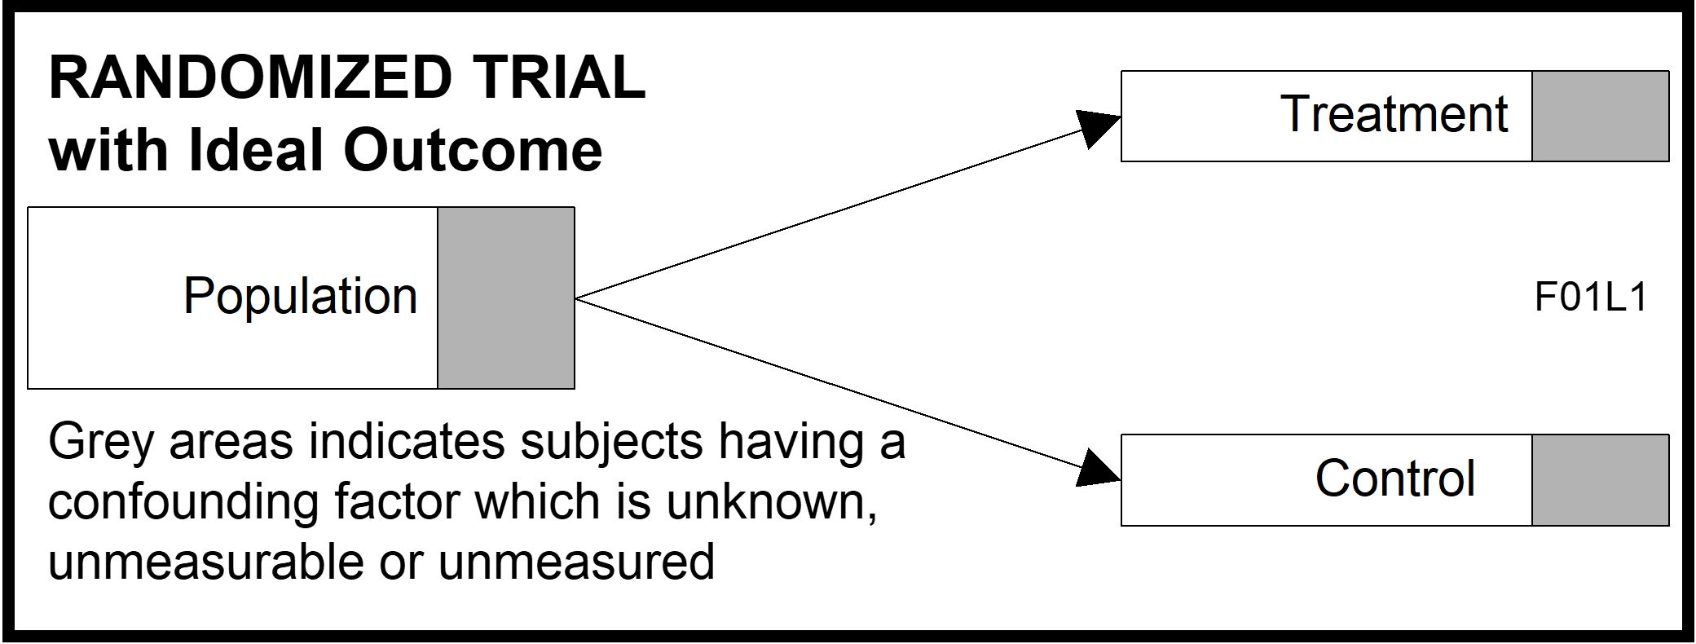
Statistical Significance:
Influenced by Randomness
8.4.3, P 327
8
Suppose the difference between treatment sample and control sample is statistically significant.
Statistically significant: 1 chance in 20 (5%) of error
Notes:
Model Trendline Linear 2Y1X using Excel 2013
11/24/2013 V0a
www.StatLit.org/pdf/Model-Trendline-Linear-2Y1X-Excel2013-6up.pdf
8
Analyzing Numbers in the News
15 May 2008
2008SchieldNNN6up.pdf
8
8

Slide 9
Statistical Significance:
Influenced by Randomness
8.4.3, P 327
9
Suppose the treatment has no effect.
How could the difference be statistically significant?
One researcher: one trial repeated 20 times.
One researcher: one trial with 20 outcomes.
20 researchers: same trial, same outcome.
In each case, one of the 20 results is expected to be statistically-significant even though the treatment has no effect.
Notes:
Model Trendline Linear 2Y1X using Excel 2013
11/24/2013 V0a
www.StatLit.org/pdf/Model-Trendline-Linear-2Y1X-Excel2013-6up.pdf
9
Analyzing Numbers in the News
15 May 2008
2008SchieldNNN6up.pdf
9
9

Slide 10
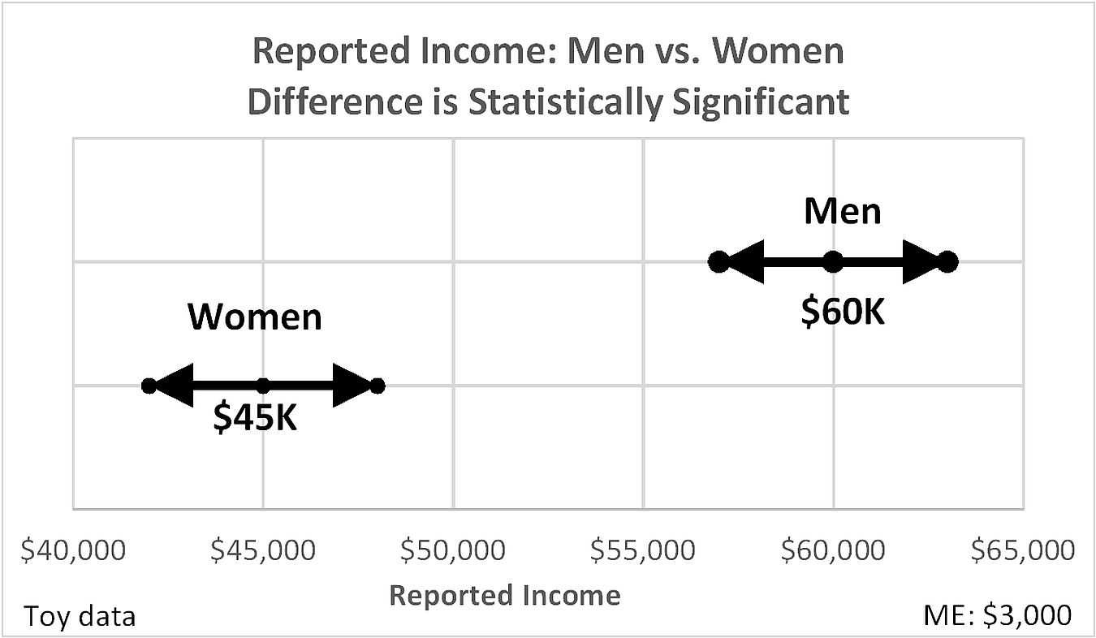
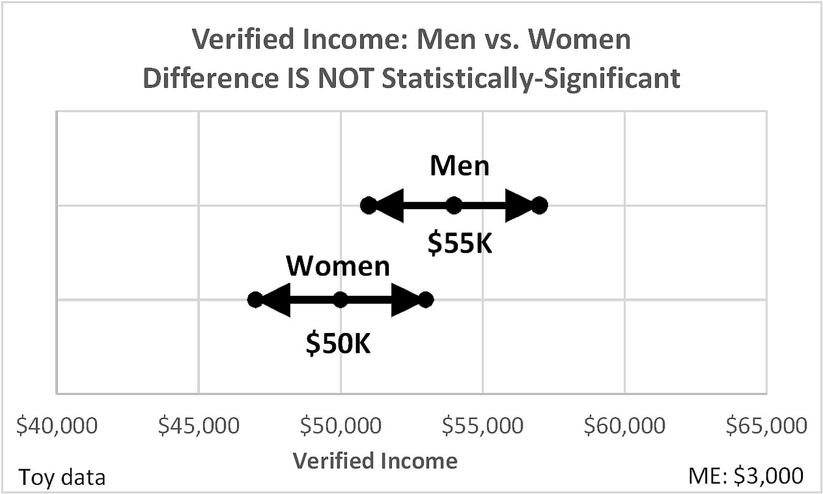
Statistical Significance:
Influenced by Error/bias
8.4.4, P 328
10
Income by Sex:
Reported vs. verified.
Subject bias!
Notes:
Model Trendline Linear 2Y1X using Excel 2013
11/24/2013 V0a
www.StatLit.org/pdf/Model-Trendline-Linear-2Y1X-Excel2013-6up.pdf
10
Analyzing Numbers in the News
15 May 2008
2008SchieldNNN6up.pdf
10
10

Slide 11
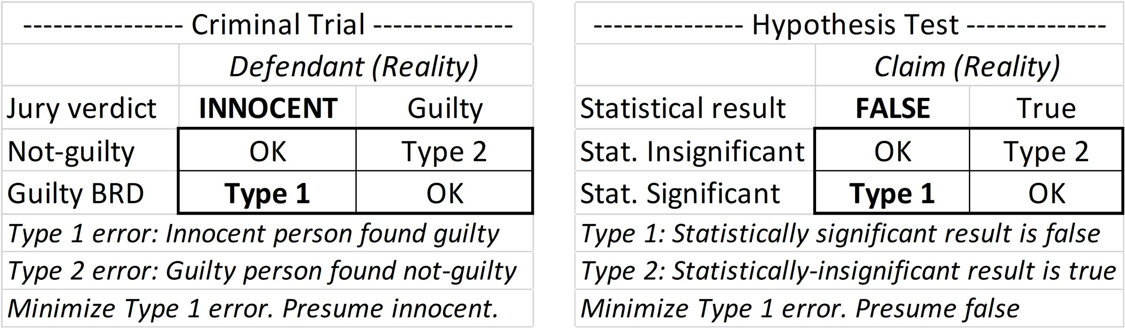
Hypothesis Tests and
Criminal Trials
8.5, P 329
11
Criminal trial: Innocent until proved guilty
Statistical trial: No difference until proved different
Type 1: false alarm. Type 2: silent alarm
Notes:
Model Trendline Linear 2Y1X using Excel 2013
11/24/2013 V0a
www.StatLit.org/pdf/Model-Trendline-Linear-2Y1X-Excel2013-6up.pdf
11
Analyzing Numbers in the News
15 May 2008
2008SchieldNNN6up.pdf
11
11

Slide 12
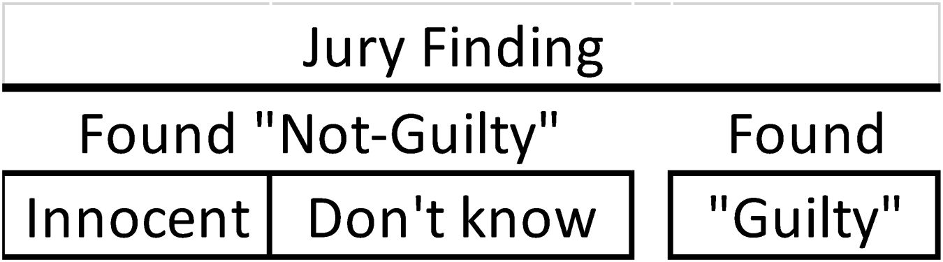
Subtle Distinctions:
Two or Three outcomes
8.3.3; P 330
12
Not guilty vs. innocent.
“Absence of evidence is not evidence of absence”
Policy X: has not been found to work versus has been found to not work.
Drug Y has: not been found to be effective versus been found to be ineffective.
‘Not been found’ includes ‘did not look or test’.
Notes:
Model Trendline Linear 2Y1X using Excel 2013
11/24/2013 V0a
www.StatLit.org/pdf/Model-Trendline-Linear-2Y1X-Excel2013-6up.pdf
12
Analyzing Numbers in the News
15 May 2008
2008SchieldNNN6up.pdf
12
12

Slide 13
Political Polls
8.6; P 331
13
Political polls ‘predict’ results of a future event.
Pollsters ‘adjust’. Polls are like weather forecasts.
Suppose pollsters ask, “Which of 2 candidates are you most likely to vote for: A or B?”
Q1. What are some other answers than A or B?
Q2. Why do pollsters adjust their data?
Notes:
Model Trendline Linear 2Y1X using Excel 2013
11/24/2013 V0a
www.StatLit.org/pdf/Model-Trendline-Linear-2Y1X-Excel2013-6up.pdf
13
Analyzing Numbers in the News
15 May 2008
2008SchieldNNN6up.pdf
13
13

Slide 14
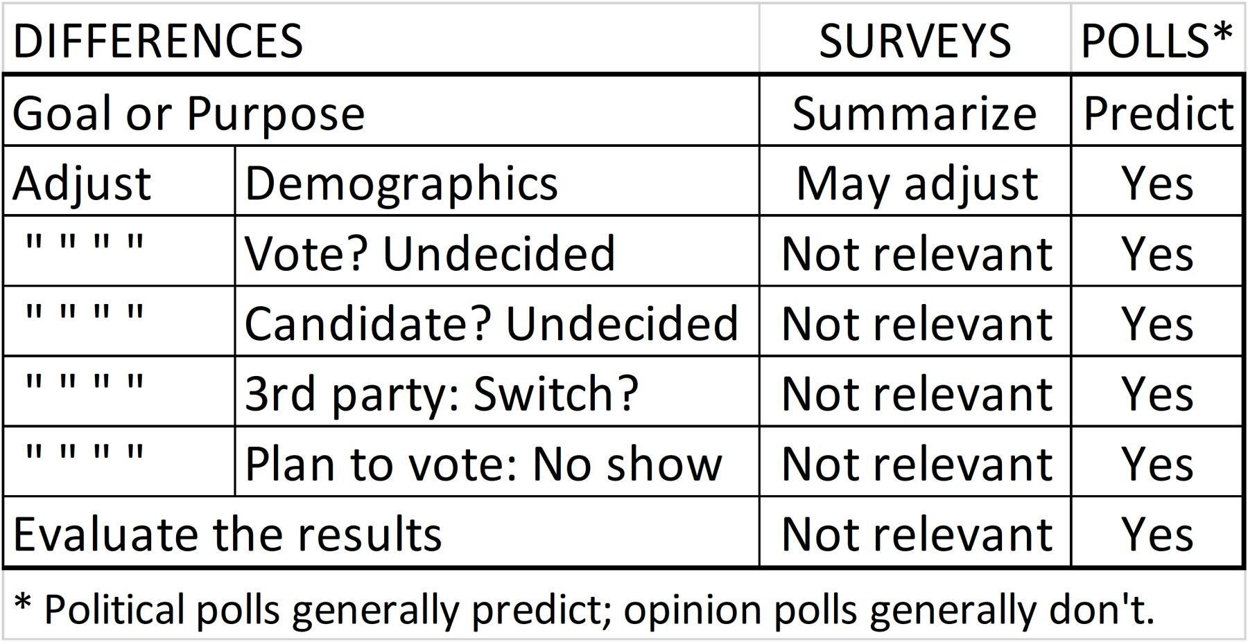
Political Polls
8.6; P 331
14
Political polls ‘predict’ results of a future event.
Pollsters ‘adjust’. Polls are like weather forecasts.
Surveys ‘summarize’ current situation (more factual).
Notes:
Model Trendline Linear 2Y1X using Excel 2013
11/24/2013 V0a
www.StatLit.org/pdf/Model-Trendline-Linear-2Y1X-Excel2013-6up.pdf
14
Analyzing Numbers in the News
15 May 2008
2008SchieldNNN6up.pdf
14
14

Slide 15
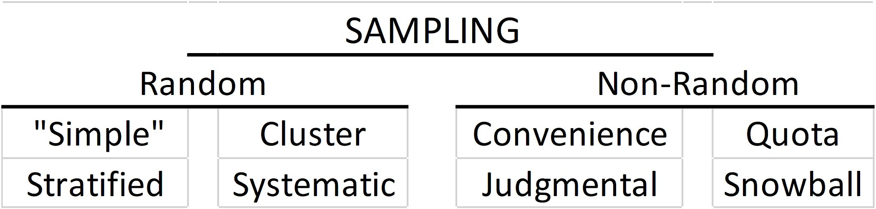
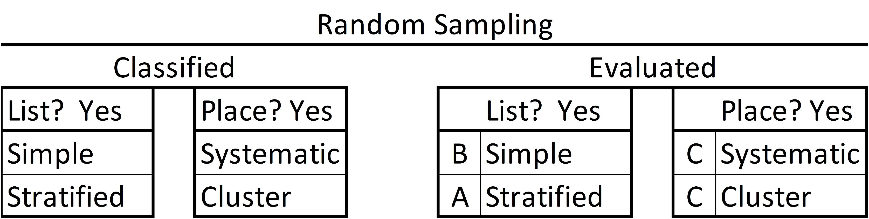
Sampling:
Random and Nonrandom
8.7; P 333
15
Random sample: sample obtained by random sampling.
Notes:
Model Trendline Linear 2Y1X using Excel 2013
11/24/2013 V0a
www.StatLit.org/pdf/Model-Trendline-Linear-2Y1X-Excel2013-6up.pdf
15
Analyzing Numbers in the News
15 May 2008
2008SchieldNNN6up.pdf
15
15

Slide 16
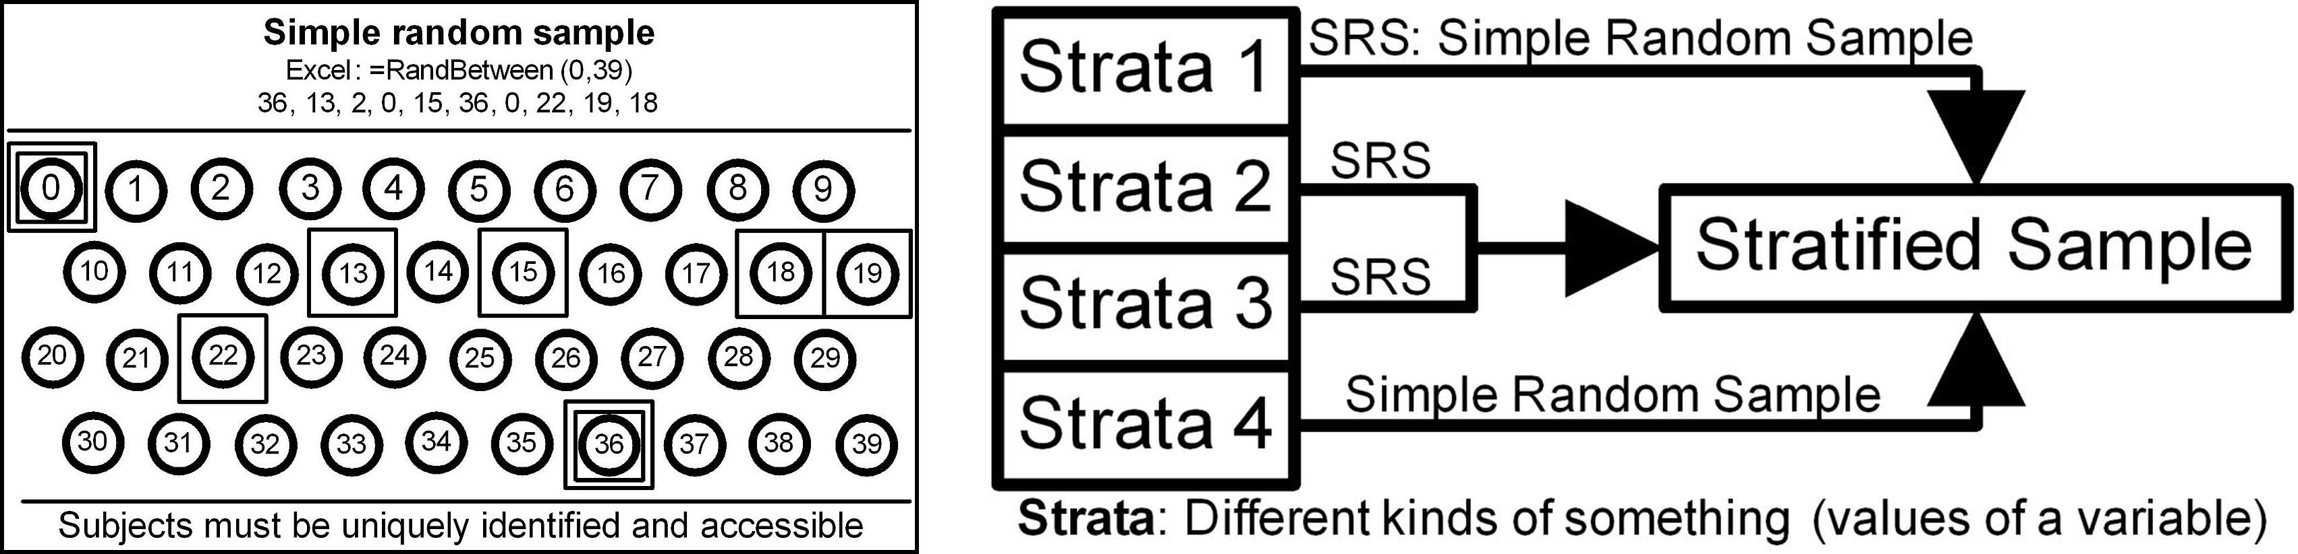
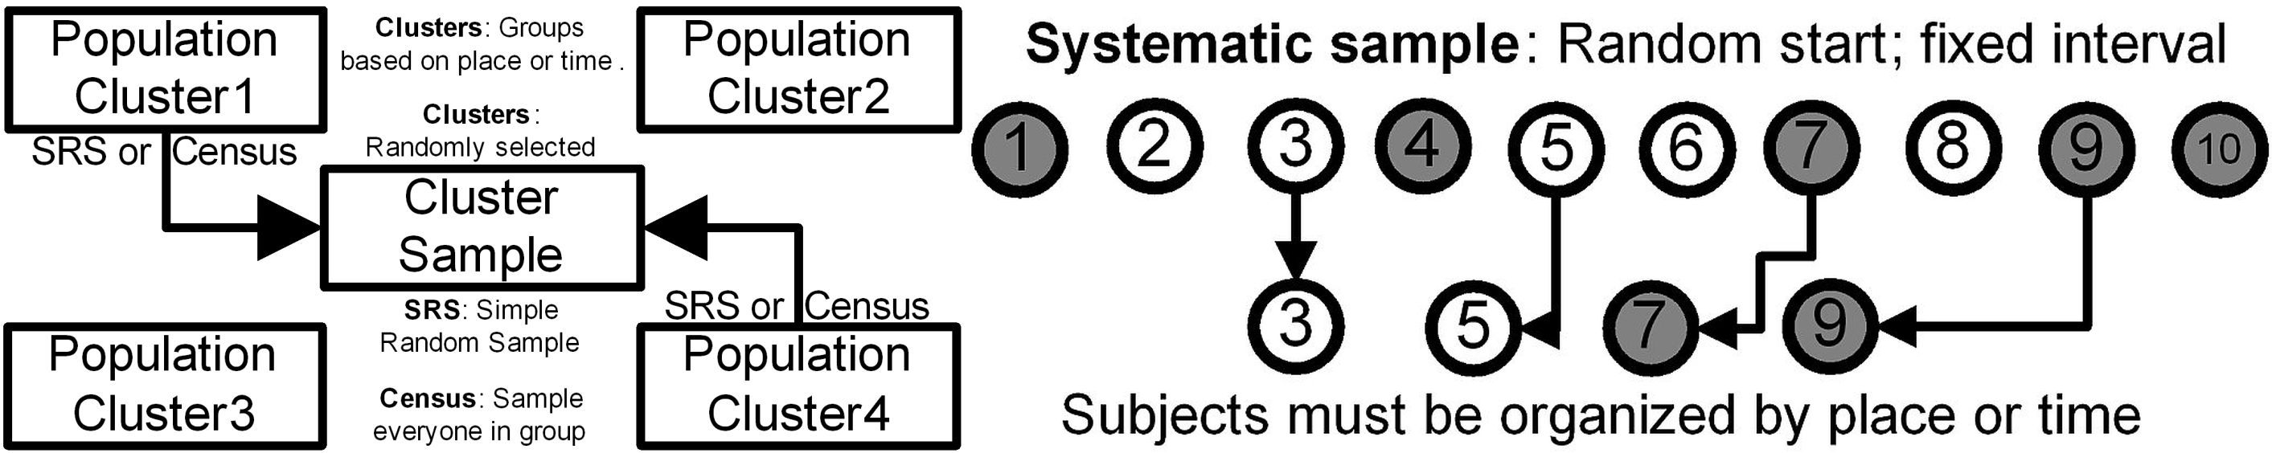
Random Sampling:
Simple, Stratified, Cluster, Systemic
8.7.1; P 334
16
n
Notes:
Model Trendline Linear 2Y1X using Excel 2013
11/24/2013 V0a
www.StatLit.org/pdf/Model-Trendline-Linear-2Y1X-Excel2013-6up.pdf
16
Analyzing Numbers in the News
15 May 2008
2008SchieldNNN6up.pdf
16
16

Slide 17
Sampling:
Random and Nonrandom
8.7; P 333
17
Random sample: sample obtained by random sampling.
Why is a random sample preferred to a non-random?
Why is a stratified sample preferred to a ‘simple’?
Why is a ‘simple’ sample preferred to a cluster?
When is a systematic sample the best available?
Notes:
Model Trendline Linear 2Y1X using Excel 2013
11/24/2013 V0a
www.StatLit.org/pdf/Model-Trendline-Linear-2Y1X-Excel2013-6up.pdf
17
Analyzing Numbers in the News
15 May 2008
2008SchieldNNN6up.pdf
17
17

Slide 18
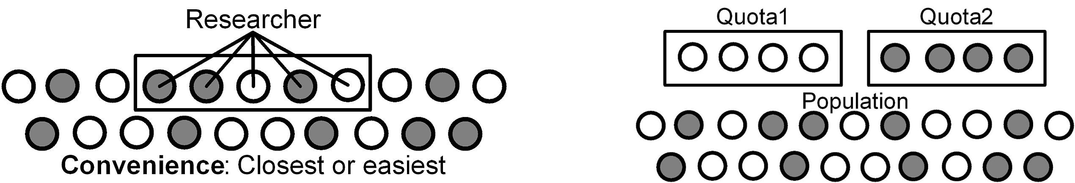
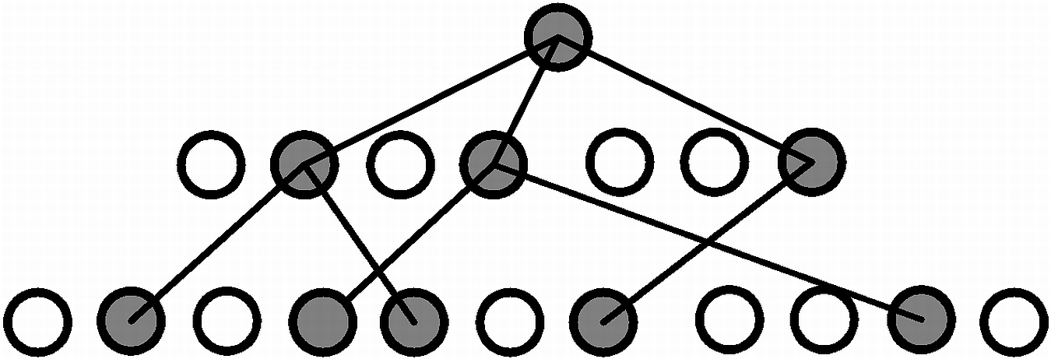
Nonrandom Sampling:
Convenience, Quota & Snowball
8.7.2; P 335
18
Snowball: Contact those with similar interests
Notes:
Model Trendline Linear 2Y1X using Excel 2013
11/24/2013 V0a
www.StatLit.org/pdf/Model-Trendline-Linear-2Y1X-Excel2013-6up.pdf
18
Analyzing Numbers in the News
15 May 2008
2008SchieldNNN6up.pdf
18
18

Slide 19
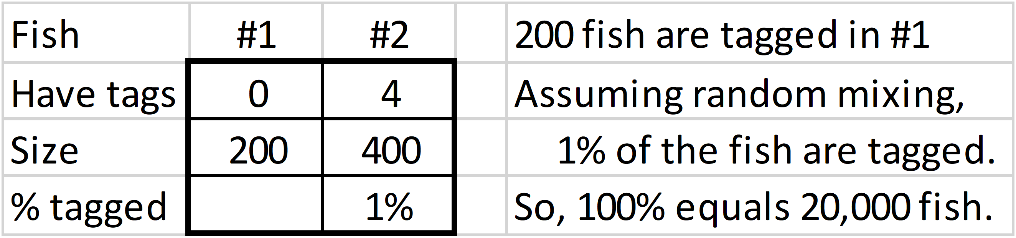
Randomness:
Counting the Uncountable
8.7.3, P 336
19
1st try: Capture 200 fish. Tag each. Return to water.
2nd try: Capture 400 subjects. Count those tagged.
Four (1%) of #2 fish are tagged.
If tagged randomly mixed, then 1% of all fish are tagged.
200 = 1% * N, so N = 200/1% = 20,000
Notes:
Model Trendline Linear 2Y1X using Excel 2013
11/24/2013 V0a
www.StatLit.org/pdf/Model-Trendline-Linear-2Y1X-Excel2013-6up.pdf
19
Analyzing Numbers in the News
15 May 2008
2008SchieldNNN6up.pdf
19
19

Slide 20
Chance:
Evolution
8.9, P 340
20
Life is too complex to be due to chance alone. Agreed.
Chance of songbird: run of 1,000 ones with 10-sided die.
Expected by chance alone: one chance in 10^{1,000}.
If 317 throws/second, (10¹⁰ times/year),
Expected in 10⁹⁹⁰ years. Age of earth: <10¹⁰ years
Assume inheritance: Save every success.
Expected with inheritance: 10,000 tries: 10 x 1,000.
Expected in 10⁻⁶ years: 30 seconds.
Chance alone? No! Chance with inheritance? Maybe.
Notes:
Model Trendline Linear 2Y1X using Excel 2013
11/24/2013 V0a
www.StatLit.org/pdf/Model-Trendline-Linear-2Y1X-Excel2013-6up.pdf
20
Analyzing Numbers in the News
15 May 2008
2008SchieldNNN6up.pdf
20
20

Slide 21
Chance:
Common Misunderstandings
8.10, P 341
21
If two outcomes, then 50% chance of either. Maybe.
If 90% chance of rain and no rain, forecast was wrong. Maybe. Can’t tell from a single event.
If excess from expected, offset is predicted.
No. Dilution is slower but maintains independence.
If medical test is 99% accurate and result is positive, then 99% chance that patient has disease. Maybe.
The more unlikely the outcome, the more likely it is causal. Maybe. Unlikely sometime, somewhere or unlikely then, there?
Notes:
Model Trendline Linear 2Y1X using Excel 2013
11/24/2013 V0a
www.StatLit.org/pdf/Model-Trendline-Linear-2Y1X-Excel2013-6up.pdf
21
Analyzing Numbers in the News
15 May 2008
2008SchieldNNN6up.pdf
21
21

Slide 22
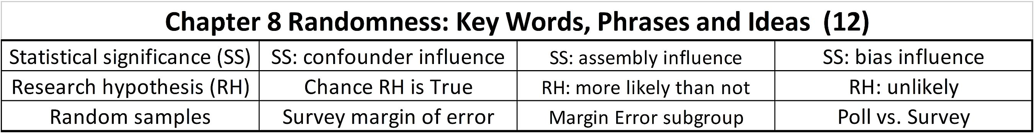
Chapter 8 Summary
8.11, P 342
22
Statistical significance can be influenced
Political polls are different from surveys
Random sampling is better than non-random.
Stratified sampling is better than simple.
Simple random is better than cluster or systematic.
Uncounted can be estimated if random.
Notes:
Model Trendline Linear 2Y1X using Excel 2013
11/24/2013 V0a
www.StatLit.org/pdf/Model-Trendline-Linear-2Y1X-Excel2013-6up.pdf
22
Analyzing Numbers in the News
15 May 2008
2008SchieldNNN6up.pdf
22
22

Slide 23
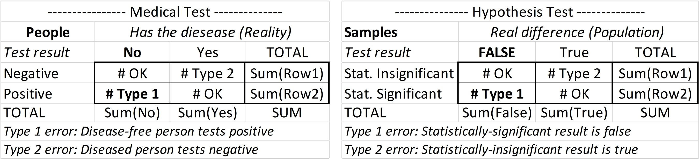
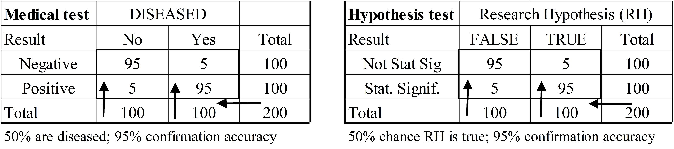
Interpreting Statistical Significance
Bayesian Medical Tests (>50%)
8.12.1, P 343
23
Shift from confirmation (column %) to prediction (row %).
If research hypothesis (RH) is more likely than not (prior) and result is statistically significant, 95% chance RH is true.
Notes:
Model Trendline Linear 2Y1X using Excel 2013
11/24/2013 V0a
www.StatLit.org/pdf/Model-Trendline-Linear-2Y1X-Excel2013-6up.pdf
23
Analyzing Numbers in the News
15 May 2008
2008SchieldNNN6up.pdf
23
23

Slide 24
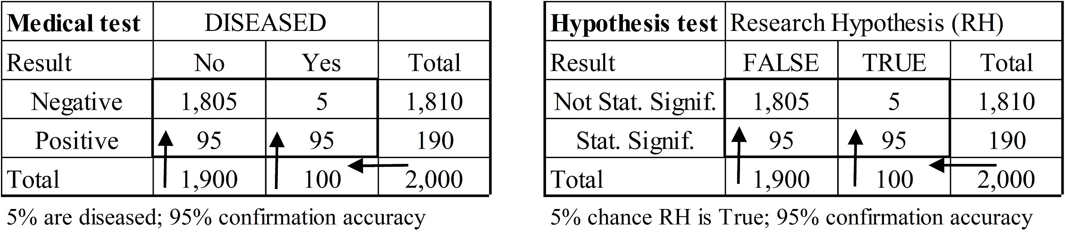
Interpreting Statistical Significance
Bayesian Medical Tests (5%)
8.12.1, P 345, 346
24
Unlikely to be true in reality:
Group: prone to heart attacks on 4th day of the month
Women who eat cereal are more likely to have boys.
Hurricanes with female names are deadlier.
Extraordinary claims require extraordinary evidence (Ecree)
Notes:
Model Trendline Linear 2Y1X using Excel 2013
11/24/2013 V0a
www.StatLit.org/pdf/Model-Trendline-Linear-2Y1X-Excel2013-6up.pdf
24
Analyzing Numbers in the News
15 May 2008
2008SchieldNNN6up.pdf
24
24

Slide 25
Interpreting Statistical Significance
Bayesian Medical Tests
8.12.1, P 346
25
Let R = Prior chance the research hypothesis (RH) is true.
Let P-value = confirmation error: P(T1|Null=True).
Let Q = Posterior chance that the research hypothesis is true.
If R < 50% and the result of the hypothesis test is positive (Bayesian significant), then the P-value must be:
the same as R to give a 50% chance that Q is true.
a tenth of R to give a 90% chance that Q is true.
a twentieth of R to give a 95% chance that Q is true.
See Schield (2026).
Notes:
Model Trendline Linear 2Y1X using Excel 2013
11/24/2013 V0a
www.StatLit.org/pdf/Model-Trendline-Linear-2Y1X-Excel2013-6up.pdf
25
Analyzing Numbers in the News
15 May 2008
2008SchieldNNN6up.pdf
25
25

