Slide 1
Statistical Literacy Textbook:
Chapter 7 Slides
Statistical Literacy:
Critical Thinking about Everyday Statistics
Kendall-Hunt 2023
Milo Schield
ASA Fellow
Adjunct: University of New Mexico
Visiting Professor: New College of Florida
www.StatLit.org/pdf/
2023-Schield-StatLit-Ch7-Slides.pdf
Notes:
Model Trendline Linear 2Y1X using Excel 2013
11/24/2013 V0a
www.StatLit.org/pdf/Model-Trendline-Linear-2Y1X-Excel2013-6up.pdf
1
Analyzing Numbers in the News
15 May 2008
2008SchieldNNN6up.pdf
1
1

Slide 2
Interpreting Confusing Ratios
Chapter 7: Table of Contentents
6.0, P 234
2
Section Page Slide Title/Topic
7.1 p 270 # 2 Table of Contents
7.2 p 271 # 3 Review
7.3 p 271 # 5 Diabolical Denominators
7.3.2 p 274 # 9 Scanlan’s Paradox
7.5 p 278 #22 Errors and Fallacies
7.6 p 280 #24 Medical Tests
7.7 p 286 #33 Social Statistics
7.8 p 291 #41 Three-term Ratios
7.9 p 292 #44 Confounding and Simpson’s Paradox
Notes:
Model Trendline Linear 2Y1X using Excel 2013
11/24/2013 V0a
www.StatLit.org/pdf/Model-Trendline-Linear-2Y1X-Excel2013-6up.pdf
2
Analyzing Numbers in the News
15 May 2008
2008SchieldNNN6up.pdf
2
2

Slide 3
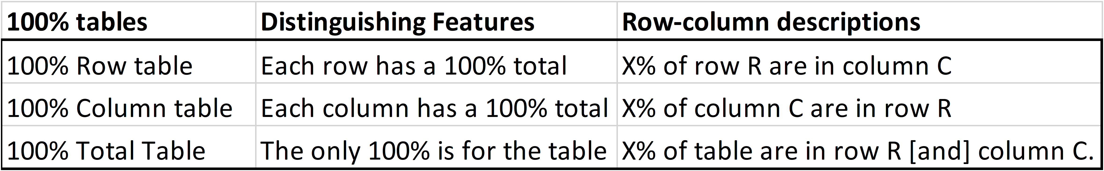
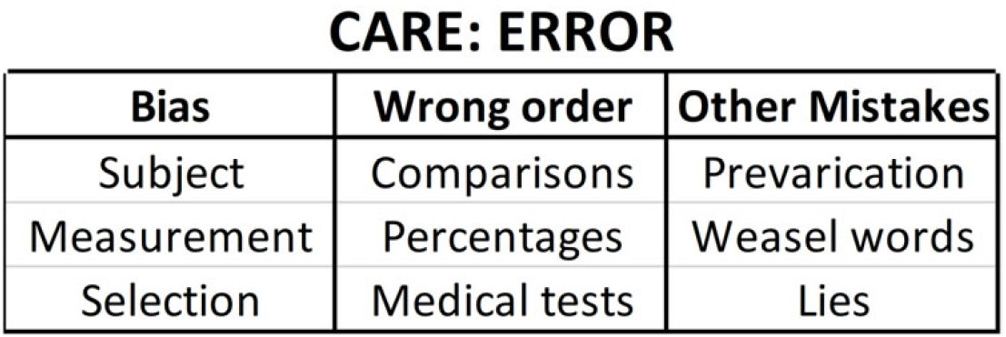
Review: 100% Tables:
Column, Row and Total Table
7.1, P 271
3
Review chapter 4: Describing Ratios in Tables
Notes:
Model Trendline Linear 2Y1X using Excel 2013
11/24/2013 V0a
www.StatLit.org/pdf/Model-Trendline-Linear-2Y1X-Excel2013-6up.pdf
3
Analyzing Numbers in the News
15 May 2008
2008SchieldNNN6up.pdf
3
3

Slide 4
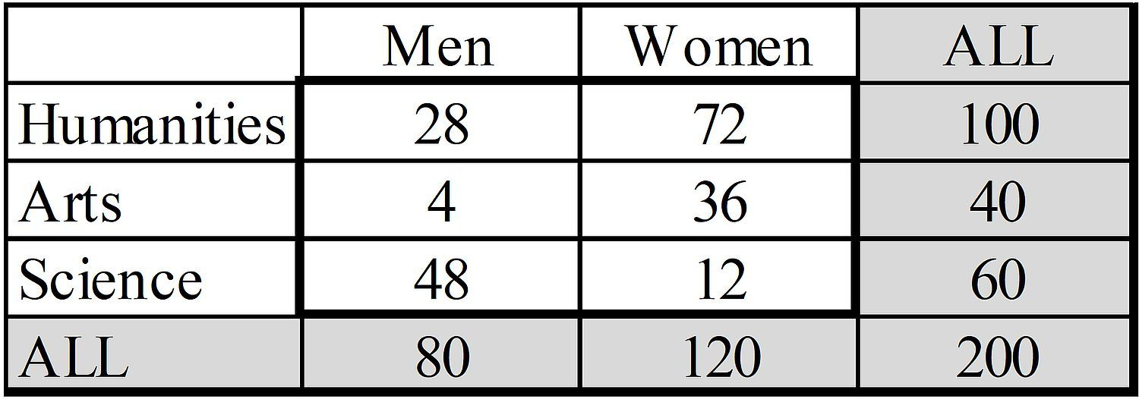
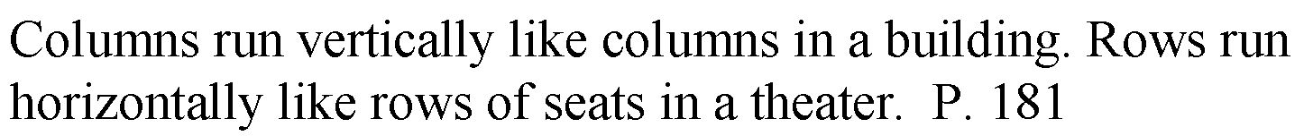
Confusion of the Inverse:
Confusing Rows and Columns
4. P
4
1) What fraction of these men are art majors?
2) What proportion of these art majors are men?
3) What percentage of these people are male art majors?
Notes:
Model Trendline Linear 2Y1X using Excel 2013
11/24/2013 V0a
www.StatLit.org/pdf/Model-Trendline-Linear-2Y1X-Excel2013-6up.pdf
4
Analyzing Numbers in the News
15 May 2008
2008SchieldNNN6up.pdf
4
4

Slide 5
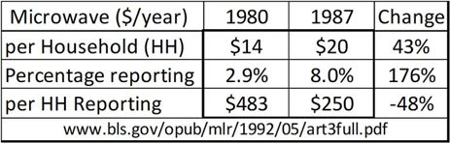
Diabolical Denominator
7.3, P 271
5
Between 1980 and 1987, the average microwave expense per household increased by 43%.
Between 1980 and 1987, the average microwave expense per reporting household decreased by 48%.
Notes:
Model Trendline Linear 2Y1X using Excel 2013
11/24/2013 V0a
www.StatLit.org/pdf/Model-Trendline-Linear-2Y1X-Excel2013-6up.pdf
5
Analyzing Numbers in the News
15 May 2008
2008SchieldNNN6up.pdf
5
5

Slide 6
Diabolical Denominator
7.3, P 271
6
When comparing ratios, a different denominator can change the direction of the comparison.
‘Different’: no fixed relationship between the denominators.
In dealing with ratios, people pay more attention to the part.
In a comparison of ratios, the whole may be more important.
------------------------------------------
In a ratio of ‘pers’, the numbers cancel; but not the words.
Ave cost/1,000 HH in Det1 / Ave cost/1,000 HH in Det2 =
Ave cost per HH is N times as much in Det1 as in Det2.
Notes:
Model Trendline Linear 2Y1X using Excel 2013
11/24/2013 V0a
www.StatLit.org/pdf/Model-Trendline-Linear-2Y1X-Excel2013-6up.pdf
6
Analyzing Numbers in the News
15 May 2008
2008SchieldNNN6up.pdf
6
6

Slide 7
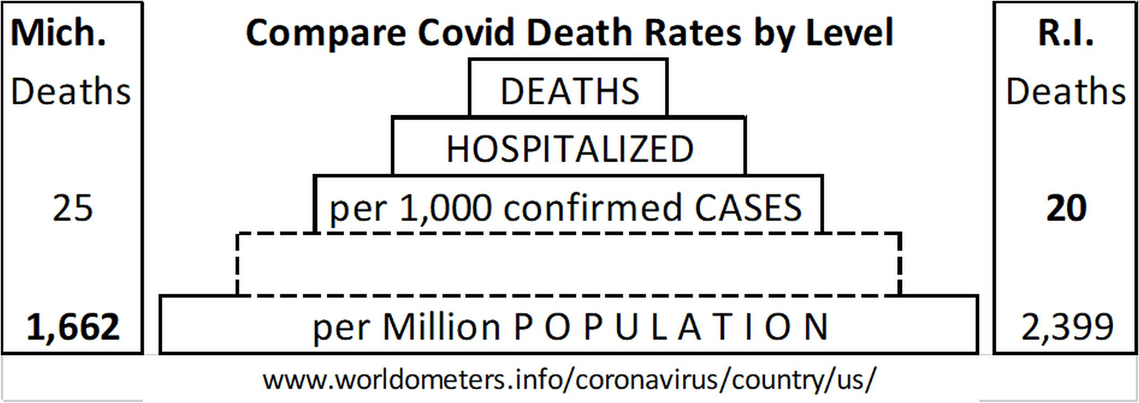
Diabolical Denominator
Choice of ‘Per’
7.3, P 272
7
Covid death rate is higher in RI than in MI per capita.
Covid death rate is higher in MI than in RI per case.
??
Per 1,000 infections
??
Cases is too small. Leaves out the infected not tested.
Population is too big. Includes those not infected
Notes:
Model Trendline Linear 2Y1X using Excel 2013
11/24/2013 V0a
www.StatLit.org/pdf/Model-Trendline-Linear-2Y1X-Excel2013-6up.pdf
7
Analyzing Numbers in the News
15 May 2008
2008SchieldNNN6up.pdf
7
7

Slide 8
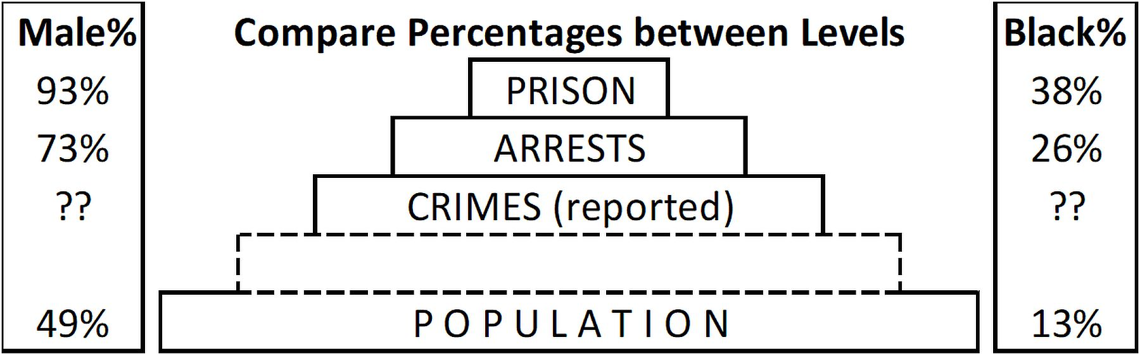
Diabolical Denominator:
Big Disparities
7.3, P 273
8
Males are 2 times as prevalent in prison as in population.
Blacks are 3 times as prevalent in prison as in population
75%
Crimes (committed)
25%
Most crimes committed are not reported.
DOJ: Crimes committed. US Victimization survey
Notes:
Model Trendline Linear 2Y1X using Excel 2013
11/24/2013 V0a
www.StatLit.org/pdf/Model-Trendline-Linear-2Y1X-Excel2013-6up.pdf
8
Analyzing Numbers in the News
15 May 2008
2008SchieldNNN6up.pdf
8
8

Slide 9
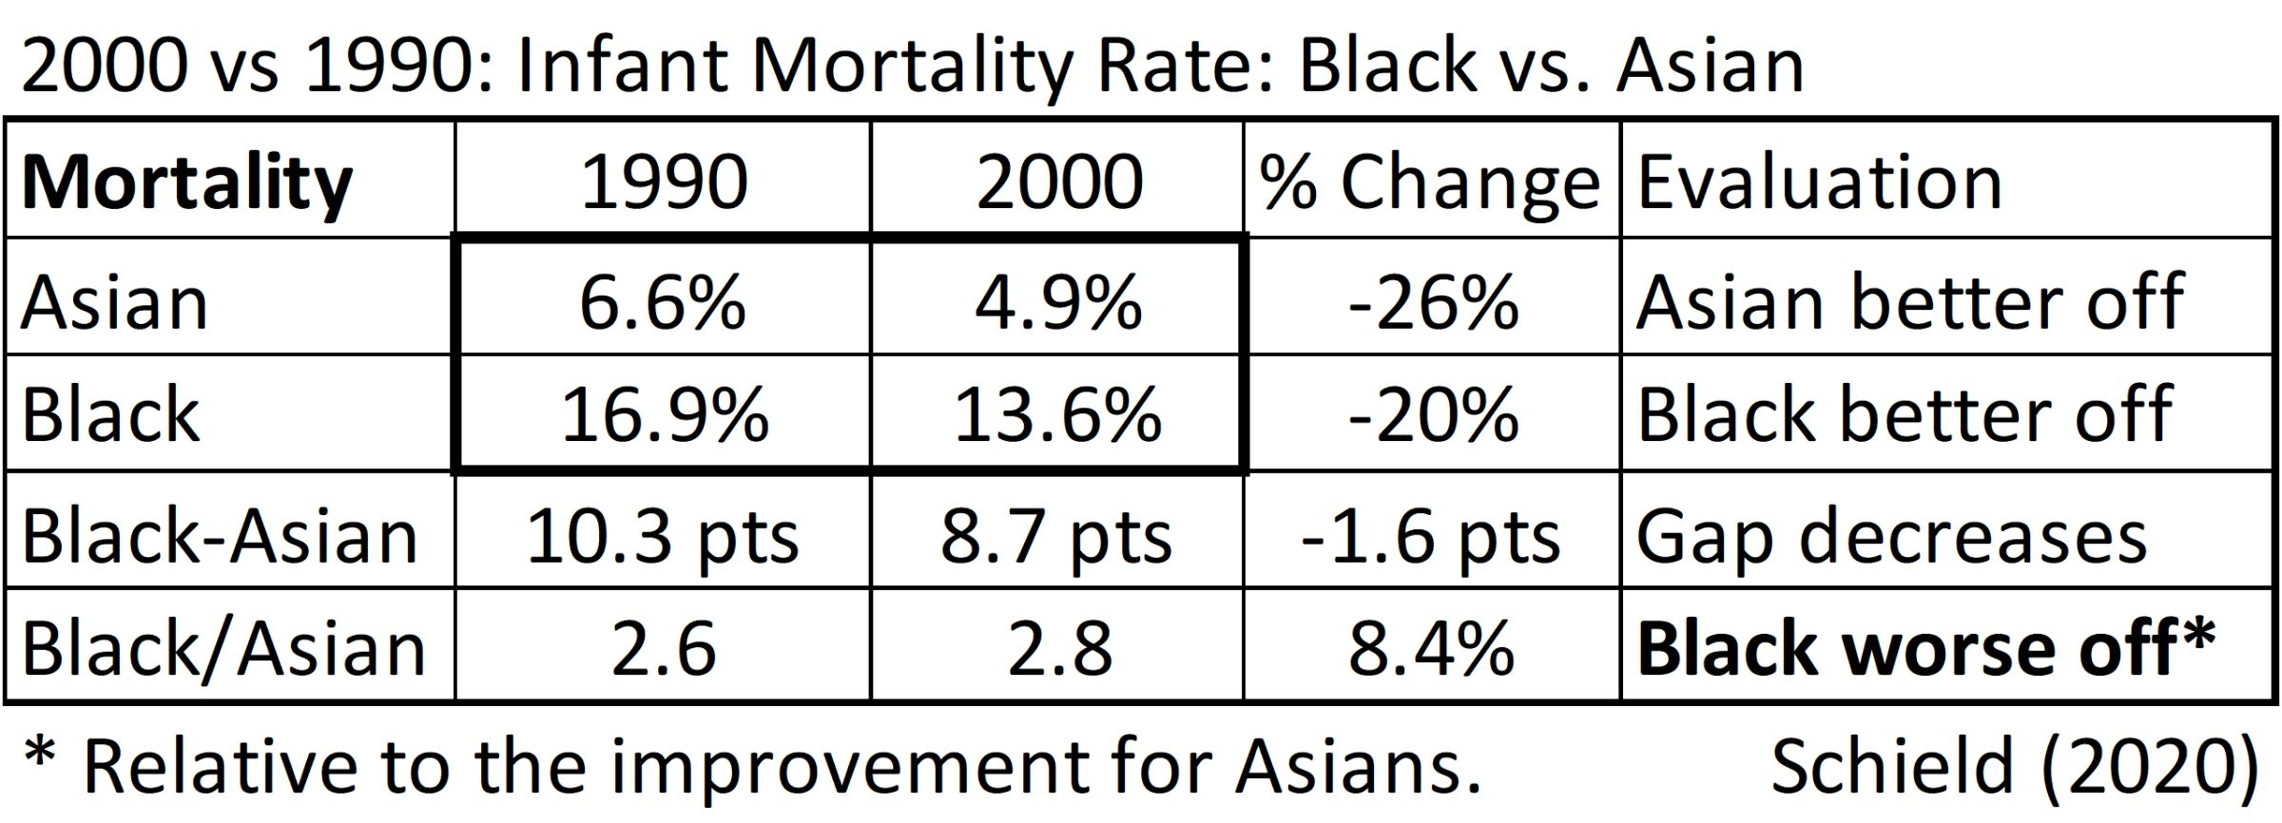
Confusing Ratios
Scanlan’s Paradox
7.3.2; P 274
9
Making something better can make other things worse.
Notes:
Model Trendline Linear 2Y1X using Excel 2013
11/24/2013 V0a
www.StatLit.org/pdf/Model-Trendline-Linear-2Y1X-Excel2013-6up.pdf
9
Analyzing Numbers in the News
15 May 2008
2008SchieldNNN6up.pdf
9
9

Slide 10
Scanlan’s Paradox
School Suspensions: Background
7.3.2; P 276
10
Racial disparities may be a sign of systemic racism. If a racial disparity is caused by racism, then reducing that disparity should be a reasonable goal.
Inner-city school suspensions were six times as likely for Blacks as for Whites. A third of school exclusions are for minor incidents: talking back, eye rolling or swearing.
If these were more common for Blacks, then eliminating
these as a basis for suspension should lower the Black-White suspension ratio.
Notes:
Model Trendline Linear 2Y1X using Excel 2013
11/24/2013 V0a
www.StatLit.org/pdf/Model-Trendline-Linear-2Y1X-Excel2013-6up.pdf
10
Analyzing Numbers in the News
15 May 2008
2008SchieldNNN6up.pdf
10
10

Slide 11
Scanlan’s Paradox
School Suspensions: Action
7.3.2; P 276
11
Change the rules:
District narrowed behaviors causing suspension,
teachers took racial equity training, and
principals were told to keep kids in class.
Good news! During the next two years, suspension rates were cut by over a third for both groups. And the difference in their suspension rates decreased.
Mission accomplished?
Notes:
Model Trendline Linear 2Y1X using Excel 2013
11/24/2013 V0a
www.StatLit.org/pdf/Model-Trendline-Linear-2Y1X-Excel2013-6up.pdf
11
Analyzing Numbers in the News
15 May 2008
2008SchieldNNN6up.pdf
11
11

Slide 12
Scanlan’s Paradox
School Suspensions: Results
7.3.2; P 276
12
Not quite! The goal was to lower the Black-White suspension ratio.
Bad news! Black-White ratio for suspensions increased! Blacks are now almost 8 times
as likely to be suspended as Whites.
This increase is politically and socially significant! It is journalistically significant! It makes headlines. Administrators can be fired for this negative result.
Notes:
Model Trendline Linear 2Y1X using Excel 2013
11/24/2013 V0a
www.StatLit.org/pdf/Model-Trendline-Linear-2Y1X-Excel2013-6up.pdf
12
Analyzing Numbers in the News
15 May 2008
2008SchieldNNN6up.pdf
12
12

Slide 13
Scanlan’s Paradox
School Suspensions: Why?
7.3.2; P 276
13
Why did the disparity ratio increase? The cut was smaller for Blacks (37%) than for Whites (44%).
Blacks were more likely to behave in ways that caused suspensions than [were] Whites.
Summary: Trying to improve things by decreasing the suspension rates for Blacks and Whites ended up making things worse for Blacks—relative to Whites.
Notes:
Model Trendline Linear 2Y1X using Excel 2013
11/24/2013 V0a
www.StatLit.org/pdf/Model-Trendline-Linear-2Y1X-Excel2013-6up.pdf
13
Analyzing Numbers in the News
15 May 2008
2008SchieldNNN6up.pdf
13
13

Slide 14
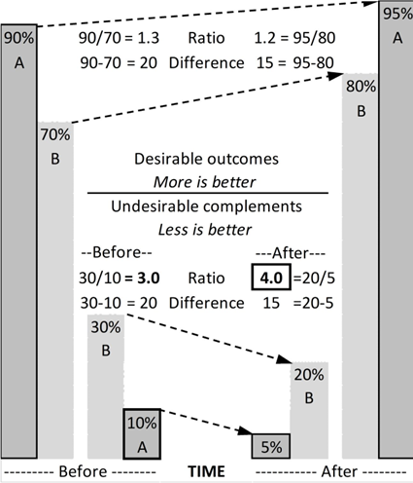
Scanlan’s Paradox
Desirable up; Undesirable down!
7.3.2, P 275
14
Undesirable: small %
5 point cut in A.
10 point cut in B.
Bigger point cut in B.
B/A ratio before cut: 3
B/A ratio after cut: 4
50% cut in A
33% cut in B
Bigger percent cut in A
Notes:
Model Trendline Linear 2Y1X using Excel 2013
11/24/2013 V0a
www.StatLit.org/pdf/Model-Trendline-Linear-2Y1X-Excel2013-6up.pdf
14
Analyzing Numbers in the News
15 May 2008
2008SchieldNNN6up.pdf
14
14

Slide 15
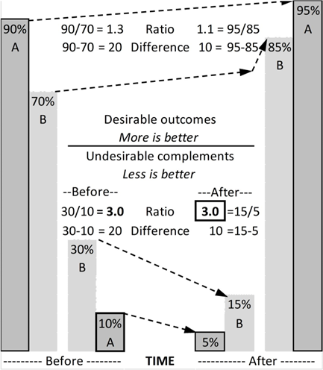
Scanlan’s Paradox
Desirable up; Undesirable down!
7.3.2, P 275
15
.
Undesirable: small %
5 point cut in A.
15 point cut in B.
Bigger point cut in B.
.
B/A ratio before cut: 3
B/A ratio after cut: 3
50% cut in A
50% cut in B
Equal percent cuts
Notes:
Model Trendline Linear 2Y1X using Excel 2013
11/24/2013 V0a
www.StatLit.org/pdf/Model-Trendline-Linear-2Y1X-Excel2013-6up.pdf
15
Analyzing Numbers in the News
15 May 2008
2008SchieldNNN6up.pdf
15
15

Slide 16
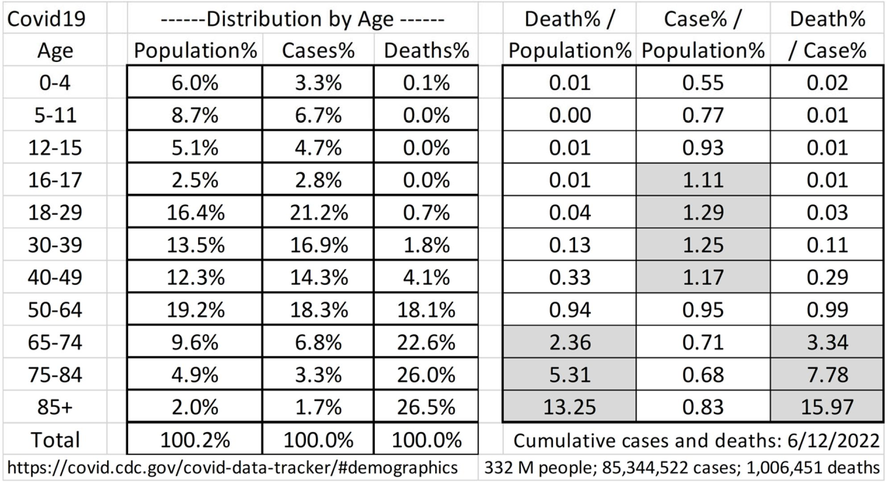
COVID Cases and Deaths:
Distribution by Age
7.4, P 277
16
Deaths 85+: 13 times their share of population (16 times of cases).
Notes:
Model Trendline Linear 2Y1X using Excel 2013
11/24/2013 V0a
www.StatLit.org/pdf/Model-Trendline-Linear-2Y1X-Excel2013-6up.pdf
16
Analyzing Numbers in the News
15 May 2008
2008SchieldNNN6up.pdf
16
16

Slide 17
Explanations vs Predictions:
Confusion of the Inverse
7.5; P 278
17
Having a pet for your child is good
since most CEOs had a pet as a child.
Most high-school dropouts skipped school.
If you want to graduate, don’t skip school.
3. Advertise your business.
Most businesses that fail did not advertise.
Are pet-owning kids more likely to be managers?
Are school-skippers more likely to drop out?
Are non-advertising businesses more likely to fail?
Notes:
Model Trendline Linear 2Y1X using Excel 2013
11/24/2013 V0a
www.StatLit.org/pdf/Model-Trendline-Linear-2Y1X-Excel2013-6up.pdf
17
Analyzing Numbers in the News
15 May 2008
2008SchieldNNN6up.pdf
17
17

Slide 18
Explanations: Uncontrolled studies
Base Rate Fallacy
7.5; P 279
18
Ignoring the base rate creates problems!
90% of schizophrenics had brain damage.
65% of Covid cases (tested positive) were vaccinated.
70% of Black males in prison grew up in single-parent homes.
90% of population had some brain damage
80% of population is vaccinated.
65% of all Black males.
Notes:
Model Trendline Linear 2Y1X using Excel 2013
11/24/2013 V0a
www.StatLit.org/pdf/Model-Trendline-Linear-2Y1X-Excel2013-6up.pdf
18
Analyzing Numbers in the News
15 May 2008
2008SchieldNNN6up.pdf
18
18

Slide 19
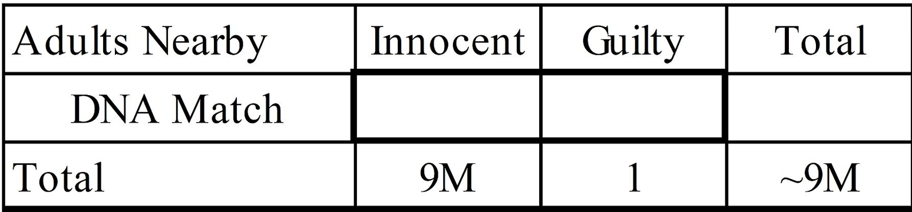



Medical Tests
DNA Match
7.6; P 280
19
O. J. Simpson accused of killing his wife in LA.
DNA match: 1 chance/million of error if innocent.
Defense; 90% chance of innocence if match.
How many matches among 9 million innocents?
What percentage of matches are innocent?
Notes:
Model Trendline Linear 2Y1X using Excel 2013
11/24/2013 V0a
www.StatLit.org/pdf/Model-Trendline-Linear-2Y1X-Excel2013-6up.pdf
19
Analyzing Numbers in the News
15 May 2008
2008SchieldNNN6up.pdf
19
19

Slide 20
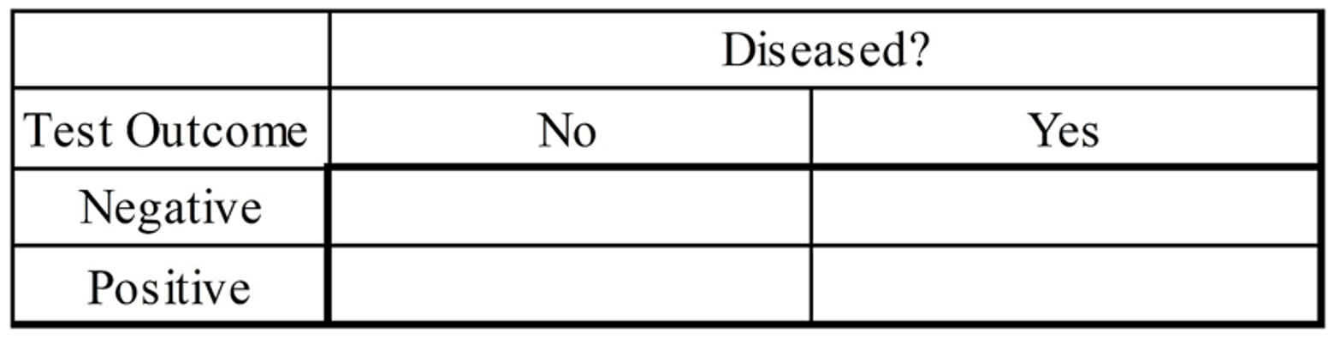




Medical Tests
7.5; P 281
20
Two conditions: Diseased or disease-free
Two outcomes: negative and positive
Medical tests aren’t perfect: wrong results
Two errors: false positive and false negative
Notes:
Model Trendline Linear 2Y1X using Excel 2013
11/24/2013 V0a
www.StatLit.org/pdf/Model-Trendline-Linear-2Y1X-Excel2013-6up.pdf
20
Analyzing Numbers in the News
15 May 2008
2008SchieldNNN6up.pdf
20
20

Slide 21
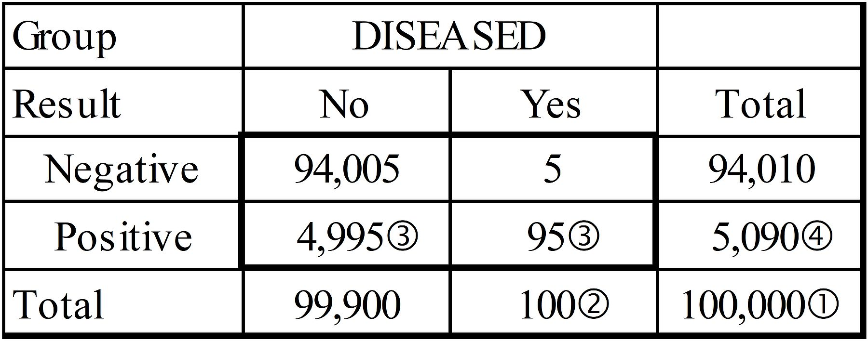
Medical Tests:
Accuracy is Ambiguous!
7.6; P 281
21
Prediction accuracy: P(Disease|Positive)
>> What percentage of positives are diseased?
Confirmation accuracy: P(Positive|Disease)
>> What percentage of diseased test positive?
Notes:
Model Trendline Linear 2Y1X using Excel 2013
11/24/2013 V0a
www.StatLit.org/pdf/Model-Trendline-Linear-2Y1X-Excel2013-6up.pdf
21
Analyzing Numbers in the News
15 May 2008
2008SchieldNNN6up.pdf
21
21

Slide 22
Simple Medical Tests
Defined
7.6; P 282
22
Simple medical test: Same confirmation accuracy
‘percentage of disease-free that test negative’ equals ‘percentage of diseased that test positive’.
Dealing with simple medical tests allows us to focus on confirmation accuracy (column %) versus prediction accuracy (row %).
Notes:
Model Trendline Linear 2Y1X using Excel 2013
11/24/2013 V0a
www.StatLit.org/pdf/Model-Trendline-Linear-2Y1X-Excel2013-6up.pdf
22
Analyzing Numbers in the News
15 May 2008
2008SchieldNNN6up.pdf
22
22

Slide 23
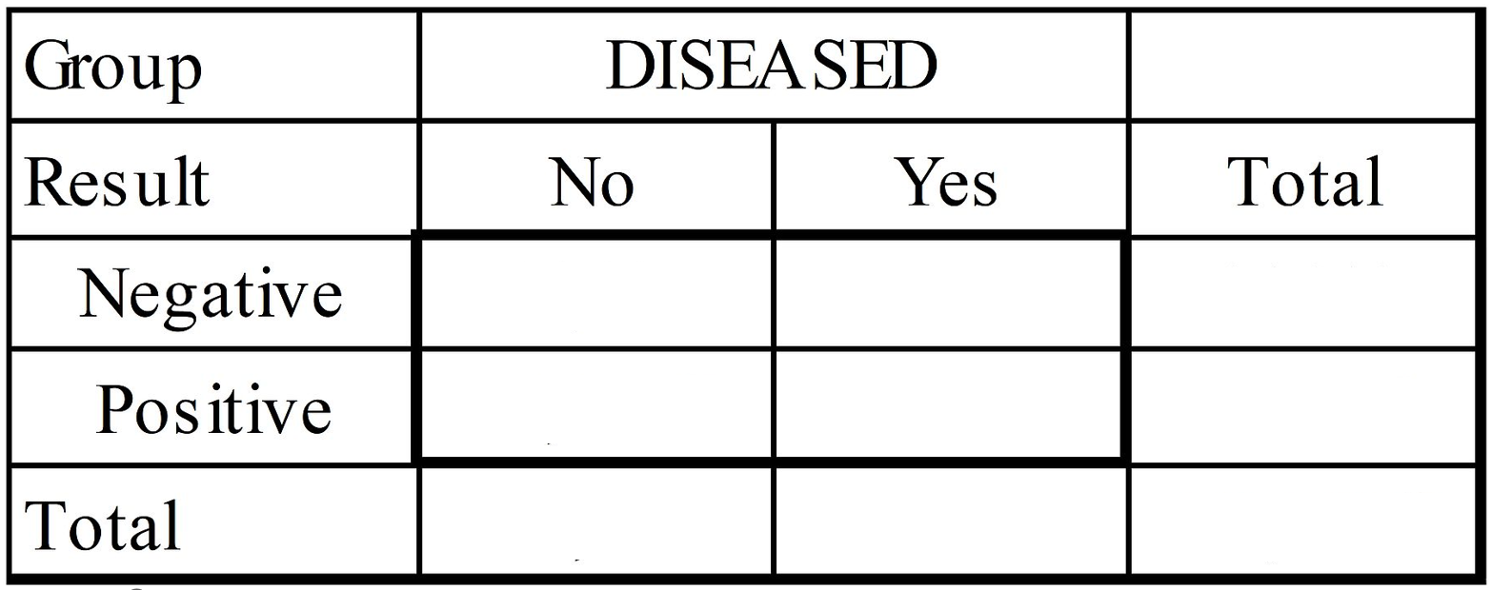






Simple Medical Tests:
Problem #1
7.6; P 283
23
95% confirmation accuracy: P(Positive|Disease).
0.1% disease prevalence. Percentage of diseased.
What percentage of positive are diseased?
Notes:
Model Trendline Linear 2Y1X using Excel 2013
11/24/2013 V0a
www.StatLit.org/pdf/Model-Trendline-Linear-2Y1X-Excel2013-6up.pdf
23
Analyzing Numbers in the News
15 May 2008
2008SchieldNNN6up.pdf
23
23

Slide 24
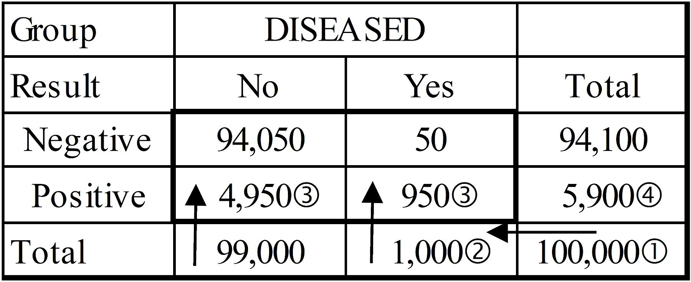
Simple Medical Tests:
Problem #2
7.6; P 284
24
95% confirmation accuracy.
1% disease prevalence. 1% are diseased.
What percentage of positive are diseased?
Notes:
Model Trendline Linear 2Y1X using Excel 2013
11/24/2013 V0a
www.StatLit.org/pdf/Model-Trendline-Linear-2Y1X-Excel2013-6up.pdf
24
Analyzing Numbers in the News
15 May 2008
2008SchieldNNN6up.pdf
24
24

Slide 25
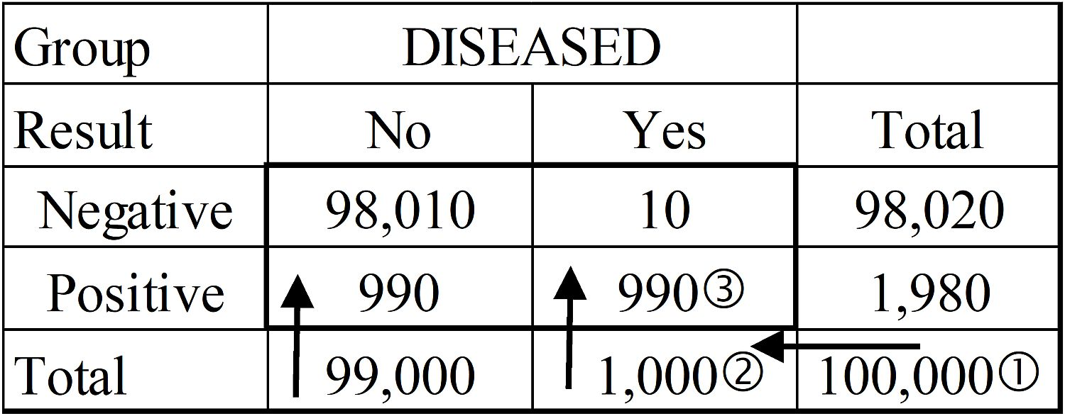
Simple Medical Tests:
Problem #3
7.6; P 284
25
99% confirmation accuracy.
1% disease prevalence. 1% are diseased.
What percentage of positive are diseased?
What is the confirmation error %?
Notes:
Model Trendline Linear 2Y1X using Excel 2013
11/24/2013 V0a
www.StatLit.org/pdf/Model-Trendline-Linear-2Y1X-Excel2013-6up.pdf
25
Analyzing Numbers in the News
15 May 2008
2008SchieldNNN6up.pdf
25
25

Slide 26
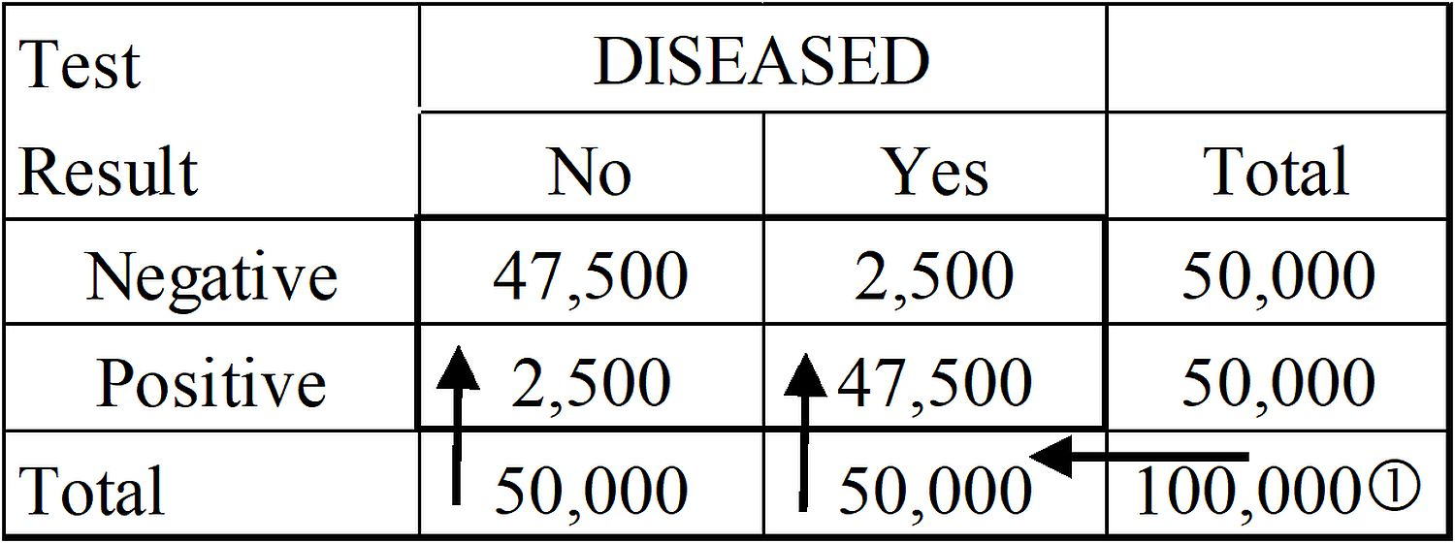
Simple Medical Tests:
Problem #4
7.6; P 285
26
95% confirmation accuracy.
50% disease prevalence. 50% are diseased.
What percentage of positive are diseased?
What percentage of diseased test positive?
Notes:
Model Trendline Linear 2Y1X using Excel 2013
11/24/2013 V0a
www.StatLit.org/pdf/Model-Trendline-Linear-2Y1X-Excel2013-6up.pdf
26
Analyzing Numbers in the News
15 May 2008
2008SchieldNNN6up.pdf
26
26

Slide 27
Simple Medical Tests:
Conclusions
7.6; P 285
27
Accuracy, error and quality are ambiguous.
Predictive accuracy (PA) is different from confirmation accuracy (CA).
As CA increases, PA increases.
PA decreases as disease % decreases.
Two handy results:
PA = 50% if Confirm error = Disease %.
PA = CA when disease % is 50%.
PA > CA when disease % is > 50%.
Notes:
Model Trendline Linear 2Y1X using Excel 2013
11/24/2013 V0a
www.StatLit.org/pdf/Model-Trendline-Linear-2Y1X-Excel2013-6up.pdf
27
Analyzing Numbers in the News
15 May 2008
2008SchieldNNN6up.pdf
27
27

Slide 28
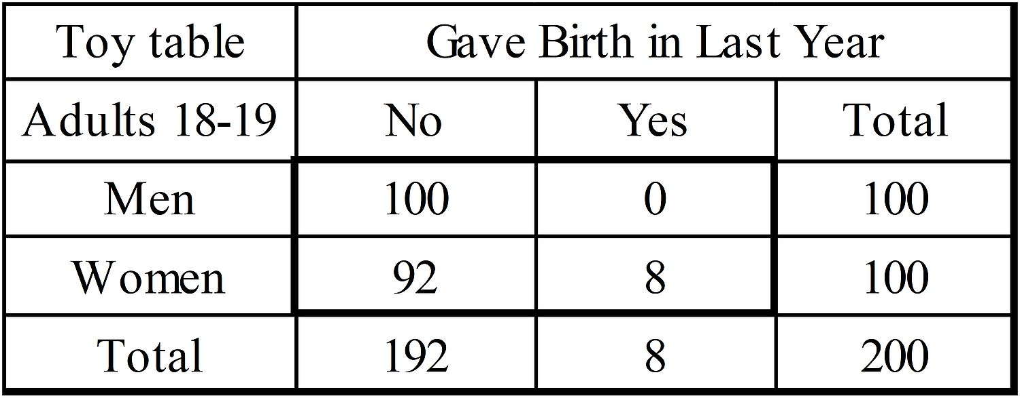
Social Statistics
Predictive vs. Explanatory
7.7; P 286, 287
28
What percentage of women gave birth?
What percentage of birth givers are women?
Which is smaller? Which is bigger?
Which predicts? Which explains?
Notes:
Model Trendline Linear 2Y1X using Excel 2013
11/24/2013 V0a
www.StatLit.org/pdf/Model-Trendline-Linear-2Y1X-Excel2013-6up.pdf
28
Analyzing Numbers in the News
15 May 2008
2008SchieldNNN6up.pdf
28
28

Slide 29
Social Statistics
Predictive vs. Explanatory
7.7; P 287
29
Three guidelines (rules)
Temporal rule: Predictive factor comes first.
Percentage of men who die: predictive.
Percentage of dead who are men: explanatory
Smaller ratio: If ‘percentage of Y who are X’ < ‘percentage of X who are Y’, then 1st is predictive.
Smaller margin: If ‘%age of X’ < ‘%age of Y’ then ‘percentage of Y who are X’ is predictive
Notes:
Model Trendline Linear 2Y1X using Excel 2013
11/24/2013 V0a
www.StatLit.org/pdf/Model-Trendline-Linear-2Y1X-Excel2013-6up.pdf
29
Analyzing Numbers in the News
15 May 2008
2008SchieldNNN6up.pdf
29
29

Slide 30
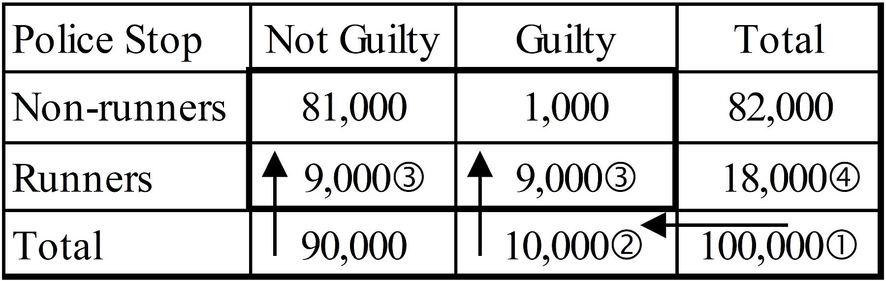
Social Statistics
Which is bigger: predictive or explanatory?
7.7; P 288
30
10% of the those stopped by police are guilty.
90% of the guilty stopped by police run.
10% of the not-guilty stopped by police run.
What percentage of runners are guilty?
Notes:
Model Trendline Linear 2Y1X using Excel 2013
11/24/2013 V0a
www.StatLit.org/pdf/Model-Trendline-Linear-2Y1X-Excel2013-6up.pdf
30
Analyzing Numbers in the News
15 May 2008
2008SchieldNNN6up.pdf
30
30

Slide 31
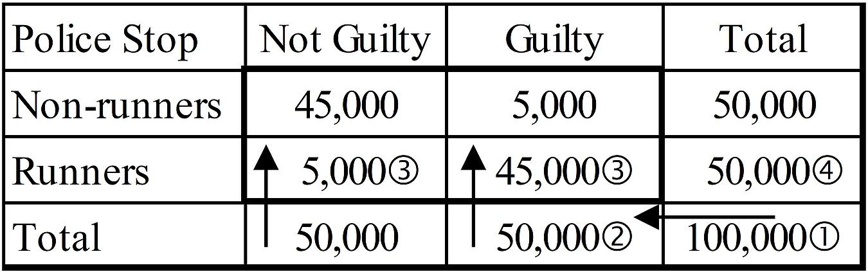
Social Statistics
Which is bigger: predictive or explanatory?
7.7; P 288
31
50% of those stopped by police are guilty.
90% of the guilty stopped by police run.
10% of not-guilty stopped by police run.
What percentage of runners are guilty?
Notes:
Model Trendline Linear 2Y1X using Excel 2013
11/24/2013 V0a
www.StatLit.org/pdf/Model-Trendline-Linear-2Y1X-Excel2013-6up.pdf
31
Analyzing Numbers in the News
15 May 2008
2008SchieldNNN6up.pdf
31
31

Slide 32
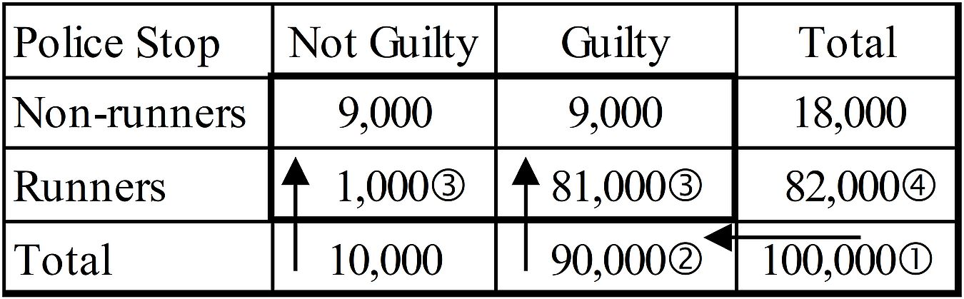
Social Statistics:
Which is bigger: predictive or explanatory?
7.7; P 288
32
90% of the those stopped by police are guilty.
90% of the guilty stopped by police run.
90% of the not-guilty police stopped don’t run.
What percentage of runners are guilty?
Notes:
Model Trendline Linear 2Y1X using Excel 2013
11/24/2013 V0a
www.StatLit.org/pdf/Model-Trendline-Linear-2Y1X-Excel2013-6up.pdf
32
Analyzing Numbers in the News
15 May 2008
2008SchieldNNN6up.pdf
32
32

Slide 33
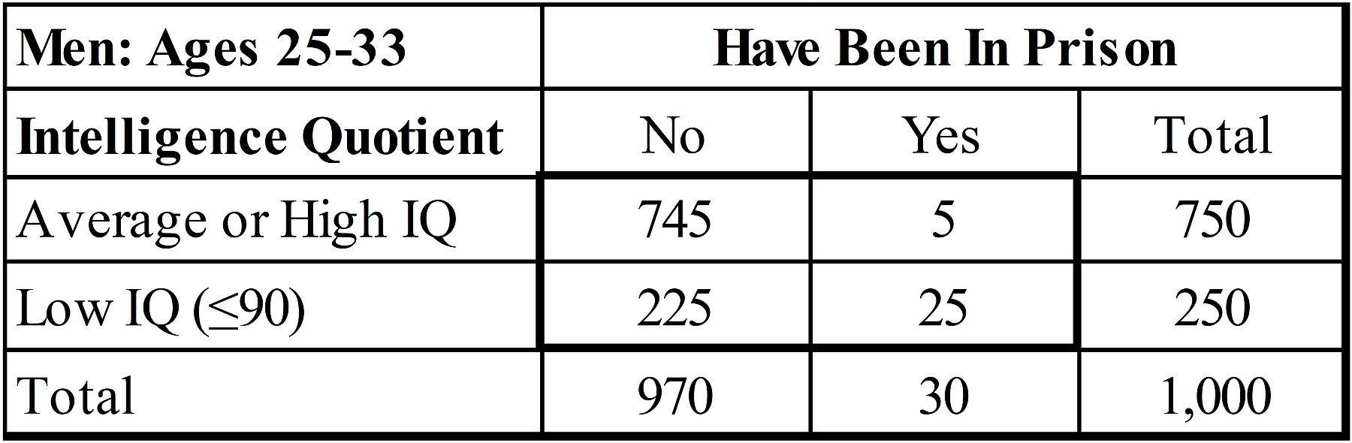
Social Statistics
Predictive vs. Explanatory
7.7; P 289
33
Predictive is smaller; explanatory is larger.
What percentage of ‘prisoners’ have low IQ?
What percentage of low-IQ have been in prison?
Which is predictive? Which is explanatory?
Notes:
Model Trendline Linear 2Y1X using Excel 2013
11/24/2013 V0a
www.StatLit.org/pdf/Model-Trendline-Linear-2Y1X-Excel2013-6up.pdf
33
Analyzing Numbers in the News
15 May 2008
2008SchieldNNN6up.pdf
33
33

Slide 34
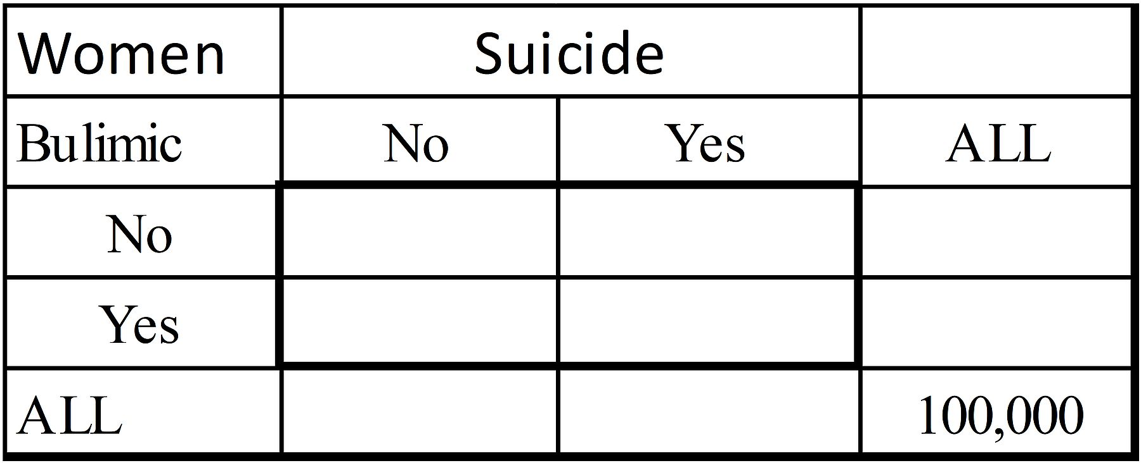

Social Statistics:
Which is predictive? Explanatory?
7.7; P 289
34
6% of women have bulimia: an eating disorder.
0.1% of women commit suicide (1 per 1,000).
1% of bulimic women commit suicide.
What percentage of female suicides are bulimic?
Notes:
Model Trendline Linear 2Y1X using Excel 2013
11/24/2013 V0a
www.StatLit.org/pdf/Model-Trendline-Linear-2Y1X-Excel2013-6up.pdf
34
Analyzing Numbers in the News
15 May 2008
2008SchieldNNN6up.pdf
34
34

Slide 35
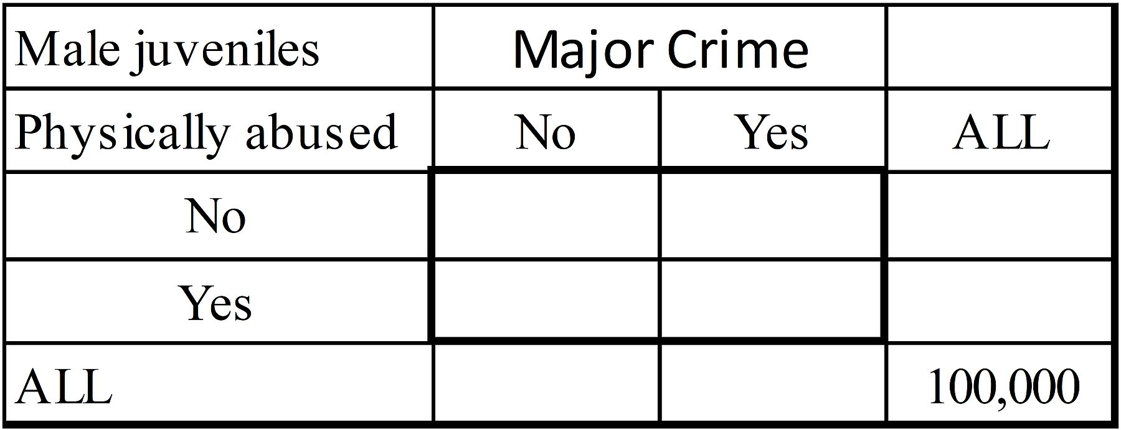
Social Statistics:
Predictive vs. Explanatory
7.7; P 290
35
10% of male juveniles were physically abused.
5% of male juveniles (MJ) commit major crimes.
40% of physically-abused MJ commit major crimes
What percentage of MJ who committed major crimes were physically abused?
Notes:
Model Trendline Linear 2Y1X using Excel 2013
11/24/2013 V0a
www.StatLit.org/pdf/Model-Trendline-Linear-2Y1X-Excel2013-6up.pdf
35
Analyzing Numbers in the News
15 May 2008
2008SchieldNNN6up.pdf
35
35

Slide 36
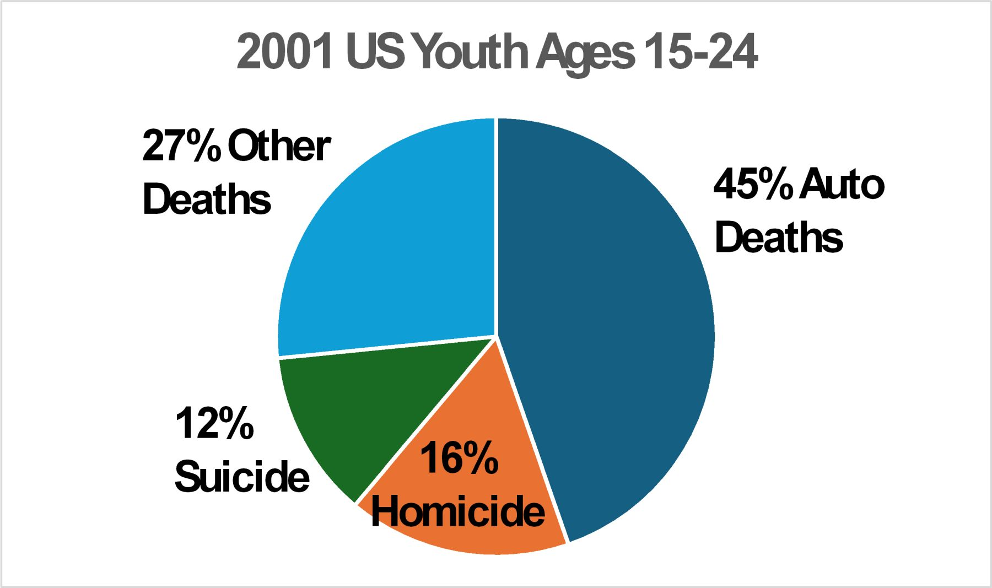
Three-Term Ratios:
Term in wrong slot (Error)
7.8; P 291
36
What percentage of 2001 US youth ages 15-24 die from suicide?
What percentage of these deaths are suicides?
Notes:
Model Trendline Linear 2Y1X using Excel 2013
11/24/2013 V0a
www.StatLit.org/pdf/Model-Trendline-Linear-2Y1X-Excel2013-6up.pdf
36
Analyzing Numbers in the News
15 May 2008
2008SchieldNNN6up.pdf
36
36

Slide 37
Three-Term Ratios:
Which must be the smaller?
7.8; P 291
37
1) Percentage of Asian teens who smoke
2) Percentage of Asians who are teen smokers
‘Teen’ is the switch factor.
Which ratio must be smaller based on grammar?
Which has the smaller part?
Which the bigger whole?
Recall: Adding modifiers decreases the count.
Notes:
Model Trendline Linear 2Y1X using Excel 2013
11/24/2013 V0a
www.StatLit.org/pdf/Model-Trendline-Linear-2Y1X-Excel2013-6up.pdf
37
Analyzing Numbers in the News
15 May 2008
2008SchieldNNN6up.pdf
37
37

Slide 38
Three-Term Ratios:
7.8; P 291
38
Percentage Comparison Rule: If two percentages have the same factors and differ only by the location of a “switch” factor in part or whole, the percentage having the “switch” factor in the part is always the smaller ratio.
Which is smaller?
1) Percentage of teens who drop out and do drugs
2) Percentage of teen dropouts who do drugs.
Notes:
Model Trendline Linear 2Y1X using Excel 2013
11/24/2013 V0a
www.StatLit.org/pdf/Model-Trendline-Linear-2Y1X-Excel2013-6up.pdf
38
Analyzing Numbers in the News
15 May 2008
2008SchieldNNN6up.pdf
38
38

Slide 39
Three Greatest Contributions of Statistics to Human Knowledge
7.9; P 293
39
Sampling Theory: Proving the Central Limit theorem: the basis for sampling error, margin of error, confidence intervals and hypothesis testing. Laplace in 1810.
Experimental Causation: Allowing a statistically-significant difference in outcomes to serve as strong evidence for causation if heterogeneous subjects are randomly assigned to treatment and control groups. Introduced by Ronald Fisher in 1925, 1926 and 1935.
Observational Causation: Establishing a minimum effect size for a confounder to nullify or reverse an observed association. Proved by Jerome Cornfield in 1959.
Notes:
Model Trendline Linear 2Y1X using Excel 2013
11/24/2013 V0a
www.StatLit.org/pdf/Model-Trendline-Linear-2Y1X-Excel2013-6up.pdf
39
Analyzing Numbers in the News
15 May 2008
2008SchieldNNN6up.pdf
39
39

Slide 40
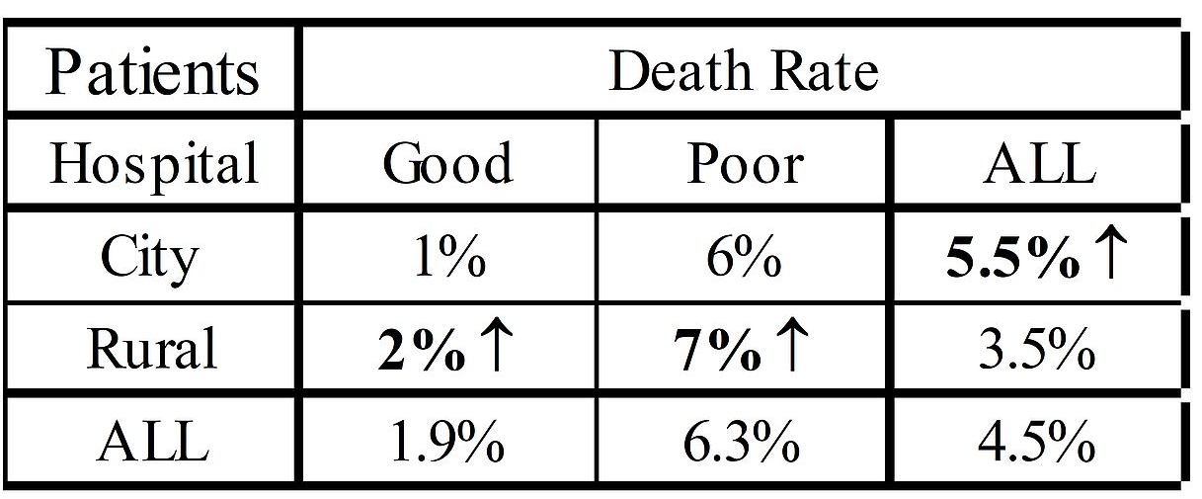
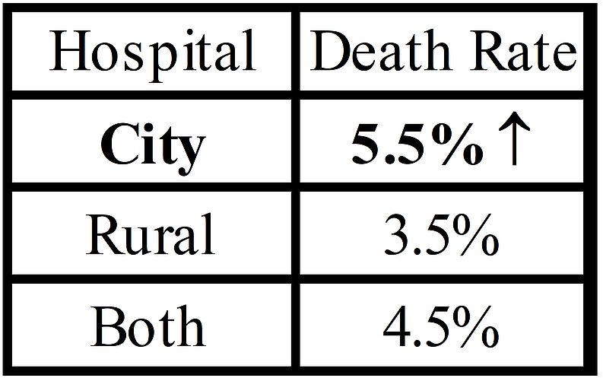
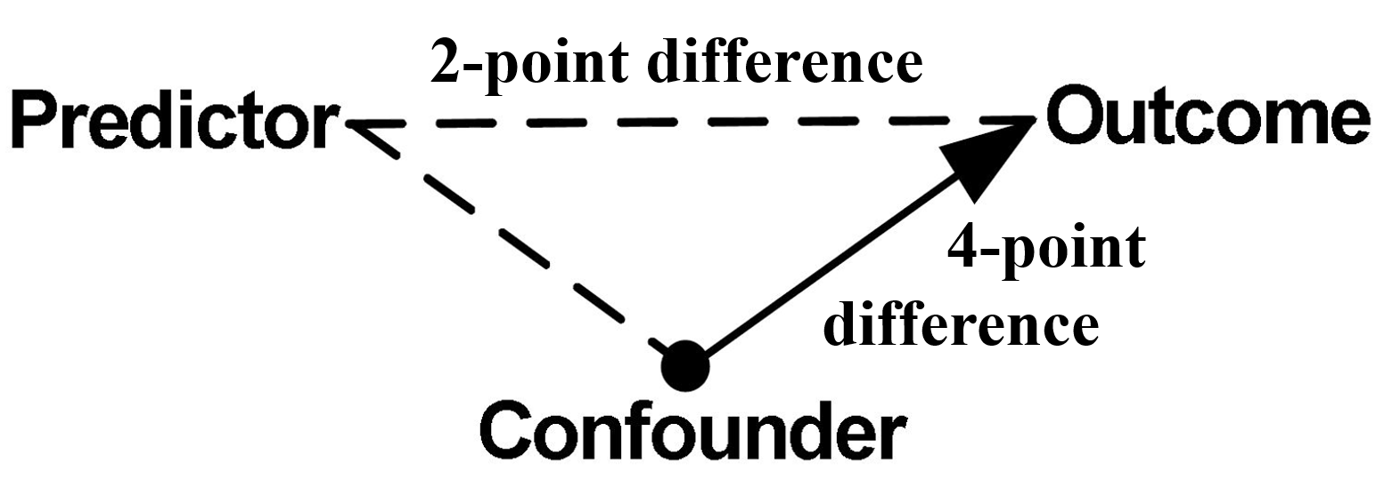
Patients’ Death Rates:
City vs. Rural Hospital
7.9; P 293
40
Simpson’s paradox reversal. Proof by selection.
Confounder gap (6.3-1.9) exceeds predictor (5.5-3.5)
Notes:
Model Trendline Linear 2Y1X using Excel 2013
11/24/2013 V0a
www.StatLit.org/pdf/Model-Trendline-Linear-2Y1X-Excel2013-6up.pdf
40
Analyzing Numbers in the News
15 May 2008
2008SchieldNNN6up.pdf
40
40

Slide 41
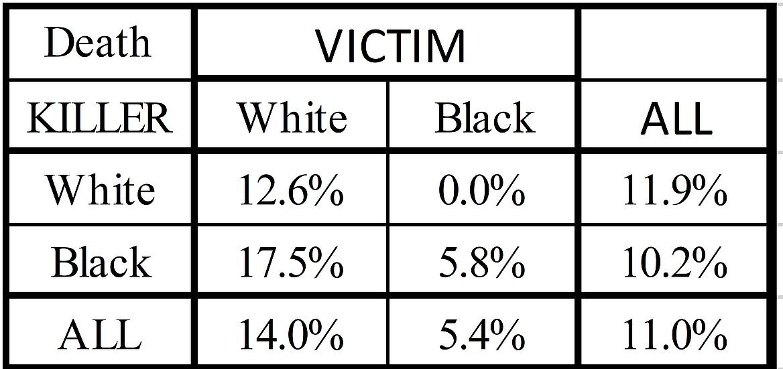
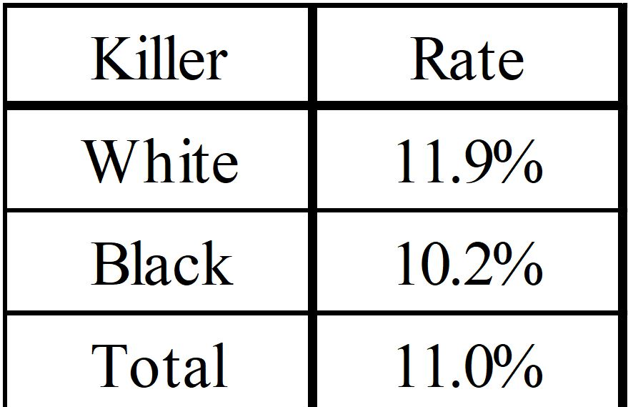
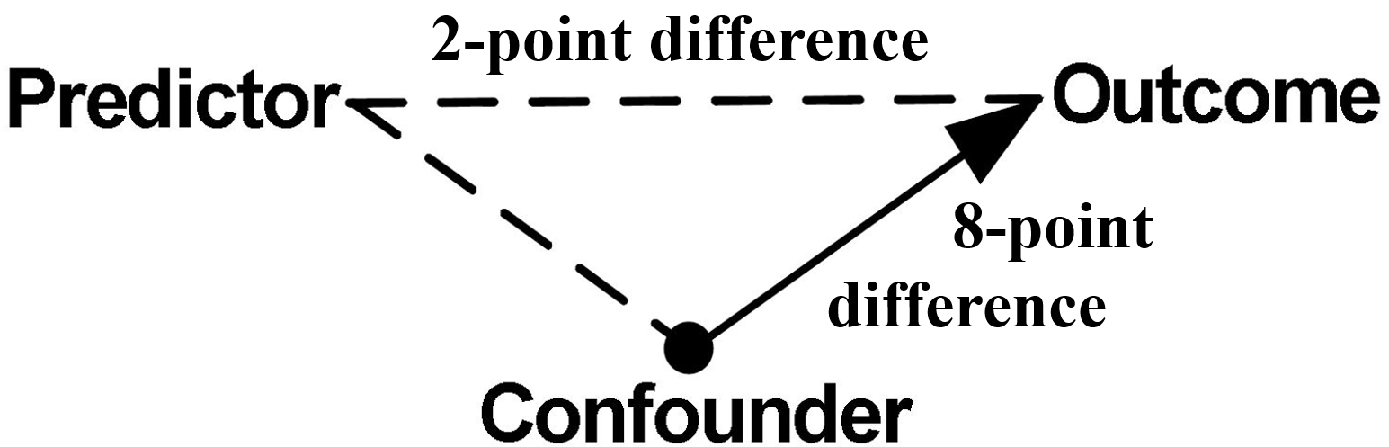
1970s Florida: Anti-White Bias?
Murderers & Death Penalty
7.9; P 296
41
Simpson’s paradox reversal. Proof by selection!
Victim gap (14.0 - 5.4) exceeds Killer gap (11.9 - 10.2)
Notes:
Model Trendline Linear 2Y1X using Excel 2013
11/24/2013 V0a
www.StatLit.org/pdf/Model-Trendline-Linear-2Y1X-Excel2013-6up.pdf
41
Analyzing Numbers in the News
15 May 2008
2008SchieldNNN6up.pdf
41
41

Slide 42
1970s Florida: Anti-White Bias?
Murderers & Death Penalty
7.9; P 293
42
What percentage ___ got the Death penalty:
Of white murderers who killed a Black?
Of Black murderers who killed a White? ,
Notes:
Model Trendline Linear 2Y1X using Excel 2013
11/24/2013 V0a
www.StatLit.org/pdf/Model-Trendline-Linear-2Y1X-Excel2013-6up.pdf
42
Analyzing Numbers in the News
15 May 2008
2008SchieldNNN6up.pdf
42
42

Slide 43
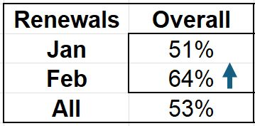
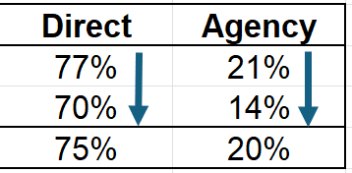
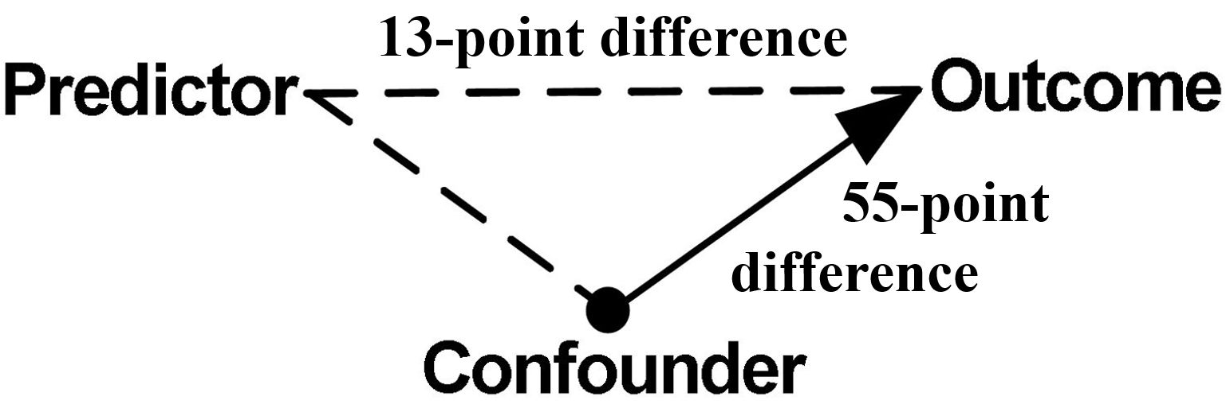
Magazine Renewal Rates:
February higher than January.
7.9; P 298
43
Simpson’s paradox. Proof by selection
Confounder gap (55pt) exceeds predictor gap (13pt)
Notes:
Model Trendline Linear 2Y1X using Excel 2013
11/24/2013 V0a
www.StatLit.org/pdf/Model-Trendline-Linear-2Y1X-Excel2013-6up.pdf
43
Analyzing Numbers in the News
15 May 2008
2008SchieldNNN6up.pdf
43
43

Slide 44
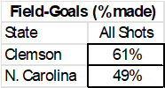
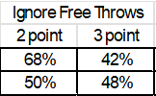
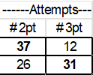
Field Goal Percentage:
Clemson vs. North Carolina State
7.9; P 299
44
Clemson had higher field-goal percentage.
But North Carolina won!
Not quite Simpson’s paradox.
Confounder is the mix of 2- and 3-point shots.
Clemson shot more 2 pt; Clemson more 3 pt.
Notes:
Model Trendline Linear 2Y1X using Excel 2013
11/24/2013 V0a
www.StatLit.org/pdf/Model-Trendline-Linear-2Y1X-Excel2013-6up.pdf
44
Analyzing Numbers in the News
15 May 2008
2008SchieldNNN6up.pdf
44
44

Slide 45
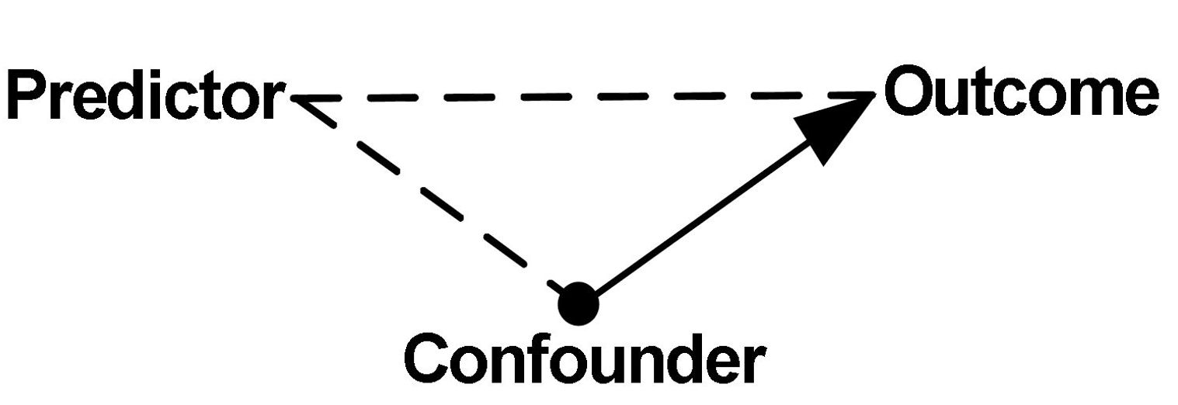
Necessary Condition for
Simpson’s Paradox
7.9; P 295
45
Confounder-outcome comparison must exceed
the predictor-outcome comparison (crude).
Two-group ‘comparison’ can be difference or ratio.
Notes:
Model Trendline Linear 2Y1X using Excel 2013
11/24/2013 V0a
www.StatLit.org/pdf/Model-Trendline-Linear-2Y1X-Excel2013-6up.pdf
45
Analyzing Numbers in the News
15 May 2008
2008SchieldNNN6up.pdf
45
45

Slide 46
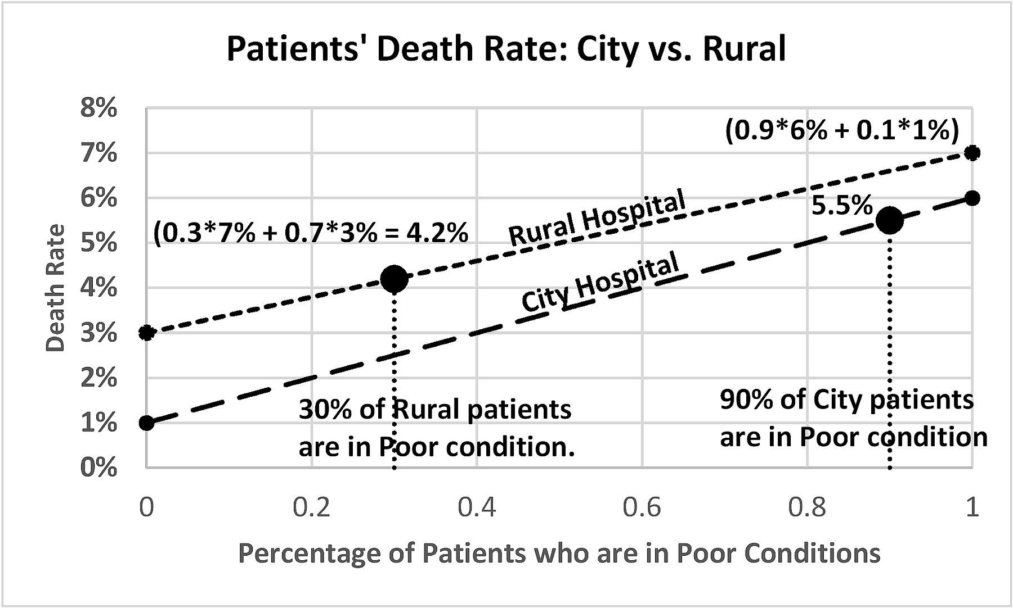
Hospital Patient Mortality:
Crude: City > Rural
7.9; P 301
46
.
Notes:
Model Trendline Linear 2Y1X using Excel 2013
11/24/2013 V0a
www.StatLit.org/pdf/Model-Trendline-Linear-2Y1X-Excel2013-6up.pdf
46
Analyzing Numbers in the News
15 May 2008
2008SchieldNNN6up.pdf
46
46

Slide 47
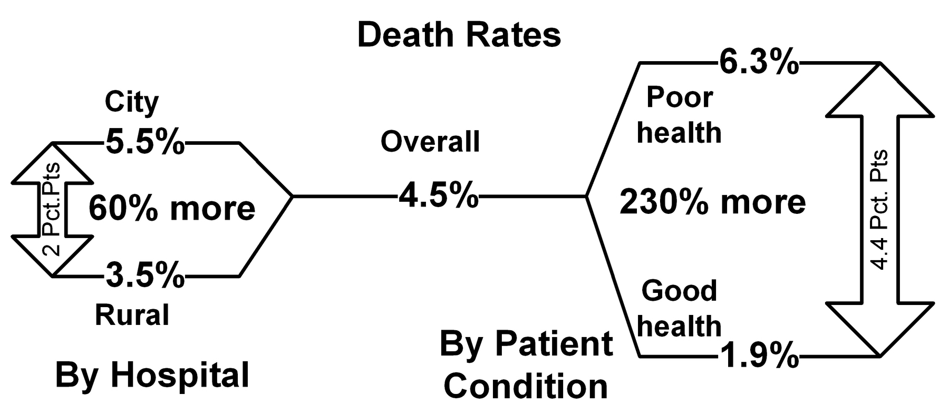
Cornfield Conditions:
Patient Death Rate by Hospital
7.9; P 295
47
To nullify or reverse, confounder-outcome difference/ratio must be bigger than predictor-outcome difference/ratio.
Notes:
Model Trendline Linear 2Y1X using Excel 2013
11/24/2013 V0a
www.StatLit.org/pdf/Model-Trendline-Linear-2Y1X-Excel2013-6up.pdf
47
Analyzing Numbers in the News
15 May 2008
2008SchieldNNN6up.pdf
47
47

Slide 48
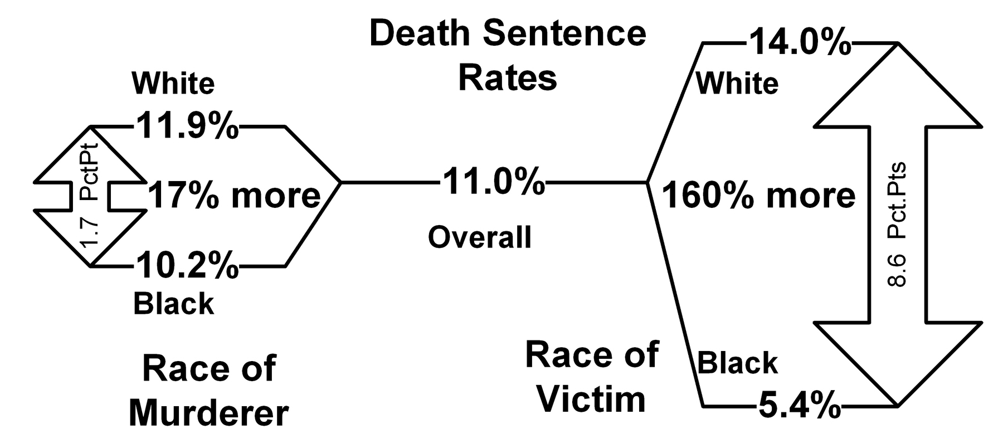
Cornfield Conditions:
Death Sentence by Race
7.9; P 297
48
To nullify or reverse, confounder-outcome difference/ratio must be bigger than predictor-outcome difference/ratio.
Notes:
Model Trendline Linear 2Y1X using Excel 2013
11/24/2013 V0a
www.StatLit.org/pdf/Model-Trendline-Linear-2Y1X-Excel2013-6up.pdf
48
Analyzing Numbers in the News
15 May 2008
2008SchieldNNN6up.pdf
48
48

Slide 49
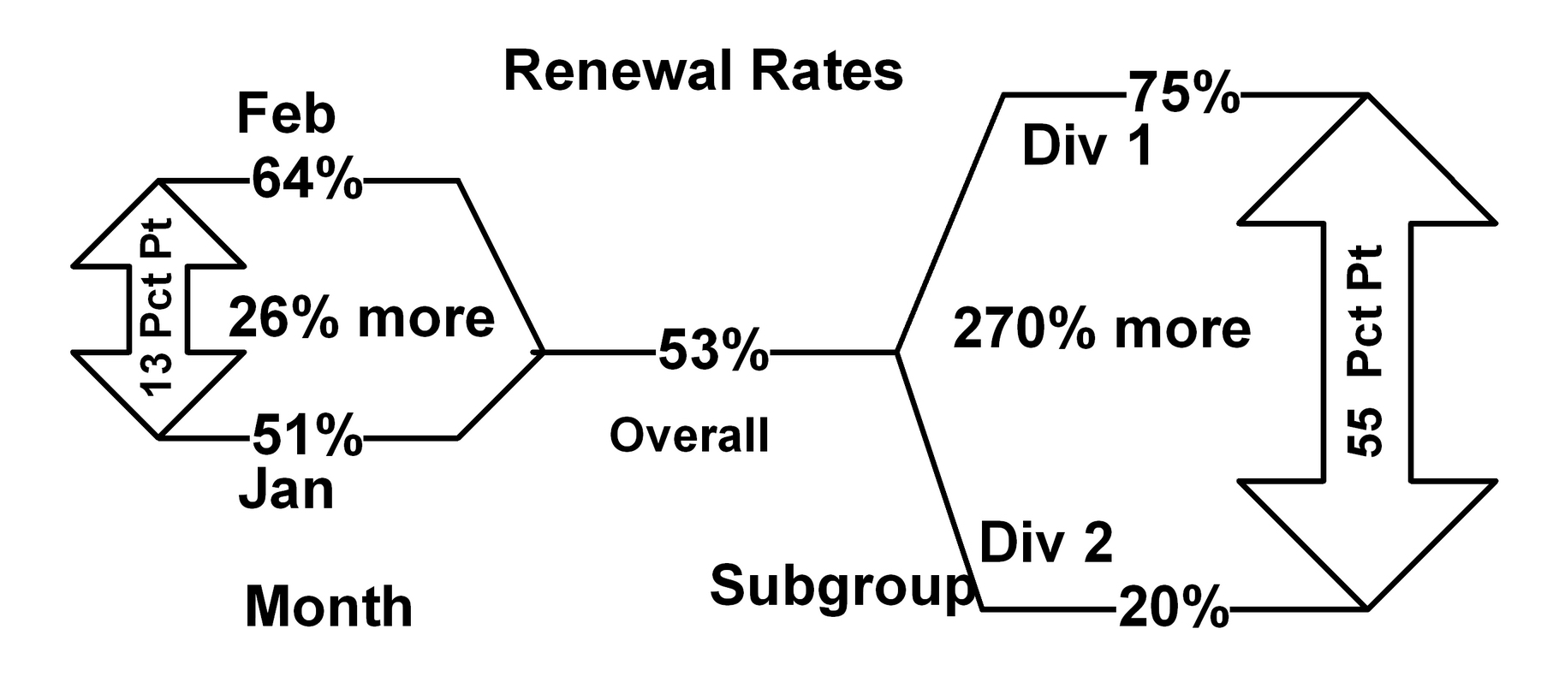
Cornfield Conditions:
Renewal Rates by Month
7.9; P 298
49
To nullify or reverse, confounder-outcome difference/ratio must be bigger than predictor-outcome difference/ratio.
Notes:
Model Trendline Linear 2Y1X using Excel 2013
11/24/2013 V0a
www.StatLit.org/pdf/Model-Trendline-Linear-2Y1X-Excel2013-6up.pdf
49
Analyzing Numbers in the News
15 May 2008
2008SchieldNNN6up.pdf
49
49

Slide 50
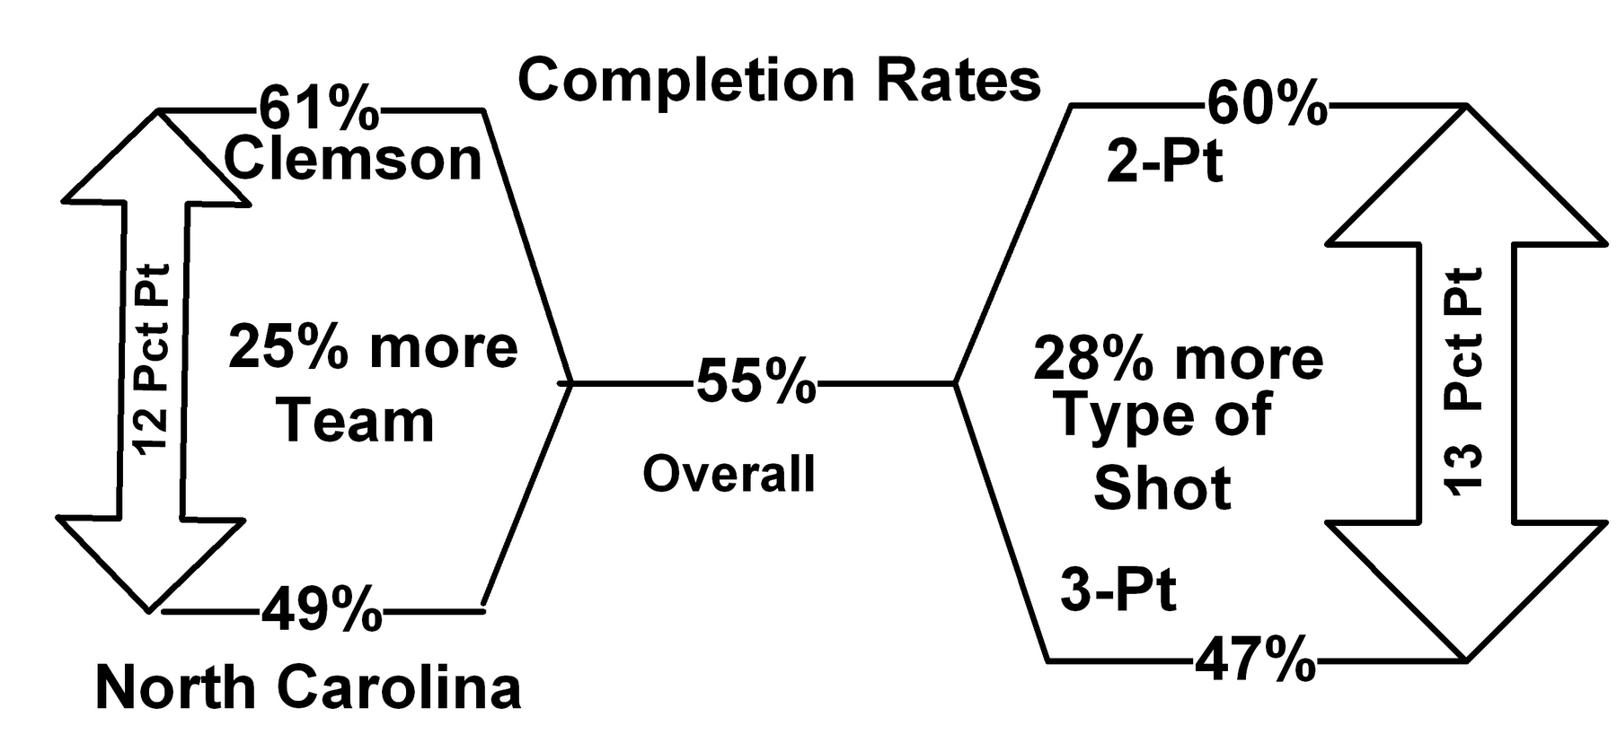
Cornfield Conditions:
Field-Goal Rates by Team
7.9; P 299
50
To nullify or reverse, confounder-outcome difference/ratio must be bigger than predictor-outcome difference/ratio.
Notes:
Model Trendline Linear 2Y1X using Excel 2013
11/24/2013 V0a
www.StatLit.org/pdf/Model-Trendline-Linear-2Y1X-Excel2013-6up.pdf
50
Analyzing Numbers in the News
15 May 2008
2008SchieldNNN6up.pdf
50
50

Slide 51
Standardizing by Mix-Matching
7.9; P 300-304
51
Skipped pages 300-304. Same technique as introduced in chapter 3 – only now the outcome and the mixture both involve percentages.
Since these two percentages (outcome and mixture) are easily confused, this textbook uses decimal fractions for the mixture (weights) and reserves percentages for the outcome.
Notes:
Model Trendline Linear 2Y1X using Excel 2013
11/24/2013 V0a
www.StatLit.org/pdf/Model-Trendline-Linear-2Y1X-Excel2013-6up.pdf
51
Analyzing Numbers in the News
15 May 2008
2008SchieldNNN6up.pdf
51
51

Slide 52
Biggest Confounder:
Biggest Connection with Outcome
7.9; P 304
52
Always take into account the biggest confounder first.
Otherwise, your crude association may be misleading in size if not in direction.
Beware of crude association. They may mislead!!!
Beware of crude associations with a small effect size.
The smaller the effect size, the more vulnerable to confounding.
Notes:
Model Trendline Linear 2Y1X using Excel 2013
11/24/2013 V0a
www.StatLit.org/pdf/Model-Trendline-Linear-2Y1X-Excel2013-6up.pdf
52
Analyzing Numbers in the News
15 May 2008
2008SchieldNNN6up.pdf
52
52

