Slide 1
Statistical Literacy Textbook:
Chapter 3 Slides
Statistical Literacy:
Critical Thinking about Everyday Statistics
Kendall-Hunt 2023
Milo Schield
ASA Fellow
University of New Mexico and New College of Florida
www.StatLit.org/
pdf/2023-Schield-StatLit1-Ch3-Slides.pdf
V/2023-StatLit2-Slides-Ch3A.mp4
V/2023-StatLit2-Slides-Ch3B.mp4
Notes:
Model Trendline Linear 2Y1X using Excel 2013
11/24/2013 V0a
www.StatLit.org/pdf/Model-Trendline-Linear-2Y1X-Excel2013-6up.pdf
1
Analyzing Numbers in the News
15 May 2008
2008SchieldNNN6up.pdf
1
1

Slide 2
Understanding Measurements:
Ch 3 Table of Contents
2
3.1 p 116 Learning Outcomes
3.2 p 117 Review
3.3 p 117 Data and Data Distributions
3.4 p 121 Measures of Location
3.5 p 125 Measures of Center
3.6 p 134 Assembly on Measures of Center
3.7 p 137 Confounder Solutions
3.8 p 157 The Essentials
3.9 p 159 Chapter Summary
3.10 p 160 Advanced/Optional
Notes:
Model Trendline Linear 2Y1X using Excel 2013
11/24/2013 V0a
www.StatLit.org/pdf/Model-Trendline-Linear-2Y1X-Excel2013-6up.pdf
2
Analyzing Numbers in the News
15 May 2008
2008SchieldNNN6up.pdf
2
2

Slide 3
Understanding Measurements:
3.1 Learning Outcomes
3
Understand ranks and percentiles.
Distinguish percent, percentage points and percentile points
Recognize order of mean, median, and mode if skewed
Compare means, medians, or modes using ordinary English
See how assembly can influence the size of a comparison
See how ratios can change size & direction of comparison
Take into account confounder influence by standardizing
Standardize comparisons of ratios with weighted averages
Notes:
Model Trendline Linear 2Y1X using Excel 2013
11/24/2013 V0a
www.StatLit.org/pdf/Model-Trendline-Linear-2Y1X-Excel2013-6up.pdf
3
Analyzing Numbers in the News
15 May 2008
2008SchieldNNN6up.pdf
3
3

Slide 4
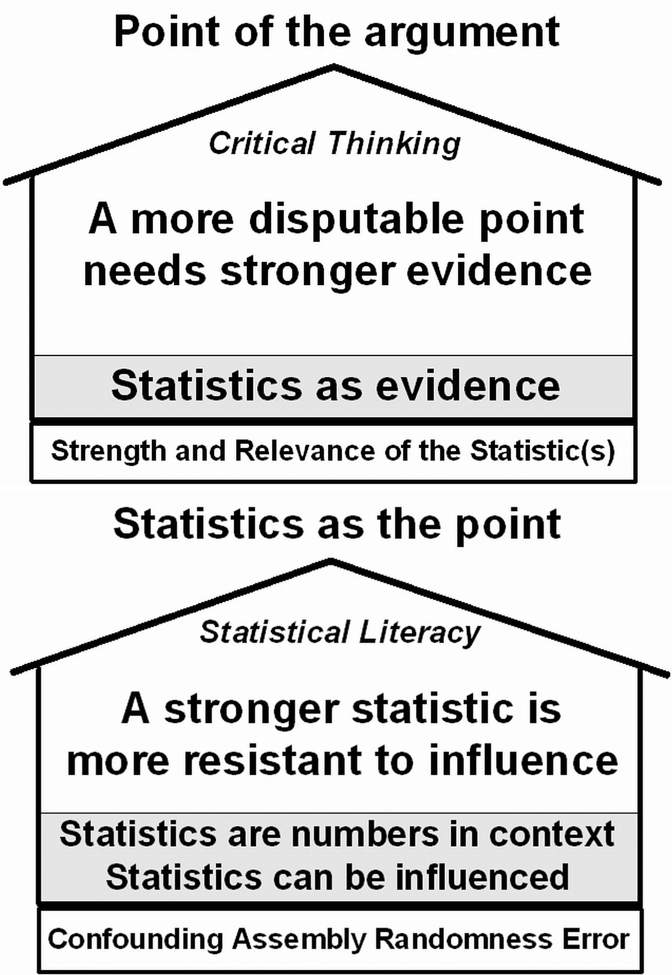
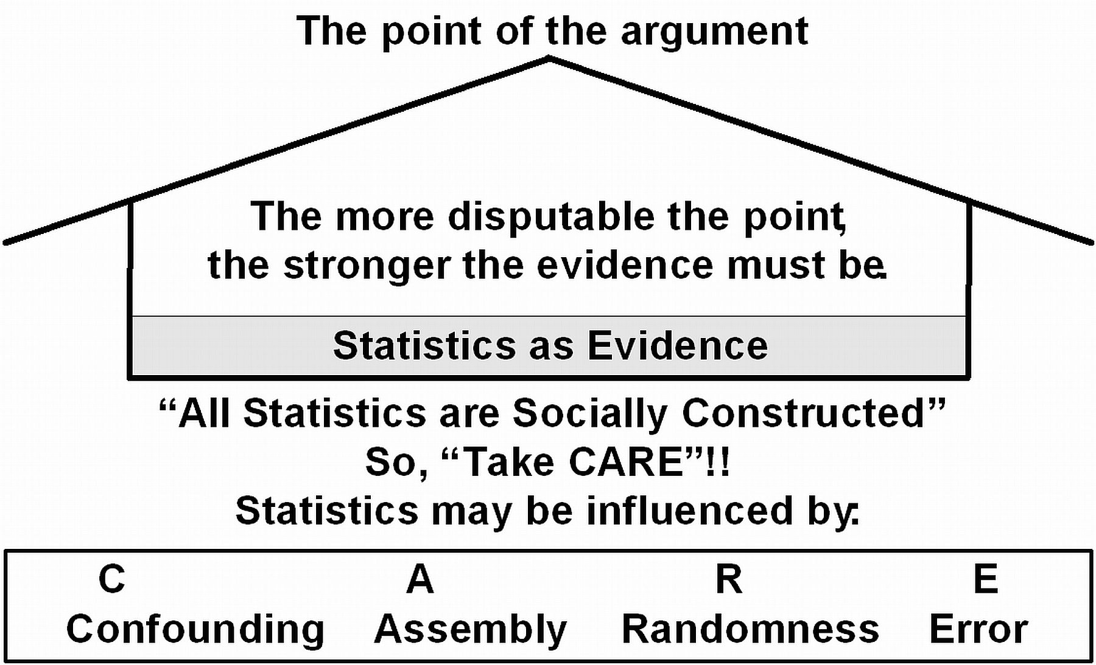
3.2 Review Chapter 1
P 117
4
Statistics are numbers in context: they can be influenced.
Statistics are commonly
used as evidence in arguments.
Notes:
Model Trendline Linear 2Y1X using Excel 2013
11/24/2013 V0a
www.StatLit.org/pdf/Model-Trendline-Linear-2Y1X-Excel2013-6up.pdf
4
Analyzing Numbers in the News
15 May 2008
2008SchieldNNN6up.pdf
4
4

Slide 5
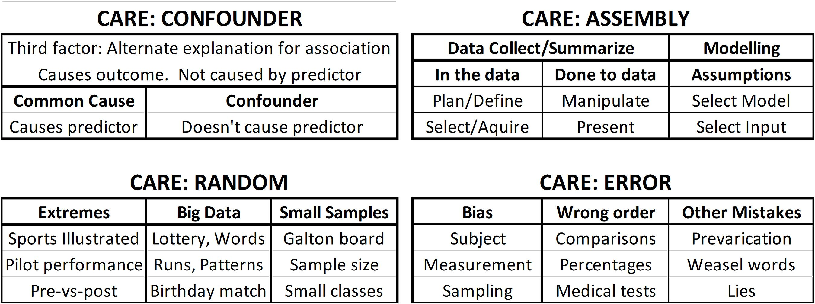
3.2 Review Statistical Influences/Problems
.
5
Best advice in dealing with statistics: Take CARE.
The influences on a statistic are classified into four groups:
* Confounding, Assembly, Randomness and Error/bias
Notes:
Model Trendline Linear 2Y1X using Excel 2013
11/24/2013 V0a
www.StatLit.org/pdf/Model-Trendline-Linear-2Y1X-Excel2013-6up.pdf
5
Analyzing Numbers in the News
15 May 2008
2008SchieldNNN6up.pdf
5
5

Slide 6
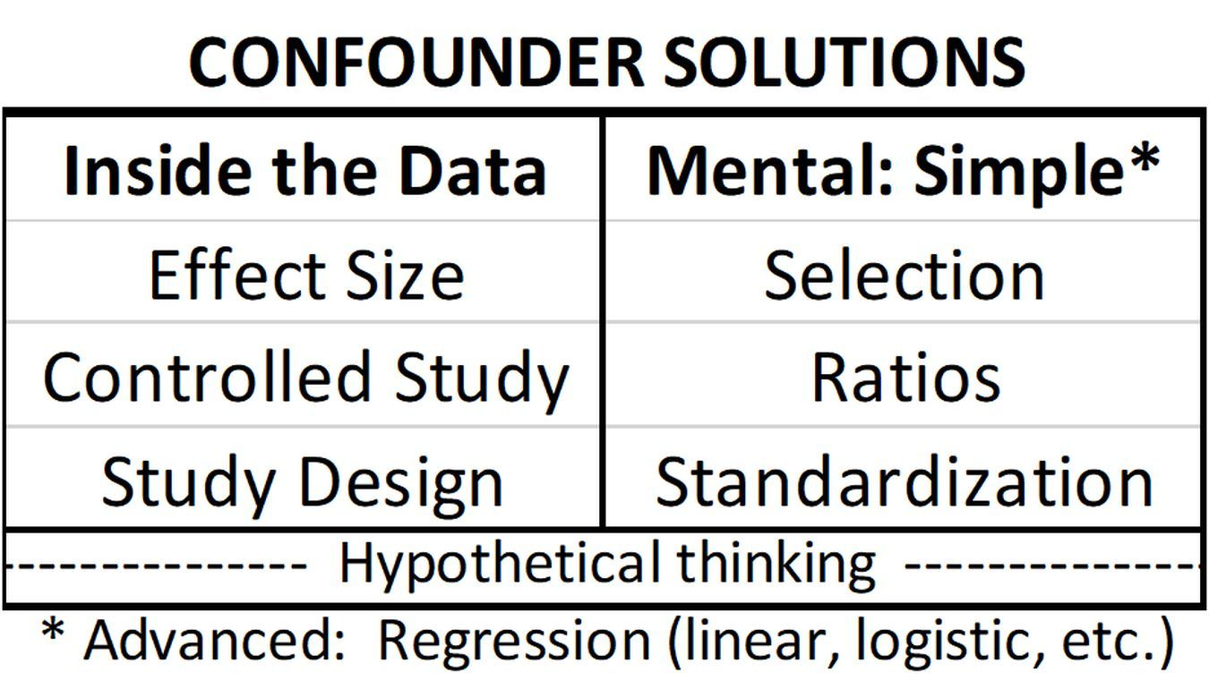
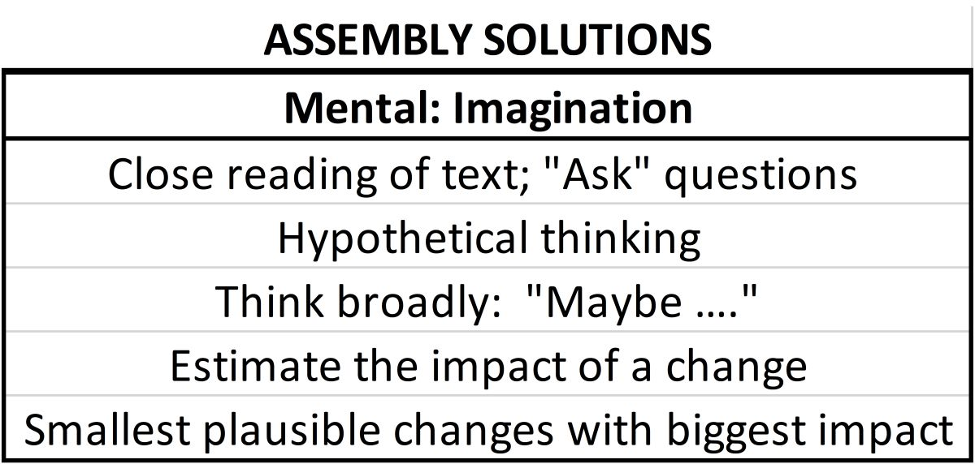
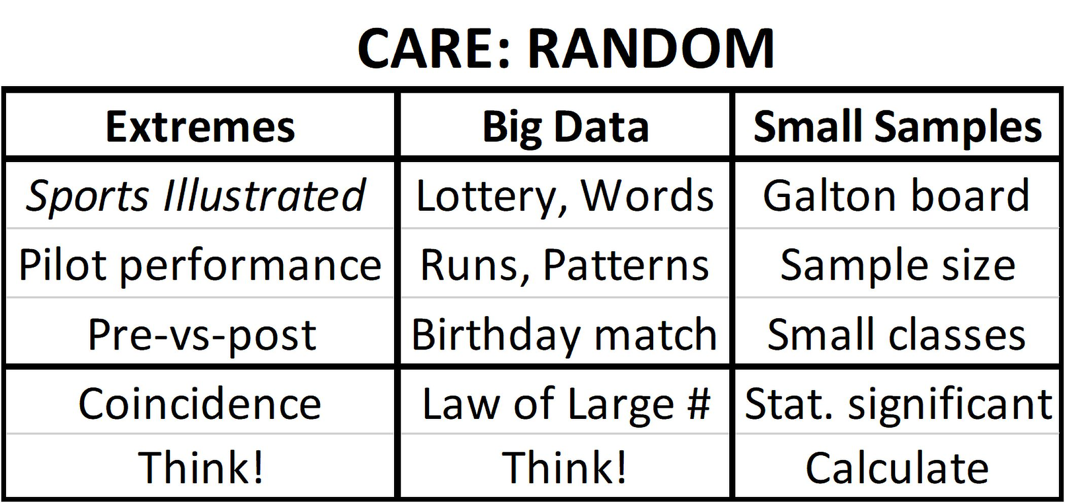
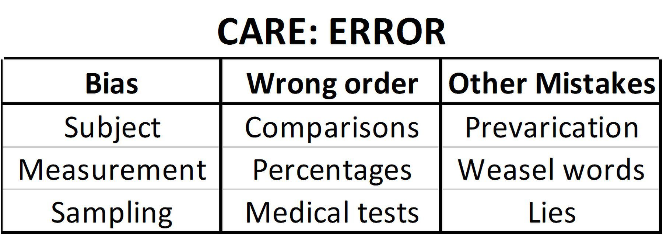
Review CARE Solutions
.
6
See below Think! Think!
*Bias: Single blind, double blind, random selection
*
Notes:
Model Trendline Linear 2Y1X using Excel 2013
11/24/2013 V0a
www.StatLit.org/pdf/Model-Trendline-Linear-2Y1X-Excel2013-6up.pdf
6
Analyzing Numbers in the News
15 May 2008
2008SchieldNNN6up.pdf
6
6

Slide 7
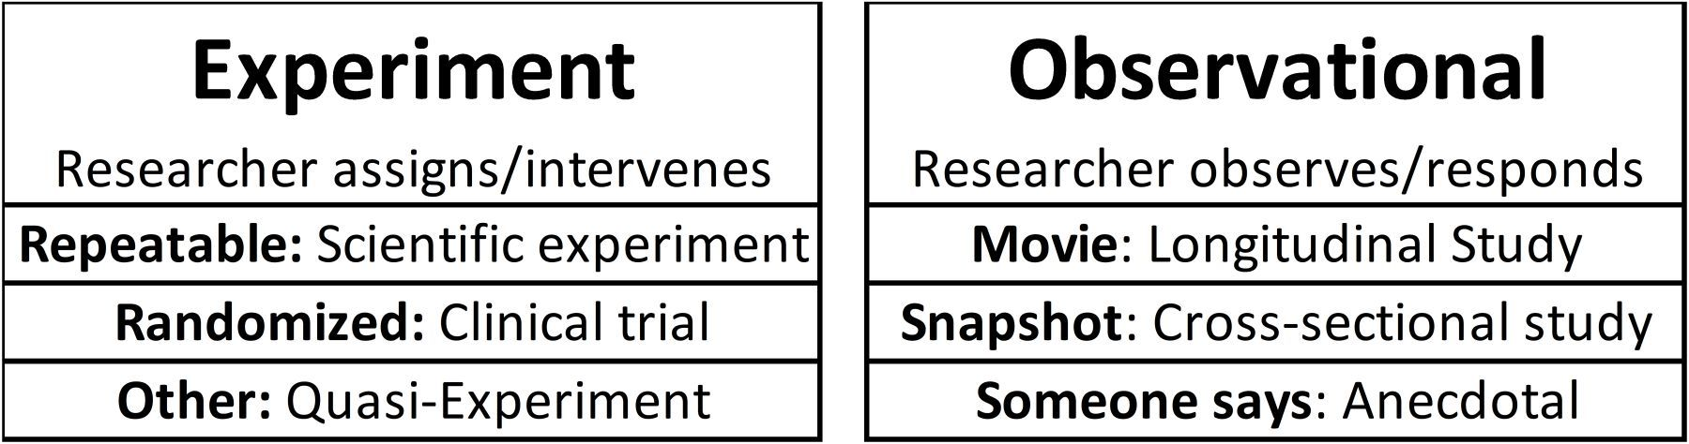
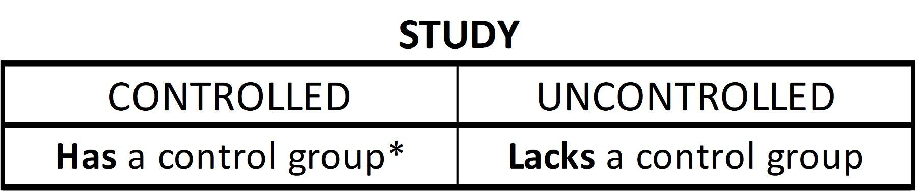
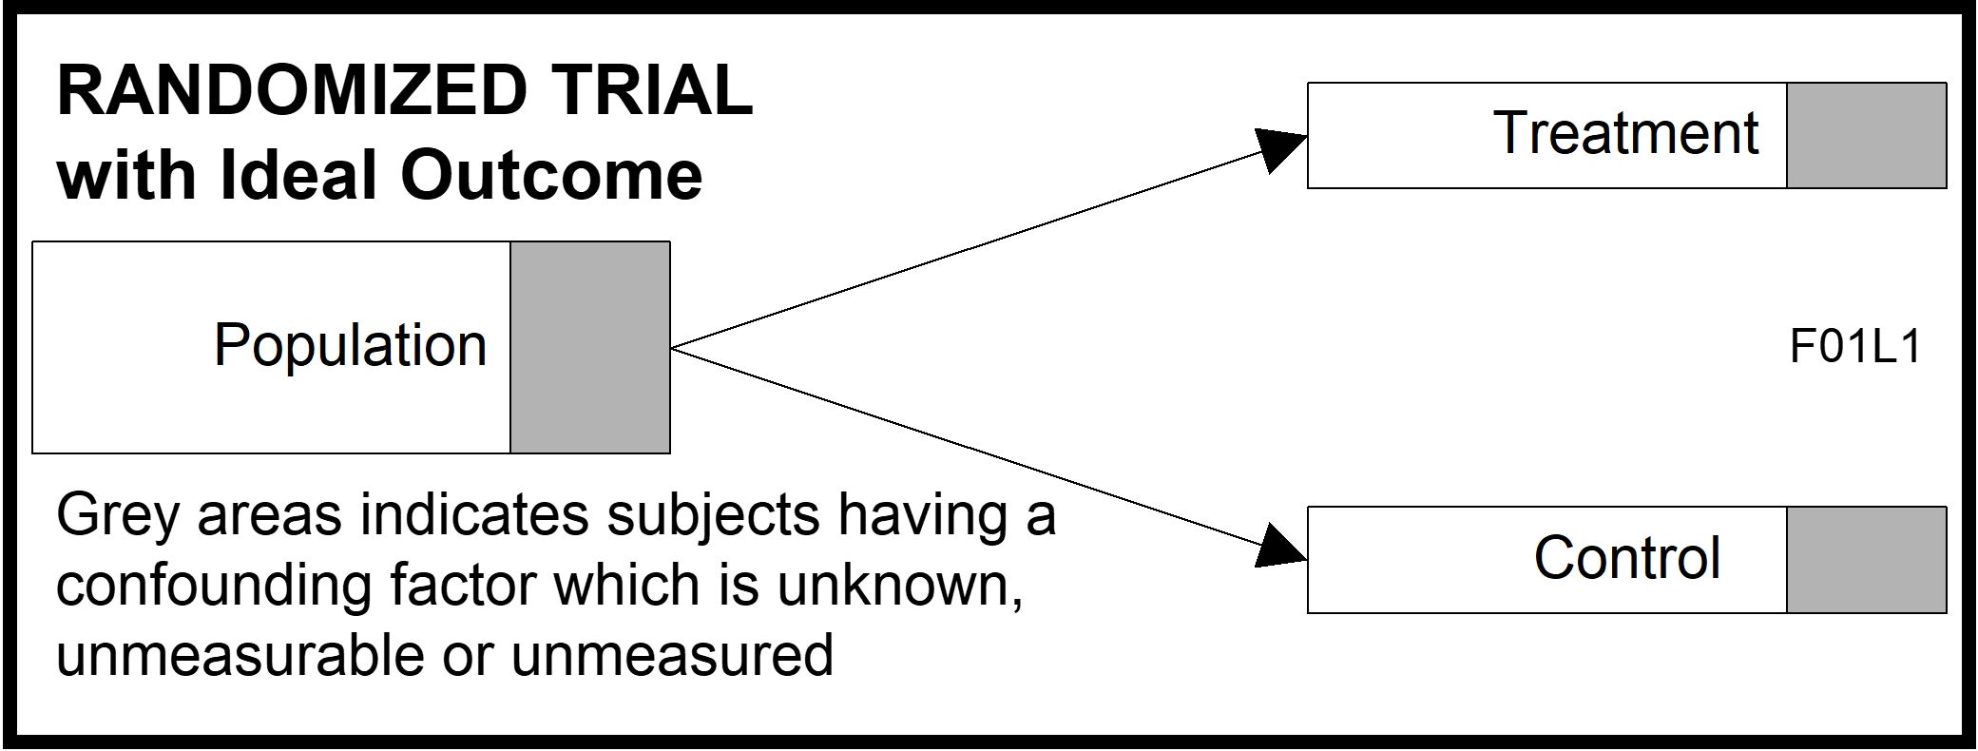
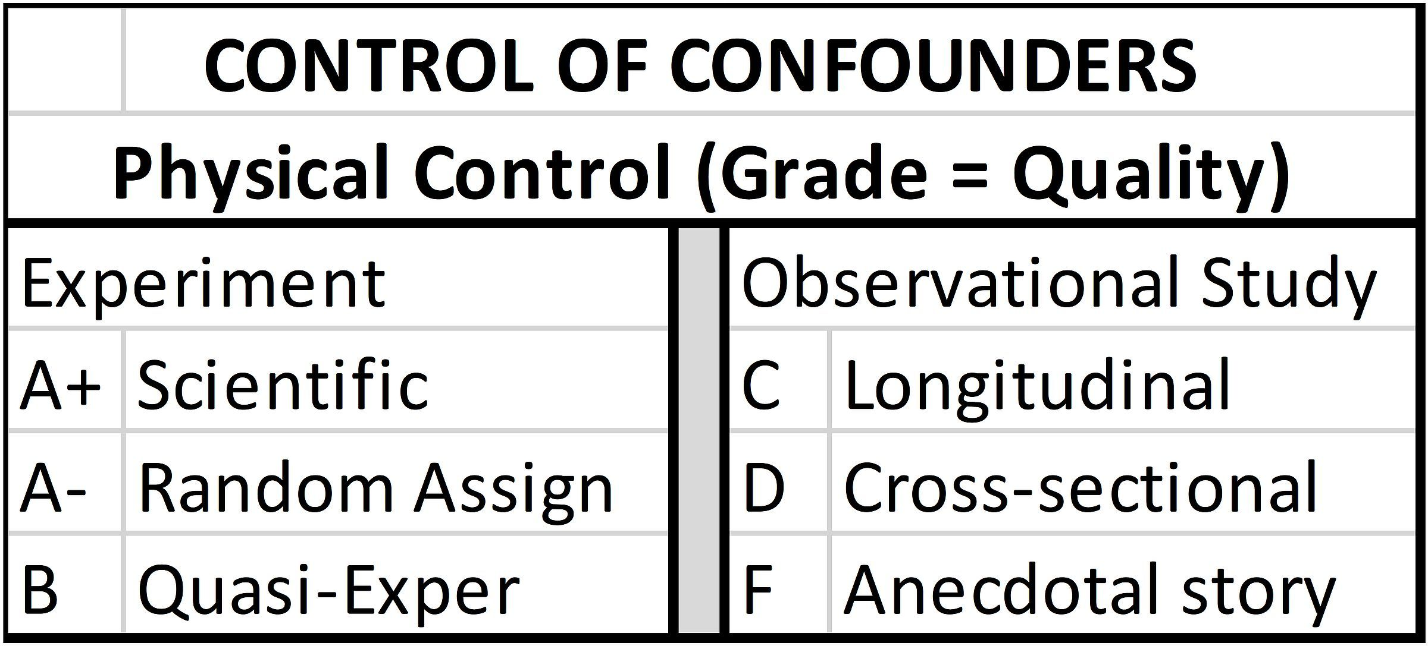
Review Confounder Solution:
Study Design
.
7
Hard Science Soft Science
.
Notes:
Model Trendline Linear 2Y1X using Excel 2013
11/24/2013 V0a
www.StatLit.org/pdf/Model-Trendline-Linear-2Y1X-Excel2013-6up.pdf
7
Analyzing Numbers in the News
15 May 2008
2008SchieldNNN6up.pdf
7
7

Slide 8
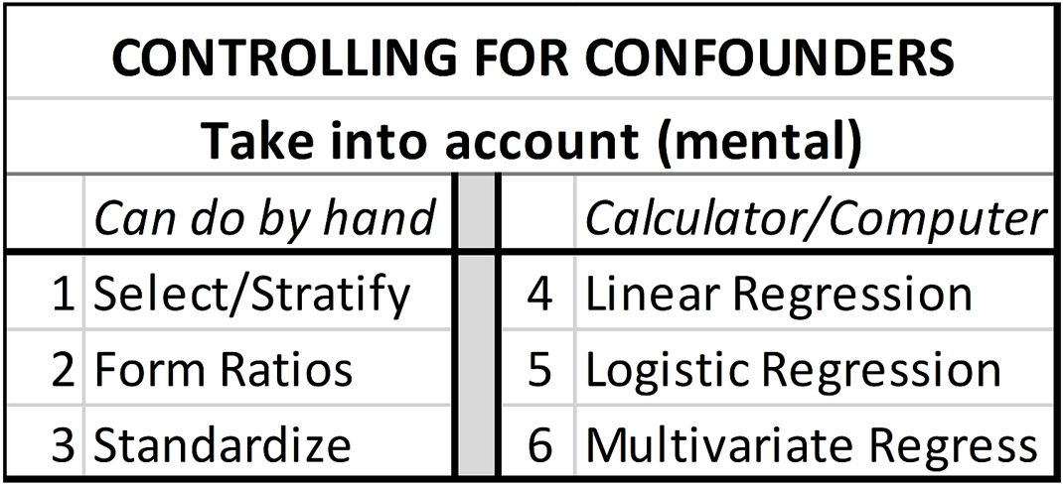
3.2 Review Ch 2
P 117
8
Other classes focus on what can be done using computers.
This class focuses on what can be done mentally (by hand)
This chapter introduces ‘standardization’.
Notes:
Model Trendline Linear 2Y1X using Excel 2013
11/24/2013 V0a
www.StatLit.org/pdf/Model-Trendline-Linear-2Y1X-Excel2013-6up.pdf
8
Analyzing Numbers in the News
15 May 2008
2008SchieldNNN6up.pdf
8
8

Slide 9
3.3 Data
P 117
9
Data is of two kinds:
Measurement (continuous) data. Chapter 3
Examples: height, income, GPA
Count (discrete) data: Chapters 4-7.
Examples: Yes/No (1/0), Small/medium/large (1/2/3), # of siblings (0-9)
Presented differently. Table vs graph: kinds of
Notes:
Model Trendline Linear 2Y1X using Excel 2013
11/24/2013 V0a
www.StatLit.org/pdf/Model-Trendline-Linear-2Y1X-Excel2013-6up.pdf
9
Analyzing Numbers in the News
15 May 2008
2008SchieldNNN6up.pdf
9
9

Slide 10
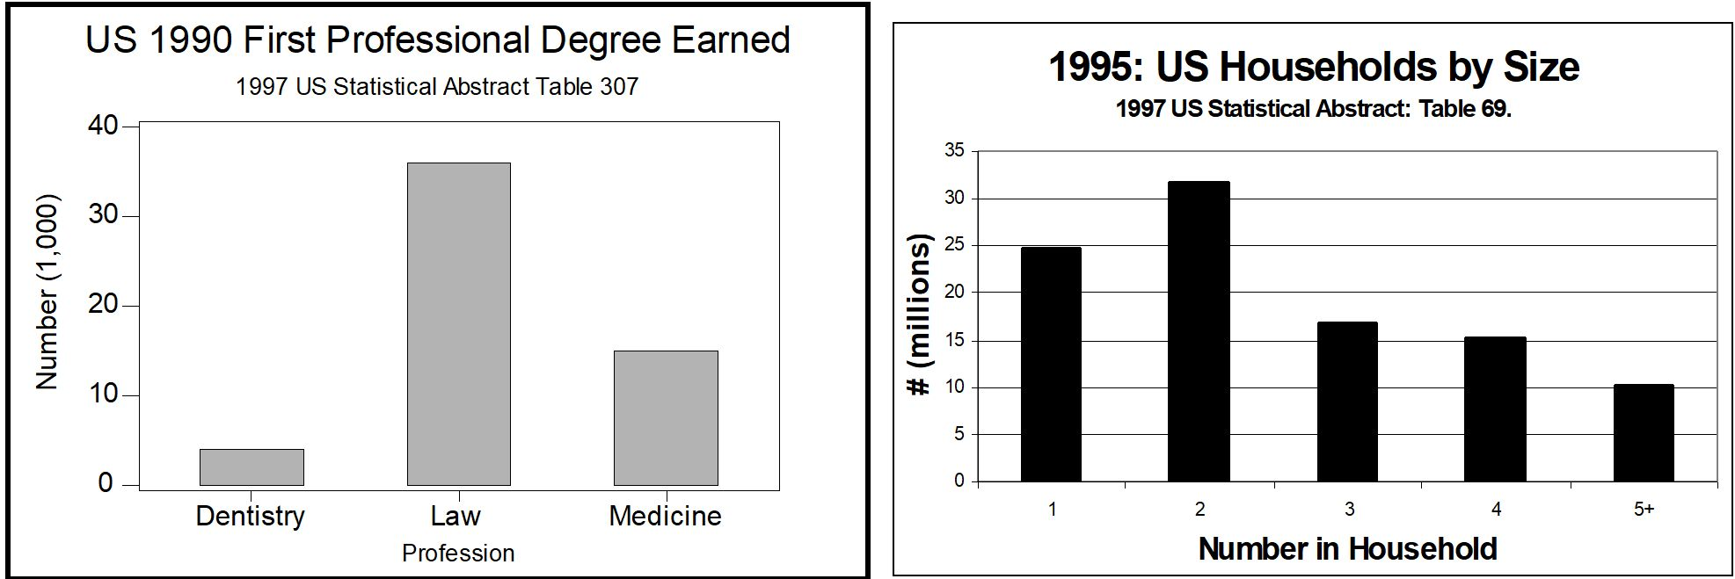
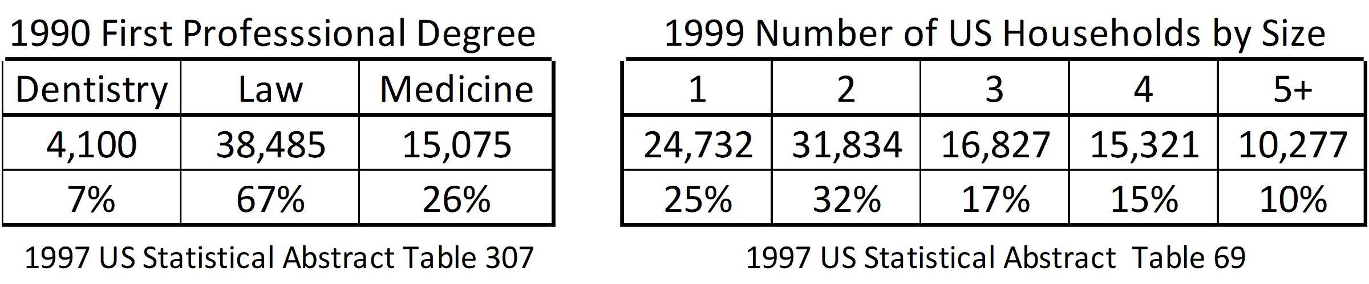
3.3.1 Count (Discrete) Data
P 118
10
.
Notes:
Model Trendline Linear 2Y1X using Excel 2013
11/24/2013 V0a
www.StatLit.org/pdf/Model-Trendline-Linear-2Y1X-Excel2013-6up.pdf
10
Analyzing Numbers in the News
15 May 2008
2008SchieldNNN6up.pdf
10
10

Slide 11
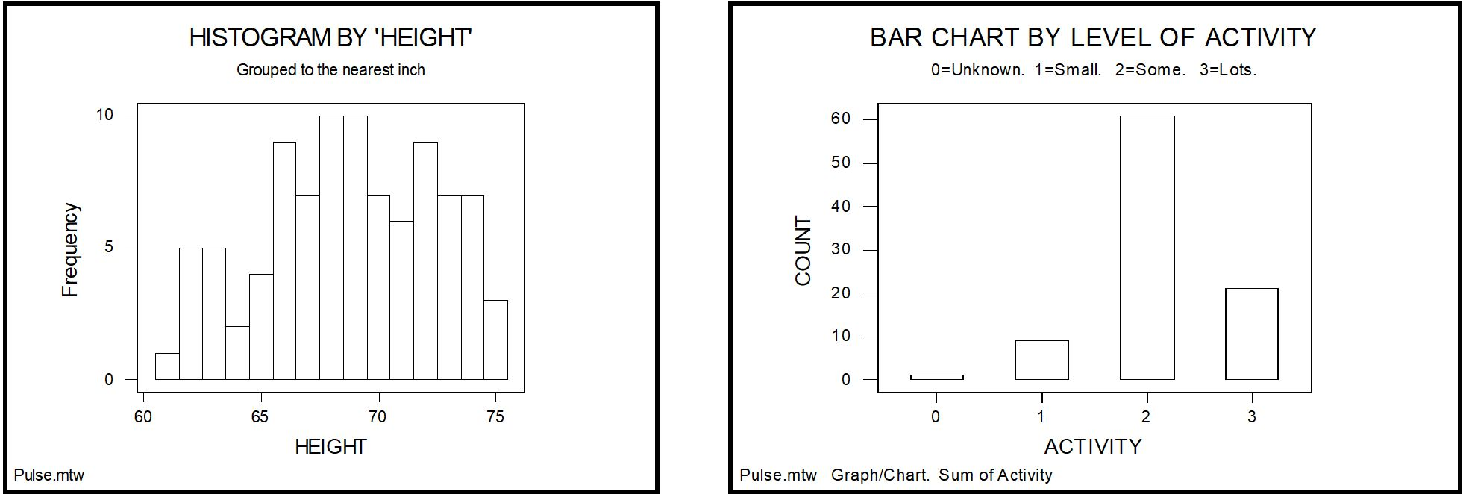
3.3.2 Measurement Data
P 119
11
Measurement data always involves an interval.
Measurement data is displayed as a distribution:
the count or fraction of subjects per interval.
Notes:
Model Trendline Linear 2Y1X using Excel 2013
11/24/2013 V0a
www.StatLit.org/pdf/Model-Trendline-Linear-2Y1X-Excel2013-6up.pdf
11
Analyzing Numbers in the News
15 May 2008
2008SchieldNNN6up.pdf
11
11

Slide 12
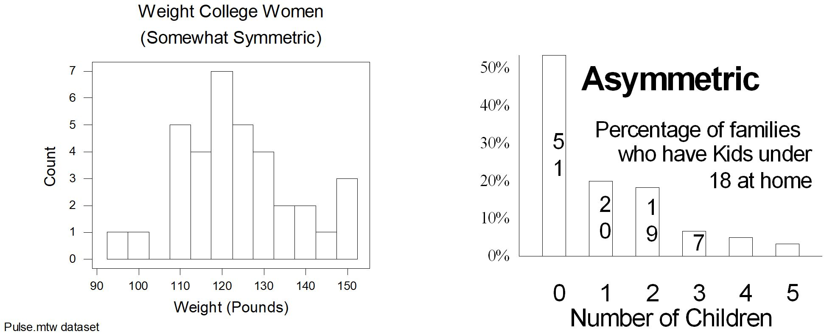
3.3.2 Measurement Data:
Shape
P 120
12
Shape can be symmetric or asymmetric (skewed)
Notes:
Model Trendline Linear 2Y1X using Excel 2013
11/24/2013 V0a
www.StatLit.org/pdf/Model-Trendline-Linear-2Y1X-Excel2013-6up.pdf
12
Analyzing Numbers in the News
15 May 2008
2008SchieldNNN6up.pdf
12
12

Slide 13
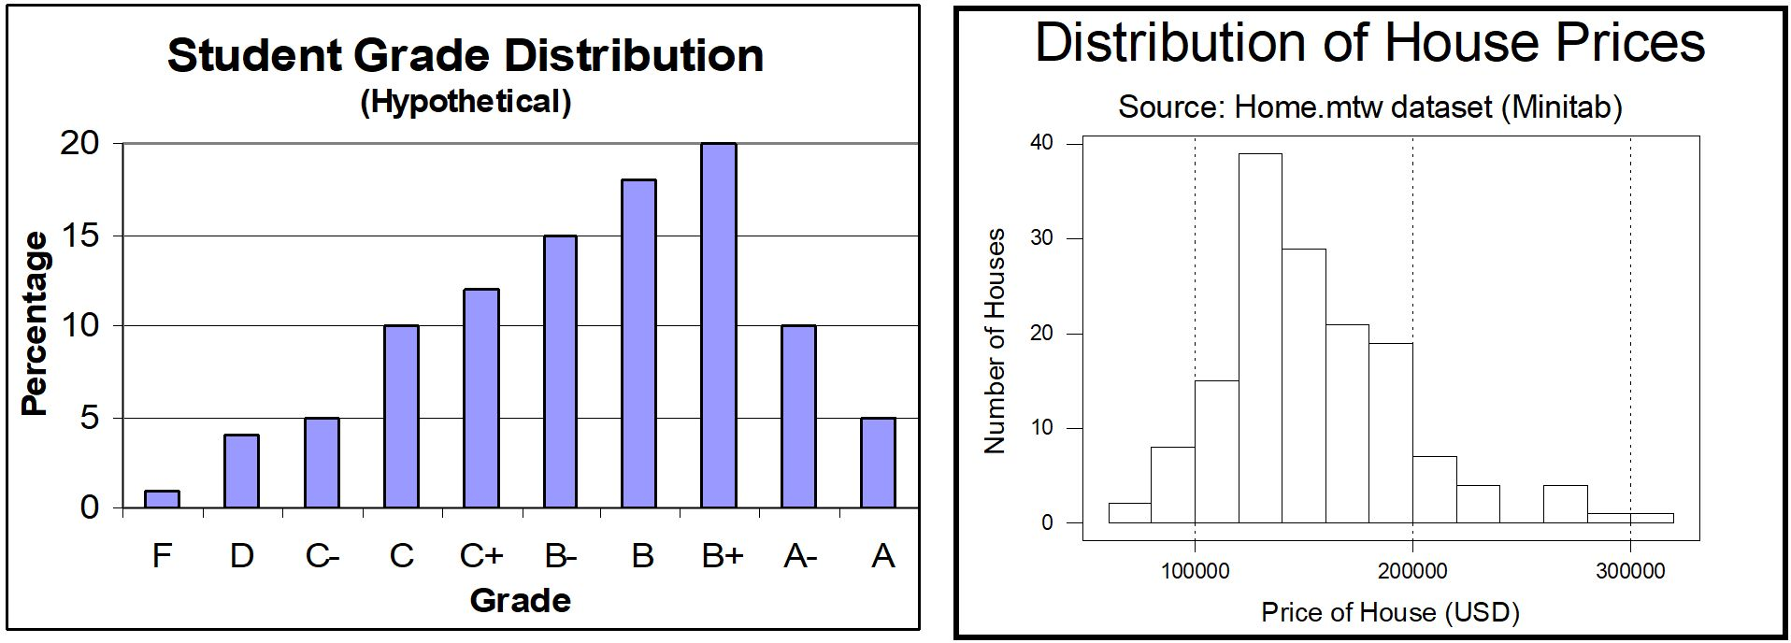
3.3.2 Measurement Data:
Shape
P 120
13
Asymmetric data can be skewed or pulled:
left or right.
Important when comparing measures of center.
Notes:
Model Trendline Linear 2Y1X using Excel 2013
11/24/2013 V0a
www.StatLit.org/pdf/Model-Trendline-Linear-2Y1X-Excel2013-6up.pdf
13
Analyzing Numbers in the News
15 May 2008
2008SchieldNNN6up.pdf
13
13

Slide 14
3.4 Measure of Location
Ranks
P 121
14
Ranks (1st, 2nd or 3rd) identify the order or place with 1st (lowest #) being the highest.
Highest rank may be
highest score: basketball
lowest score: golf
Plus: Simple. Children understand 1st place.
Minus: Ignores the size of the difference.
Notes:
Model Trendline Linear 2Y1X using Excel 2013
11/24/2013 V0a
www.StatLit.org/pdf/Model-Trendline-Linear-2Y1X-Excel2013-6up.pdf
14
Analyzing Numbers in the News
15 May 2008
2008SchieldNNN6up.pdf
14
14

Slide 15
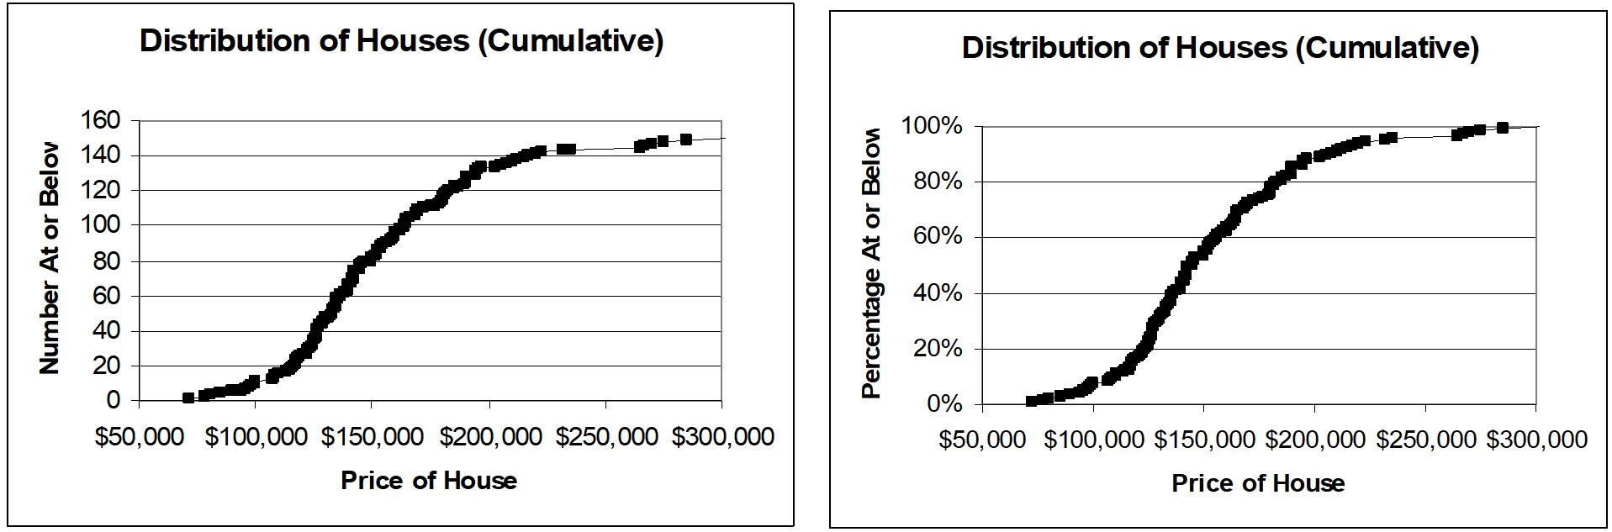
3.4 Measure of Location
Percentiles
P 122
15
Interpret the 40% at $150,000 in the right graph.
Interpret the 80% at $200,000 in the right graph.
Percentile: percentage of subjects below a value.
Notes:
Model Trendline Linear 2Y1X using Excel 2013
11/24/2013 V0a
www.StatLit.org/pdf/Model-Trendline-Linear-2Y1X-Excel2013-6up.pdf
15
Analyzing Numbers in the News
15 May 2008
2008SchieldNNN6up.pdf
15
15

Slide 16
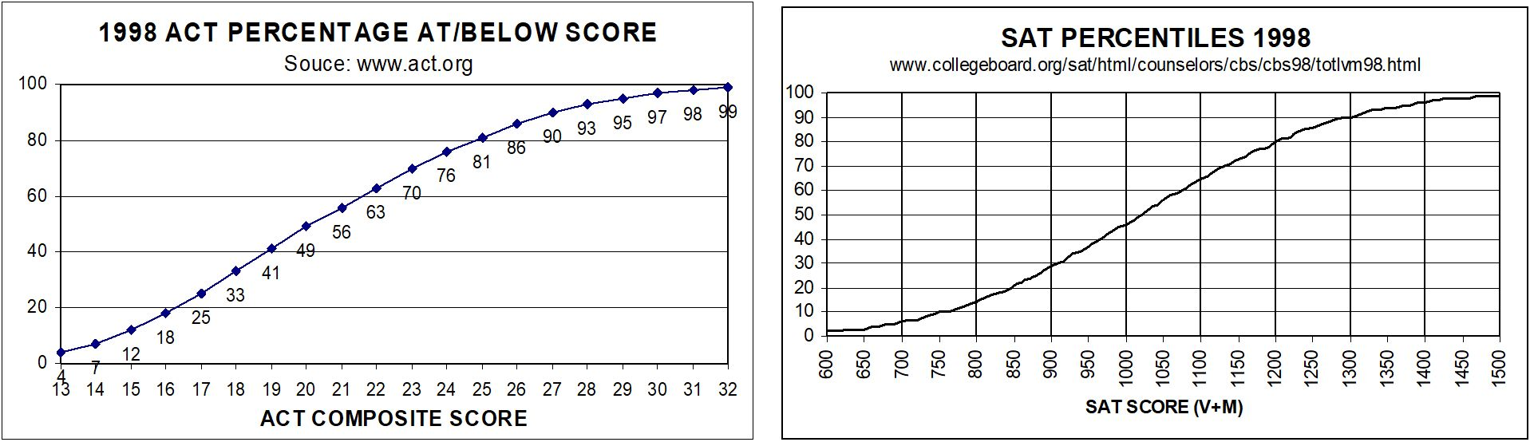
3.4 Measure of Location
Percentiles
P 122
16
Percentiles allow comparisons of measurements involving different scales. Which ranks higher?
ACT = 26 or SAT = 800
Difference of percentiles: percentile points
Notes:
Model Trendline Linear 2Y1X using Excel 2013
11/24/2013 V0a
www.StatLit.org/pdf/Model-Trendline-Linear-2Y1X-Excel2013-6up.pdf
16
Analyzing Numbers in the News
15 May 2008
2008SchieldNNN6up.pdf
16
16

Slide 17
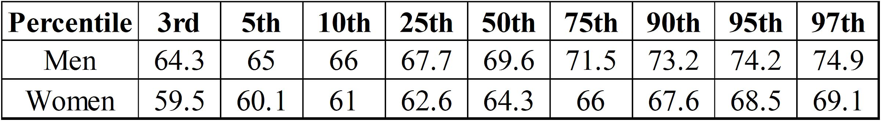
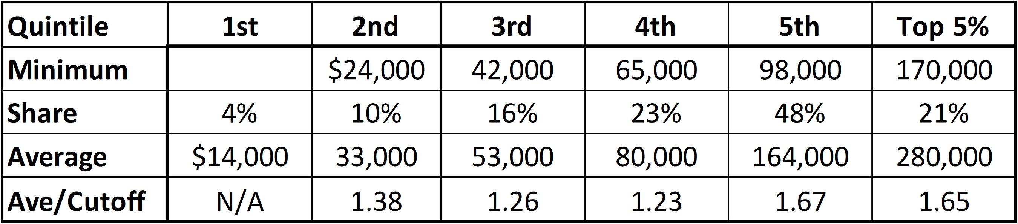
3.4 Measure of Location
Percentile Examples
P 123
17
Distribution of Heights for US 20-year Olds
US Family Income (2003):
Notes:
Model Trendline Linear 2Y1X using Excel 2013
11/24/2013 V0a
www.StatLit.org/pdf/Model-Trendline-Linear-2Y1X-Excel2013-6up.pdf
17
Analyzing Numbers in the News
15 May 2008
2008SchieldNNN6up.pdf
17
17

Slide 18
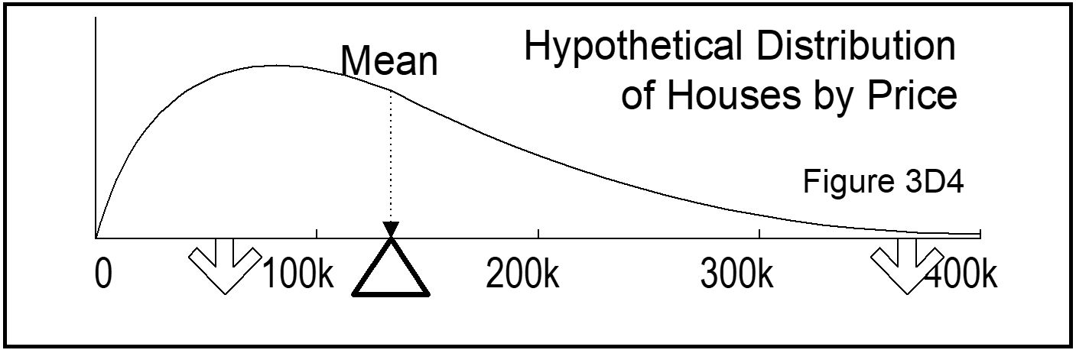
3.5 Measures of Center:
Mean, Median and Mode
P 125
18
Mean = Sum / Number. Value with equal shares.
Distribution of houses by price.
Mean is the balance point
Notes:
Model Trendline Linear 2Y1X using Excel 2013
11/24/2013 V0a
www.StatLit.org/pdf/Model-Trendline-Linear-2Y1X-Excel2013-6up.pdf
18
Analyzing Numbers in the News
15 May 2008
2008SchieldNNN6up.pdf
18
18

Slide 19
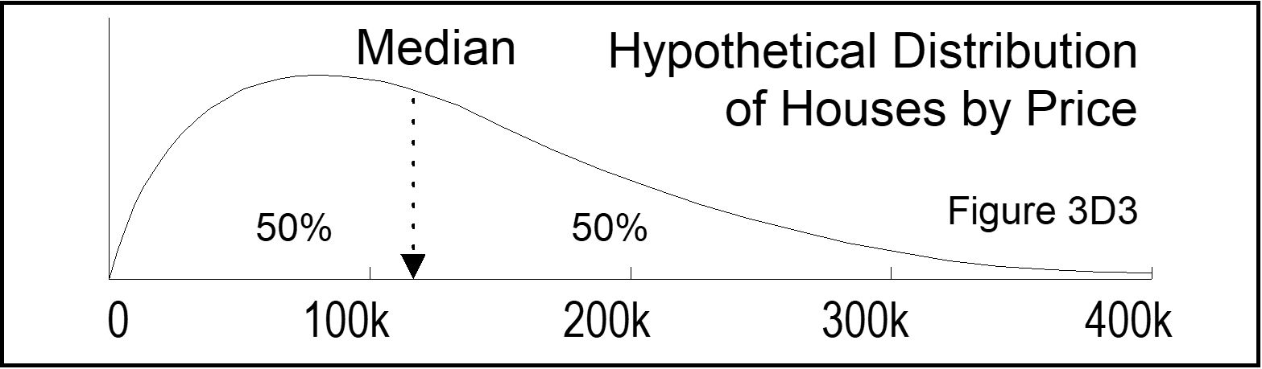
3.5 Measures of Center:
Mean, Median and Mode
P 125
19
Median: Middle value of sorted list if odd;
mid point of the two center values if even.
Median: equal area (# of subjects) on both sides.
Notes:
Model Trendline Linear 2Y1X using Excel 2013
11/24/2013 V0a
www.StatLit.org/pdf/Model-Trendline-Linear-2Y1X-Excel2013-6up.pdf
19
Analyzing Numbers in the News
15 May 2008
2008SchieldNNN6up.pdf
19
19

Slide 20
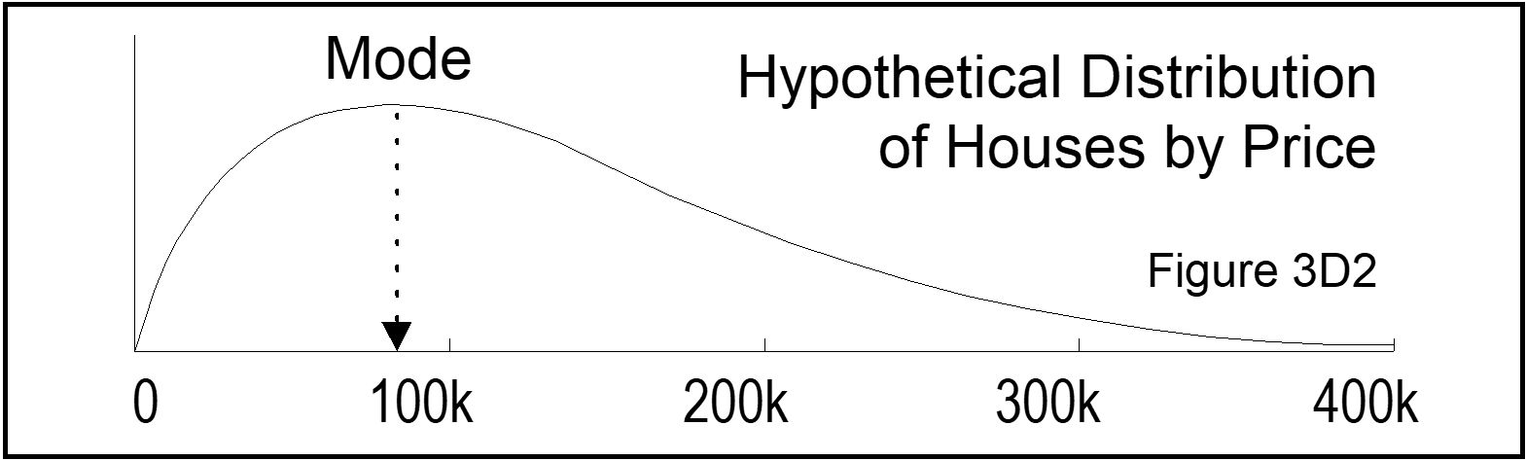
3.4 Measures of Center:
Mean, Median and Mode
P 126
20
Mode: value or category with highest count.
Mode means ‘most common’.
Notes:
Model Trendline Linear 2Y1X using Excel 2013
11/24/2013 V0a
www.StatLit.org/pdf/Model-Trendline-Linear-2Y1X-Excel2013-6up.pdf
20
Analyzing Numbers in the News
15 May 2008
2008SchieldNNN6up.pdf
20
20

Slide 21
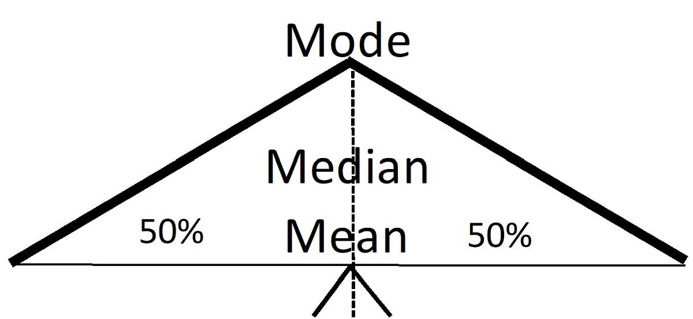
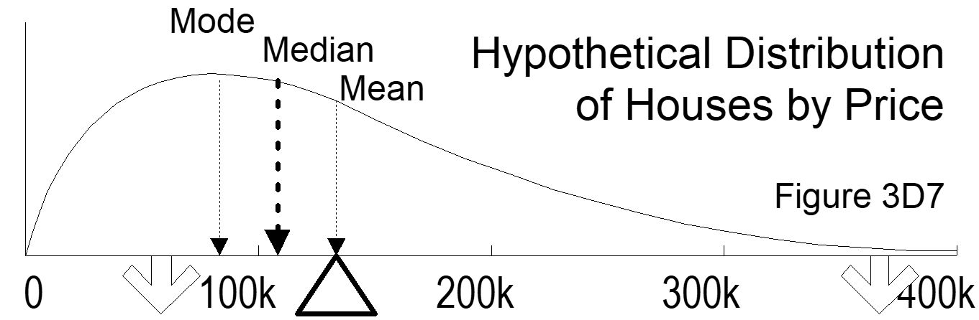
3.5.2 Center vs. Skew
Mean, Median and Mode
P 127
21
No skew: Same.
Skewed: Different
Ordered alphabetically
Mean: most influenced
Choice is assembly.
Notes:
Model Trendline Linear 2Y1X using Excel 2013
11/24/2013 V0a
www.StatLit.org/pdf/Model-Trendline-Linear-2Y1X-Excel2013-6up.pdf
21
Analyzing Numbers in the News
15 May 2008
2008SchieldNNN6up.pdf
21
21

Slide 22
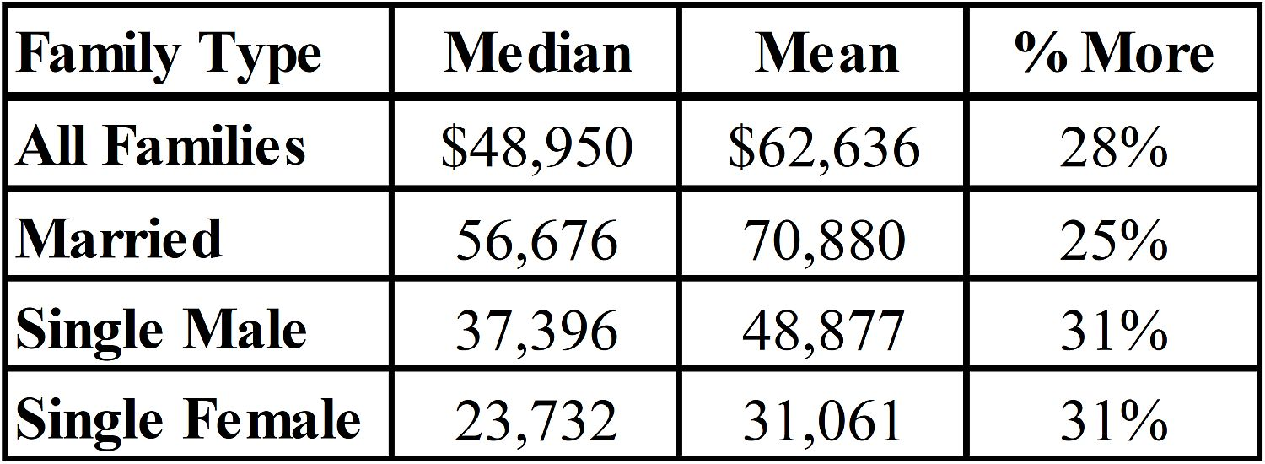
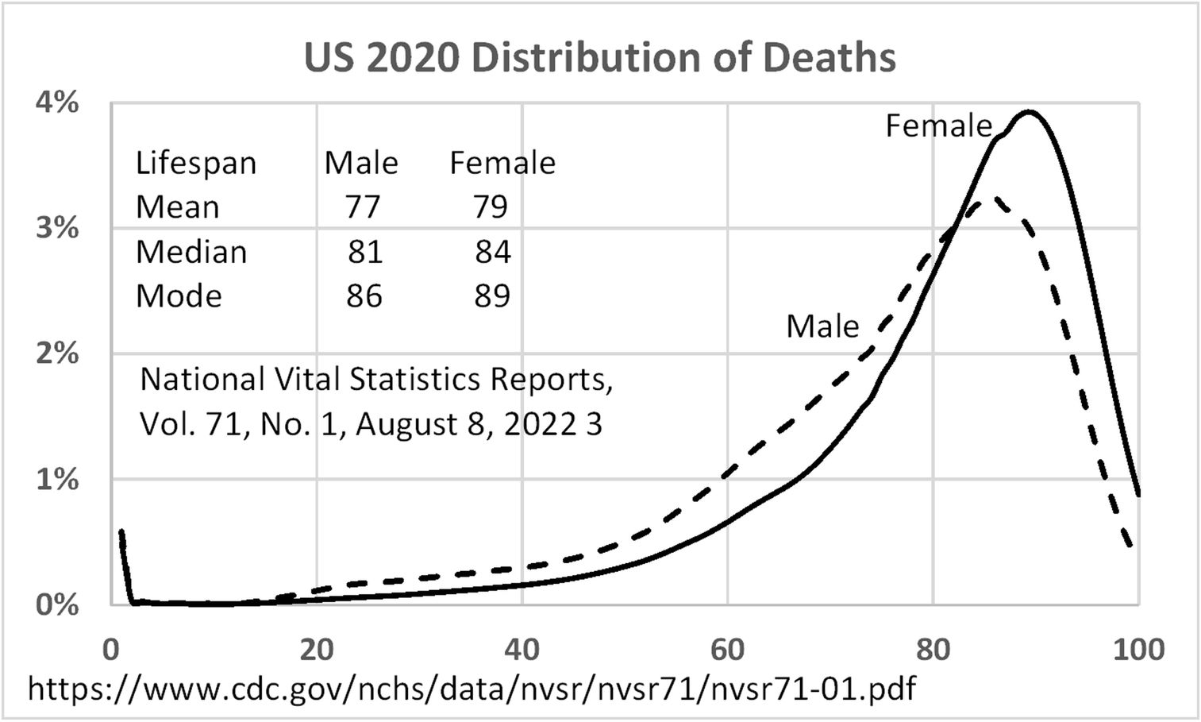
3.5.2 Center vs. Skew
Mean, Median and Mode
P 128
22
Family Income (right skew)
Deaths (left skew)
Notes:
Model Trendline Linear 2Y1X using Excel 2013
11/24/2013 V0a
www.StatLit.org/pdf/Model-Trendline-Linear-2Y1X-Excel2013-6up.pdf
22
Analyzing Numbers in the News
15 May 2008
2008SchieldNNN6up.pdf
22
22

Slide 23
3.5.3 Comparing Centers
Mean, Median and Mode
P 129
23
Subject is a group or a measure
Women live longer than men (on average)
Lifespan is longer for women than men (on average)
Two ‘group’ comparisons:
Two groups at same time
One group at two times or two places
-----
Must specify the measure of center!
Frequently (often) is different from likely (chance)
Frequently compares counts or amounts;
likely compares ratios of counts or chances of events.
Notes:
Model Trendline Linear 2Y1X using Excel 2013
11/24/2013 V0a
www.StatLit.org/pdf/Model-Trendline-Linear-2Y1X-Excel2013-6up.pdf
23
Analyzing Numbers in the News
15 May 2008
2008SchieldNNN6up.pdf
23
23

Slide 24
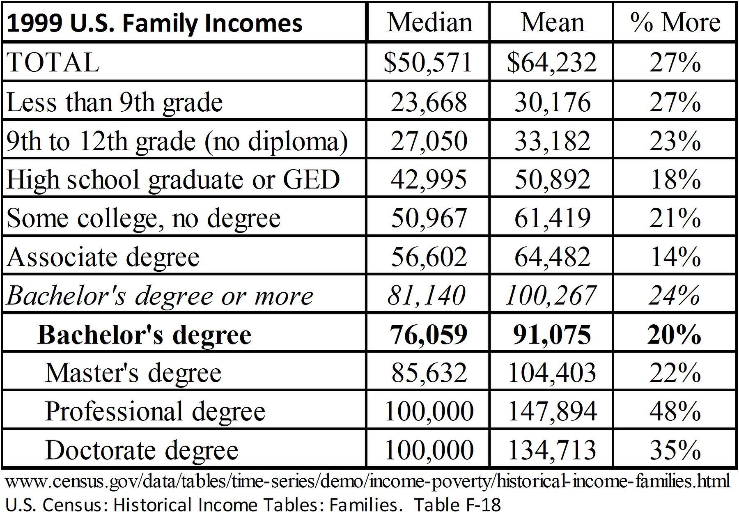
3.5.4 Form Comparisons;
Use ‘Between’ grammar
P 132
24
.
Notes:
Model Trendline Linear 2Y1X using Excel 2013
11/24/2013 V0a
www.StatLit.org/pdf/Model-Trendline-Linear-2Y1X-Excel2013-6up.pdf
24
Analyzing Numbers in the News
15 May 2008
2008SchieldNNN6up.pdf
24
24

Slide 25
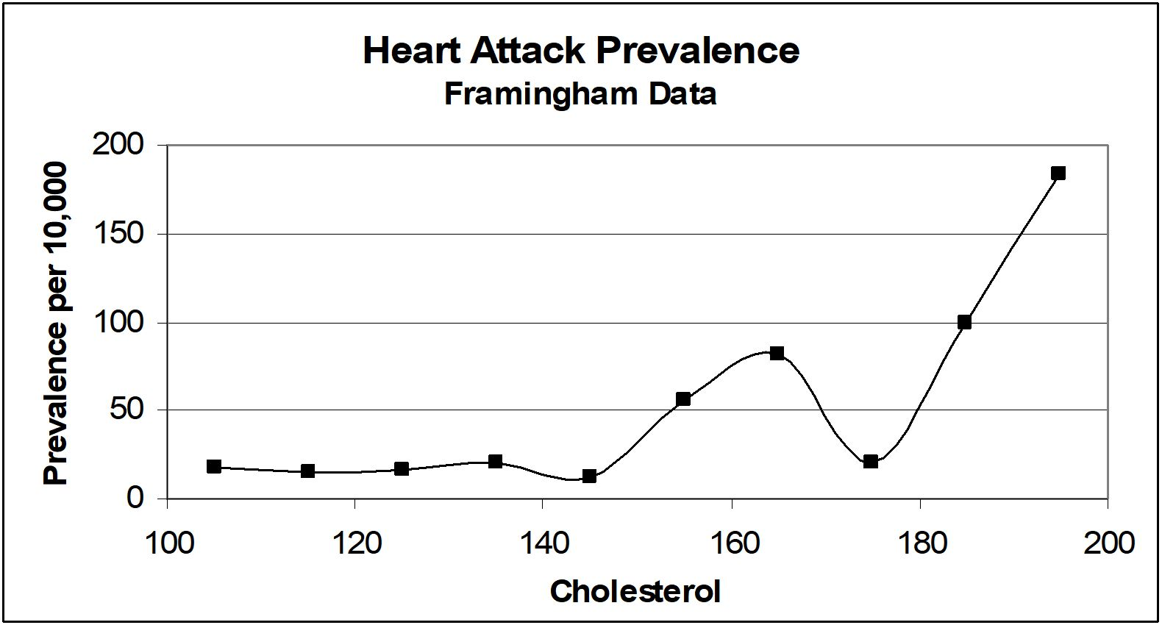
3.6 Assembly:
Choosing a Cut Point
P 134
25
Plus/minus of lower cutoff versus a higher cutoff.
Notes:
Model Trendline Linear 2Y1X using Excel 2013
11/24/2013 V0a
www.StatLit.org/pdf/Model-Trendline-Linear-2Y1X-Excel2013-6up.pdf
25
Analyzing Numbers in the News
15 May 2008
2008SchieldNNN6up.pdf
25
25

Slide 26
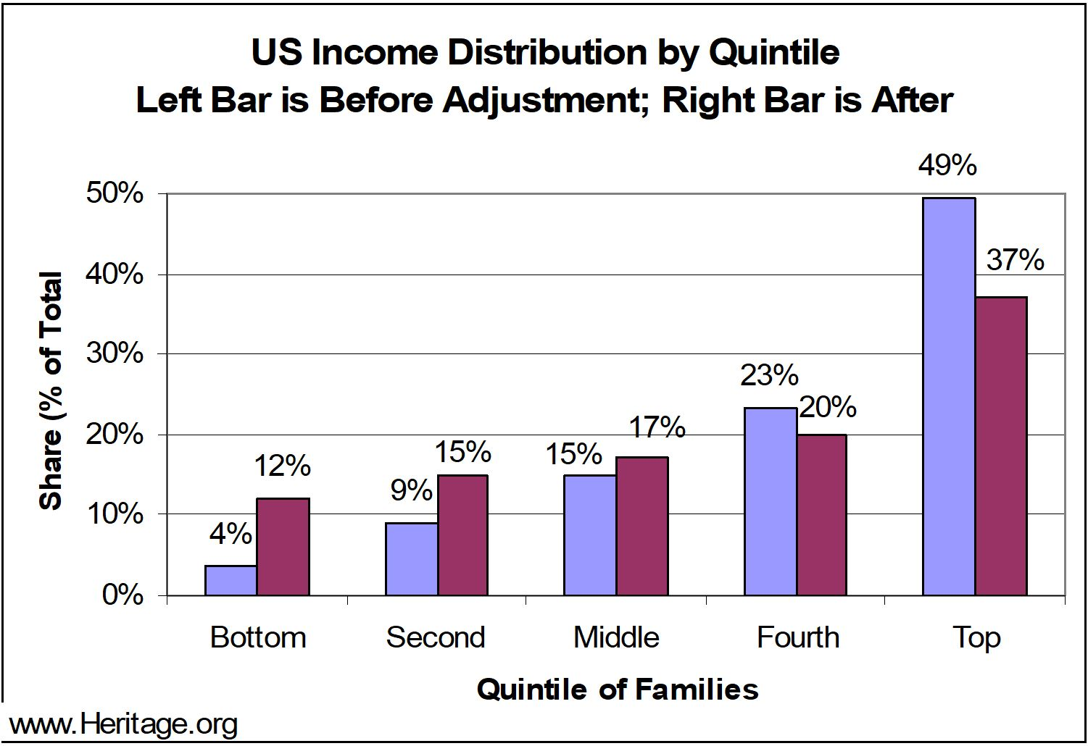
3.7 Assembly & Confounding:
Crude vs. Adjusted
P 137
26
Assembly: Add untaxed income; subtract taxes.
Confounding: Control for # of workers per family.
Notes:
Model Trendline Linear 2Y1X using Excel 2013
11/24/2013 V0a
www.StatLit.org/pdf/Model-Trendline-Linear-2Y1X-Excel2013-6up.pdf
26
Analyzing Numbers in the News
15 May 2008
2008SchieldNNN6up.pdf
26
26

Slide 27
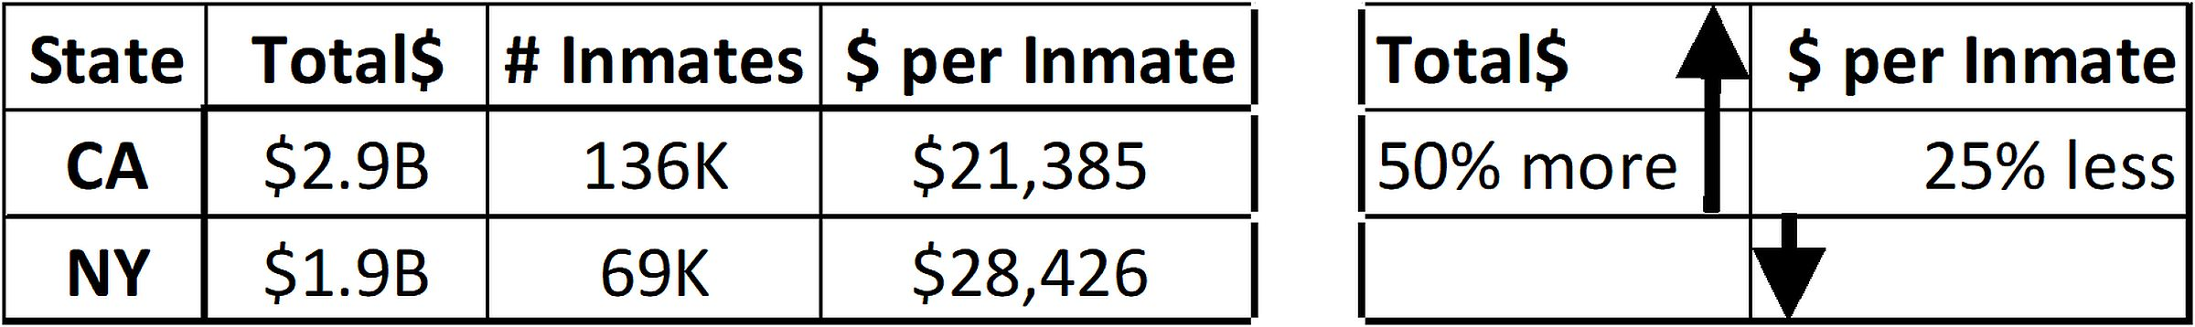
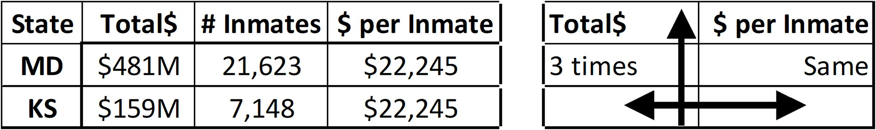
3.6 Comparisons:
Count versus Ratio
P 137
27
Reverse
Nullify (make spurious)
Notes:
Model Trendline Linear 2Y1X using Excel 2013
11/24/2013 V0a
www.StatLit.org/pdf/Model-Trendline-Linear-2Y1X-Excel2013-6up.pdf
27
Analyzing Numbers in the News
15 May 2008
2008SchieldNNN6up.pdf
27
27

Slide 28
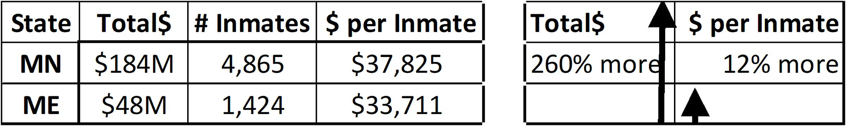
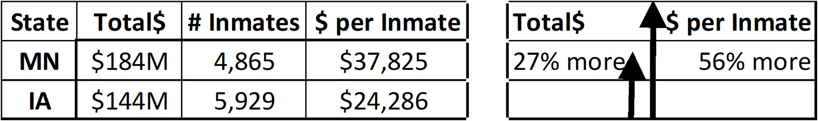
3.6 Comparisons:
Count versus Ratio
P 137
28
Decrease without Reversal
Increase
Notes:
Model Trendline Linear 2Y1X using Excel 2013
11/24/2013 V0a
www.StatLit.org/pdf/Model-Trendline-Linear-2Y1X-Excel2013-6up.pdf
28
Analyzing Numbers in the News
15 May 2008
2008SchieldNNN6up.pdf
28
28

Slide 29
3.7 Confounder Outcomes:
Every College Graduate
.P 138
29
should know that (how) ratios take into account the proportional influence of confounder on the size or comparison of counts or amounts.
should know what it means to take something into account quantitatively.
To take into account (to control or adjust for) something quantitatively eliminates the influence of a related factor.
Notes:
Model Trendline Linear 2Y1X using Excel 2013
11/24/2013 V0a
www.StatLit.org/pdf/Model-Trendline-Linear-2Y1X-Excel2013-6up.pdf
29
Analyzing Numbers in the News
15 May 2008
2008SchieldNNN6up.pdf
29
29

Slide 30
3.7 Confounding:
Ratios vs. Standardization
P 138
30
In describing or comparing counts or amounts, ratios take into account the size of something proportional: e.g., the size of the group.
Ratios are assumed to be the furthest one can go manually in controlling for a confounder.
That’s not true! Standardization, an older manual technique, will be used in this course to control for influences on ratios.
Notes:
Model Trendline Linear 2Y1X using Excel 2013
11/24/2013 V0a
www.StatLit.org/pdf/Model-Trendline-Linear-2Y1X-Excel2013-6up.pdf
30
Analyzing Numbers in the News
15 May 2008
2008SchieldNNN6up.pdf
30
30

Slide 31
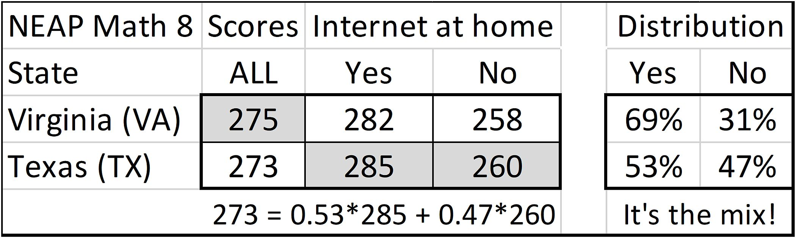
3.7 Confounding:
Standardizing Non-Arithmtically
P 140
31
Crude: Virginia scored higher than Texas
Reversal: Simpson’s paradox.
If compare holds for all subgroups, it must hold for Adjust.
Adjusted: After taking into account internet access, Texas will score higher than Virginia.
Notes:
Model Trendline Linear 2Y1X using Excel 2013
11/24/2013 V0a
www.StatLit.org/pdf/Model-Trendline-Linear-2Y1X-Excel2013-6up.pdf
31
Analyzing Numbers in the News
15 May 2008
2008SchieldNNN6up.pdf
31
31

Slide 32
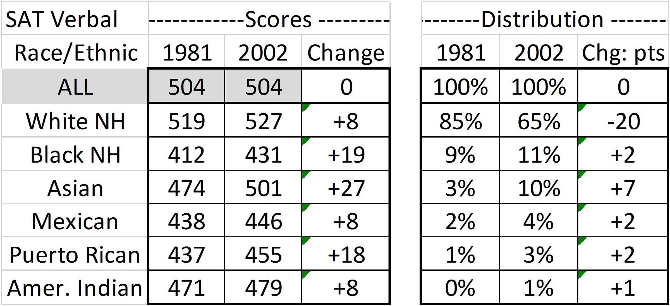
3.7 Confounding:
Crude vs. Adjusted
P 141
32
Crude: Average SAT same in 2002 as in 1981
Scores of all subgroups increased. Adjust must increase!
Adjusted: After taking into account race and ethnicity, average SAT scores will increase.
Notes:
Model Trendline Linear 2Y1X using Excel 2013
11/24/2013 V0a
www.StatLit.org/pdf/Model-Trendline-Linear-2Y1X-Excel2013-6up.pdf
32
Analyzing Numbers in the News
15 May 2008
2008SchieldNNN6up.pdf
32
32

Slide 33
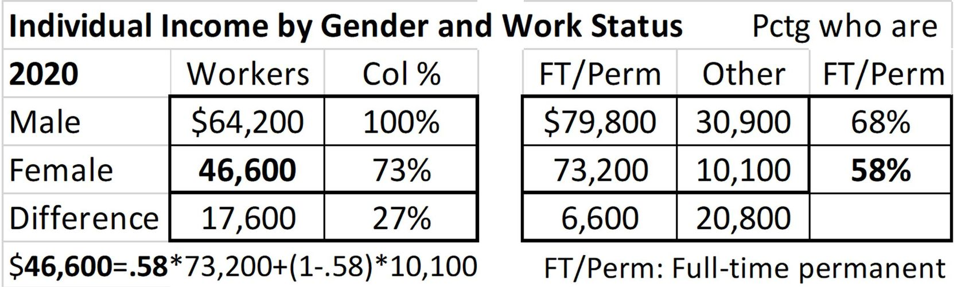
Standardizing Arithmetically:
Male-Female Income Gap
P 144
33
Women make 73¢ for every dollar a man makes.
No reversal in subgroups; no Simpson’s paradox.
Crude comparison: Mixed-fruit comparison!
Confounder: Work status. Difference in mix!!!
Notes:
Model Trendline Linear 2Y1X using Excel 2013
11/24/2013 V0a
www.StatLit.org/pdf/Model-Trendline-Linear-2Y1X-Excel2013-6up.pdf
33
Analyzing Numbers in the News
15 May 2008
2008SchieldNNN6up.pdf
33
33

Slide 34
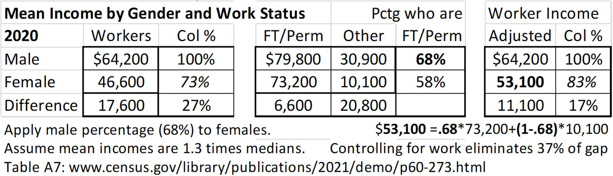
Standardizing Arithmetically:
Male-Female Income Gap
P 144
34
Solution: Give women the same mix as men!
Adjusting: Recalculate women’s income using 68%.
Adjusted: After taking into account work status, women make 83¢ for every dollar a man makes.
Notes:
Model Trendline Linear 2Y1X using Excel 2013
11/24/2013 V0a
www.StatLit.org/pdf/Model-Trendline-Linear-2Y1X-Excel2013-6up.pdf
34
Analyzing Numbers in the News
15 May 2008
2008SchieldNNN6up.pdf
34
34

Slide 35
3.7 Confounding:
Every college grad should know:
P 142
35
that standardization controls for the influence of a confounder on a comparison of ratios.
that standardization converts a mixed-fruit (apples & oranges) comparison of ratios into a same-fruit (apples & apples) comparison
how standardization works by giving all groups the same mix of confounder values.
Notes:
Model Trendline Linear 2Y1X using Excel 2013
11/24/2013 V0a
www.StatLit.org/pdf/Model-Trendline-Linear-2Y1X-Excel2013-6up.pdf
35
Analyzing Numbers in the News
15 May 2008
2008SchieldNNN6up.pdf
35
35

Slide 36
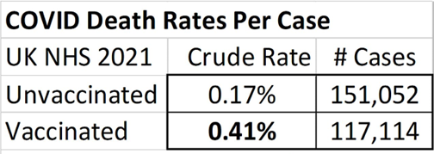
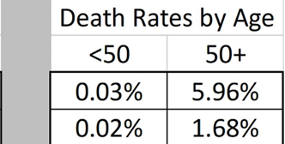
Standardizing Arithmetically:
COVID
P 144
36
Crude: Vaccinated cases are more likely to die than [are] unvaccinated. Counter-intuitive!!!
Vaccinated are 2.4 (41/17) times as likely to die as unvaccinated
Reversal in both subgroups. Simpson’s paradox.
Adjusted death rate must be higher for unvaccinated!
Notes:
Model Trendline Linear 2Y1X using Excel 2013
11/24/2013 V0a
www.StatLit.org/pdf/Model-Trendline-Linear-2Y1X-Excel2013-6up.pdf
36
Analyzing Numbers in the News
15 May 2008
2008SchieldNNN6up.pdf
36
36

Slide 37
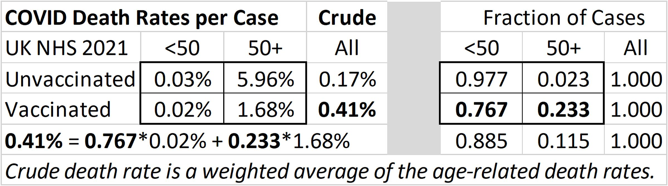
Standardizing Arithmetically:
COVID
P 146
37
Elderly are much more likely to die (~100 times).
Vaccinated are 10 times as likely to be elderly.
Solution: Give both groups the same mix of ages.
Notes:
Model Trendline Linear 2Y1X using Excel 2013
11/24/2013 V0a
www.StatLit.org/pdf/Model-Trendline-Linear-2Y1X-Excel2013-6up.pdf
37
Analyzing Numbers in the News
15 May 2008
2008SchieldNNN6up.pdf
37
37

Slide 38
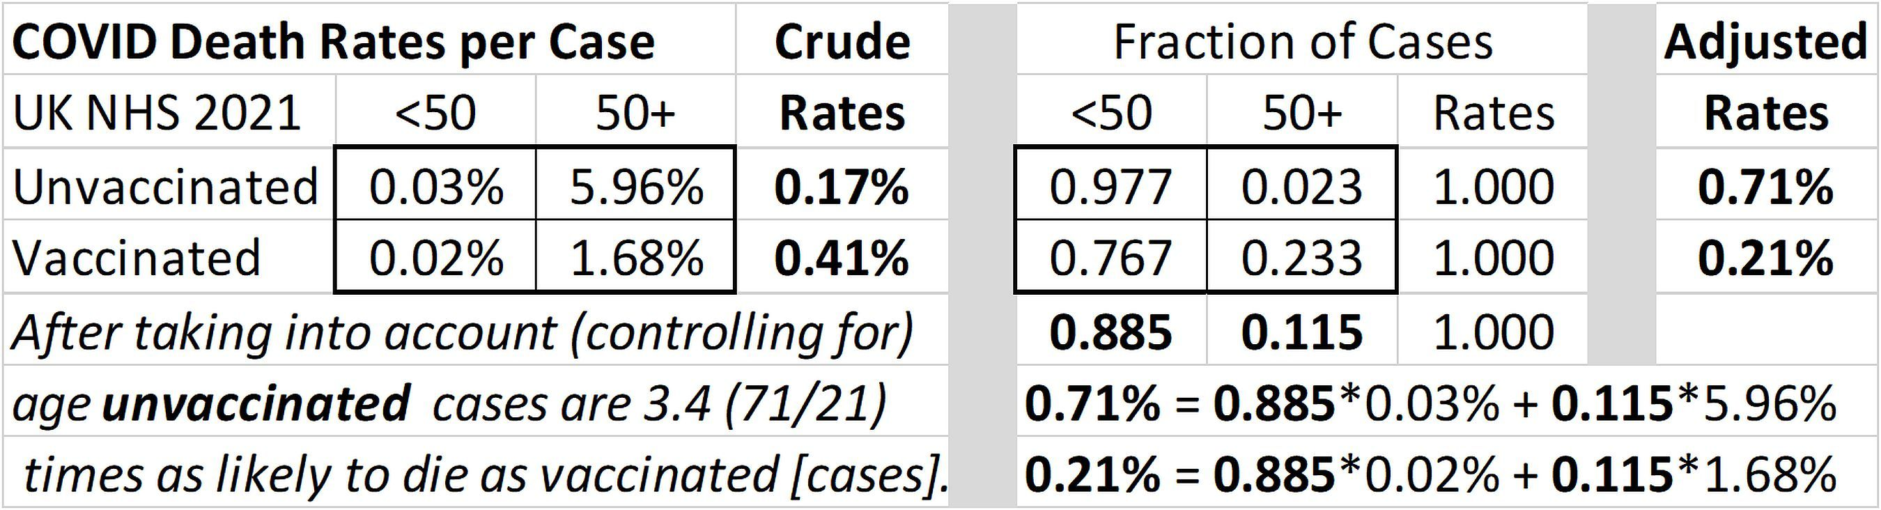
Standardizing Arithmetically:
COVID
P 147
38
Solution: Give both the combined mix: 11.5%!
Adjusted: After controlling for age, unvaccinated are
3.4 times as likely to die as vaccinated [are].
A reversal!! Simpson’s paradox!
Notes:
Model Trendline Linear 2Y1X using Excel 2013
11/24/2013 V0a
www.StatLit.org/pdf/Model-Trendline-Linear-2Y1X-Excel2013-6up.pdf
38
Analyzing Numbers in the News
15 May 2008
2008SchieldNNN6up.pdf
38
38

Slide 39
Standardizing
Arithmetic vs. Graphic
P 148
39
The arithmetic method is precise.
But, it doesn’t show how standardizing works.
Fortunately, there is a graphic technique available.
The graphic technique shows how a confounder disparity can influence a comparison disparity.
Notes:
Model Trendline Linear 2Y1X using Excel 2013
11/24/2013 V0a
www.StatLit.org/pdf/Model-Trendline-Linear-2Y1X-Excel2013-6up.pdf
39
Analyzing Numbers in the News
15 May 2008
2008SchieldNNN6up.pdf
39
39

Slide 40
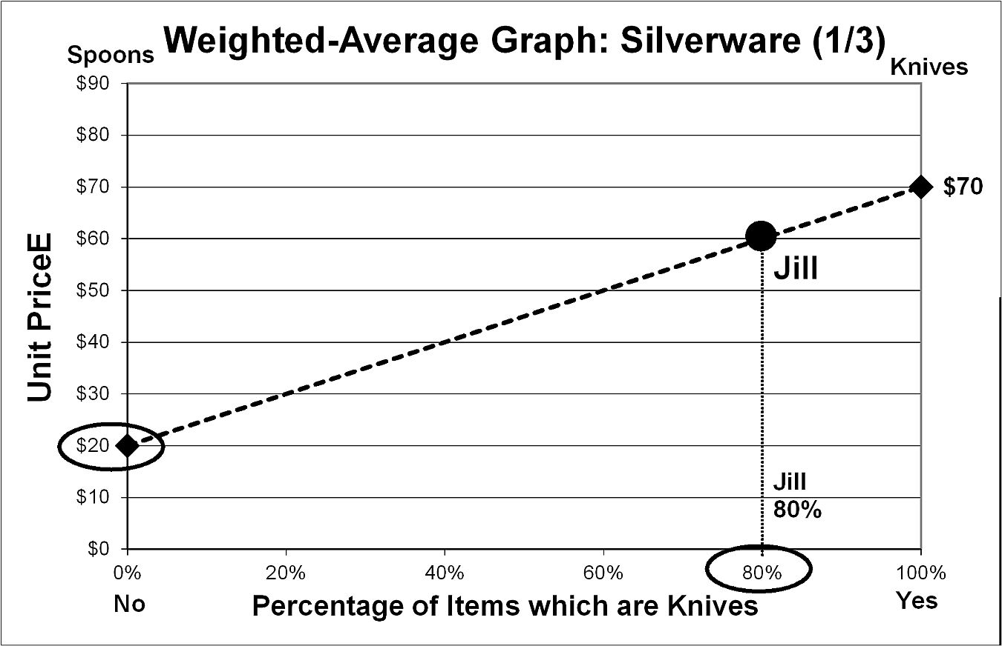
Standardizing Graphically:
Silverware
P 149
40
Outlet: Jill buys 8 knives ($70) and 2 forks ($20).
Mix: 80% are knives. Average cost is $60.
Notes:
Model Trendline Linear 2Y1X using Excel 2013
11/24/2013 V0a
www.StatLit.org/pdf/Model-Trendline-Linear-2Y1X-Excel2013-6up.pdf
40
Analyzing Numbers in the News
15 May 2008
2008SchieldNNN6up.pdf
40
40

Slide 41
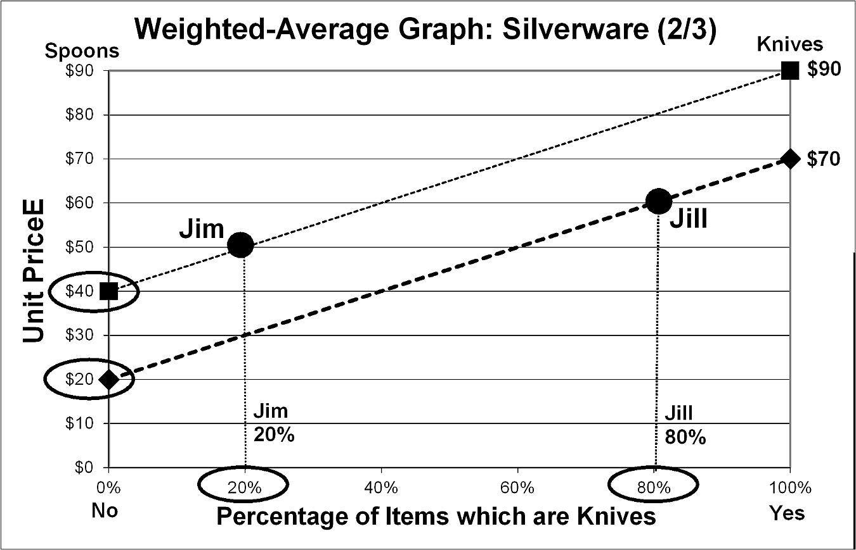
Standardizing Graphically:
Silverware
P 150
41
Mall: Jim buys 2 knives ($90) and 8 forks ($40).
Mix: 20% are knives. Average cost is $50.
Crude compare: Mall is cheaper than outlet.
Notes:
Model Trendline Linear 2Y1X using Excel 2013
11/24/2013 V0a
www.StatLit.org/pdf/Model-Trendline-Linear-2Y1X-Excel2013-6up.pdf
41
Analyzing Numbers in the News
15 May 2008
2008SchieldNNN6up.pdf
41
41

Slide 42
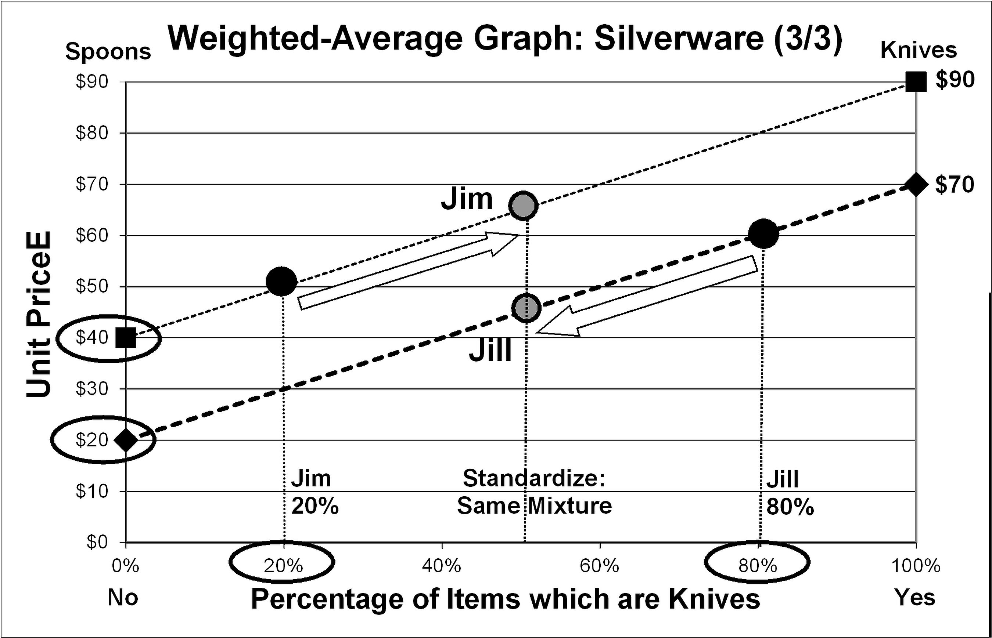
Standardizing Graphically:
Silverware
P 151
42
Standardize: Give both same mix: 50% knives
After controlling for the kinds of silverware,
Jim’s average cost ($65) is higher than Jill’s ($45).
A reversal. Simpson’s paradox.
Notes:
Model Trendline Linear 2Y1X using Excel 2013
11/24/2013 V0a
www.StatLit.org/pdf/Model-Trendline-Linear-2Y1X-Excel2013-6up.pdf
42
Analyzing Numbers in the News
15 May 2008
2008SchieldNNN6up.pdf
42
42

Slide 43
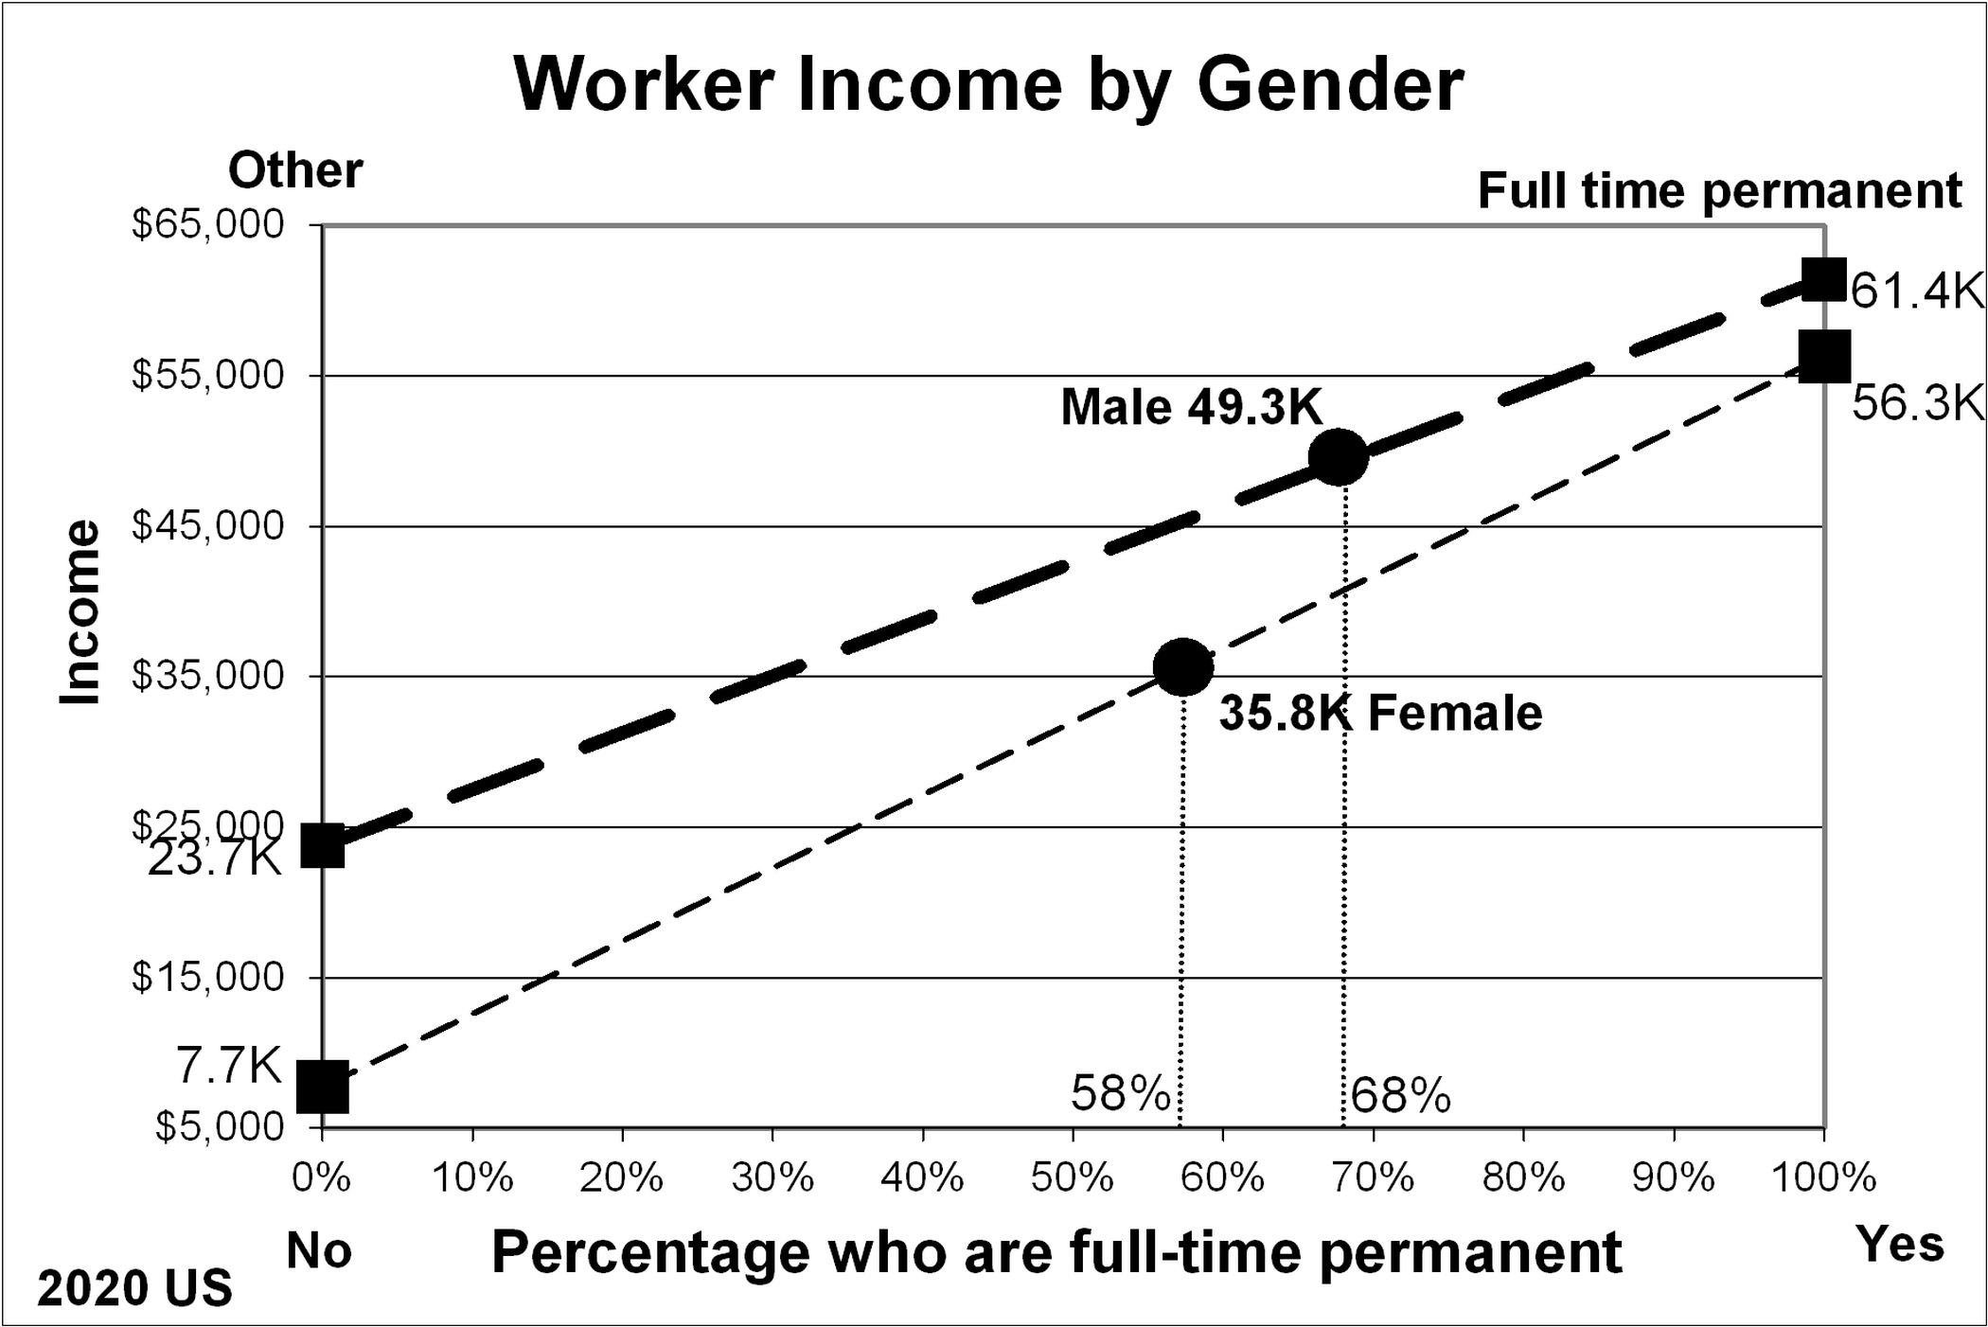
Standardizing Graphically:
Male-Female Income Gap
P 153
43
Women make 73¢ for every dollar a man makes.
Crude Comparison: Difference in mix.
Full-time permanent: 68% of men; 58% of women.
Notes:
Model Trendline Linear 2Y1X using Excel 2013
11/24/2013 V0a
www.StatLit.org/pdf/Model-Trendline-Linear-2Y1X-Excel2013-6up.pdf
43
Analyzing Numbers in the News
15 May 2008
2008SchieldNNN6up.pdf
43
43

Slide 44
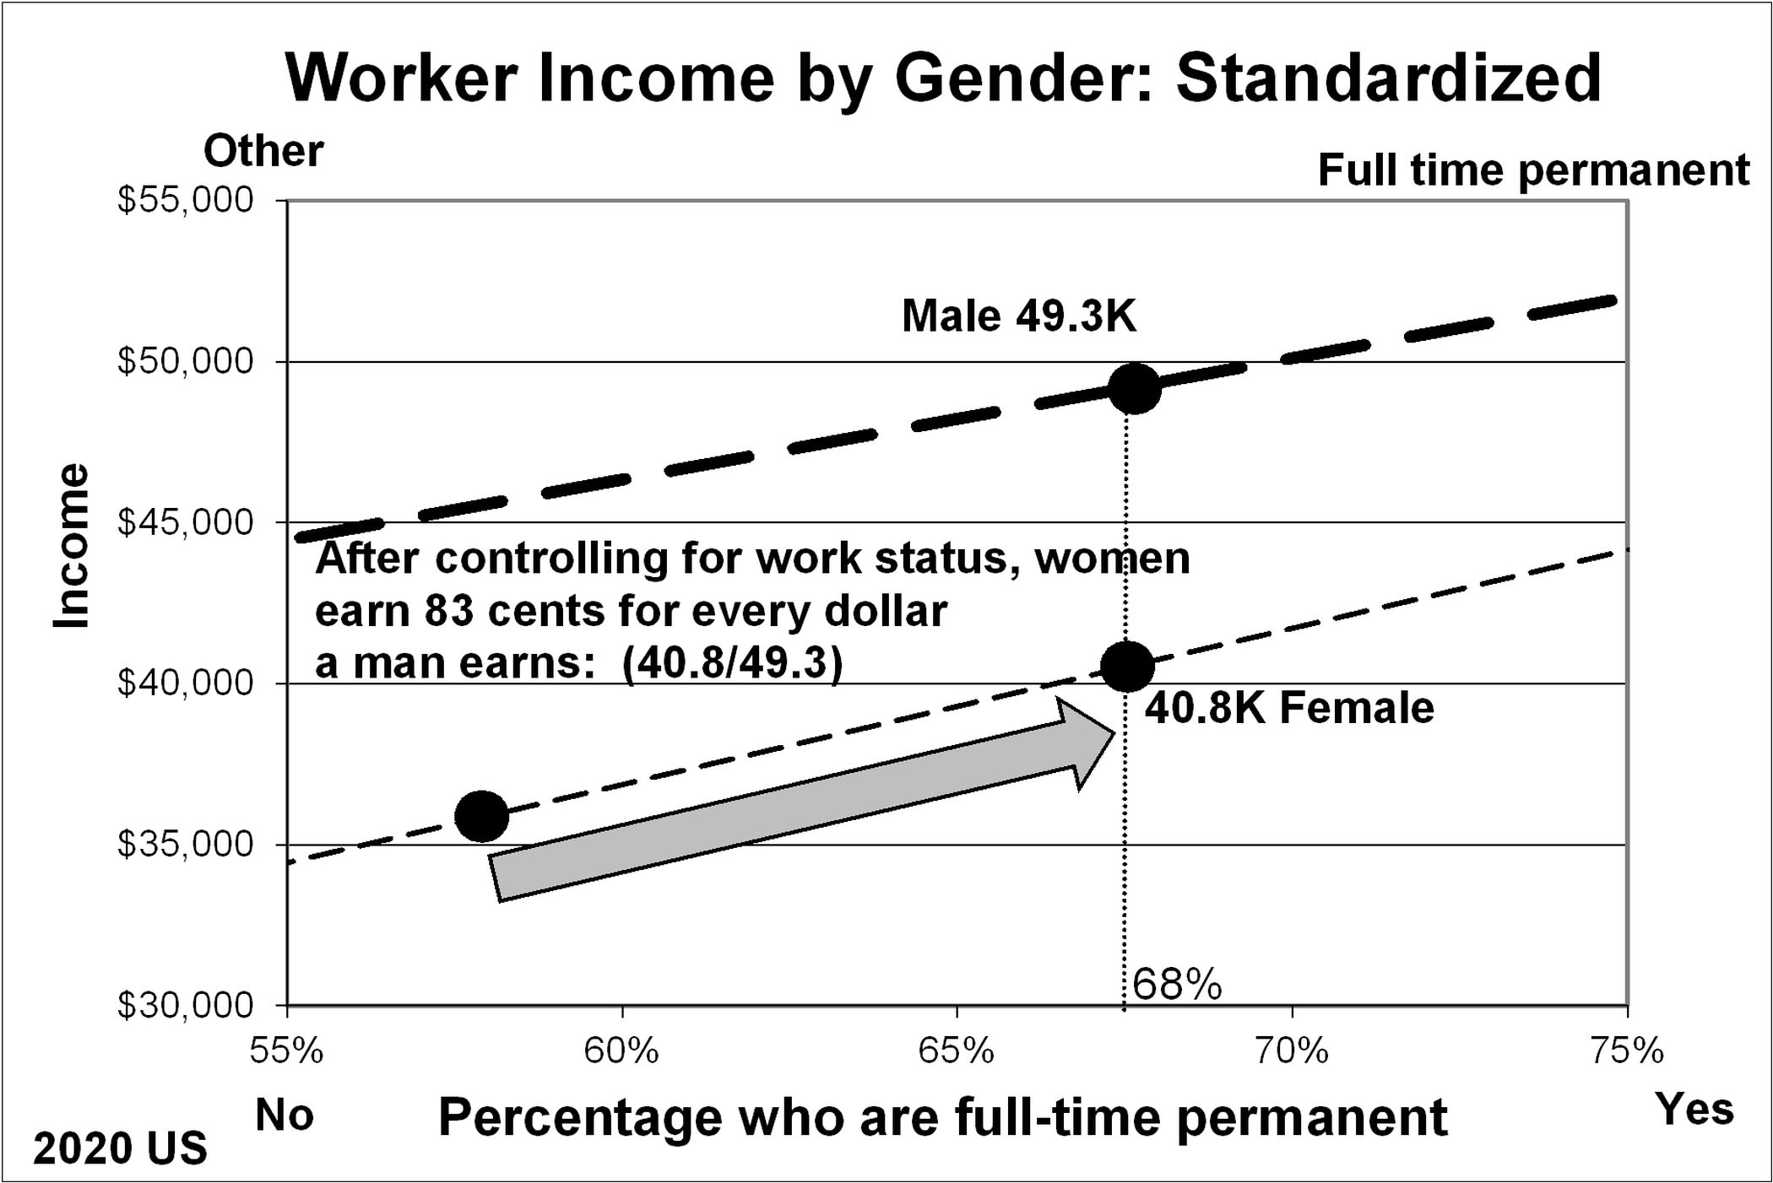
Standardizing Graphically:
Male-Female Income Gap
P 154
44
Standardize: Give women the same mix as men.
Adjusted (reduction): After controlling for work status,
women make 83¢ for every dollar a man makes.
Notes:
Model Trendline Linear 2Y1X using Excel 2013
11/24/2013 V0a
www.StatLit.org/pdf/Model-Trendline-Linear-2Y1X-Excel2013-6up.pdf
44
Analyzing Numbers in the News
15 May 2008
2008SchieldNNN6up.pdf
44
44

Slide 45
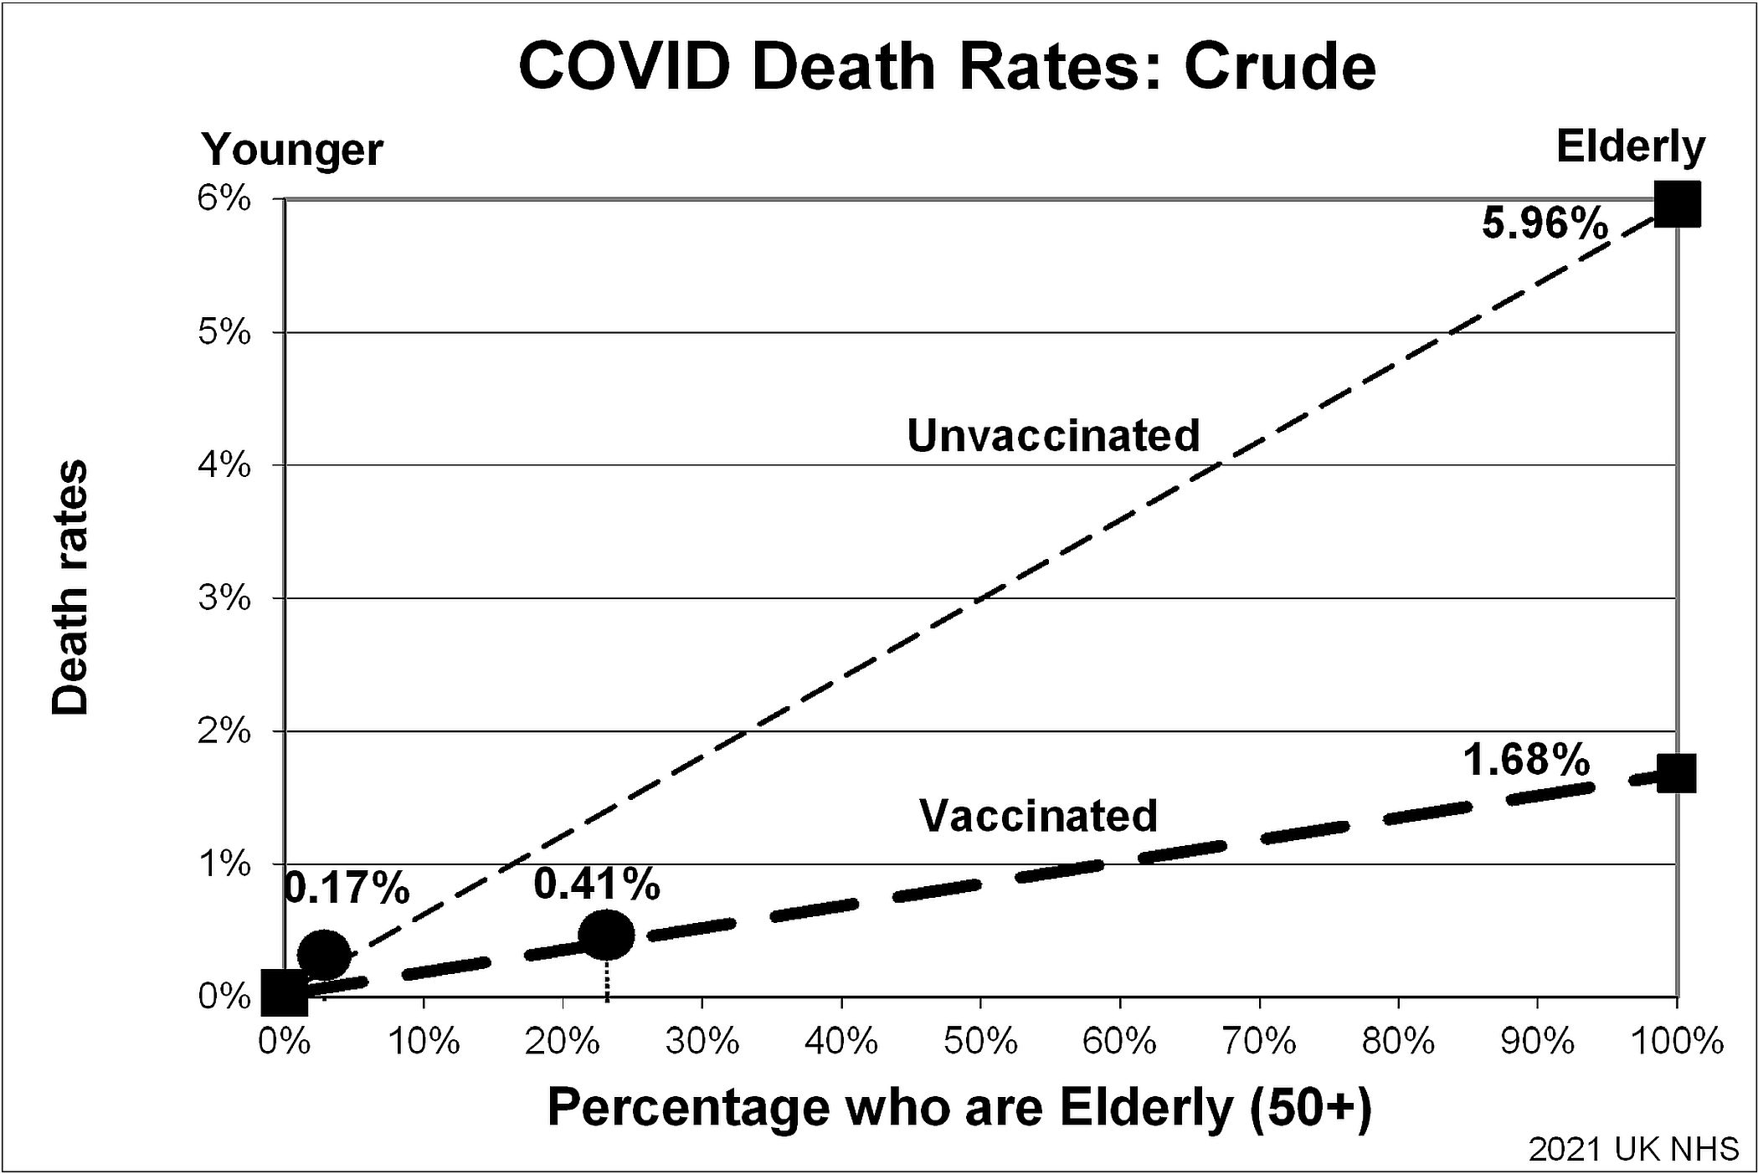
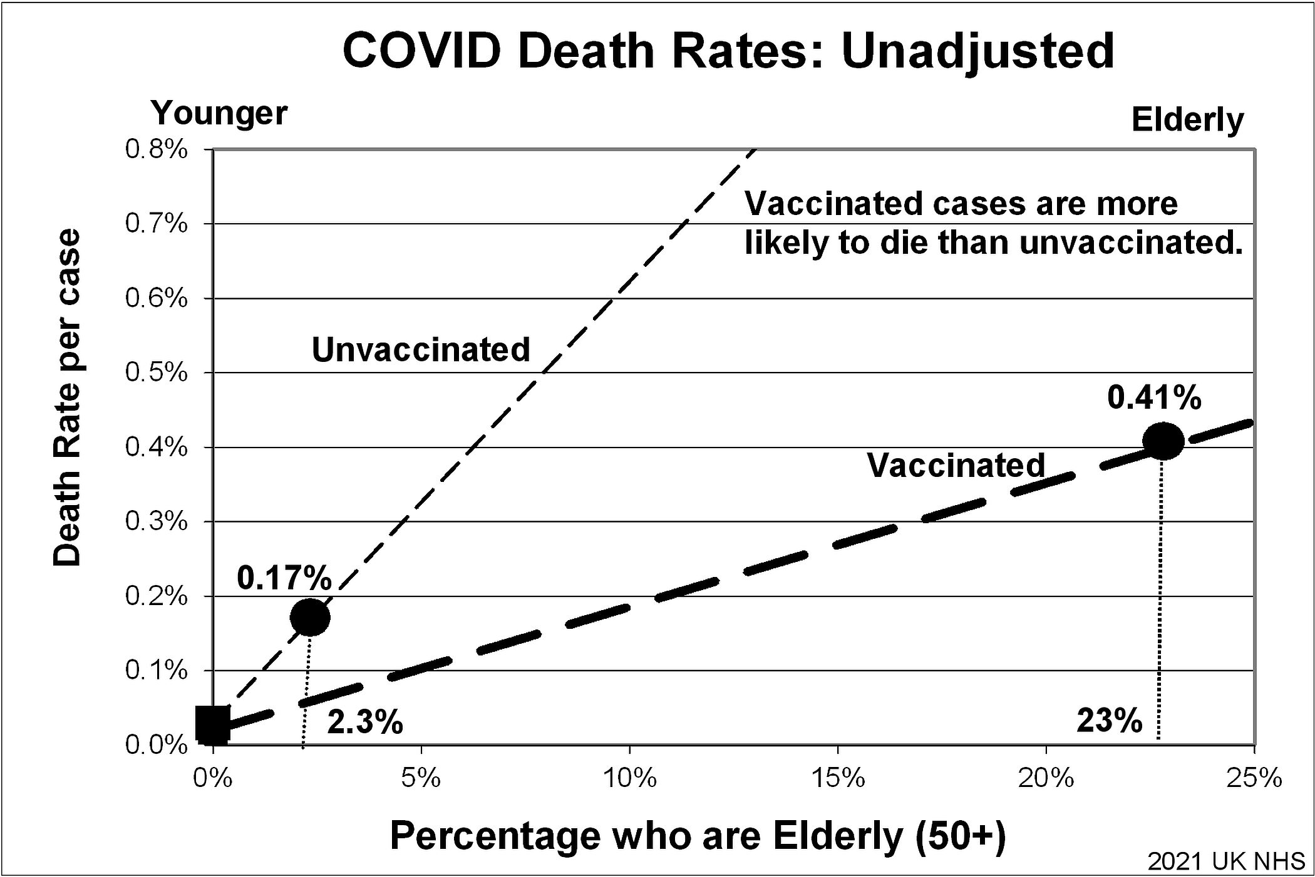
Standardizing Graphically:
COVID
P 155
45
Notes:
Model Trendline Linear 2Y1X using Excel 2013
11/24/2013 V0a
www.StatLit.org/pdf/Model-Trendline-Linear-2Y1X-Excel2013-6up.pdf
45
Analyzing Numbers in the News
15 May 2008
2008SchieldNNN6up.pdf
45
45

Slide 46

Standardizing Graphically:
COVID
P 155
46
Give unvaccinated and vaccinated same elderly mix.
See the reversal after controlling for age
Notes:
Model Trendline Linear 2Y1X using Excel 2013
11/24/2013 V0a
www.StatLit.org/pdf/Model-Trendline-Linear-2Y1X-Excel2013-6up.pdf
46
Analyzing Numbers in the News
15 May 2008
2008SchieldNNN6up.pdf
46
46

Slide 47
StatLit Essentials:
Seven Big Ideas
P 157
47
Statistics are # in context (socially constructed)
Statistics can be influenced (like words)
Best advice with statistics: “Take CARE”
All influences grouped into 4 groups: CARE
Confounding, Assembly, Randomness, Error/bias
Two kinds of studies: hard (exp) and soft (obs)
Comparisons of ratios can be crude: mixed fruit
‘Controlling for’ mix yields ‘same-fruit’ compare
Notes:
Model Trendline Linear 2Y1X using Excel 2013
11/24/2013 V0a
www.StatLit.org/pdf/Model-Trendline-Linear-2Y1X-Excel2013-6up.pdf
47
Analyzing Numbers in the News
15 May 2008
2008SchieldNNN6up.pdf
47
47

Slide 48
Seven StatLit Questions for
Citizens and Decision Makers
P 158
48
Confounding. How big/many/much?
Assembly: Compared to what?
Assembly: How are things defined, counted/
measured, summarized, grouped, presented?
Confounded: Why not a rate? Per what?
Confounded: What was ‘taken into account’?
Confounded: What should be controlled for?
Random/Error: Coincidence/selection bias?
Notes:
Model Trendline Linear 2Y1X using Excel 2013
11/24/2013 V0a
www.StatLit.org/pdf/Model-Trendline-Linear-2Y1X-Excel2013-6up.pdf
48
Analyzing Numbers in the News
15 May 2008
2008SchieldNNN6up.pdf
48
48

Slide 49


Chapter 3 Summary
P 159
49
.
Notes:
Model Trendline Linear 2Y1X using Excel 2013
11/24/2013 V0a
www.StatLit.org/pdf/Model-Trendline-Linear-2Y1X-Excel2013-6up.pdf
49
Analyzing Numbers in the News
15 May 2008
2008SchieldNNN6up.pdf
49
49

Slide 50
Optional Topics
P 160
50
Some topics are advanced or have more detail:
Forming arithmetic comparisons
The Cornfield conditions
Some topics are ‘sensitive’:
Statewide math scores confounded by race
Black-white income gap
Male-female intelligence
Notes:
Model Trendline Linear 2Y1X using Excel 2013
11/24/2013 V0a
www.StatLit.org/pdf/Model-Trendline-Linear-2Y1X-Excel2013-6up.pdf
50
Analyzing Numbers in the News
15 May 2008
2008SchieldNNN6up.pdf
50
50

Slide 51

Standardization Arithmetically:
4th Grade Math: WV vs. LA
P 164
51
National Assessment Educational Progress
Overall, W. Virginia students did better than Louisiana
But Louisiana did better for Blacks and Whites.
If we control for race, Louisiana must do better.
Notes:
Model Trendline Linear 2Y1X using Excel 2013
11/24/2013 V0a
www.StatLit.org/pdf/Model-Trendline-Linear-2Y1X-Excel2013-6up.pdf
51
Analyzing Numbers in the News
15 May 2008
2008SchieldNNN6up.pdf
51
51

Slide 52

Standardization Arithmetically:
4th Grade Math: WV vs. LA
P 164
52
Standardize: Use West Virginia mix for LA.
Louisiana (before crude): 218 Worse than VW.
Louisiana (after adjusted): 229 Better than WV
Blacks score lower! Is this evidence of racism?
Notes:
Model Trendline Linear 2Y1X using Excel 2013
11/24/2013 V0a
www.StatLit.org/pdf/Model-Trendline-Linear-2Y1X-Excel2013-6up.pdf
52
Analyzing Numbers in the News
15 May 2008
2008SchieldNNN6up.pdf
52
52

Slide 53

Standardization Arithmetically:
Black-White Income Gap
P 165
53
White families earn 66% more than Black families
22K is a crude comparison: true but it prevaricates
Adjust for (take into account) family structure.
Notes:
Model Trendline Linear 2Y1X using Excel 2013
11/24/2013 V0a
www.StatLit.org/pdf/Model-Trendline-Linear-2Y1X-Excel2013-6up.pdf
53
Analyzing Numbers in the News
15 May 2008
2008SchieldNNN6up.pdf
53
53

Slide 54

Standardization Arithmetically:
Black-White Income Gap
P 165
54
Standardize: Give Blacks the same mix as Whites
Income gap: 22K before; 7K gap after
Adjusting for family structure removes 2/3 of gap
Notes:
Model Trendline Linear 2Y1X using Excel 2013
11/24/2013 V0a
www.StatLit.org/pdf/Model-Trendline-Linear-2Y1X-Excel2013-6up.pdf
54
Analyzing Numbers in the News
15 May 2008
2008SchieldNNN6up.pdf
54
54

Slide 55
Interpreting Adjusted Results:
Discrimination?
P 165
55
Student: Doesn’t this prove that only the remainer ($7K) could be due to racism?
Teacher: I can’t answer this As a statistician I have no expertise on whether discrimination caused this disparity.
Student was not satisfied. How could the initial disparity ($22K) still be due to racism?
Teacher: Suppose criminal justice system discriminated against Blacks. Black men are more likely to be in jail. More likely to divorce. Less likely to marry after release.
Notes:
Model Trendline Linear 2Y1X using Excel 2013
11/24/2013 V0a
www.StatLit.org/pdf/Model-Trendline-Linear-2Y1X-Excel2013-6up.pdf
55
Analyzing Numbers in the News
15 May 2008
2008SchieldNNN6up.pdf
55
55

Slide 56

Standardization Graphically:
4th Grade math: WV vs. LA
P 166
56
Crude: WV scored higher than LA
Notes:
Model Trendline Linear 2Y1X using Excel 2013
11/24/2013 V0a
www.StatLit.org/pdf/Model-Trendline-Linear-2Y1X-Excel2013-6up.pdf
56
Analyzing Numbers in the News
15 May 2008
2008SchieldNNN6up.pdf
56
56

Slide 57

Standardization Graphically:
4th Grade math: WV vs. LA
P 167
57
Standardized: WV scored lower than LA.
Notes:
Model Trendline Linear 2Y1X using Excel 2013
11/24/2013 V0a
www.StatLit.org/pdf/Model-Trendline-Linear-2Y1X-Excel2013-6up.pdf
57
Analyzing Numbers in the News
15 May 2008
2008SchieldNNN6up.pdf
57
57

Slide 58

Standardization Graphically:
Family Income: Whites vs Black
P 169
58
BW Family Income Gap (crude) = 22K (55K-33K)
Notes:
Model Trendline Linear 2Y1X using Excel 2013
11/24/2013 V0a
www.StatLit.org/pdf/Model-Trendline-Linear-2Y1X-Excel2013-6up.pdf
58
Analyzing Numbers in the News
15 May 2008
2008SchieldNNN6up.pdf
58
58

Slide 59

Standardization Graphically:
Family Income: Whites vs Black
P 170
59
BW Family Income Gap (adjust) = 8K (53-45)
Notes:
Model Trendline Linear 2Y1X using Excel 2013
11/24/2013 V0a
www.StatLit.org/pdf/Model-Trendline-Linear-2Y1X-Excel2013-6up.pdf
59
Analyzing Numbers in the News
15 May 2008
2008SchieldNNN6up.pdf
59
59

Slide 60

Standardization Graphically:
Family Income: Whites vs Black
P 170
60
Percentage of gap explained by family structure:
Does this prove: most of gap is not discrimination?
No! Black family structure could be due to racism!
Notes:
Model Trendline Linear 2Y1X using Excel 2013
11/24/2013 V0a
www.StatLit.org/pdf/Model-Trendline-Linear-2Y1X-Excel2013-6up.pdf
60
Analyzing Numbers in the News
15 May 2008
2008SchieldNNN6up.pdf
60
60

Slide 61
Cornfield Conditions
P 172
61
After learning how easily everyday statistics can be influenced, a student decided never to trust a statistic.
This is not a undesirable outcome. Cynicism
isn’t much better than naivete (being clueless).
Cornfield proved: confounder must be bigger
than a predictor to reverse an association.
Cornfield conditions are necessary – not sufficient
Notes:
Model Trendline Linear 2Y1X using Excel 2013
11/24/2013 V0a
www.StatLit.org/pdf/Model-Trendline-Linear-2Y1X-Excel2013-6up.pdf
61
Analyzing Numbers in the News
15 May 2008
2008SchieldNNN6up.pdf
61
61

Slide 62

Cornfield Conditions:
4th Grade Math: White vs. Black
P 172
62
To reverse, confounder must be bigger than predictor
Racial gap (24 points) > State gap (7 points)
Will standardizing reverse? Not necessarily!
Notes:
Model Trendline Linear 2Y1X using Excel 2013
11/24/2013 V0a
www.StatLit.org/pdf/Model-Trendline-Linear-2Y1X-Excel2013-6up.pdf
62
Analyzing Numbers in the News
15 May 2008
2008SchieldNNN6up.pdf
62
62

Slide 63

Cornfield Conditions:
Family Income: White vs. Black
P 173
63
To reverse, confounder must be bigger than predictor.
This is a necessary condition.
Marital status gap (35K) > Race gap (22K)
Will standardizing reverse? Not necessarily!
Notes:
Model Trendline Linear 2Y1X using Excel 2013
11/24/2013 V0a
www.StatLit.org/pdf/Model-Trendline-Linear-2Y1X-Excel2013-6up.pdf
63
Analyzing Numbers in the News
15 May 2008
2008SchieldNNN6up.pdf
63
63

Slide 64
Two-group Compare versus Two-Factor Covariation
P 173
64
Two-factor covariation is common in science.
As height increases, weight increases.
Two-group comparisons are common in humanities and in social sciences.
Women live longer than men (on average).
Can covariation be standardized? Yes!
How? Use a ‘trend’ or ‘expected’ line.
Notes:
Model Trendline Linear 2Y1X using Excel 2013
11/24/2013 V0a
www.StatLit.org/pdf/Model-Trendline-Linear-2Y1X-Excel2013-6up.pdf
64
Analyzing Numbers in the News
15 May 2008
2008SchieldNNN6up.pdf
64
64

Slide 65

Covariation:
Yankees vs. Mets (Crude)
P 173
65
Average is the horizontal line: 50% wins.
Mets: Below average. Yankees: Above average.
Notes:
Model Trendline Linear 2Y1X using Excel 2013
11/24/2013 V0a
www.StatLit.org/pdf/Model-Trendline-Linear-2Y1X-Excel2013-6up.pdf
65
Analyzing Numbers in the News
15 May 2008
2008SchieldNNN6up.pdf
65
65

Slide 66

Confounded by Payroll:
Dashed diagonal is ‘expected’
P 173
66
Standardize: Both teams get $32 million.
To standardize, move team parallel to expected.
Compared to expected, Mets above; Yankees below!
Notes:
Model Trendline Linear 2Y1X using Excel 2013
11/24/2013 V0a
www.StatLit.org/pdf/Model-Trendline-Linear-2Y1X-Excel2013-6up.pdf
66
Analyzing Numbers in the News
15 May 2008
2008SchieldNNN6up.pdf
66
66

Slide 67

Intelligence (IQ):
Boys vs. Girls
P 175
67
Same means; small difference in deviations.
Notes:
Model Trendline Linear 2Y1X using Excel 2013
11/24/2013 V0a
www.StatLit.org/pdf/Model-Trendline-Linear-2Y1X-Excel2013-6up.pdf
67
Analyzing Numbers in the News
15 May 2008
2008SchieldNNN6up.pdf
67
67

Slide 68

IQ
Men vs. Women
P 175
68
Big ratios at BOTH extremes.
Based on a study of 80,000 Scottish students.
Notes:
Model Trendline Linear 2Y1X using Excel 2013
11/24/2013 V0a
www.StatLit.org/pdf/Model-Trendline-Linear-2Y1X-Excel2013-6up.pdf
68
Analyzing Numbers in the News
15 May 2008
2008SchieldNNN6up.pdf
68
68

Slide 69
Intelligence-Related:
Men vs. Women
,
69
Men are more prevalent in the highest rank of
philosophy, mathematics and duplicate bridge.
Men are more prevalent among the
school dropouts, GED, homeless & mentally ill
https://stanmed.stanford.edu/how-mens-and-womens-brains-are-different/
Notes:
Model Trendline Linear 2Y1X using Excel 2013
11/24/2013 V0a
www.StatLit.org/pdf/Model-Trendline-Linear-2Y1X-Excel2013-6up.pdf
69
Analyzing Numbers in the News
15 May 2008
2008SchieldNNN6up.pdf
69
69

Slide 70
Non-Intelligence Differences:
Men vs. Women
.
70
Men are better:
2X more able to separate emotions from tasks
Half as likely to be clinically depressed.
: Men are worse
40% more likely to be schizophrenic.
2X times as likely to become alcoholic.
4X as likely to be on autism spectrum.
10X as likely to be dyslexic.
Notes:
Model Trendline Linear 2Y1X using Excel 2013
11/24/2013 V0a
www.StatLit.org/pdf/Model-Trendline-Linear-2Y1X-Excel2013-6up.pdf
70
Analyzing Numbers in the News
15 May 2008
2008SchieldNNN6up.pdf
70
70

