Slide 1
Statistical Literacy Textbook:
Chapter 2 Slides
Statistical Literacy:
Critical Thinking about Everyday Statistics
Kendall-Hunt 2023
Milo Schield
ASA Fellow
Adjunct: University of New Mexico
Visiting Professor: New College of Florida
www.StatLit.org/pdf/
2023-Schield-StatLit-Ch2-Slides.pdf
Notes:
Model Trendline Linear 2Y1X using Excel 2013
11/24/2013 V0a
www.StatLit.org/pdf/Model-Trendline-Linear-2Y1X-Excel2013-6up.pdf
1
Analyzing Numbers in the News
15 May 2008
2008SchieldNNN6up.pdf
1
1

Slide 2
Comparisons, CARE Solutions:
Table of Contents
2.0 P 59
2
2.1 p. 59 Learning Outcomes
2.2 p. 60 Review
2.3 p 60 Association
2.4 p. 67 Confounder Solutions
2.5 p. 85 Assembly Solutions
2.6 p. 90 Randomness Solutions
2.7 p. 97 Error (bias) Solutions
2.8 p.100 Analyzing Stories
2.9 p.104 Chapter Summary
2.10 p.105 Advanced/Optional
Notes:
Model Trendline Linear 2Y1X using Excel 2013
11/24/2013 V0a
www.StatLit.org/pdf/Model-Trendline-Linear-2Y1X-Excel2013-6up.pdf
2
Analyzing Numbers in the News
15 May 2008
2008SchieldNNN6up.pdf
2
2

Slide 3
Comparisons, CARE Solutions:
Learning Outcomes
2.1 P 22
3
Learn how to state ordered and arithmetic:
  two-group comparisons
  two-factor covariation
Learn ways to block or cancel the influence of:
  Confounding,
  Assembly,
  Randomness, and
  Error/bias.
Notes:
Model Trendline Linear 2Y1X using Excel 2013
11/24/2013 V0a
www.StatLit.org/pdf/Model-Trendline-Linear-2Y1X-Excel2013-6up.pdf
3
Analyzing Numbers in the News
15 May 2008
2008SchieldNNN6up.pdf
3
3

Slide 4
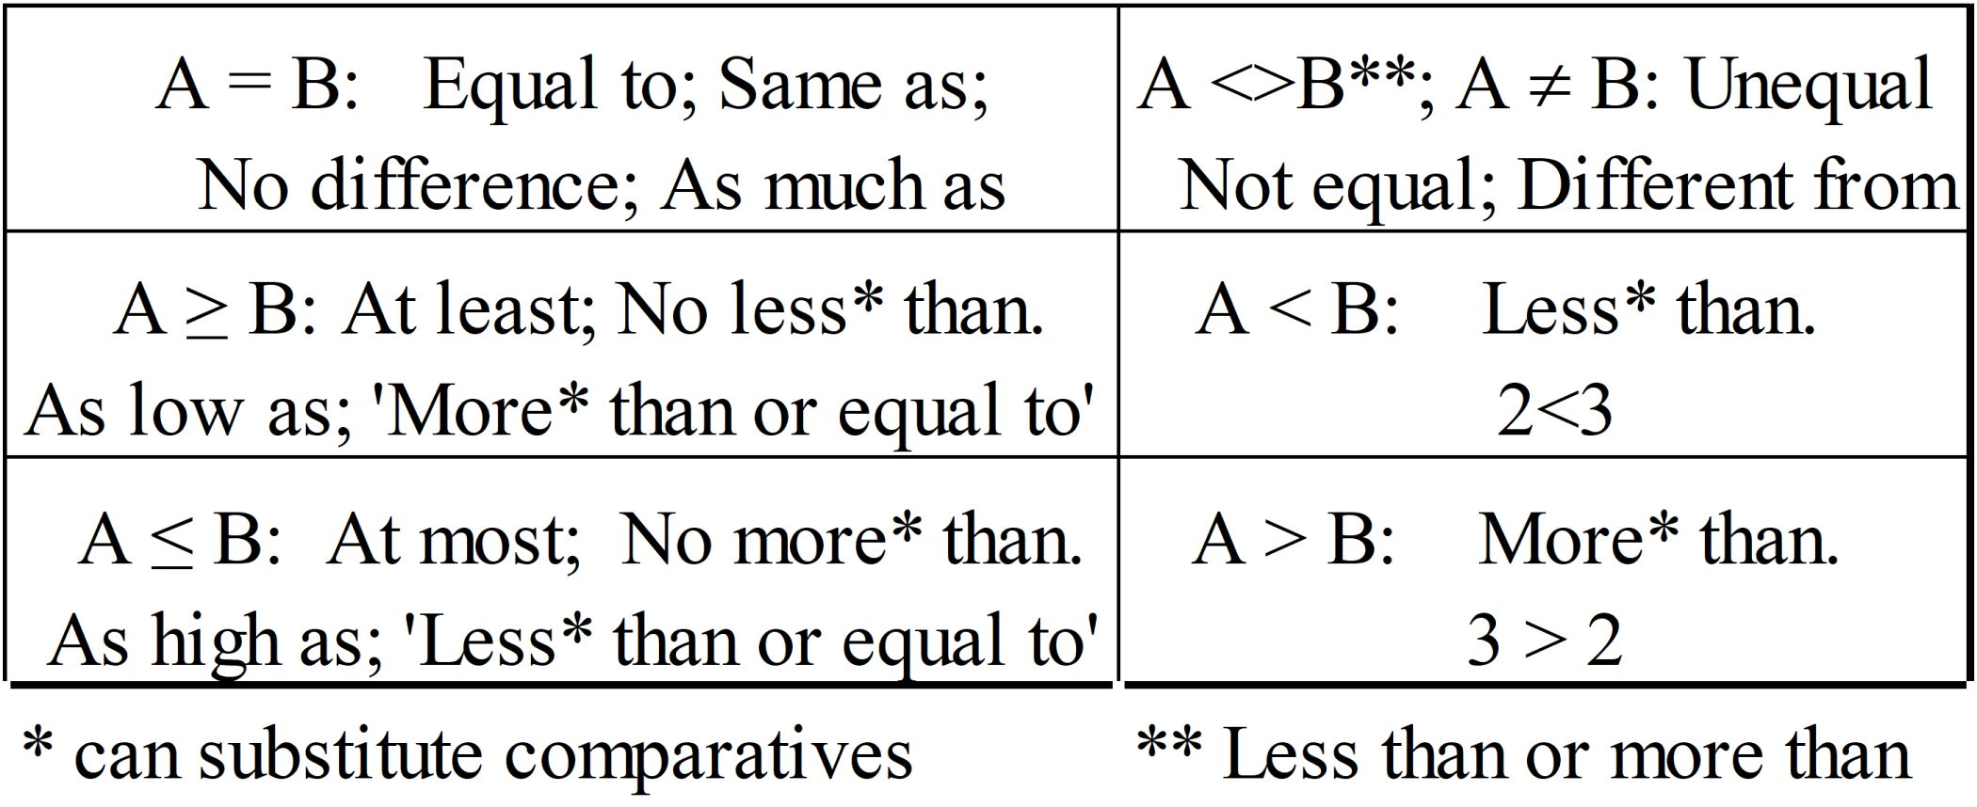
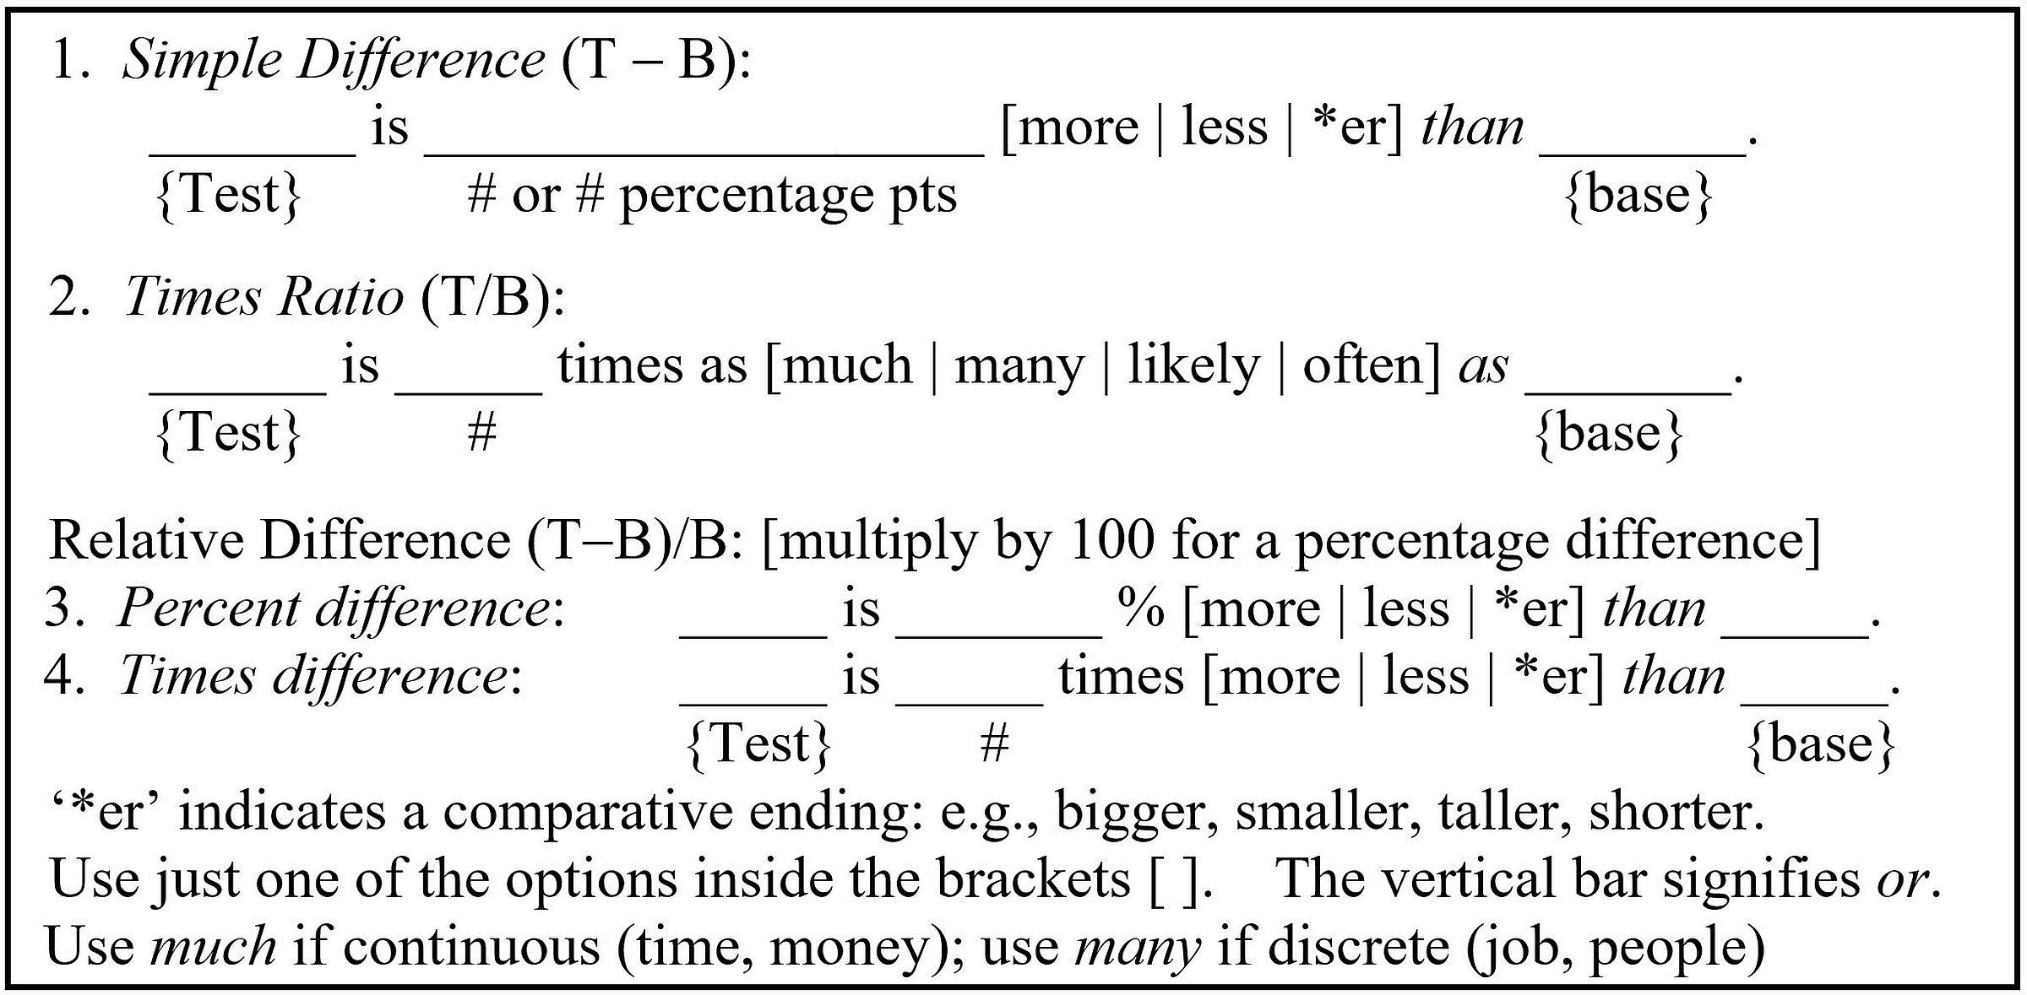
Two-Group Comparisons:
Ordered and Arithmetic
2.3 P 61, 62
4
.
Notes:
Model Trendline Linear 2Y1X using Excel 2013
11/24/2013 V0a
www.StatLit.org/pdf/Model-Trendline-Linear-2Y1X-Excel2013-6up.pdf
4
Analyzing Numbers in the News
15 May 2008
2008SchieldNNN6up.pdf
4
4

Slide 5
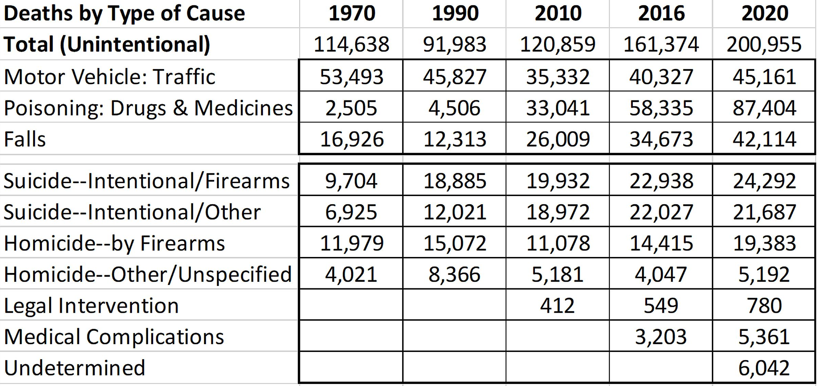
Form Comparisons:
Ordered and Arithmetic
2.1 P 61
5
US Accidental Deaths:
Notes:
Model Trendline Linear 2Y1X using Excel 2013
11/24/2013 V0a
www.StatLit.org/pdf/Model-Trendline-Linear-2Y1X-Excel2013-6up.pdf
5
Analyzing Numbers in the News
15 May 2008
2008SchieldNNN6up.pdf
5
5

Slide 6
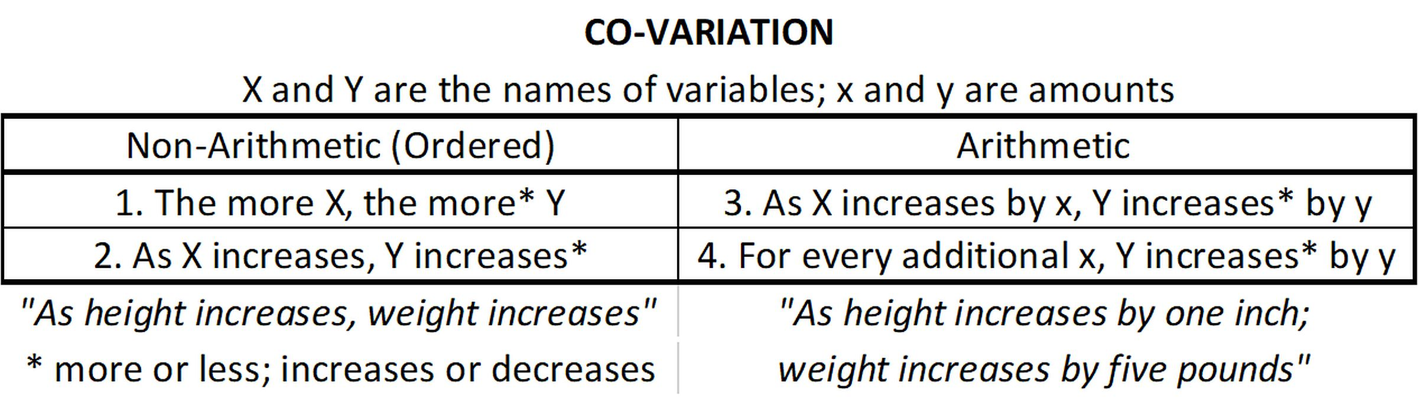
Comparison Exceptions;
Co-variation (Between)
2.3 P 66
6
Arithmetic two-group comparison exceptions:
percentage points (not %) measure a difference between two percentages.
times less (new): 2 is 3 times (B/T) less than 6.
Applies if the test and base must be positive.
Notes:
Model Trendline Linear 2Y1X using Excel 2013
11/24/2013 V0a
www.StatLit.org/pdf/Model-Trendline-Linear-2Y1X-Excel2013-6up.pdf
6
Analyzing Numbers in the News
15 May 2008
2008SchieldNNN6up.pdf
6
6

Slide 7
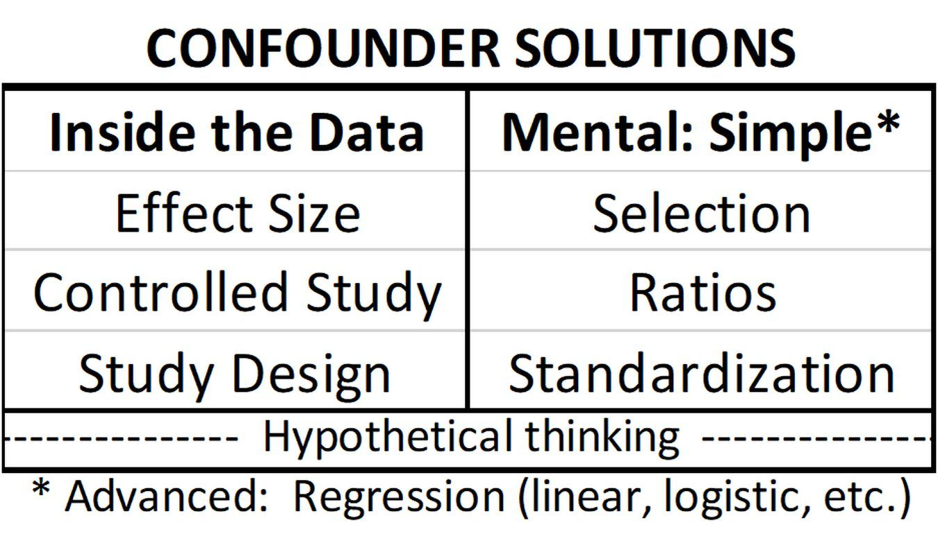
CARE:
Confounder Solutions
2.4 P 67
7
Confounder: Anything that provides an alternate explanation for an association.
Notes:
Model Trendline Linear 2Y1X using Excel 2013
11/24/2013 V0a
www.StatLit.org/pdf/Model-Trendline-Linear-2Y1X-Excel2013-6up.pdf
7
Analyzing Numbers in the News
15 May 2008
2008SchieldNNN6up.pdf
7
7

Slide 8
2.4.1 Confounder Solution:
Effect Size
2.4.1 P 68
8
Effect size: size of an arithmetic comparison.
The larger the effect size, the fewer the # of confounders that can influence an association.
The smaller the effect size, the more likely the association is influenced by confounding.
A study that doesn’t present the effect size:
probably has a small effect size.
Notes:
Model Trendline Linear 2Y1X using Excel 2013
11/24/2013 V0a
www.StatLit.org/pdf/Model-Trendline-Linear-2Y1X-Excel2013-6up.pdf
8
Analyzing Numbers in the News
15 May 2008
2008SchieldNNN6up.pdf
8
8

Slide 9
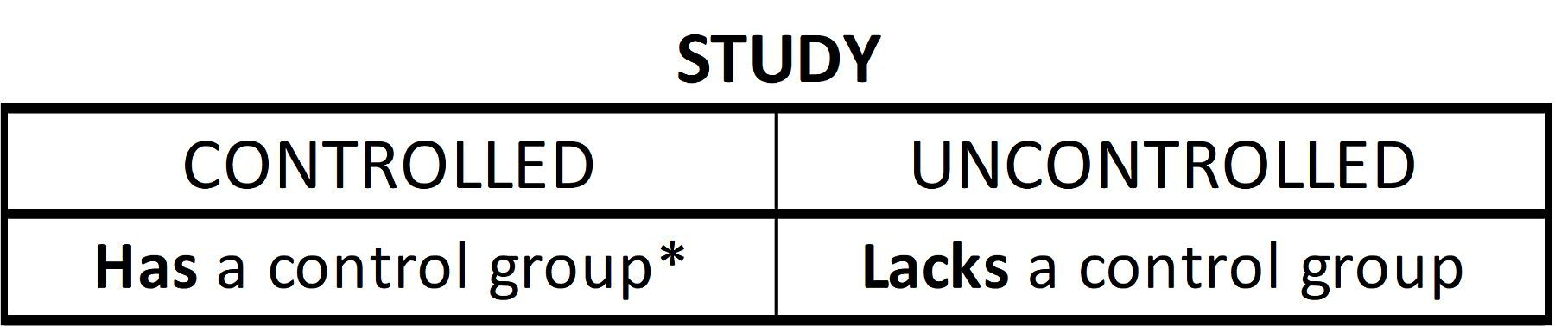
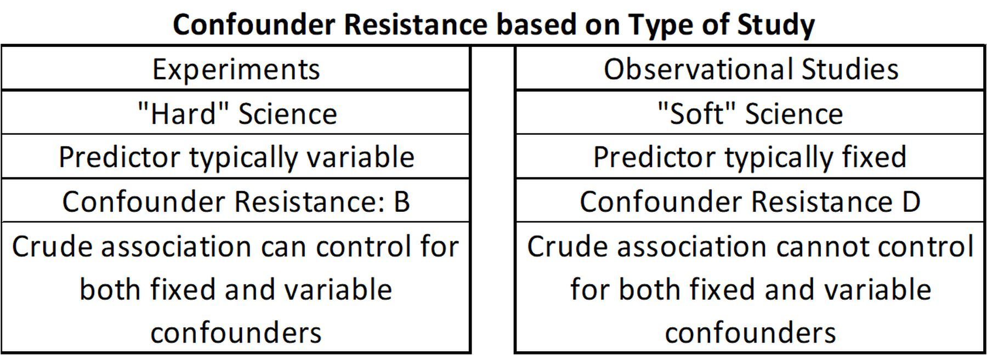
Confounder Resistance:
Control Group; Study Design
2.4 P 69, 70
9
Resisting confounder influence (warding off confounders)
controlled study is better than an uncontrolled study
experiment is better than an observational study.
Notes:
Model Trendline Linear 2Y1X using Excel 2013
11/24/2013 V0a
www.StatLit.org/pdf/Model-Trendline-Linear-2Y1X-Excel2013-6up.pdf
9
Analyzing Numbers in the News
15 May 2008
2008SchieldNNN6up.pdf
9
9

Slide 10
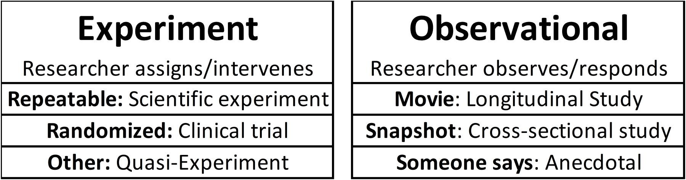
Types of Studies:
Experiments vs. Observational
2.4.3 P 71
10
Doing versus just Seeing
Notes:
Model Trendline Linear 2Y1X using Excel 2013
11/24/2013 V0a
www.StatLit.org/pdf/Model-Trendline-Linear-2Y1X-Excel2013-6up.pdf
10
Analyzing Numbers in the News
15 May 2008
2008SchieldNNN6up.pdf
10
10

Slide 11
Experiment #1:
Ideal Experiment
2.4.3 P 71-72
11
The subjects:
are homogeneous (alike internally)
have no memory of being treated
can be switched: treatment and control.
Examples: most laboratory assignments in
physics, chemistry or biology.
Notes:
Model Trendline Linear 2Y1X using Excel 2013
11/24/2013 V0a
www.StatLit.org/pdf/Model-Trendline-Linear-2Y1X-Excel2013-6up.pdf
11
Analyzing Numbers in the News
15 May 2008
2008SchieldNNN6up.pdf
11
11

Slide 12
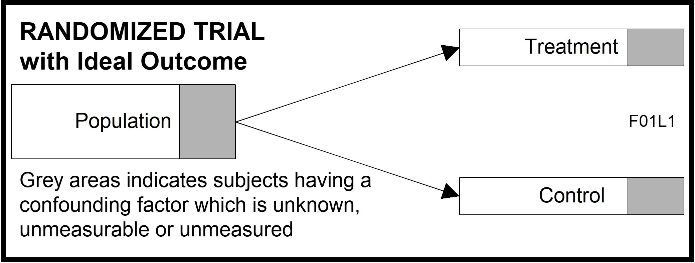
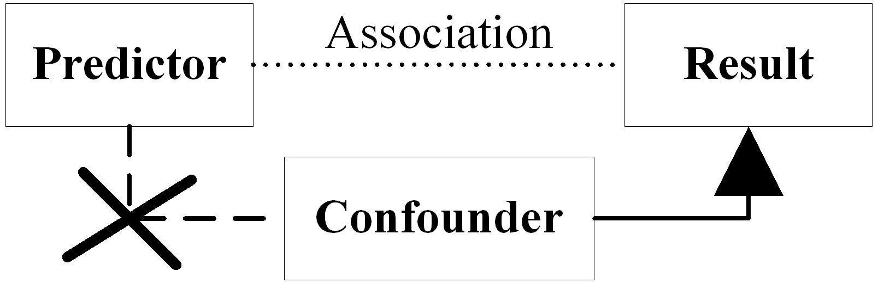
Experiment #2:
Randomized Clinical Trial
2.4.3 P 72
12
Best way to create two groups balanced on known and unknown factors without looking.
Randomizing: breaks predictor-confounder link
Shuffle cards (randomize) to get ‘equal’ hands
Notes:
Model Trendline Linear 2Y1X using Excel 2013
11/24/2013 V0a
www.StatLit.org/pdf/Model-Trendline-Linear-2Y1X-Excel2013-6up.pdf
12
Analyzing Numbers in the News
15 May 2008
2008SchieldNNN6up.pdf
12
12

Slide 13
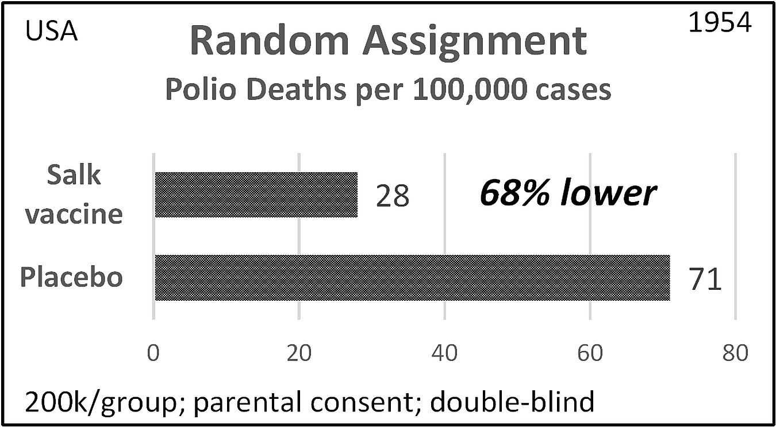
Randomized Clinical Trial
Salk Vaccine
2.4.3 P 72
13
.
Notes:
Model Trendline Linear 2Y1X using Excel 2013
11/24/2013 V0a
www.StatLit.org/pdf/Model-Trendline-Linear-2Y1X-Excel2013-6up.pdf
13
Analyzing Numbers in the News
15 May 2008
2008SchieldNNN6up.pdf
13
13

Slide 14
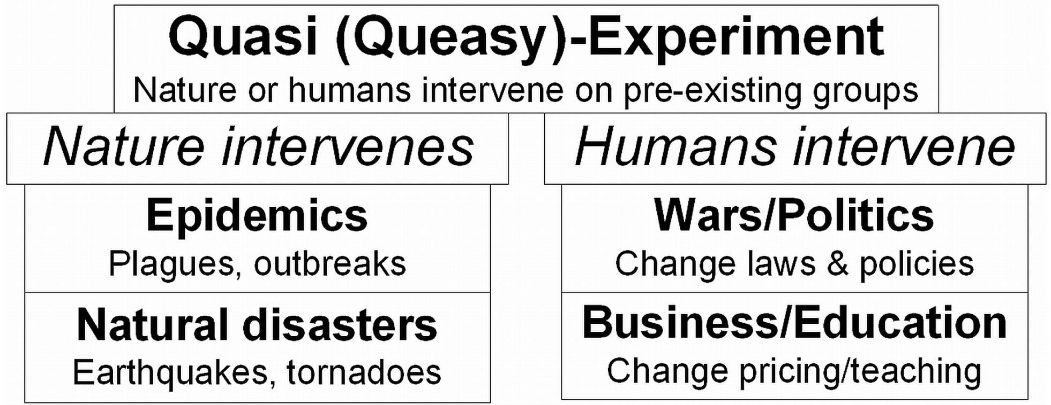
Experiment #3:
Quasi-Experiments
2.4.3 P 74
14
Quasi-experiments: experiments that involve pre-existing groups.
Notes:
Model Trendline Linear 2Y1X using Excel 2013
11/24/2013 V0a
www.StatLit.org/pdf/Model-Trendline-Linear-2Y1X-Excel2013-6up.pdf
14
Analyzing Numbers in the News
15 May 2008
2008SchieldNNN6up.pdf
14
14

Slide 15
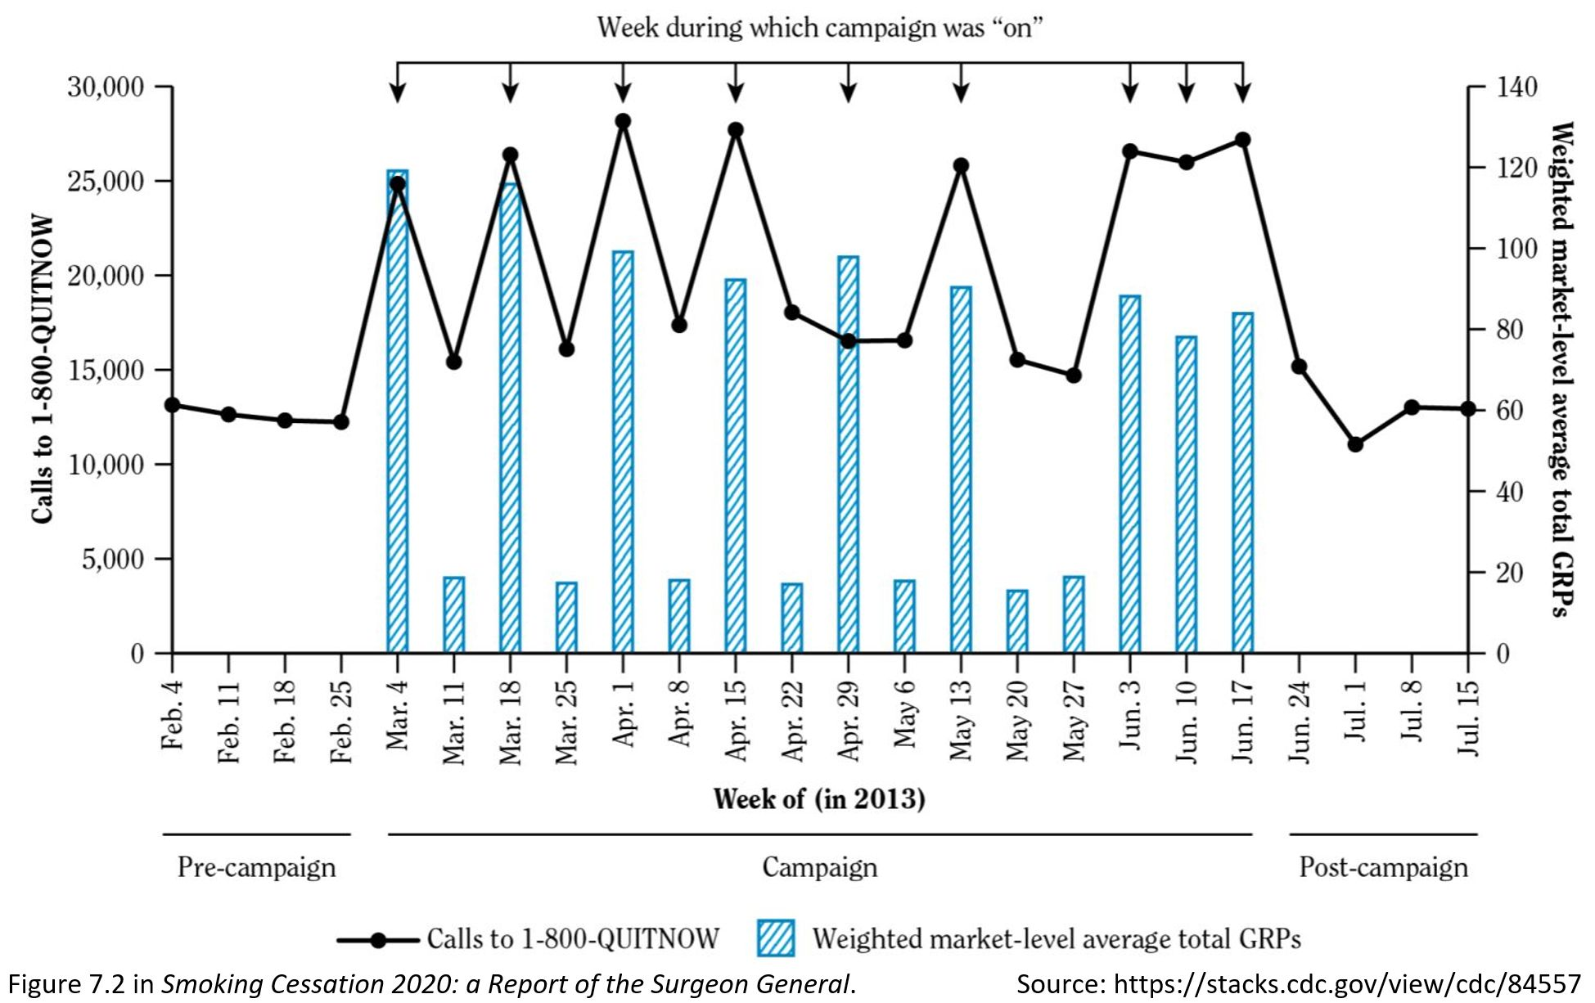
Quasi-Experiment
2.4.3 P 22
15
Notes:
Model Trendline Linear 2Y1X using Excel 2013
11/24/2013 V0a
www.StatLit.org/pdf/Model-Trendline-Linear-2Y1X-Excel2013-6up.pdf
15
Analyzing Numbers in the News
15 May 2008
2008SchieldNNN6up.pdf
15
15

Slide 16
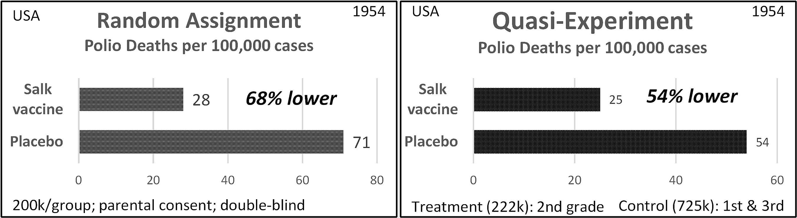
Comparison:
Clinical Trial vs Quasi-Experiment
2.4.3 P 75
16
Researchers trusted the clinical trial.
Parents trusted the quasi-experiment.
Notes:
Model Trendline Linear 2Y1X using Excel 2013
11/24/2013 V0a
www.StatLit.org/pdf/Model-Trendline-Linear-2Y1X-Excel2013-6up.pdf
16
Analyzing Numbers in the News
15 May 2008
2008SchieldNNN6up.pdf
16
16

Slide 17
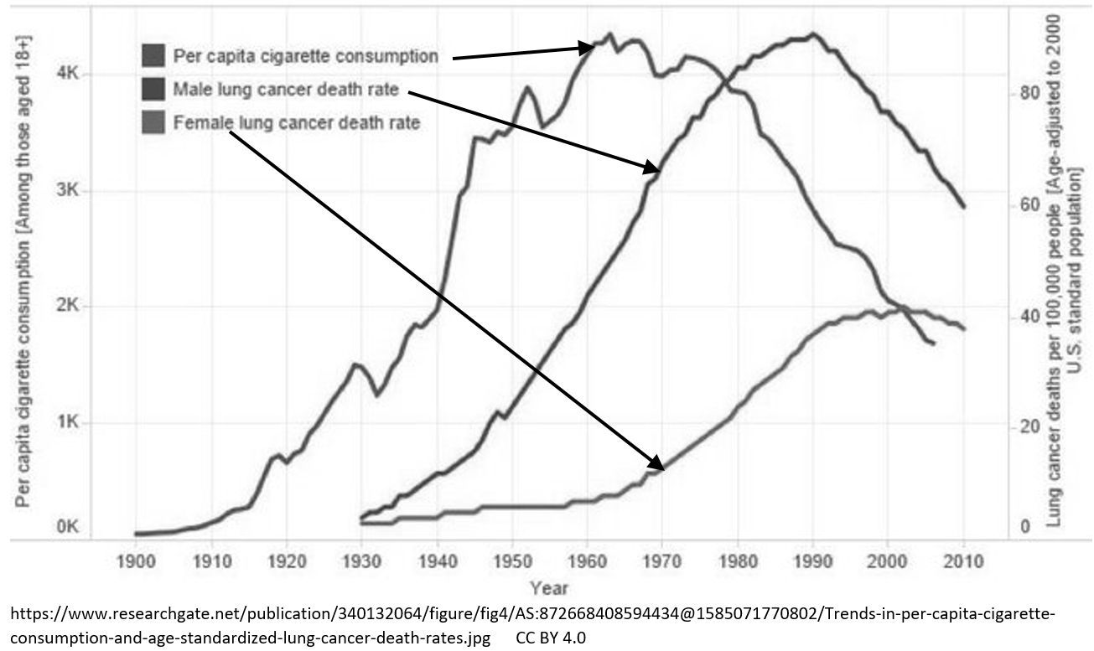
Observational study #1: Longitudinal (movie)
2.4.3 P 76
17
Notes:
Model Trendline Linear 2Y1X using Excel 2013
11/24/2013 V0a
www.StatLit.org/pdf/Model-Trendline-Linear-2Y1X-Excel2013-6up.pdf
17
Analyzing Numbers in the News
15 May 2008
2008SchieldNNN6up.pdf
17
17

Slide 18
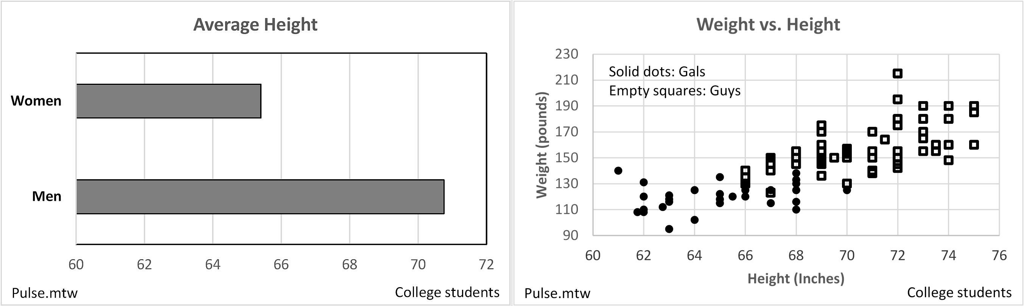
Observational study #2:
Cross-Sectional (snapshot)
C: Confounding
18
Two-group Two Factor
Comparison Co-variation
Notes:
Model Trendline Linear 2Y1X using Excel 2013
11/24/2013 V0a
www.StatLit.org/pdf/Model-Trendline-Linear-2Y1X-Excel2013-6up.pdf
18
Analyzing Numbers in the News
15 May 2008
2008SchieldNNN6up.pdf
18
18

Slide 19
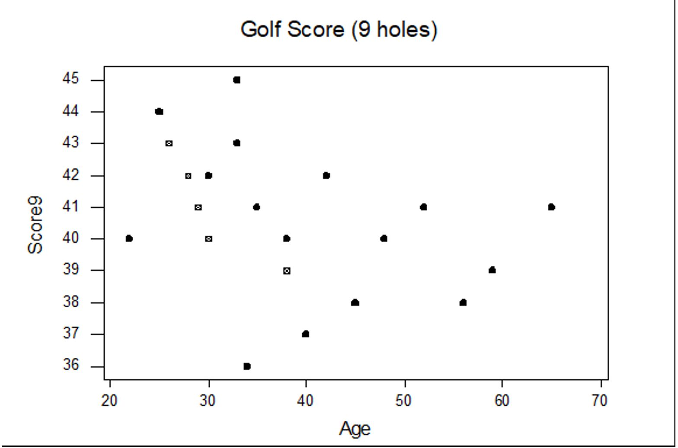
Cross-Sectional Study:
Time-Related Snapshot
C: Confounding
19
As age increases, golf scores improve???
Notes:
Model Trendline Linear 2Y1X using Excel 2013
11/24/2013 V0a
www.StatLit.org/pdf/Model-Trendline-Linear-2Y1X-Excel2013-6up.pdf
19
Analyzing Numbers in the News
15 May 2008
2008SchieldNNN6up.pdf
19
19

Slide 20
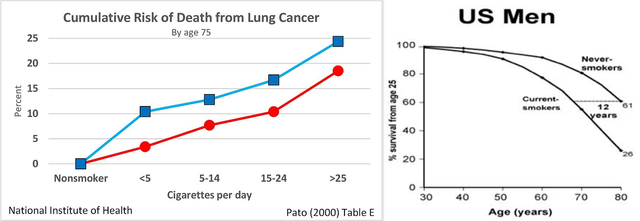
Cross-Sectional Study:
Time-Related Snapshots
C: Confounding
20
Left: Dose-response Right: % who Survive
Notes:
Model Trendline Linear 2Y1X using Excel 2013
11/24/2013 V0a
www.StatLit.org/pdf/Model-Trendline-Linear-2Y1X-Excel2013-6up.pdf
20
Analyzing Numbers in the News
15 May 2008
2008SchieldNNN6up.pdf
20
20

Slide 21
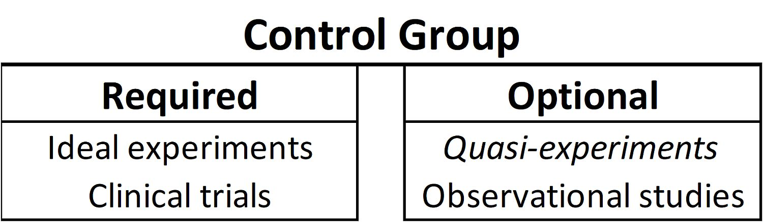
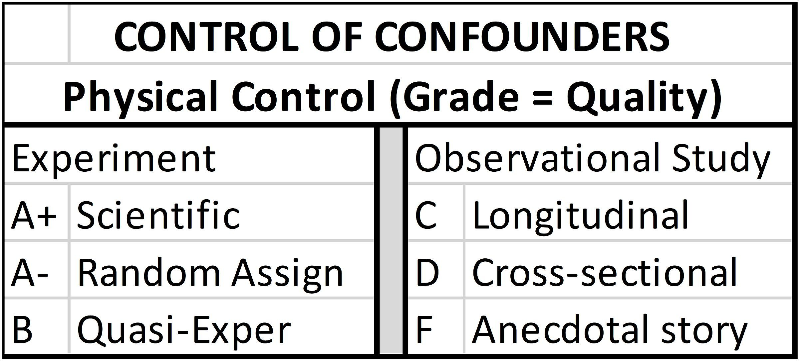
Control Group (Review);
Study Design: Graded
C: Confounding
21
Notes:
Model Trendline Linear 2Y1X using Excel 2013
11/24/2013 V0a
www.StatLit.org/pdf/Model-Trendline-Linear-2Y1X-Excel2013-6up.pdf
21
Analyzing Numbers in the News
15 May 2008
2008SchieldNNN6up.pdf
21
21

Slide 22
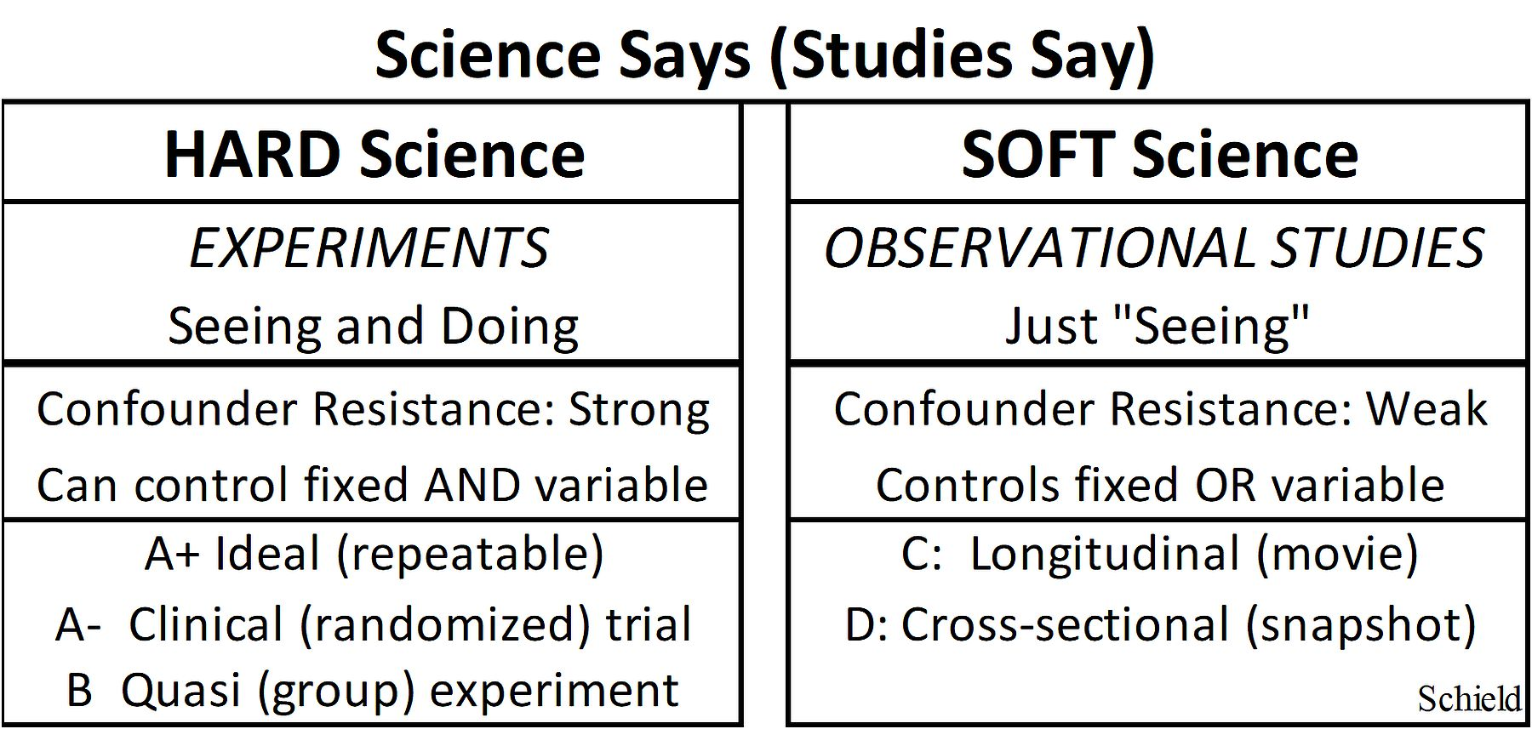
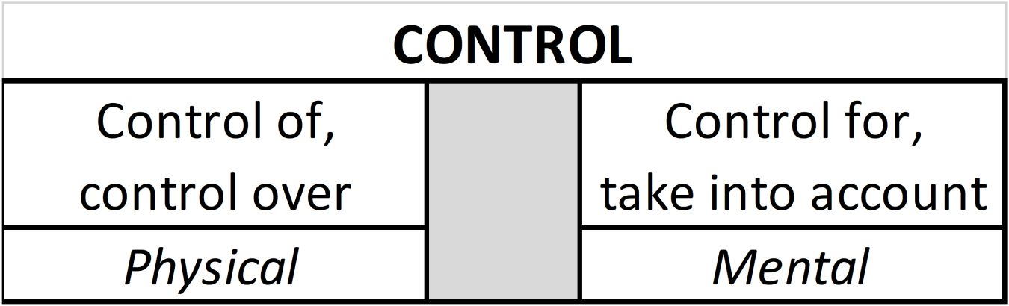
Study Design: Hard vs. Soft.
‘Control of’ versus ‘Control for’
C: Confounding
22
Notes:
Model Trendline Linear 2Y1X using Excel 2013
11/24/2013 V0a
www.StatLit.org/pdf/Model-Trendline-Linear-2Y1X-Excel2013-6up.pdf
22
Analyzing Numbers in the News
15 May 2008
2008SchieldNNN6up.pdf
22
22

Slide 23
Confounder Solutions
(Repeat)
C: Confounding
23
Confounder: Anything that provides an alternate explanation for an association.
Notes:
Model Trendline Linear 2Y1X using Excel 2013
11/24/2013 V0a
www.StatLit.org/pdf/Model-Trendline-Linear-2Y1X-Excel2013-6up.pdf
23
Analyzing Numbers in the News
15 May 2008
2008SchieldNNN6up.pdf
23
23

Slide 24
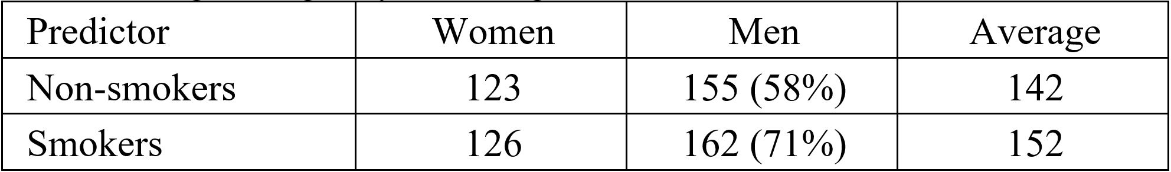
Mental Solution:
Control For/Selection
C: Confounding
24
Selection: simple way to control for the influence of a confounder. Convert mixed-fruit compare into an apples and apples comparison.
Notes:
Model Trendline Linear 2Y1X using Excel 2013
11/24/2013 V0a
www.StatLit.org/pdf/Model-Trendline-Linear-2Y1X-Excel2013-6up.pdf
24
Analyzing Numbers in the News
15 May 2008
2008SchieldNNN6up.pdf
24
24

Slide 25
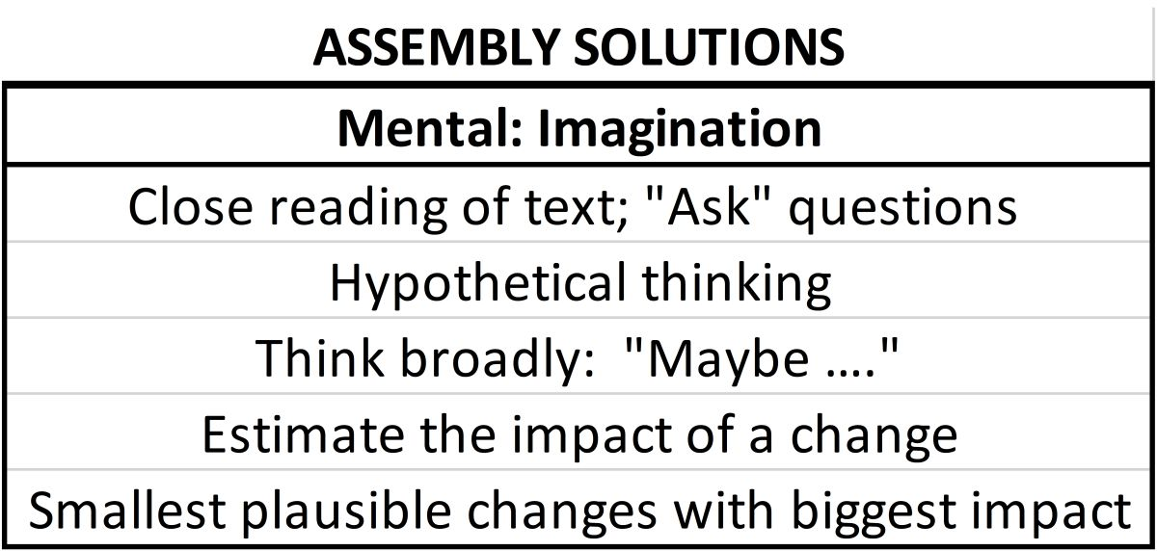
CARE:
2.5 Assembly “Solutions”
A: Assembly
25
Assembly: How things are selected, defined, counted, measured, grouped, and presented.
Notes:
Model Trendline Linear 2Y1X using Excel 2013
11/24/2013 V0a
www.StatLit.org/pdf/Model-Trendline-Linear-2Y1X-Excel2013-6up.pdf
25
Analyzing Numbers in the News
15 May 2008
2008SchieldNNN6up.pdf
25
25

Slide 26
Assembly “Solutions”:
Ask Questions
A: Assembly
26
How were things:
selected (included/excluded)?
defined, counted or measured?
compared?
What relevant factors:
were not controlled for?
could have been controlled for?
could have made a major difference
Notes:
Model Trendline Linear 2Y1X using Excel 2013
11/24/2013 V0a
www.StatLit.org/pdf/Model-Trendline-Linear-2Y1X-Excel2013-6up.pdf
26
Analyzing Numbers in the News
15 May 2008
2008SchieldNNN6up.pdf
26
26

Slide 27
Assembly “Solutions”:
Critical Thinking
A: Assembly
27
It takes a difference to explain a difference.
A variation over time cannot explain a difference at a given moment in time)
People getting taller cannot explain the height difference between men and women.
It takes a change to explain a change (over time).
Anything fixed can not explain a change.
Race and gender cannot explain a change,
but a change in culture for a race could.
Notes:
Model Trendline Linear 2Y1X using Excel 2013
11/24/2013 V0a
www.StatLit.org/pdf/Model-Trendline-Linear-2Y1X-Excel2013-6up.pdf
27
Analyzing Numbers in the News
15 May 2008
2008SchieldNNN6up.pdf
27
27

Slide 28
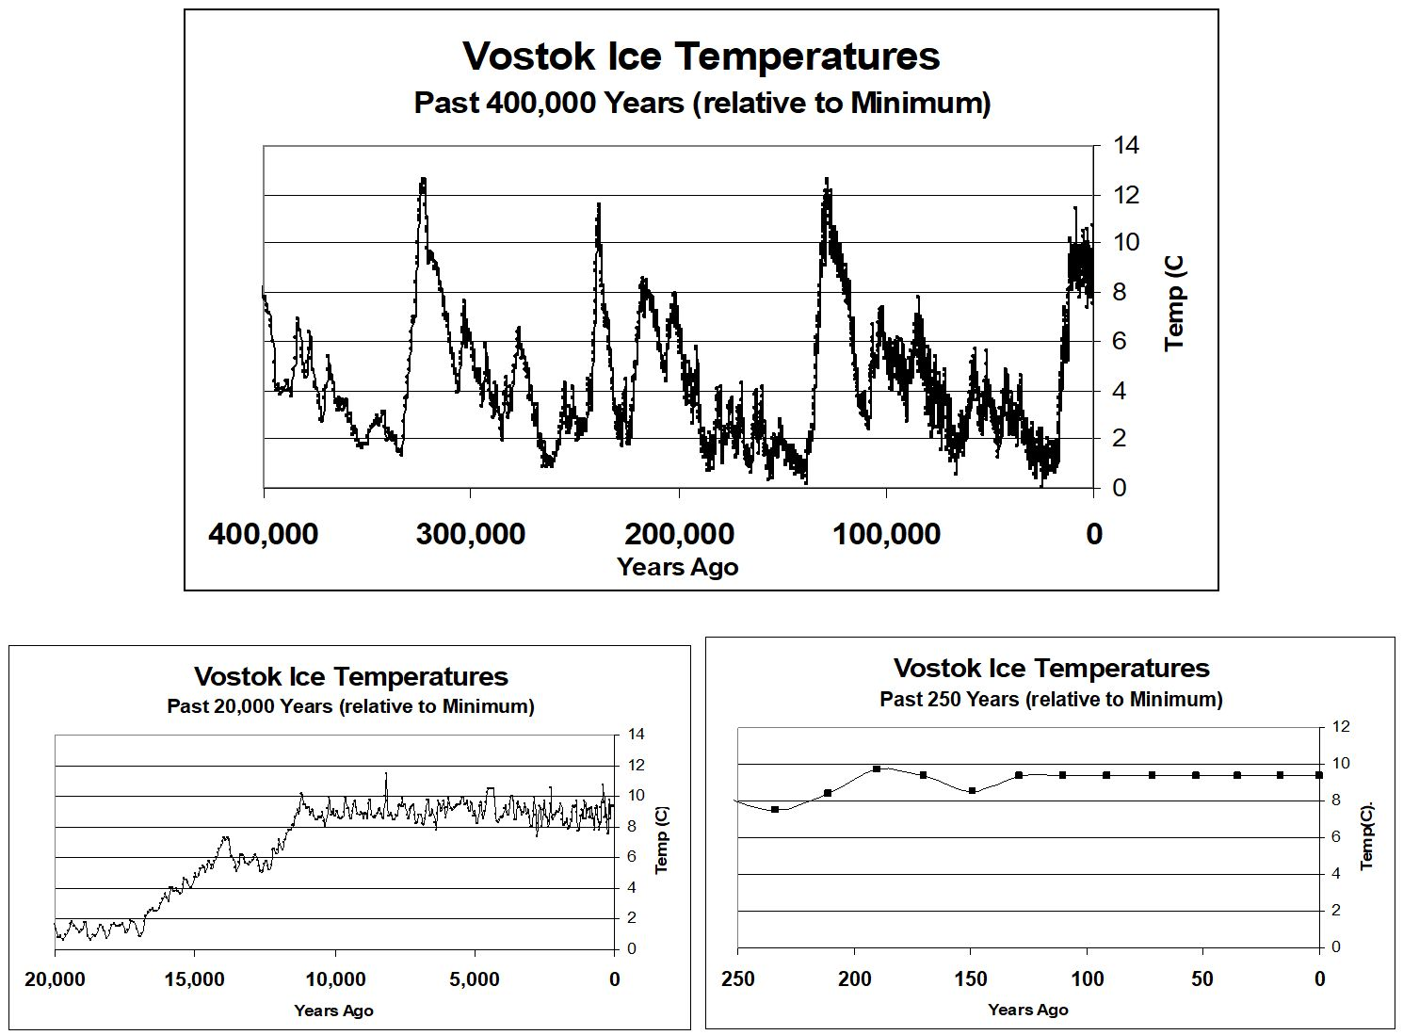
Assembly Example
A: Assembly
28
Notes:
Model Trendline Linear 2Y1X using Excel 2013
11/24/2013 V0a
www.StatLit.org/pdf/Model-Trendline-Linear-2Y1X-Excel2013-6up.pdf
28
Analyzing Numbers in the News
15 May 2008
2008SchieldNNN6up.pdf
28
28

Slide 29
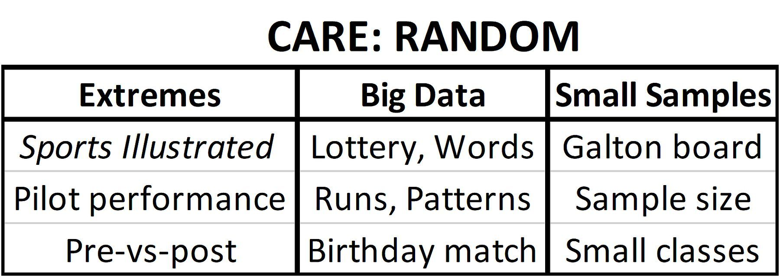
CARE:
2.6 Randomness Solutions:
R: Randomness
29
Randomness: variation where the next outcome is unpredictable (cannot make money gambling).
Notes:
Model Trendline Linear 2Y1X using Excel 2013
11/24/2013 V0a
www.StatLit.org/pdf/Model-Trendline-Linear-2Y1X-Excel2013-6up.pdf
29
Analyzing Numbers in the News
15 May 2008
2008SchieldNNN6up.pdf
29
29

Slide 30
2.6 Randomness Solutions:
2.6.1 Extremes
R: Randomness
30
Extremes (mental ‘solution’): Identify the situation (extremes) and look for regression to the mean. Chance explains the extreme, but luck seldom repeats.
Note: No calculation in ‘solving’ this
Notes:
Model Trendline Linear 2Y1X using Excel 2013
11/24/2013 V0a
www.StatLit.org/pdf/Model-Trendline-Linear-2Y1X-Excel2013-6up.pdf
30
Analyzing Numbers in the News
15 May 2008
2008SchieldNNN6up.pdf
30
30

Slide 31
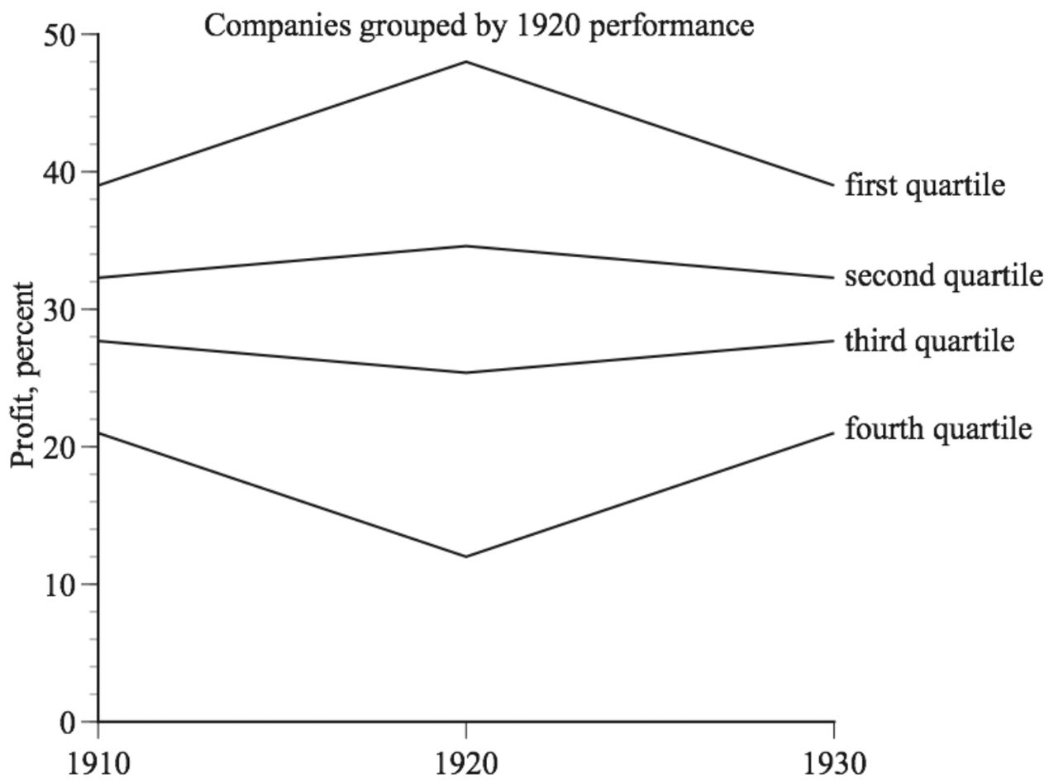
Randomness Solutions:
Coincidence explains Extremes
R: Randomness
31
Coincidence seldom repeats. Wait for it!
Notes:
Model Trendline Linear 2Y1X using Excel 2013
11/24/2013 V0a
www.StatLit.org/pdf/Model-Trendline-Linear-2Y1X-Excel2013-6up.pdf
31
Analyzing Numbers in the News
15 May 2008
2008SchieldNNN6up.pdf
31
31

Slide 32
2.6 Randomness Solutions:
2.6.2 Big Data
R: Randomness
32
Law of Very Large Data: If chance of success equal to 1/n, then success is ‘expected’ in n tries.
Big Data (mental ‘solution’): When the unlikely happens all too often, look for big data that is compressed into ‘small’ data. Recall the longest run when flipping coins or the unexpected matches in the Birthday problem.
Notes:
Model Trendline Linear 2Y1X using Excel 2013
11/24/2013 V0a
www.StatLit.org/pdf/Model-Trendline-Linear-2Y1X-Excel2013-6up.pdf
32
Analyzing Numbers in the News
15 May 2008
2008SchieldNNN6up.pdf
32
32

Slide 33
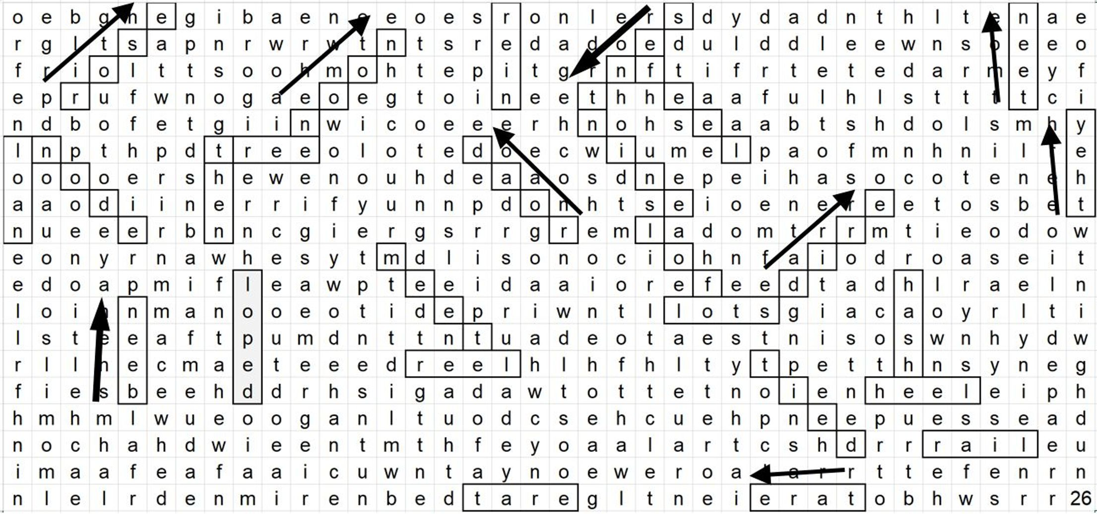
Randomness Solutions:
Laws of Very Large Numbers
R: Randomness
33
Coincidence explains rare outcomes in big data.
Rare outcomes are expected given enough tries.
Notes:
Model Trendline Linear 2Y1X using Excel 2013
11/24/2013 V0a
www.StatLit.org/pdf/Model-Trendline-Linear-2Y1X-Excel2013-6up.pdf
33
Analyzing Numbers in the News
15 May 2008
2008SchieldNNN6up.pdf
33
33

Slide 34
2.6 Small-Group Randomness:
0) Problem & Solution
R: Randomness
34
Problem: Does a difference in sample averages or proportions mean they came from different groups?
Or did they come from the same group and the sample differences are just due to randomness?
If the samples were obtained by random selection, we can tell.
If the difference in their sample averages (or proportions) is statistically significant, we can conclude that they came from different populations: the difference is real (scientifically).
What is statistical significance?
Notes:
Model Trendline Linear 2Y1X using Excel 2013
11/24/2013 V0a
www.StatLit.org/pdf/Model-Trendline-Linear-2Y1X-Excel2013-6up.pdf
34
Analyzing Numbers in the News
15 May 2008
2008SchieldNNN6up.pdf
34
34

Slide 35
2.6 Small-Group Randomness:
1) Statistical Significance
R: Randomness
35
Statistically significant result is unlikely: less than 5%.
Statistically significant random outcomes:
Run of 5 heads in 5 flips of a fair coin (1/32).
Same die face in 3 rolls of a 6-sided die (1/36)
If statistically significant, then likely due to something else: two groups (sampling); causation (experiment)
Statistically significant does not mean important!
Statistically insignificant: OK for low-stakes decisions
How can we tell if an outcome is statistically-significant?
Notes:
Model Trendline Linear 2Y1X using Excel 2013
11/24/2013 V0a
www.StatLit.org/pdf/Model-Trendline-Linear-2Y1X-Excel2013-6up.pdf
35
Analyzing Numbers in the News
15 May 2008
2008SchieldNNN6up.pdf
35
35

Slide 36
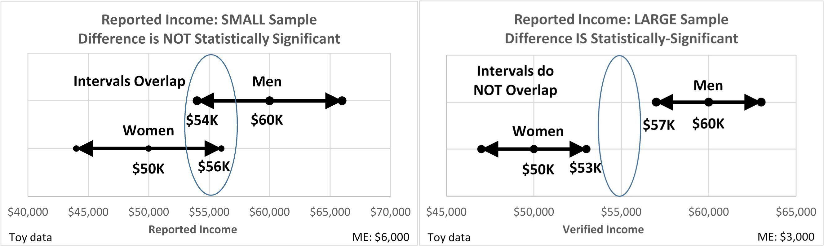
Randomness Solutions:
Confidence Intervals
R: Randomness
36
Difference in population means is statistically significant if confidence intervals do not overlap.
What are confidence intervals?
Notes:
Model Trendline Linear 2Y1X using Excel 2013
11/24/2013 V0a
www.StatLit.org/pdf/Model-Trendline-Linear-2Y1X-Excel2013-6up.pdf
36
Analyzing Numbers in the News
15 May 2008
2008SchieldNNN6up.pdf
36
36

Slide 37
2.6.3 Small-Group Randomness:
2) Confidence Intervals
R: Randomness
37
Confidence interval (absolute): interval that contains the population statistic 95% of the time in random samples.
Eq 2-1: Confidence interval: sample statistic ± margin Error
To generate a confidence interval (given a sample statistic and the margin of error), add margin of error (ME) to get the upper-right end. Subtract ME to get the lower left end.
What is margin of error (ME)?
Notes:
Model Trendline Linear 2Y1X using Excel 2013
11/24/2013 V0a
www.StatLit.org/pdf/Model-Trendline-Linear-2Y1X-Excel2013-6up.pdf
37
Analyzing Numbers in the News
15 May 2008
2008SchieldNNN6up.pdf
37
37

Slide 38
2.6.3 Small-Group Randomness:
3) 95% Margin of Error
R: Randomness
38
Margin of Error (ME): variation above [or below] the sample statistic expected 95% of time where expected means average in a large number of tries.
Why 95% accuracy? Why not 100%?
As accuracy increases, precision decreases.
100% accuracy range [0 to infinity] = 0% precision.
Counter-intuitive: Usually as accuracy↑ = precision↑.
Chose 95% accuracy as a balance with precision.
How do we get the margin of error (ME)?
Notes:
Model Trendline Linear 2Y1X using Excel 2013
11/24/2013 V0a
www.StatLit.org/pdf/Model-Trendline-Linear-2Y1X-Excel2013-6up.pdf
38
Analyzing Numbers in the News
15 May 2008
2008SchieldNNN6up.pdf
38
38

Slide 39
2.6 Small-Group Randomness:
4) Source of Margin of Error
R: Randomness
39
Margin of Error (ME) is normally shown at the end of a survey in this format: ± 3 percentage points or ± 3%
for a sample size of 1,024.
As sample size increases, margin of error decreases.
To cut margin of error in half: quadruple sample size.
Cutting sample size in half, increases ME by 41%.
Margin of Error can be calculated. Consult a statistician or take an introductory statistical inference course.
Notes:
Model Trendline Linear 2Y1X using Excel 2013
11/24/2013 V0a
www.StatLit.org/pdf/Model-Trendline-Linear-2Y1X-Excel2013-6up.pdf
39
Analyzing Numbers in the News
15 May 2008
2008SchieldNNN6up.pdf
39
39

Slide 40
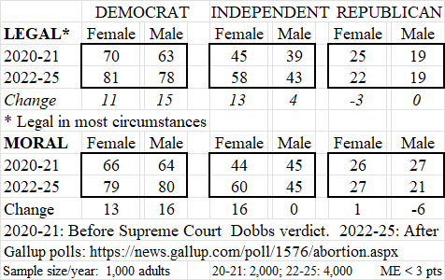
2.6 Small-Group Randomness:
Which differences are “real”?
R: Randomness
40
,
Notes:
Model Trendline Linear 2Y1X using Excel 2013
11/24/2013 V0a
www.StatLit.org/pdf/Model-Trendline-Linear-2Y1X-Excel2013-6up.pdf
40
Analyzing Numbers in the News
15 May 2008
2008SchieldNNN6up.pdf
40
40

Slide 41
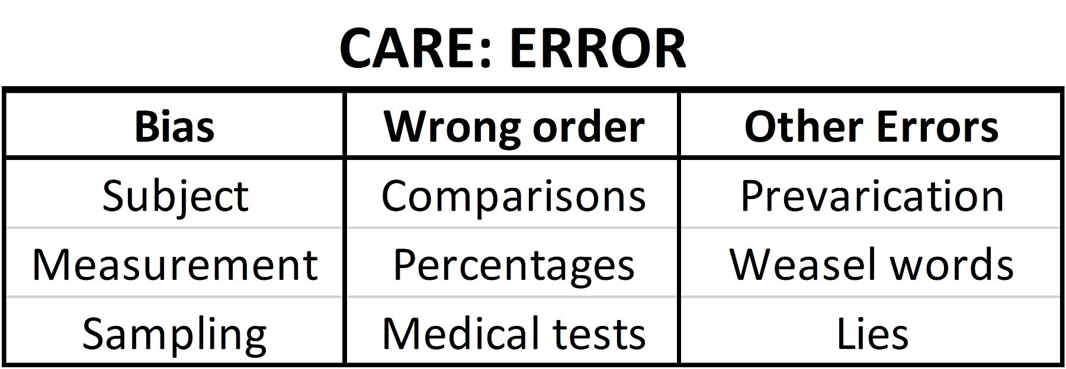
2.7 Error/Bias Influences:
Review of Problems
E: Error/Bias
41
Wrong order and Other Errors involve critical thinking (mental solutions). See Ch 4, 6 & 7.
There are physical solutions for Bias.
Notes:
Model Trendline Linear 2Y1X using Excel 2013
11/24/2013 V0a
www.StatLit.org/pdf/Model-Trendline-Linear-2Y1X-Excel2013-6up.pdf
41
Analyzing Numbers in the News
15 May 2008
2008SchieldNNN6up.pdf
41
41

Slide 42
Bias Review:
Synonyms
E: Error/Bias
42
Subject (respondent) bias
Acquiescence bias, social desirability
Sponsor bias, please the person asking
Measurement (researcher) bias
Instrument bias
Confirmation bias (select only what confirms)
Sampling bias.
Self-selection bias, non-response bias
Survivor bias, publication bias
Notes:
Model Trendline Linear 2Y1X using Excel 2013
11/24/2013 V0a
www.StatLit.org/pdf/Model-Trendline-Linear-2Y1X-Excel2013-6up.pdf
42
Analyzing Numbers in the News
15 May 2008
2008SchieldNNN6up.pdf
42
42

Slide 43
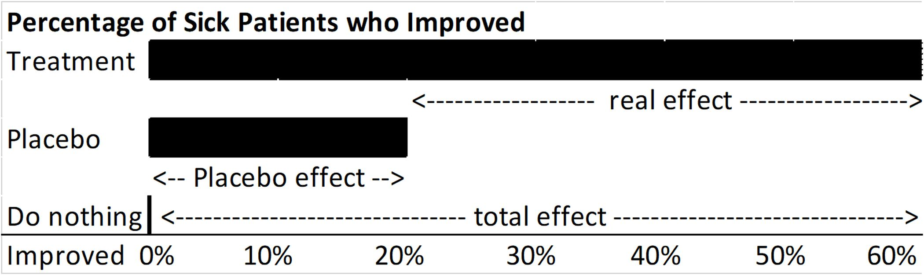
Subject-Bias Solution:
Single Blind: Placebo
E: Error/Bias
43
.
What is the effect of treatment: 60 point cure?
Placebo: a fake treatment! Mind is powerful!
What is the effect of treatment: 40 point cure.
To control subject bias: ‘blind’ the subject.
Notes:
Model Trendline Linear 2Y1X using Excel 2013
11/24/2013 V0a
www.StatLit.org/pdf/Model-Trendline-Linear-2Y1X-Excel2013-6up.pdf
43
Analyzing Numbers in the News
15 May 2008
2008SchieldNNN6up.pdf
43
43

Slide 44
Researcher-Bias Solution:
Double Blind Both
E: Error/Bias
44
To avoid researcher bias: blind the researcher
Blinding both the subject and the researcher is called a ‘double blind’ study.
Any study that involves living subjects and human researchers that could double blind and does not is immediately suspect of bias – if not of error.
Notes:
Model Trendline Linear 2Y1X using Excel 2013
11/24/2013 V0a
www.StatLit.org/pdf/Model-Trendline-Linear-2Y1X-Excel2013-6up.pdf
44
Analyzing Numbers in the News
15 May 2008
2008SchieldNNN6up.pdf
44
44

Slide 45
Sampling Bias Solution:
Random Selection or Assignment
E: Error/Bias
45
To avoid sampling bias in selecting, select subject randomly: random selection.
To avoid sampling bias in creating, assign the subjects randomly: random assignment. This statistically controls for pre-existing confounders. See clinical trials.
Note: Randomness can be both an unwanted influence (a problem) and a desired solution (random selection or random assignment).
Notes:
Model Trendline Linear 2Y1X using Excel 2013
11/24/2013 V0a
www.StatLit.org/pdf/Model-Trendline-Linear-2Y1X-Excel2013-6up.pdf
45
Analyzing Numbers in the News
15 May 2008
2008SchieldNNN6up.pdf
45
45

Slide 46
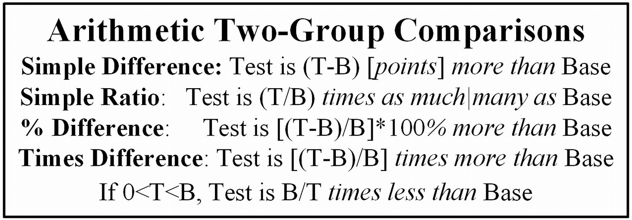
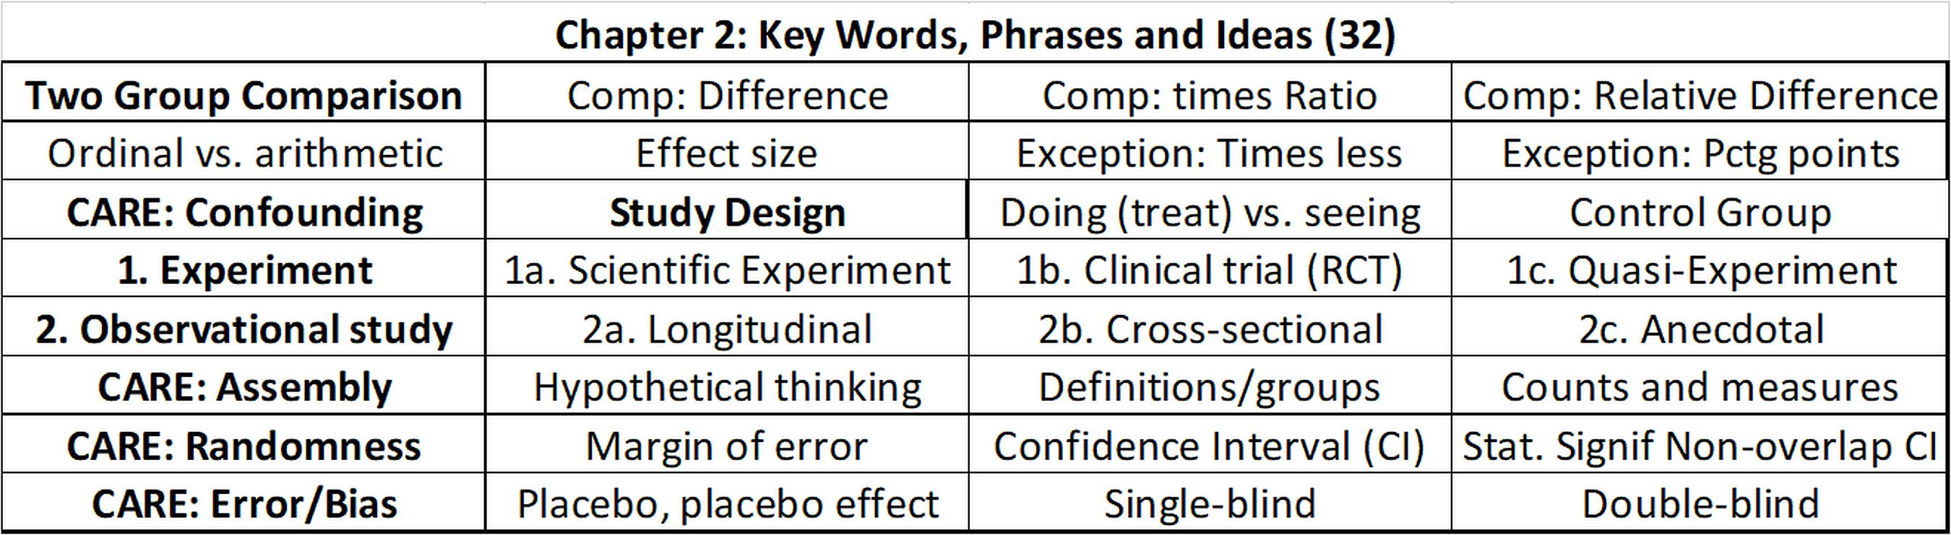
Chapter 2 Summary
46
.
Notes:
Model Trendline Linear 2Y1X using Excel 2013
11/24/2013 V0a
www.StatLit.org/pdf/Model-Trendline-Linear-2Y1X-Excel2013-6up.pdf
46
Analyzing Numbers in the News
15 May 2008
2008SchieldNNN6up.pdf
46
46

Slide 47
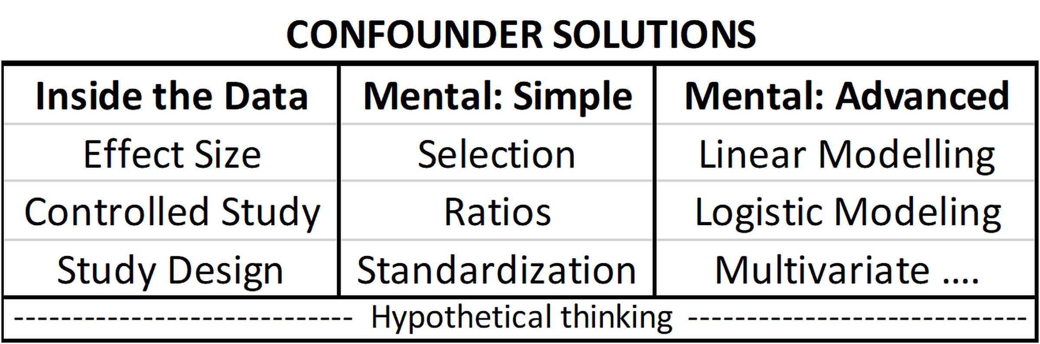
Optional: Confounder Solution
47
Includes mental advanced in Statistics courses.
Notes:
Model Trendline Linear 2Y1X using Excel 2013
11/24/2013 V0a
www.StatLit.org/pdf/Model-Trendline-Linear-2Y1X-Excel2013-6up.pdf
47
Analyzing Numbers in the News
15 May 2008
2008SchieldNNN6up.pdf
47
47

Slide 48
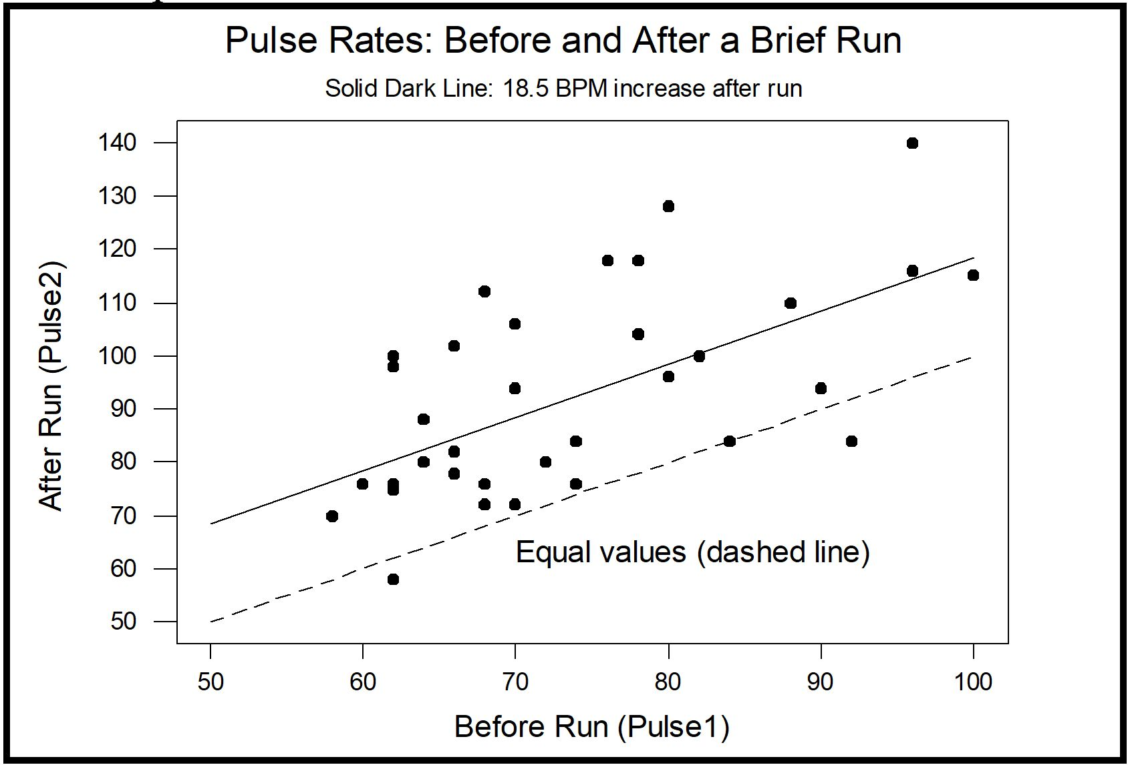
Quasi-Experiments
Running is assigned to some.
48
.
Notes:
Model Trendline Linear 2Y1X using Excel 2013
11/24/2013 V0a
www.StatLit.org/pdf/Model-Trendline-Linear-2Y1X-Excel2013-6up.pdf
48
Analyzing Numbers in the News
15 May 2008
2008SchieldNNN6up.pdf
48
48

Slide 49
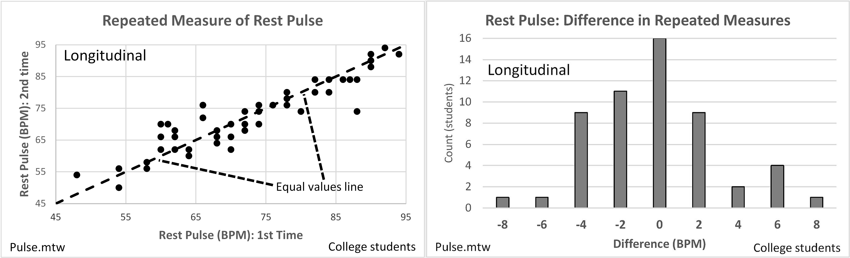
Observational study
Repeated Measures
49
Two ways to display repeated measures.
Educational psychology studies repeated measures.
Notes:
Model Trendline Linear 2Y1X using Excel 2013
11/24/2013 V0a
www.StatLit.org/pdf/Model-Trendline-Linear-2Y1X-Excel2013-6up.pdf
49
Analyzing Numbers in the News
15 May 2008
2008SchieldNNN6up.pdf
49
49

Slide 50
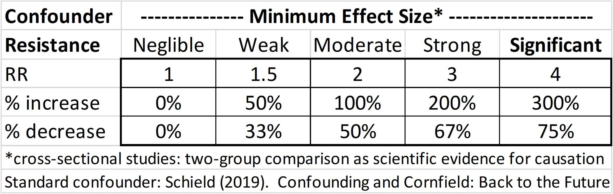
Confounder Resistance:
Effect Size
50
How big is ‘big’?
This model is arbitrary. Two kinds of arbitrary: Speed limit: 200 mph versus 75 mph.
Notes:
Model Trendline Linear 2Y1X using Excel 2013
11/24/2013 V0a
www.StatLit.org/pdf/Model-Trendline-Linear-2Y1X-Excel2013-6up.pdf
50
Analyzing Numbers in the News
15 May 2008
2008SchieldNNN6up.pdf
50
50

Slide 51
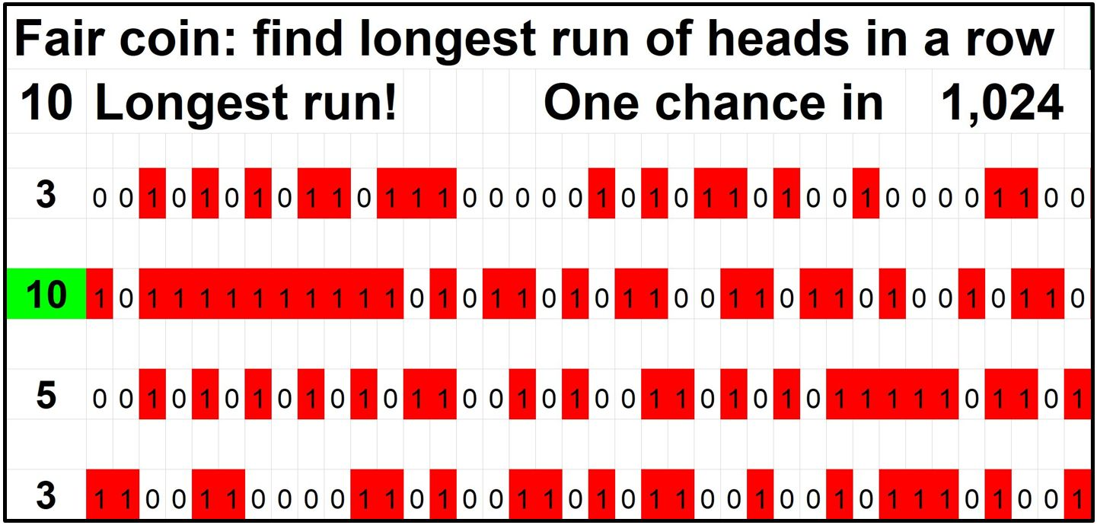
Randomness: Big Data
Run of Heads
51
www.statlit.org/Excel/2012Schield-Runs.xls
Notes:
Model Trendline Linear 2Y1X using Excel 2013
11/24/2013 V0a
www.StatLit.org/pdf/Model-Trendline-Linear-2Y1X-Excel2013-6up.pdf
51
Analyzing Numbers in the News
15 May 2008
2008SchieldNNN6up.pdf
51
51

Slide 52
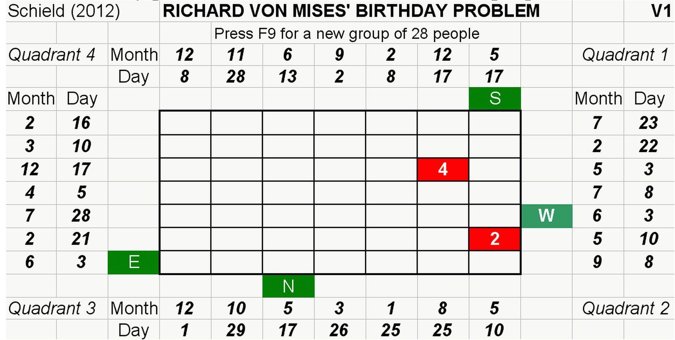
Randomness: Big Data
Birthday Problem
52
www.statlit.org/Excel/2012Schield-Bday.xls
Notes:
Model Trendline Linear 2Y1X using Excel 2013
11/24/2013 V0a
www.StatLit.org/pdf/Model-Trendline-Linear-2Y1X-Excel2013-6up.pdf
52
Analyzing Numbers in the News
15 May 2008
2008SchieldNNN6up.pdf
52
52

Slide 53
Birthday Problem:
28 People or More
53
>50% chance two people share same birthday.
Assume 12 months each with 30 days.
Expected* if there are 360 possible pairs.
*Due to Law of Large Numbers.
49 (7x7) pairs in each of 4 quadrants (~200)
49 (7x7) pairs in top-bottom and left-right (~100)
(6+5+4+3+2+1) with each of 4 sides (~80)
200+100+80 pairs > 360 pairs. QED.
Notes:
Model Trendline Linear 2Y1X using Excel 2013
11/24/2013 V0a
www.StatLit.org/pdf/Model-Trendline-Linear-2Y1X-Excel2013-6up.pdf
53
Analyzing Numbers in the News
15 May 2008
2008SchieldNNN6up.pdf
53
53

