Slide 1
Teaching Confounding:
Part 2
Milo Schield, Augsburg University
Fellow: American Statistical Association
Member: International Statistical Institute
US Rep: International Statistical Literacy Project
President National Numeracy Network
USCOTS 2021
June 26, 2021
www.StatLit.org/pdf/2021-Schield-USCOTS-Slides2.pdf
Notes:
StatLit for Managers
2013
2013Schield-MBAA
1
Analyzing Numbers in the News
15 May 2008
2008SchieldNNN6up.pdf
1
1
The 2016 update to the ASA GAISE guidelines is arguably the biggest change in the introductory course content since discrete math was dropped in the 1980s.

Slide 2
GAISE 2016
Add Multivariable Thinking
give "students experience with multivariable thinking"
understand “the possible impact of ... confounding"
See how "a third variable can change our understanding"
Help students "identify observational studies"
teach multivariate thinking "in stages" and
use "simple approaches (such as stratification)”
This change is HUGE! It may be the biggest content change since dropping combinations in the 1980s.
Notes:
StatLit for Managers
2013
2013Schield-MBAA
2
Analyzing Numbers in the News
15 May 2008
2008SchieldNNN6up.pdf
2
2
Understand the impact of confounding.
Identify observational studies.
Teach multivariate thinking “in stages”

Slide 3

GAISE 2016 Appendix B:
Observational Data
Multivariable thinking is critical to make sense of the observational data around us. The real world is complex and can’t be described well by one or two variables. [Italics added]
Notes:
StatLit for Managers
2013
2013Schield-MBAA
3
Analyzing Numbers in the News
15 May 2008
2008SchieldNNN6up.pdf
3
3
Appendix B is a must read for every statistical educator.
Notice the phrase “observational data”.
Observational data, confounding and multivariable thinking: these three represent a massive change in focus!

Slide 4
2016 GAISE Appendix B:
Closing Thoughts (1)
“Multivariable thinking is critical to make sense of the observational data around us. This type of thinking might be introduced in stages”:
Learn to identify observational studies
Why randomized assignment … improves things
Wary: cause-effect conclusions from observational data
Consider – and explain -- confounding factors
Simple approaches (stratification) to show confounding
http://www.amstat.org/education/gaise/collegeupdate/GAISE2016_DRAFT.pdf
Notes:
StatLit for Managers
2013
2013Schield-MBAA
4
Analyzing Numbers in the News
15 May 2008
2008SchieldNNN6up.pdf
4
4
This page alone is incredible.
Big three ideas: Observational studies, Confounding and multivariable thinking

Slide 5
2016 GAISE Appendix B
Closing Thoughts (2)
“If students do not have exposure to simple tools for disentangling complex relationships, they may dismiss statistics as an old-school discipline only suitable for small sample inference of randomized studies.”
“This report recommends that students be introduced to multivariable thinking, preferably early in the introductory course and not as an afterthought at the end of the course.”
Notes:
StatLit for Managers
2013
2013Schield-MBAA
5
Analyzing Numbers in the News
15 May 2008
2008SchieldNNN6up.pdf
5
5

Slide 6
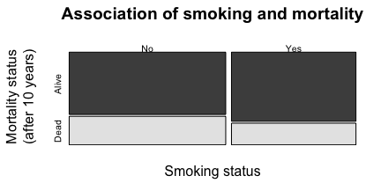
Show Multivariable
#1: Ekisogram
Show probabilities as areas:
Comparing height and width: not compelling.
Notes:
StatLit for Managers
2013
2013Schield-MBAA
6
Analyzing Numbers in the News
15 May 2008
2008SchieldNNN6up.pdf
6
6
First method is not intuitive

Slide 7
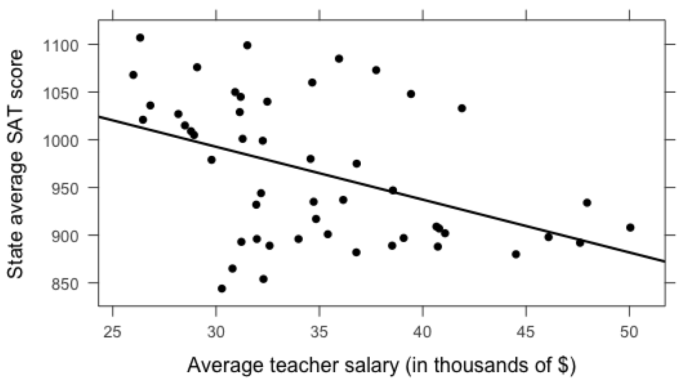
Show Multivariable:
#2: XY Plot (2 factors)
.
Notes:
StatLit for Managers
2013
2013Schield-MBAA
7
Analyzing Numbers in the News
15 May 2008
2008SchieldNNN6up.pdf
7
7
Second method starts with a simple two-variable XY-plot.
As average teacher salary increases, state average SAT decreases.
To increase student SATs, cut teacher salaries.

Slide 8
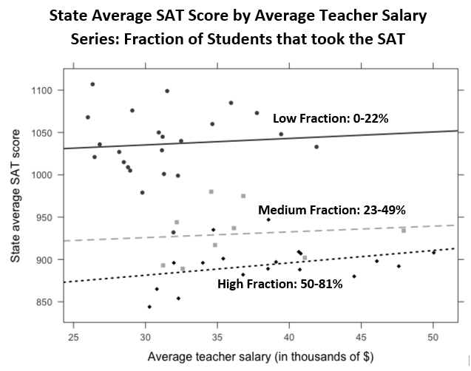
GAISE 2016
Multivariable Thinking
.
Notes:
StatLit for Managers
2013
2013Schield-MBAA
8
Analyzing Numbers in the News
15 May 2008
2008SchieldNNN6up.pdf
8
8
Second method involves modeling separate series in that same XY plot.
The confounder is the percentage of students that took the SAT.
Consider the top “low-fraction” group.
Most students in the Midwest and the South take the ACT – not the SAT.
Only the best students take the SAT in applying to colleges on the East or West coast.
Being in the Midwest and the South, their teacher salaries are lower.
They cluster in the upper-left corner.
Consider the bottom “high fraction” group.
Most students on the East and West coast take the SAT.
These students include the best, the middle and the below-average.
Their average SAT is lower.
Being on the coasts, their teacher salaries are higher.
They cluster in the lower right corner.
Controlling for the percentage taking the SAT changes the association between teacher salaries and average student scores.

Slide 9
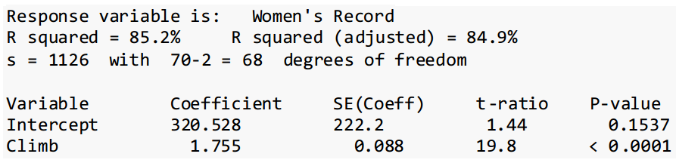
#3 Show Multivariable
Regression X-Y Output
Scottish Hill Races (Time in seconds)
Assumes that all modelling assumptions are satisfied
Assumes that all coefficients are statistically significant.
http://www.scottishhillracing.co.uk/
Notes:
StatLit for Managers
2013
2013Schield-MBAA
9
Analyzing Numbers in the News
15 May 2008
2008SchieldNNN6up.pdf
9
9
The third recommended method is to read and interpret computer output.
This output shows the relationship between climb distance and total time in Scottish Hill Races.
An additional 1.8 seconds for every additional meter of hill climb.
This model omits the length of the race – an important factor in predicting race time.

Slide 10
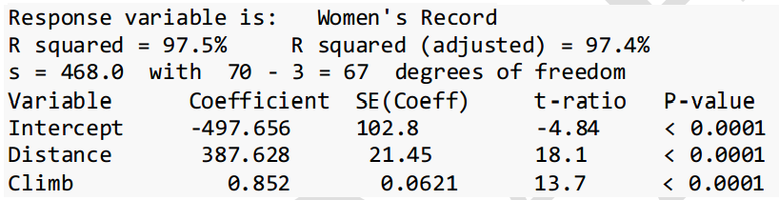
#3 Show Multivariate:
Regression X1-X2-Y Output
Scottish Hill Races (Time in seconds)
Controlling for Distance decreases Climb coefficient
from 1.755 to 0.852; increases R² from 85% to 97%.
Notes:
StatLit for Managers
2013
2013Schield-MBAA
10
Analyzing Numbers in the News
15 May 2008
2008SchieldNNN6up.pdf
10
10
This model includes both Climb and Distance.
Including distance cuts the climb coefficient from 1.8 to 0.8 seconds per meter.
Here controlling for a confounder “reduced that observed association.”

Slide 11
Problems with these Three Techniques
Do these visualizations “explain” confounding?
Can students use these to work problems with numerical answers?
Will this be on the final?
If all three answers are “No”, teachers are unlikely to spend much time showing multivariable thinking on observational data.
The GAISE 2016 update may be DOA:
Dead on Arrival ☹
Notes:
StatLit for Managers
2013
2013Schield-MBAA
11
Analyzing Numbers in the News
15 May 2008
2008SchieldNNN6up.pdf
11
11

Slide 12
Today’s students want to engage in social issues
12
Most social issues involve social statistics:
counts and ratios (averages, percents & rates)
Most ratio (per) statistics are still crude statistics: they don’t take anything else into account.
To really understand ‘per’ statistics, students need to see how to control for per confounders.
Students get engaged in “seeing” there may be
“a story behind the statistics”.
Notes:
Analyzing Numbers in the News
15 May 2008
2008SchieldNNN6up.pdf
12
12
There is a lot going on in this page!
Standardize count comparisons by comparing per ratios.

Slide 13
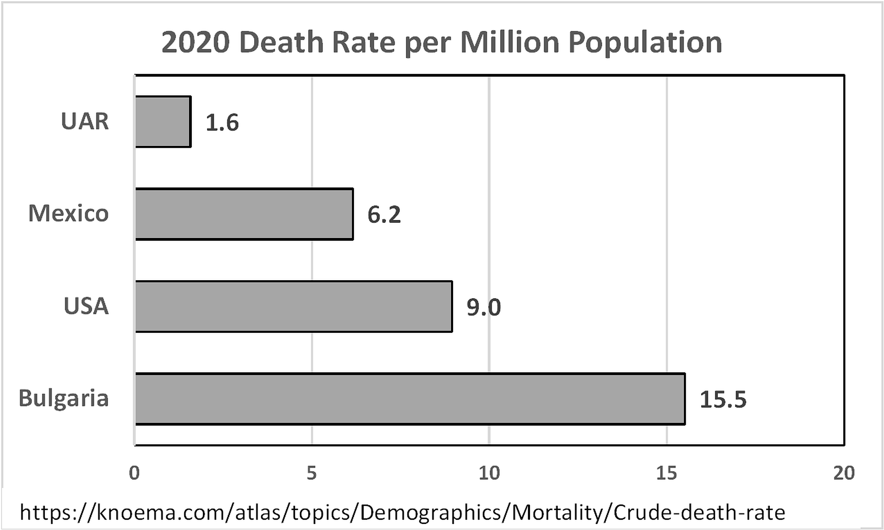
Most Social Statistics are Observational Statistics
13
This is an opportunity for hypothetical thinking!
Notes:
Analyzing Numbers in the News
15 May 2008
2008SchieldNNN6up.pdf
13
13

Slide 14
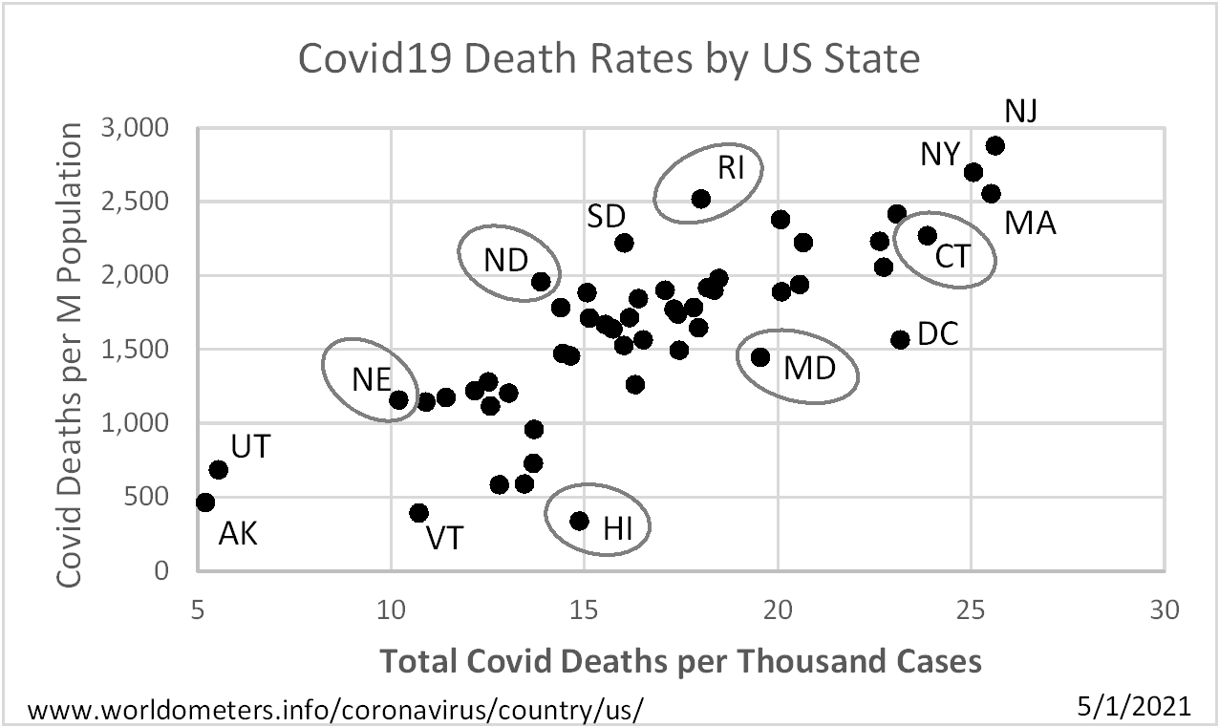
Observational Statistics:
Covid19 Death Rates: RI vs CT
14
RI: lower per case (horiz), higher per capita (vert)
Notes:
Analyzing Numbers in the News
15 May 2008
2008SchieldNNN6up.pdf
14
14

Slide 15
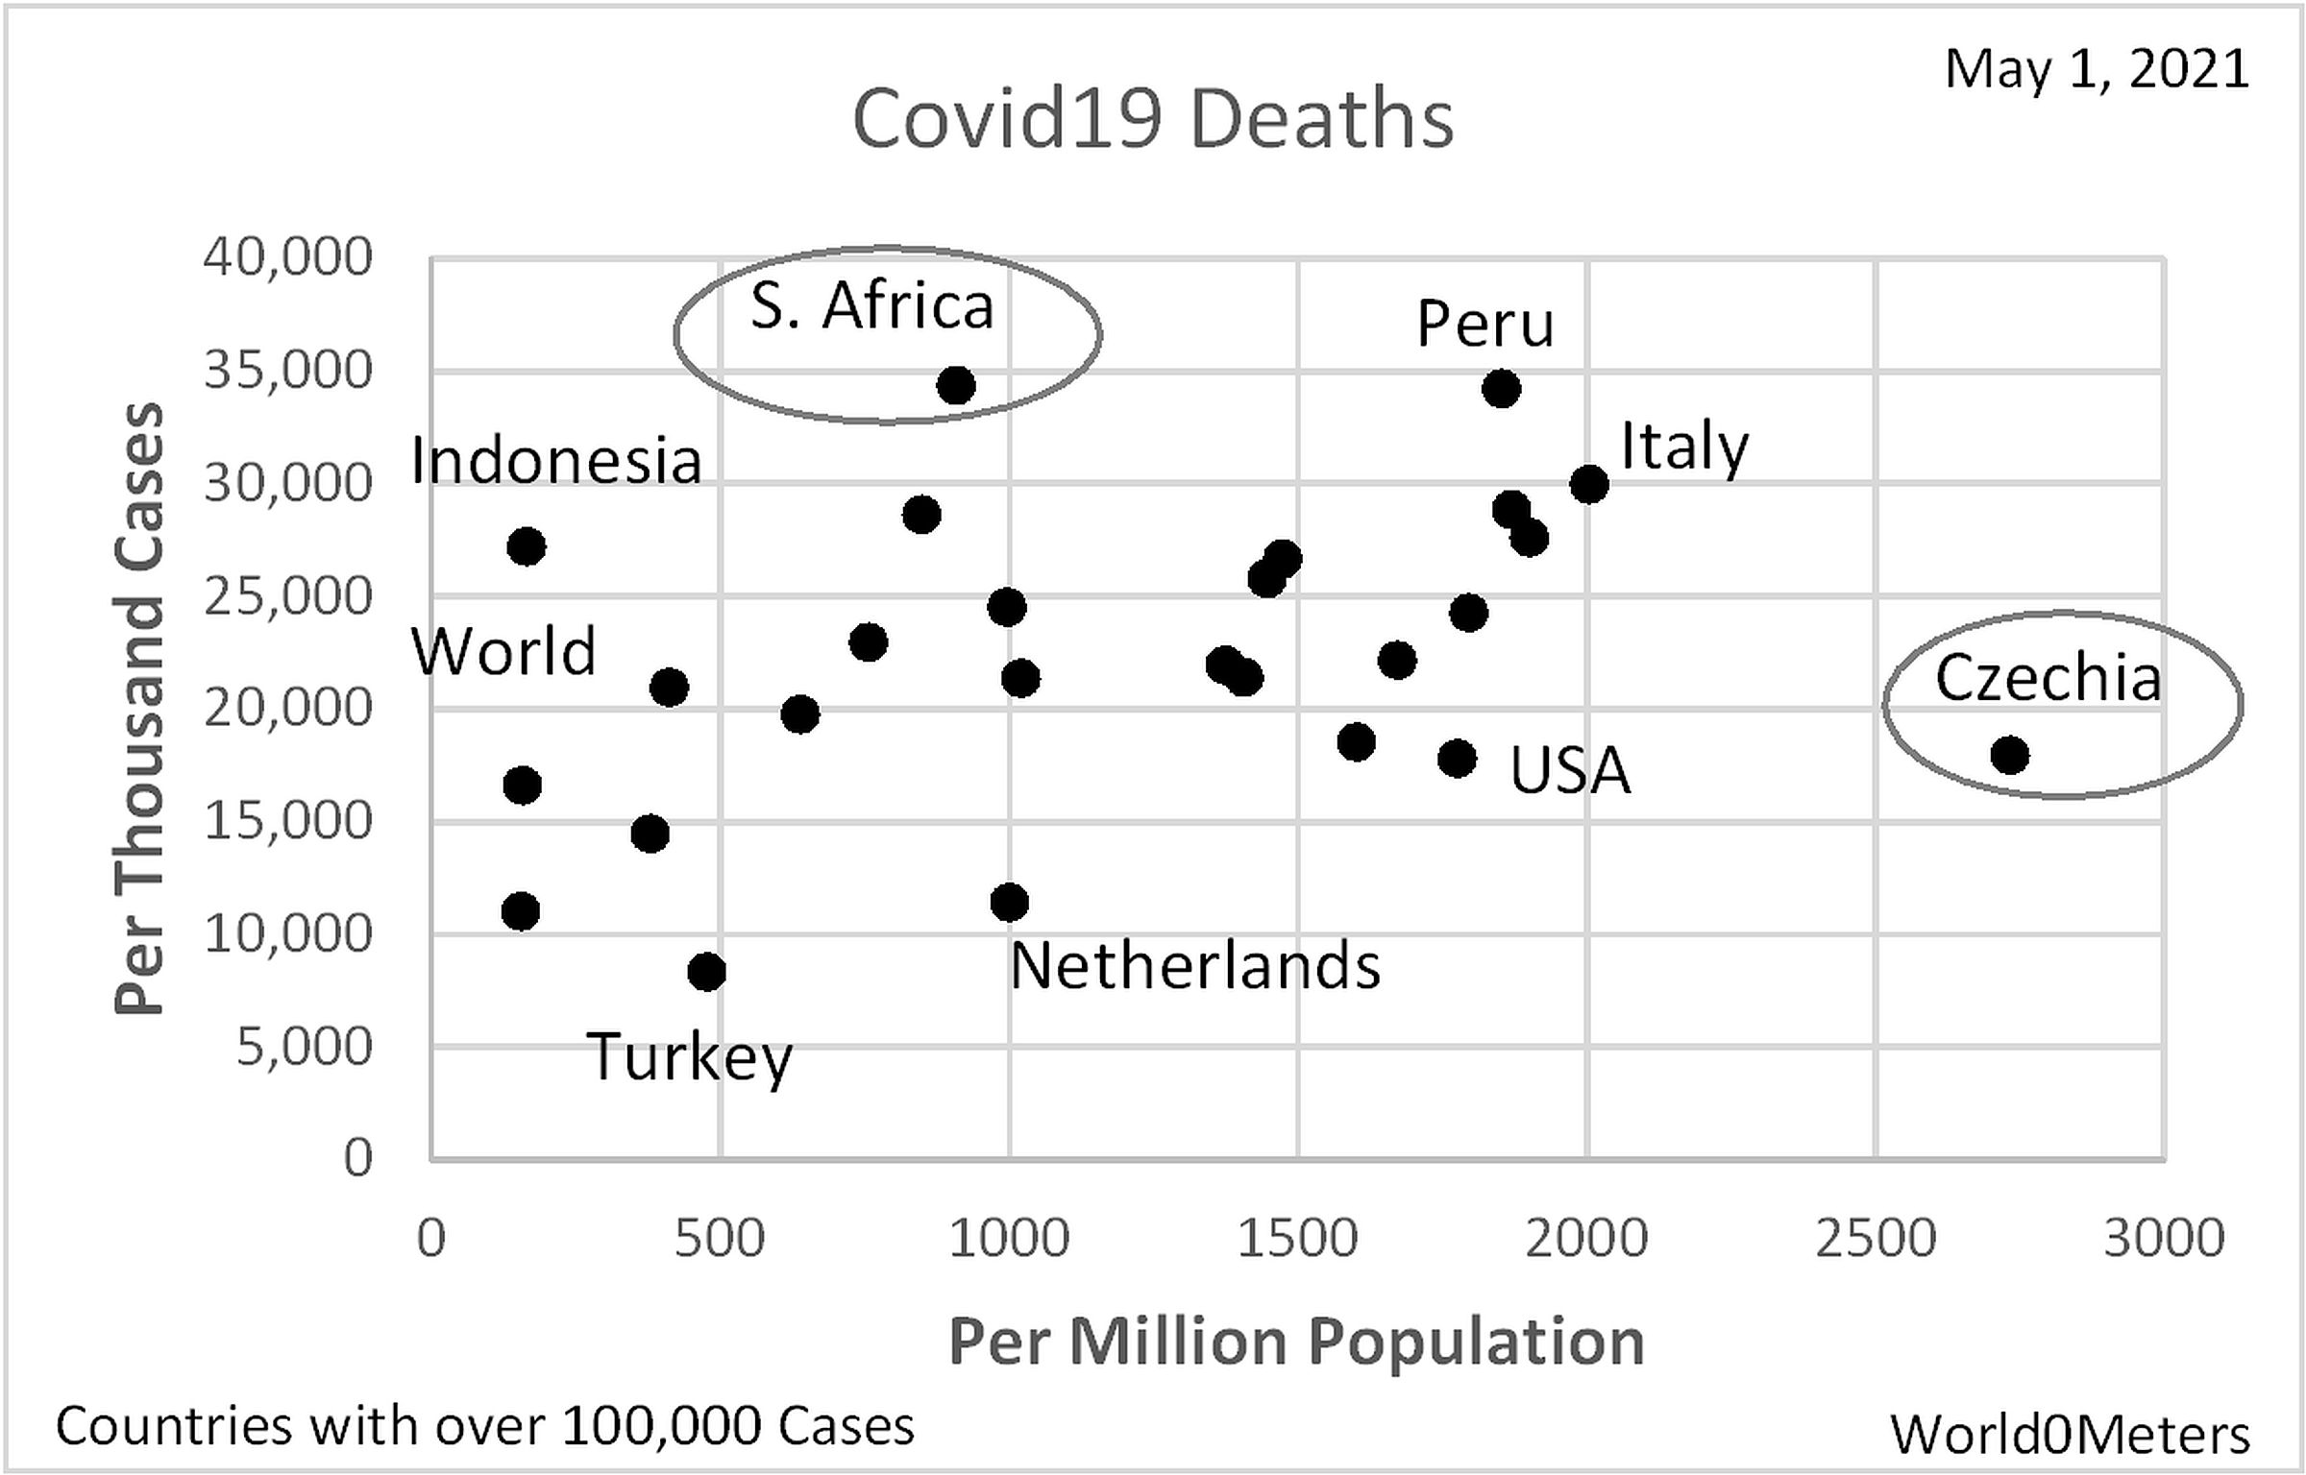
Compare Covid Death Rates:
South Africa with Czechia
15
SA: lower per capita (horiz.); higher per case (vert.)
Notes:
Analyzing Numbers in the News
15 May 2008
2008SchieldNNN6up.pdf
15
15

Slide 16
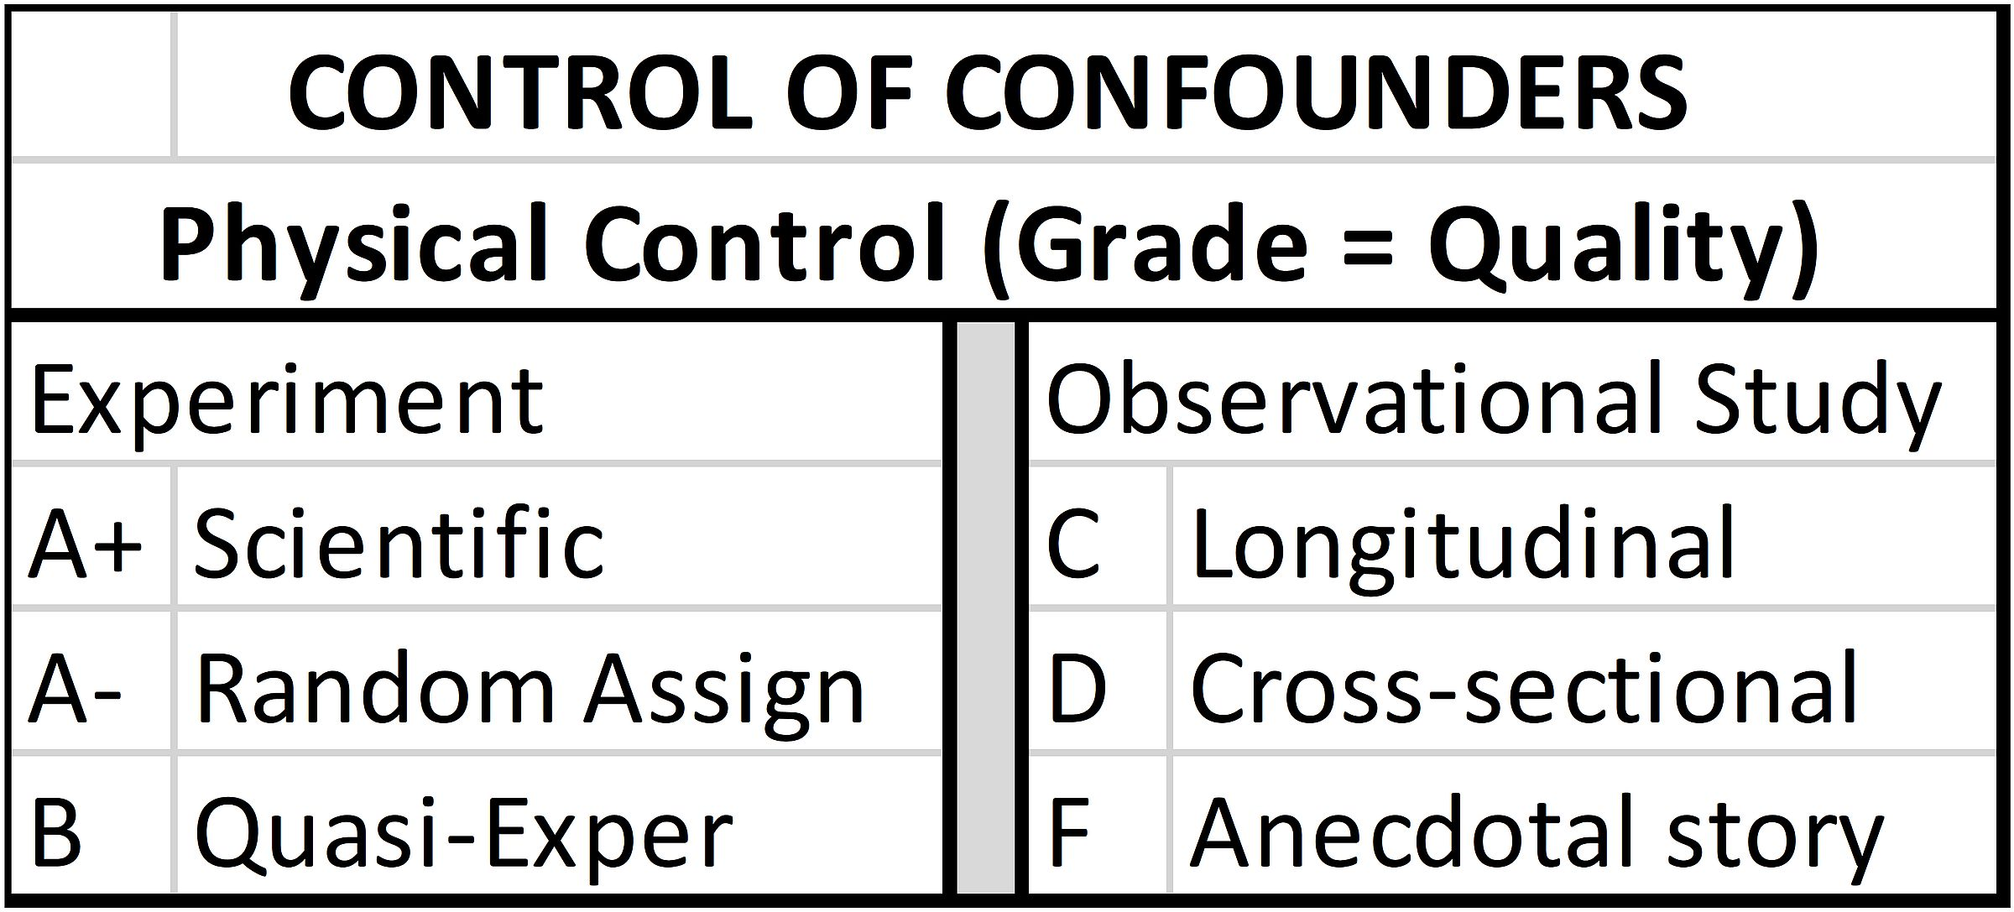
Confounder Solutions:
Effect Size and Study Design
16
.
Notes:
Analyzing Numbers in the News
15 May 2008
2008SchieldNNN6up.pdf
16
16

Slide 17
“Taking into Account”:
“Controlling FOR”: Mental
17
Computer methods: Powerful, but may obscure.
Manual methods are easy to do (weighted average) and can “show” students the key ideas (graphical).
Notes:
Analyzing Numbers in the News
15 May 2008
2008SchieldNNN6up.pdf
17
17

Slide 18
Standardizing Ratios:
MV Analysis w/o Software
18
Standardizing converts a crude comparison* of averages, rates or percents into a adjusted comparison.
* a mixed fruit -- apples and oranges -- comparison
Standardizing adjusts the weights: the mix!
Standardizing with a binary confounder can be:
Algebraic: categorical predictor
Graphical: binary predictor
Notes:
Analyzing Numbers in the News
15 May 2008
2008SchieldNNN6up.pdf
18
18

Slide 19
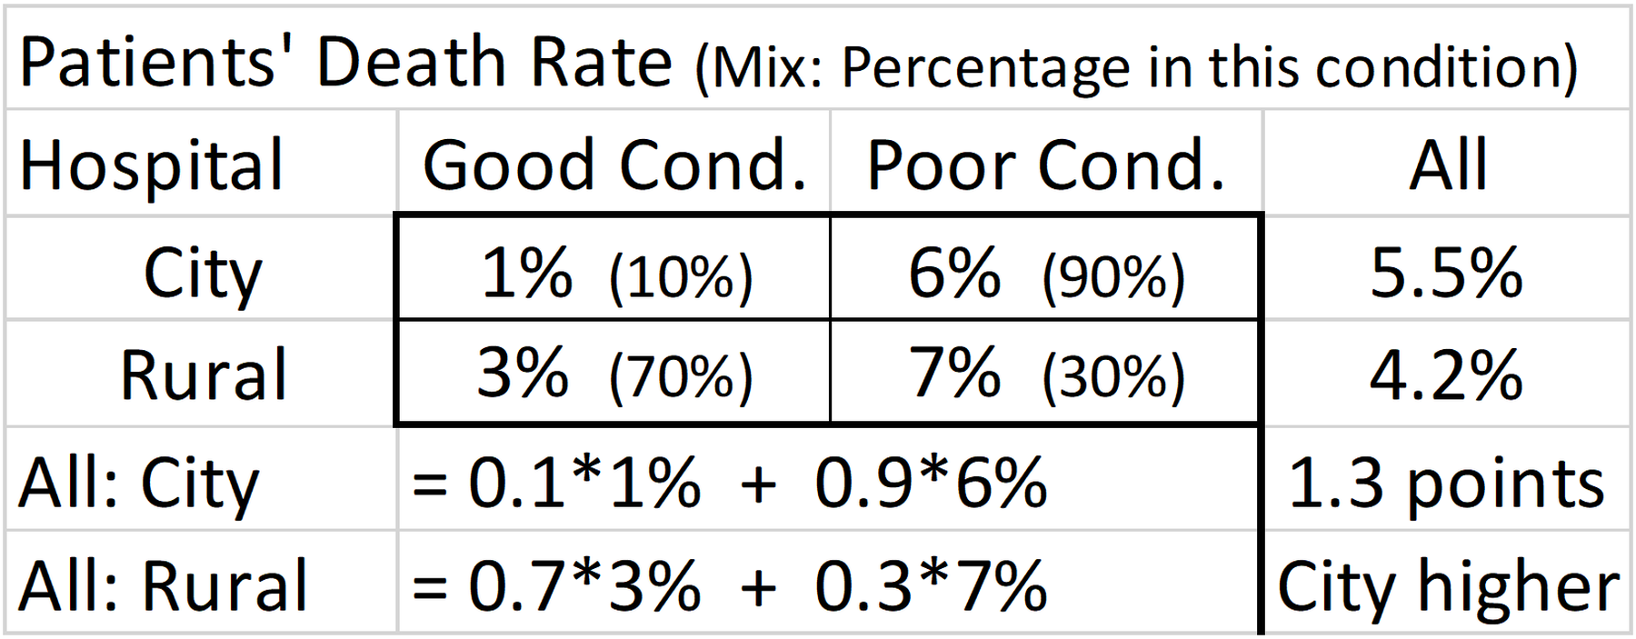
Hospital Death Rates:
Crude Comparison
19
Mixed-fruit Comparison
Notes:
Analyzing Numbers in the News
15 May 2008
2008SchieldNNN6up.pdf
19
19

Slide 20
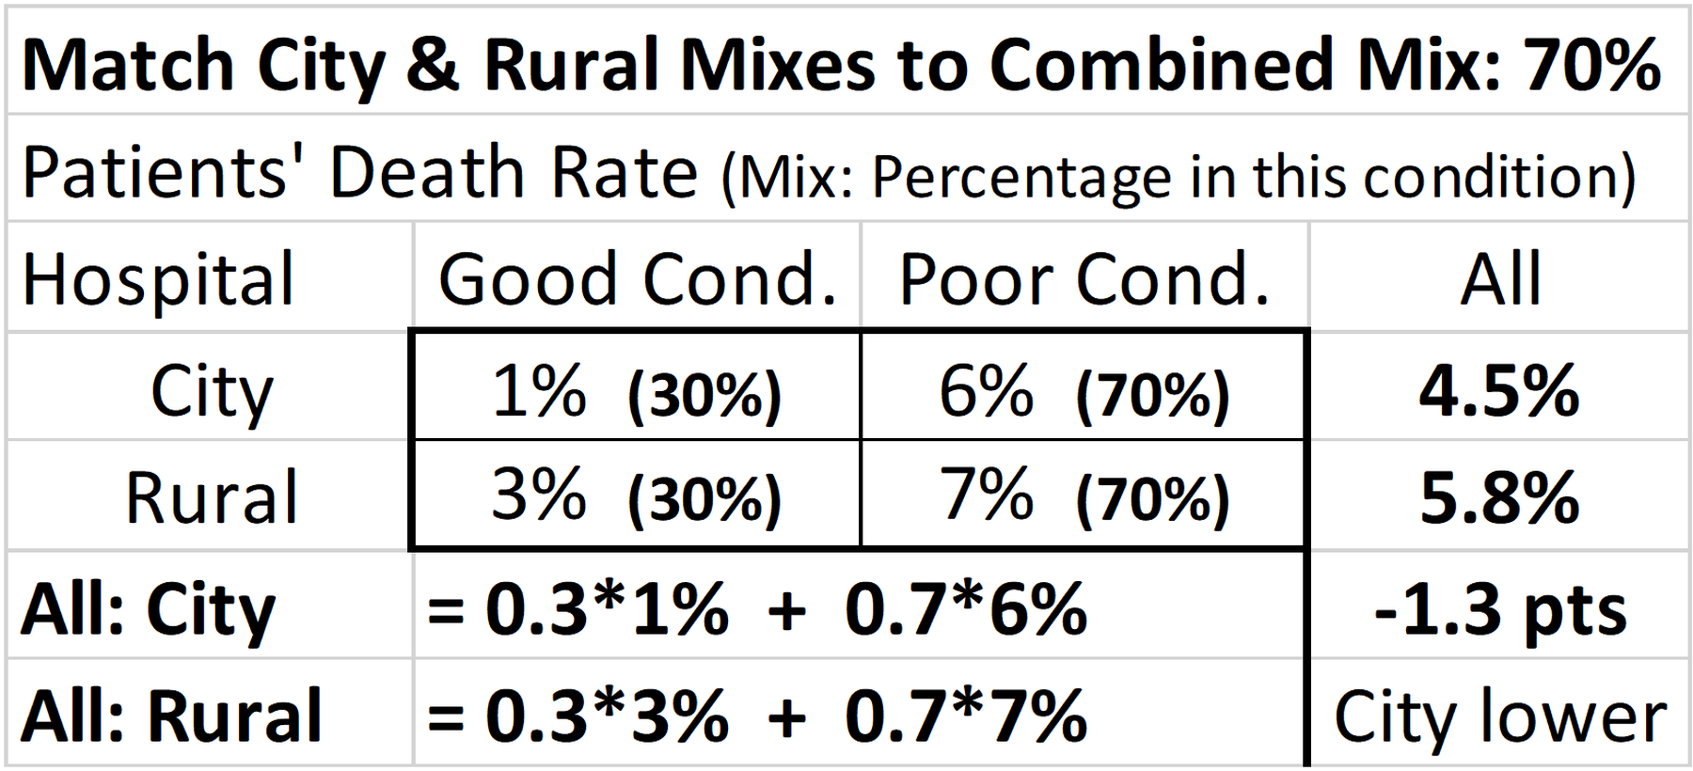
Combined Mix: Algebra #2A:
Adjust All Mixes to Combined
20
Standardized (adjusted) for patient mix.
Notes:
Analyzing Numbers in the News
15 May 2008
2008SchieldNNN6up.pdf
20
20

Slide 21
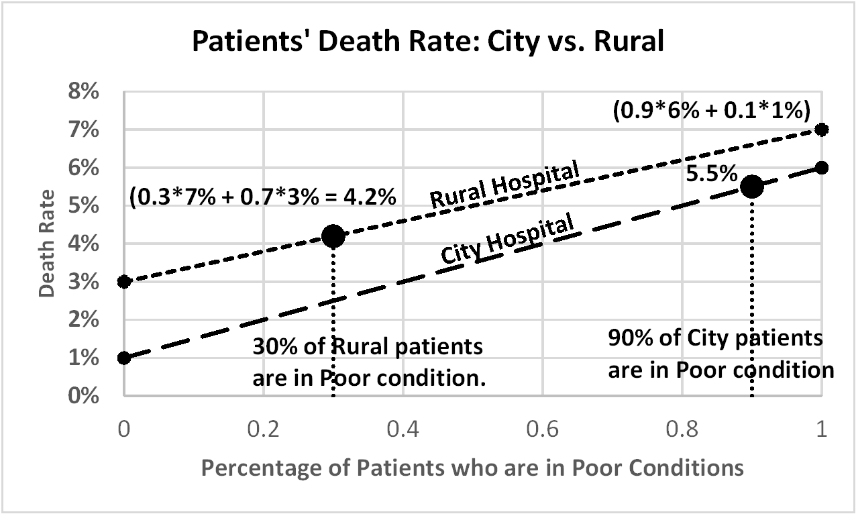
Combined Mix: Graph #2G:
Adjust All Mixes to Combined
21
.
Notes:
Analyzing Numbers in the News
15 May 2008
2008SchieldNNN6up.pdf
21
21

Slide 22
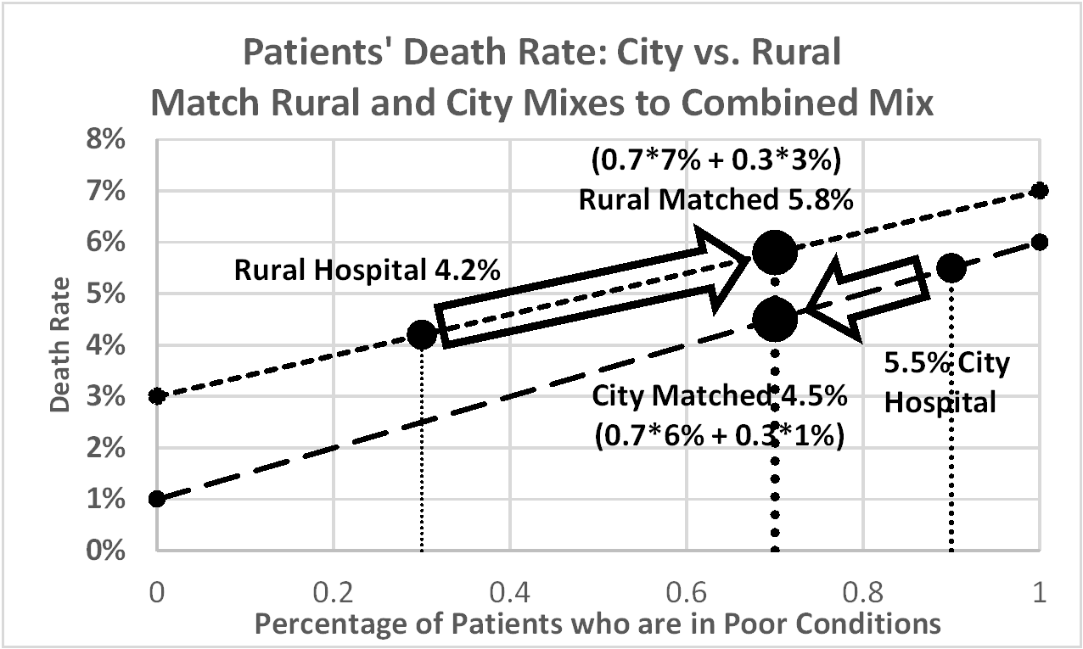
Combined Mix: Graph #2G:
Adjust All Mixes to Combined
22
.
Notes:
Analyzing Numbers in the News
15 May 2008
2008SchieldNNN6up.pdf
22
22

Slide 23
What about
Race-Based Statistics?
23
Consider 1994 US family incomes by race:
$55K for white families
$33K for black families
This $22K black-white income gap is HUGE.
Could it be due to racism? Certainly.
Does this disparity
demonstrate the influence of racism? Maybe
prove discrimination (racism)? No
Source: www.statlit.org/pdf/2006SchieldSTATS.pdf
Notes:
Analyzing Numbers in the News
15 May 2008
2008SchieldNNN6up.pdf
23
23

Slide 24
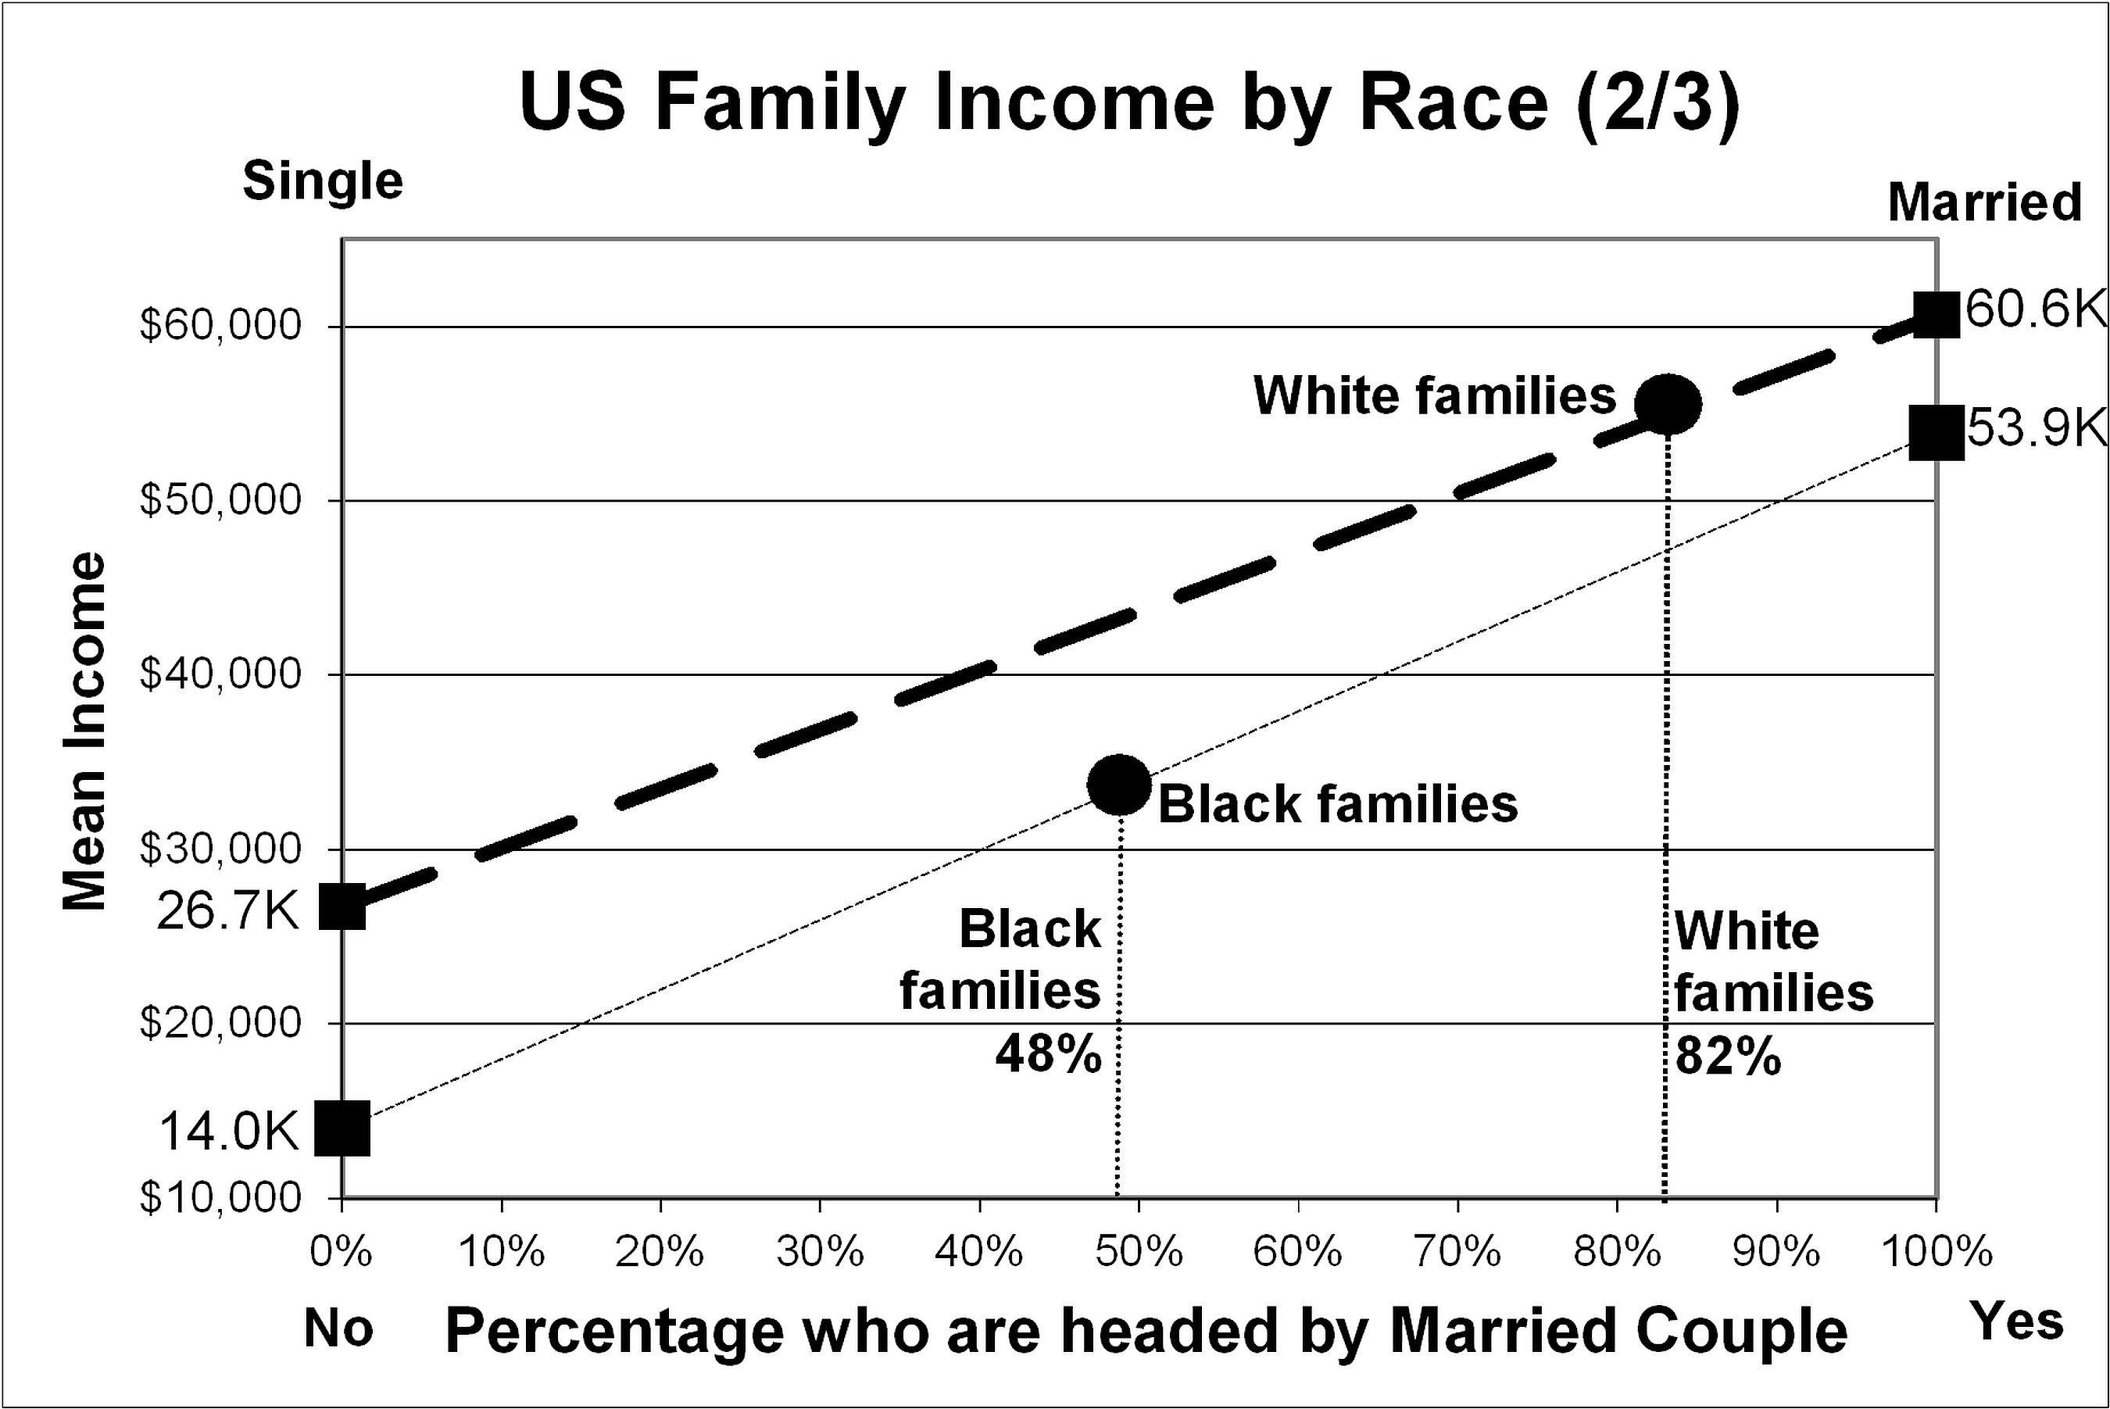
Family Income:
White (55k) versus Black (33k)
24
.
Notes:
Analyzing Numbers in the News
15 May 2008
2008SchieldNNN6up.pdf
24
24

Slide 25
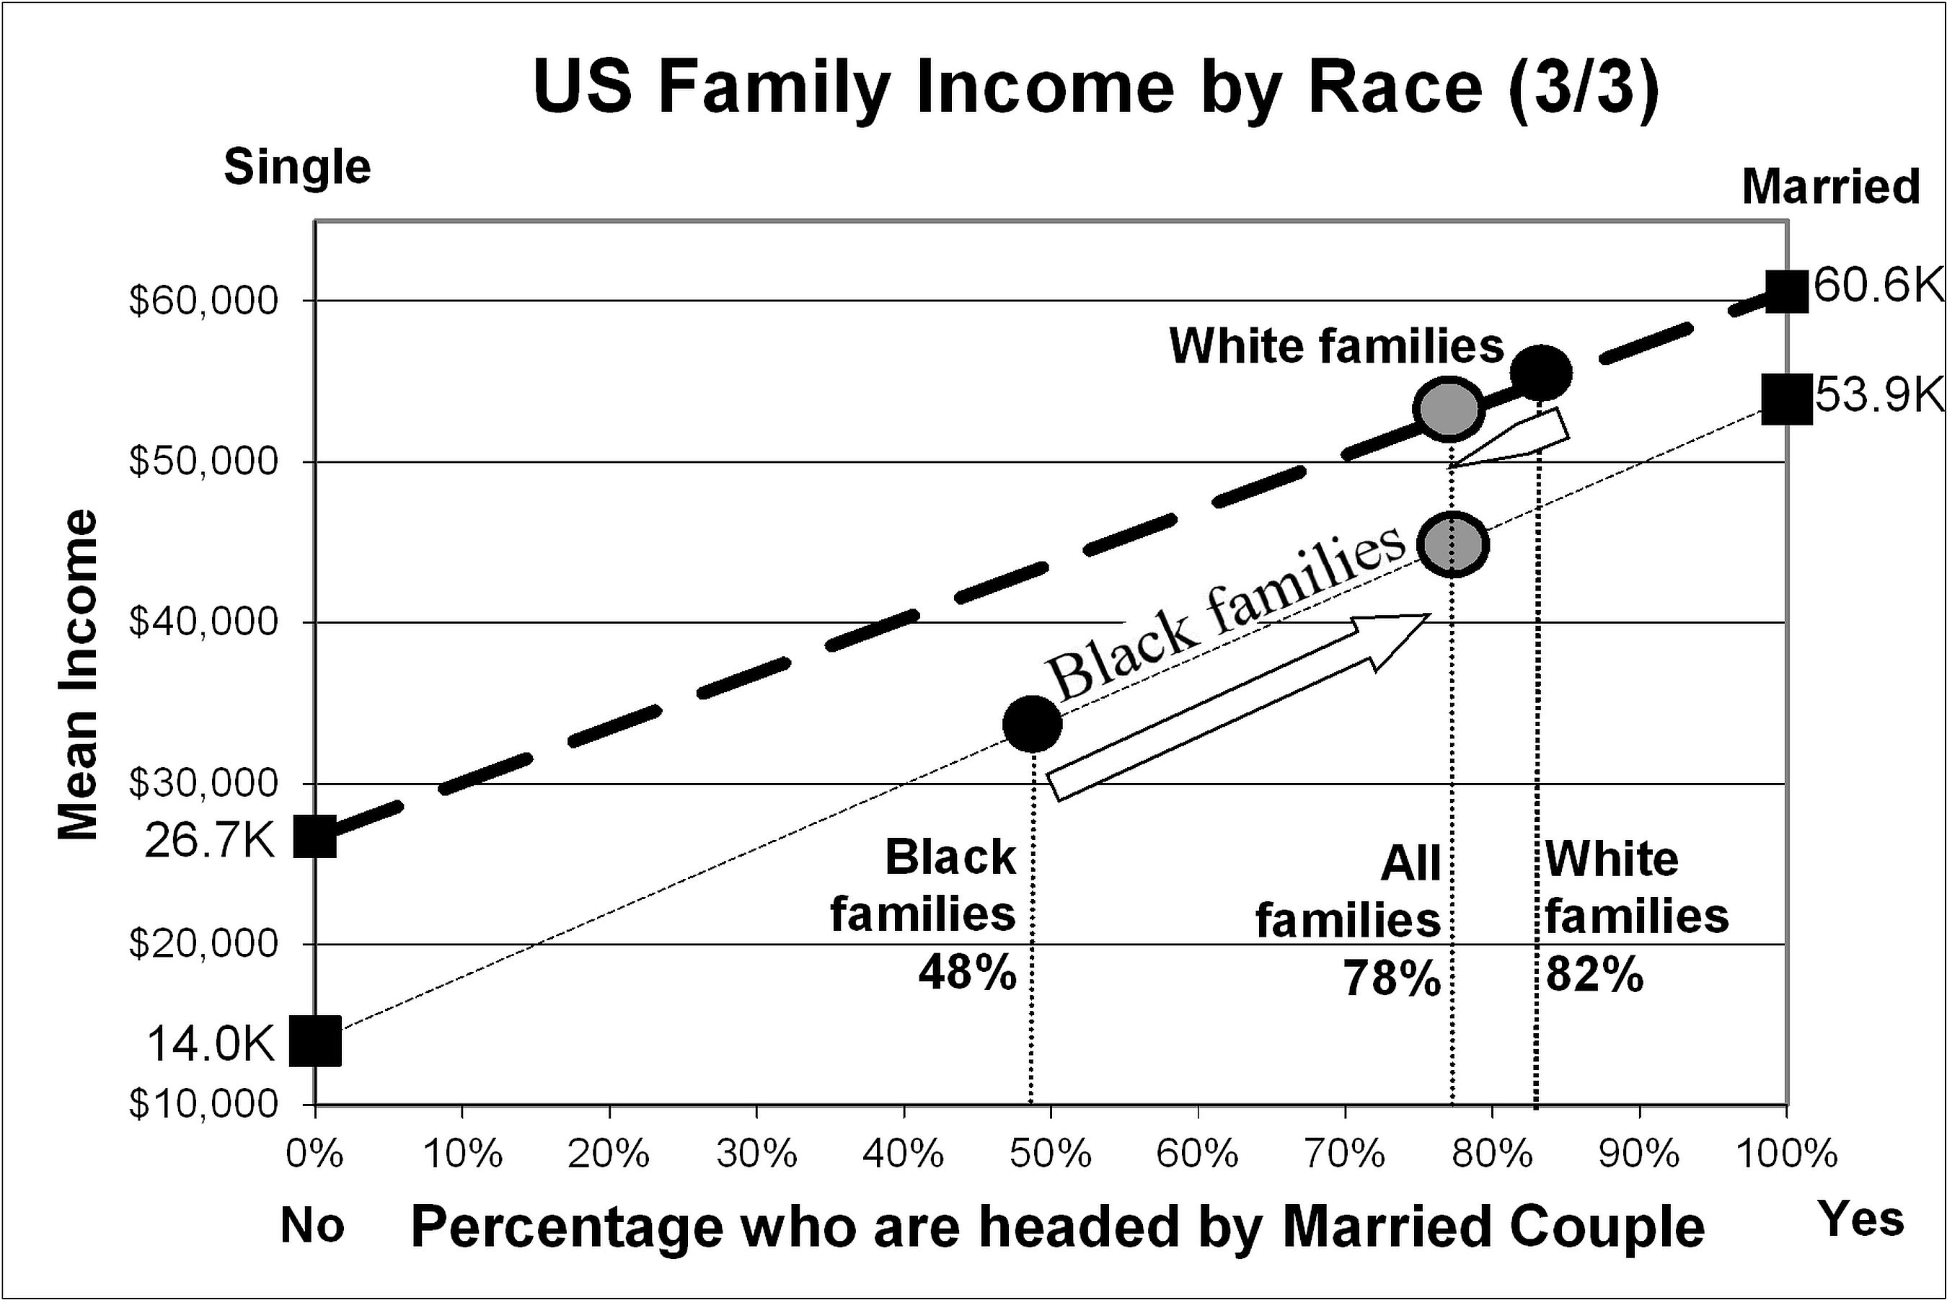
Family Income Standardized:
White (53k) versus Black (45k)
25
.
Notes:
Analyzing Numbers in the News
15 May 2008
2008SchieldNNN6up.pdf
25
25

Slide 26
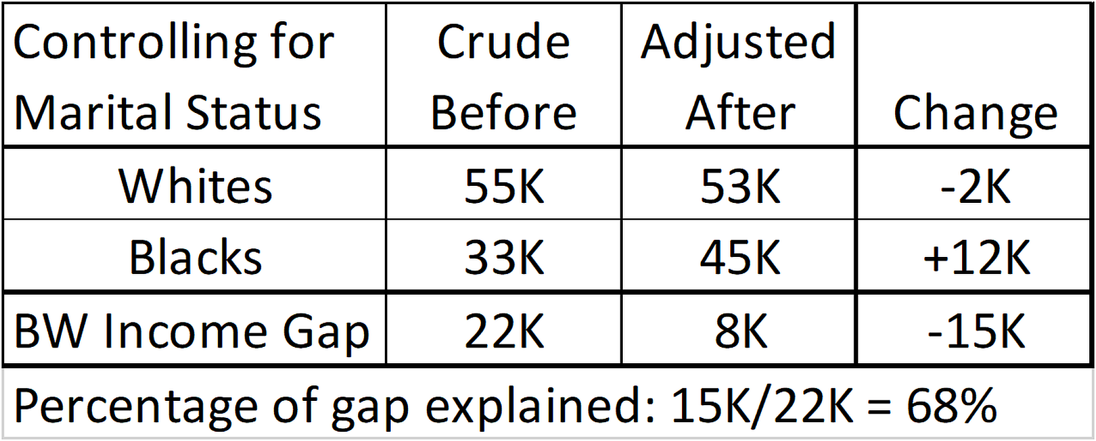
Family Income Gap:
“Explained by”
26
68% of black-white family income gap
is explained by family structure
Notes:
Analyzing Numbers in the News
15 May 2008
2008SchieldNNN6up.pdf
26
26

Slide 27
Family Income Gap:
“Explained by”
27
If 68% of black-white family income gap
is explained by family structure,
doesn’t this prove that most of the
black-white income gap
is NOT due to racism?
How would you answer this???
Notes:
Analyzing Numbers in the News
15 May 2008
2008SchieldNNN6up.pdf
27
27

Slide 28
Teaching Social Statistics
Is Our Job
28
Our students want to understand
social inequalities and inequities;
Our students want to understand
social disparities and discrimination.
One side quotes a crude comparison.
The other sides says “BS” (bad statistics).
This ‘conversation’ is not socially productive.
Notes:
Analyzing Numbers in the News
15 May 2008
2008SchieldNNN6up.pdf
28
28

Slide 29
Statistical Educators can make a Big Difference
29
By teaching confounding, statistical educators may be able to improve
the quality of the arguments
the quality of the critical thinking, and
the quality of our social and political life.
If you really want to make a difference,
think about teaching a confounder-based statistical literacy course.
Notes:
Analyzing Numbers in the News
15 May 2008
2008SchieldNNN6up.pdf
29
29

