Slide 1
Teaching Confounding:
Part 1
Milo Schield, Augsburg University
Fellow: American Statistical Association
Member: International Statistical Institute
US Rep: International Statistical Literacy Project
President National Numeracy Network
USCOTS Workshop Online
June 26, 2021
www.StatLit.org/pdf/2021-Schield-USCOTS-Slides1.pdf
Notes:
StatLit for Managers
2013
2013Schield-MBAA
1
Analyzing Numbers in the News
15 May 2008
2008SchieldNNN6up.pdf
1
1
Three parts: Overview: Standardizing, UNM/Cornfield

Slide 2
Should We Teach Confounding?
Four Questions
Who are our students and what kind of data and statistics do they deal with?
Why statistical ideas do they need?
What if we don’t teach confounding?
Are we professionally negligent if we don’t teach them about confounding and controlling for (taking into account) a confounder?
Notes:
StatLit for Managers
2013
2013Schield-MBAA
2
Analyzing Numbers in the News
15 May 2008
2008SchieldNNN6up.pdf
2
2

Slide 3
Q1. Who are our Students?
By School
.
Notes:
StatLit for Managers
2013
2013Schield-MBAA
3
Analyzing Numbers in the News
15 May 2008
2008SchieldNNN6up.pdf
3
3
We tend to represent the top 10% of SAT scores; we are not representative of most college students.
We tend to teach at the higher-end institutions; our students are not representative of most college students.
My audience is at the 60th to 80th percentile.

Slide 4
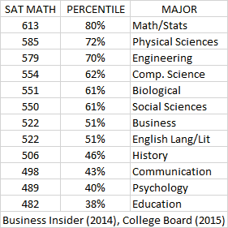
Q1. Who are our Students?
SAT Percentile By Major
Most teachers
80th percentile
Most students:
51st percentile
Notes:
StatLit for Managers
2013
2013Schield-MBAA
4
Analyzing Numbers in the News
15 May 2008
2008SchieldNNN6up.pdf
4
4
We tend to represent the top 10% of SAT scores; we are not representative of most college students.
We tend to teach at the higher-end institutions; our students are not representative of most college students.
My audience is at the 60th to 80th percentile.

Slide 5
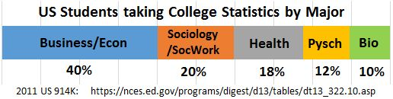
Students Taking Intro Stats at US Four-Year Colleges
Based on their majors, 57% of four-year college students
take introductory statistics: statistical inference.
Most college students taking introductory statistics (inference) deal mainly with observational studies.
Notes:
StatLit for Managers
2013
2013Schield-MBAA
5
Analyzing Numbers in the News
15 May 2008
2008SchieldNNN6up.pdf
5
5
We tend to represent the top 10% of SAT scores; we are not representative of most college students.
We tend to teach at the higher-end institutions; our students are not representative of most college students.
My audience is at the 60th to 80th percentile.

Slide 6
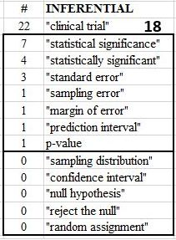
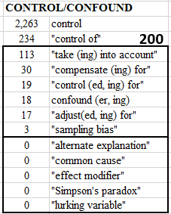
Harvard Business Review:
Search 40K Papers: Title, Abstract
.
10X
Notes:
StatLit for Managers
2013
2013Schield-MBAA
6
Analyzing Numbers in the News
15 May 2008
2008SchieldNNN6up.pdf
6
6

Slide 7
Reasons We Should
Teach Confounding
Who are our students? Majors in Business, Econ, Social Sciences, Health, Psychology…
What statistical ideas do they need? Association,
observational study, quasi-experiment, causation, confounding…
What if we don’t teach confounding? Students will treat association as evidence of causation.
E.g., social justice, gender justicie
Are we professionally negligent if we don’t teach our students what they need? Absolutely!
Notes:
StatLit for Managers
2013
2013Schield-MBAA
7
Analyzing Numbers in the News
15 May 2008
2008SchieldNNN6up.pdf
7
7
Quasi-experiment: Business majors are the largest major among those taking intro statistics. Quasi-experiments are their most common kind of study. Quasi-experiments include setting prices, slecting marketing strategies, advertising, coupons, bundling, etc.

Slide 8
Six Reasons We Should
NOT Teach Confounding
Statisticians got burned on causation: eugenics
Confounding is irrelevant with randomization
Confounding isn’t statistics. Stats = variation
Confounding => multivariate and assumptions
Confounding course requires new FTE
Confounding creates statistical cynics
Notes:
StatLit for Managers
2013
2013Schield-MBAA
8
Analyzing Numbers in the News
15 May 2008
2008SchieldNNN6up.pdf
8
8
Our founders wanted to uphold science and to exclude opinion and politics. But that can be limiting (boring?)

Slide 9


1834: Allis Exterendum
.
To be threshed out by others
Notes:
StatLit for Managers
2013
2013Schield-MBAA
9
Analyzing Numbers in the News
15 May 2008
2008SchieldNNN6up.pdf
9
9
Our founders wanted to uphold science and to exclude opinion and politics. But that can be limiting (boring?)

Slide 10
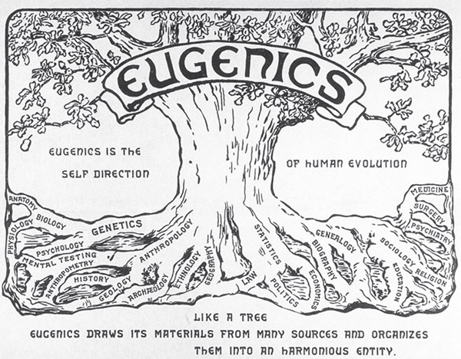
1883: Galton coined Eugenics
https://www.nature.com/articles/s41437-020-00394-6.
Notes:
StatLit for Managers
2013
2013Schield-MBAA
10
Analyzing Numbers in the News
15 May 2008
2008SchieldNNN6up.pdf
10
10
Eugenics: well born: a new science through which
human beings might take charge of their own evolution.
Notice the “many sources”: biology, Psychology, Genetics, anthropology, sociology…
Which root – which discipline -- is closest to the trunk? Statistics.

Slide 11
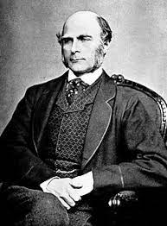
1907: Eugenics Society Formed
Galton proposed that mating be regulated so as to enhance the breeding stock of the human race.
Fitter families for Future Firesides.
Better breeding
Sow just the good seed
If the goal is improvement and progress, then eugenics would not just ameliorate social problems – it would eradicate them! An irresistible allure!
Notes:
StatLit for Managers
2013
2013Schield-MBAA
11
Analyzing Numbers in the News
15 May 2008
2008SchieldNNN6up.pdf
11
11
.

Slide 12
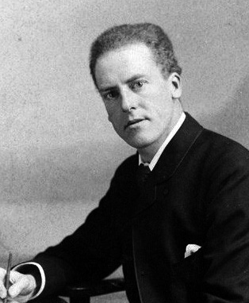
Karl Pearson
Galton’s chair in Eugenics.
Scientific racism?
Imperialism justified by nature:
Social Darwinism
1896: Created correlation coefficient
1900: Created chi-squared test. Start of Math-Stats!
1911: Causation: another fetish among the
inscrutable arcana of … modern science.
Notes:
StatLit for Managers
2013
2013Schield-MBAA
12
Analyzing Numbers in the News
15 May 2008
2008SchieldNNN6up.pdf
12
12

Slide 13
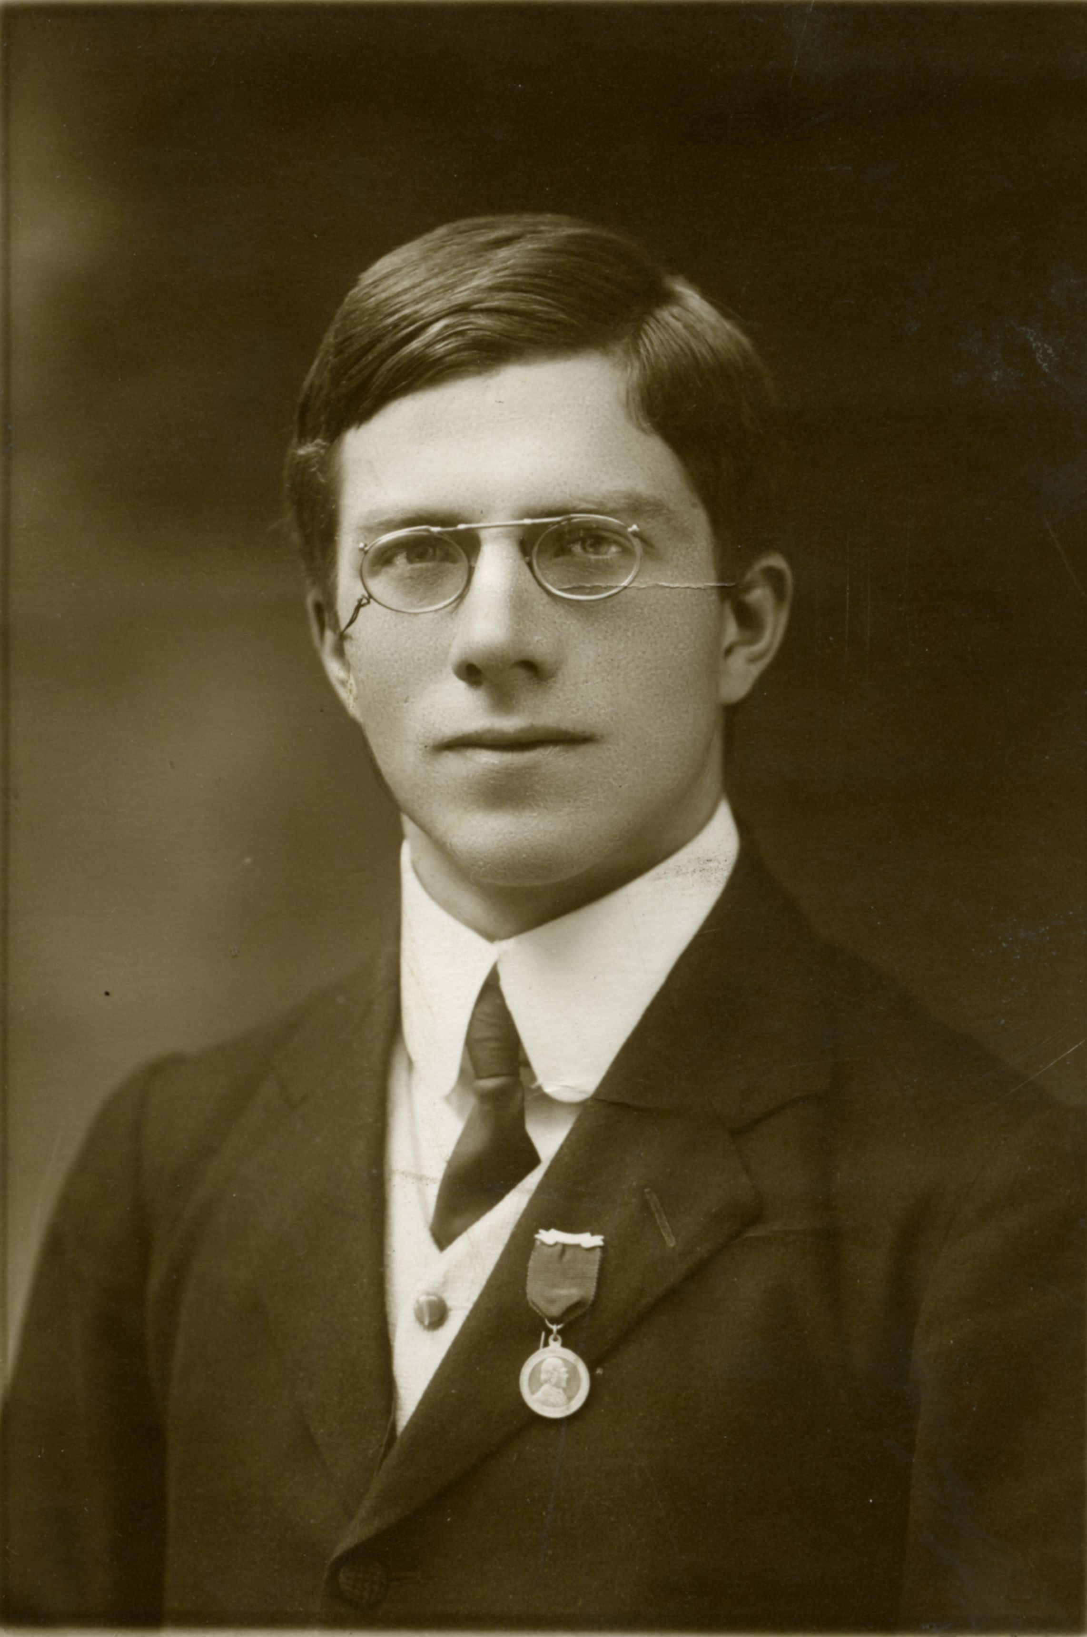
1912: Fisher (21): Steward at
International Eugenics Conf.
1914: “Some hopes of a Eugenist”
1935: Design of Experiments
Null hypothesis;
random assignments
1938: “Pay mothers for A1 babies”
https://www.adelaide.edu.au/library/special/exhibitions/significant-life-fisher/eugenics/
Notes:
StatLit for Managers
2013
2013Schield-MBAA
13
Analyzing Numbers in the News
15 May 2008
2008SchieldNNN6up.pdf
13
13
Eugenics: well born: a new science through which
human beings might take charge of their own evolution.
Notice the “many sources”: biology, Psychology, Genetics, anthropology, sociology…
Which root – which discipline -- is closest to the trunk? Statistics.

Slide 14
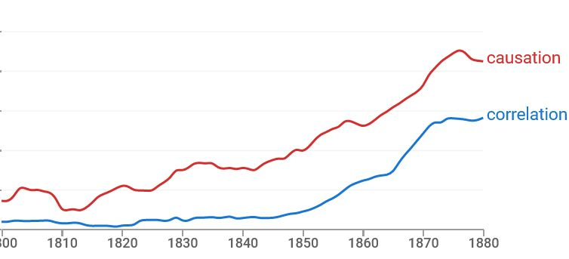
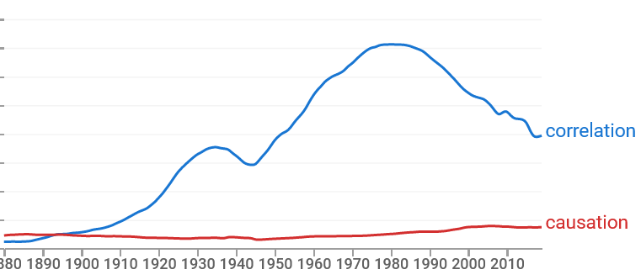
Correlation vs Causation
Google nGrams
.
Notes:
StatLit for Managers
2013
2013Schield-MBAA
14
Analyzing Numbers in the News
15 May 2008
2008SchieldNNN6up.pdf
14
14
Eugenics: well born: a new science through which
human beings might take charge of their own evolution.
Notice the “many sources”: biology, Psychology, Genetics, anthropology, sociology…
Which root – which discipline -- is closest to the trunk? Statistics.

Slide 15
Conclusion by early Statistical Educators
Many of statistics’ founders flirted with eugenics as a causal solution to social problems.
Compartmentalization or hypocrisy?
Bottom line: Statistical educators should not ‘touch’ causation in observational studies.
Notes:
StatLit for Managers
2013
2013Schield-MBAA
15
Analyzing Numbers in the News
15 May 2008
2008SchieldNNN6up.pdf
15
15

Slide 16
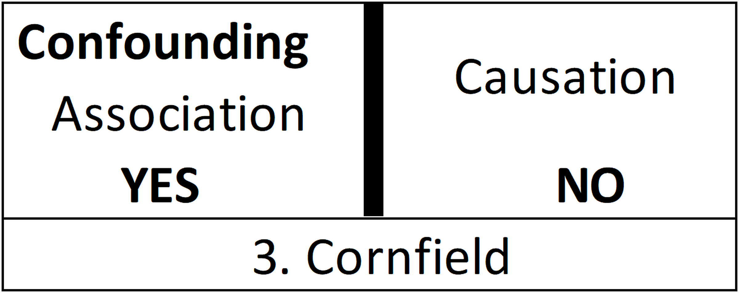
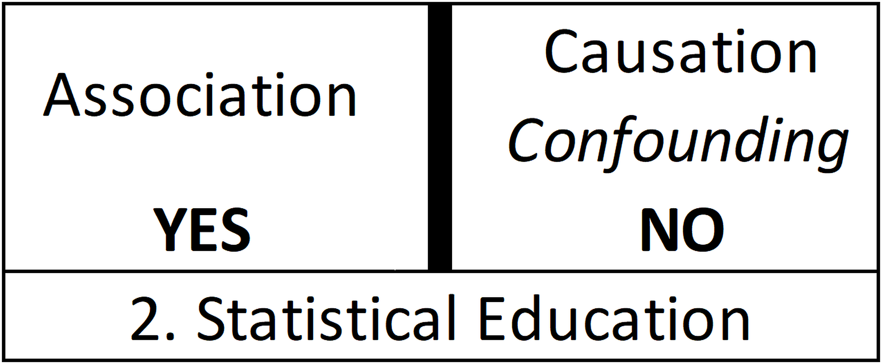
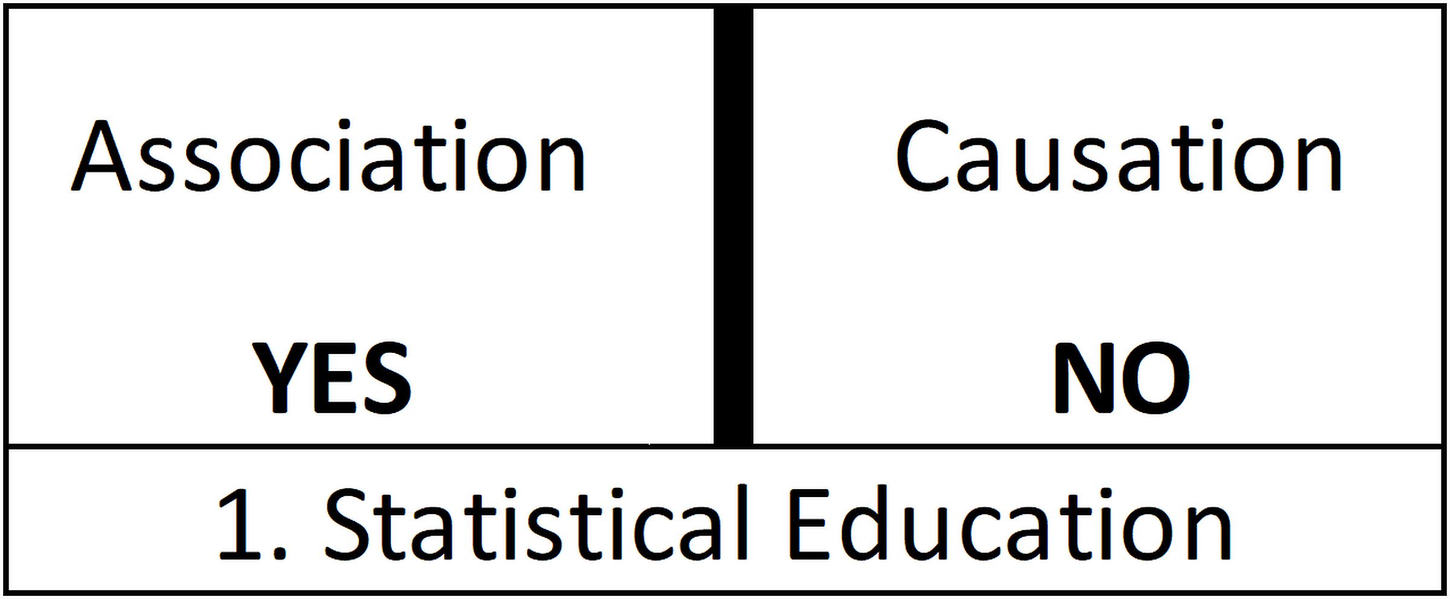
Association vs. Causation
What about Confounding?
“Association is not Causation”
No mention of confounding
Notes:
StatLit for Managers
2013
2013Schield-MBAA
16
Analyzing Numbers in the News
15 May 2008
2008SchieldNNN6up.pdf
16
16

Slide 17
Teaching Statistics
We teach the wrong things in the wrong way in the wrong order. Richard de Veaux*
Consider teaching “Association is not causation”
1973 Berkeley sex discrimination case
Ice cream sales and burglaries
Problem: These involve confounding – not chance.
* https://www.tandfonline.com/doi/full/10.1080/10691898.2016.1263493
Students are exposed to confounding one time!
Notes:
StatLit for Managers
2013
2013Schield-MBAA
17
Analyzing Numbers in the News
15 May 2008
2008SchieldNNN6up.pdf
17
17
First big idea: Statistical educators at JSM are an extremely biased sample compared to their student abilities and majors.

Slide 18
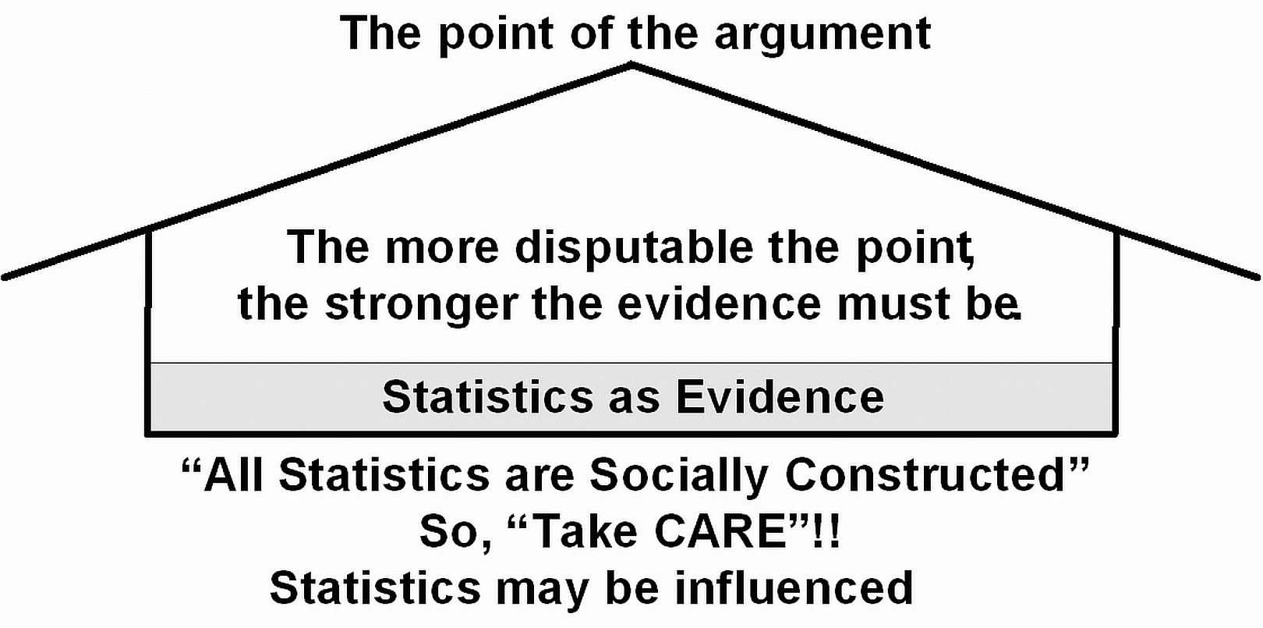
Confounder-Based
Statistical Literacy
Literacy deals with arguments.
Notes:
StatLit for Managers
2013
2013Schield-MBAA
18
Analyzing Numbers in the News
15 May 2008
2008SchieldNNN6up.pdf
18
18

Slide 19
Confounder-Based
Statistical Literacy
Different: Less than a 30% overlap with traditional stats.
Quick overview of a confounder-based statistical literacy.
Statistical Literacy versus critical thinking?
Different kinds of association?
Grammatical signs of association and causation?
Kinds of influences on a statistic?
Overlap between StatLit and traditional statistics?
Notes:
StatLit for Managers
2013
2013Schield-MBAA
19
Analyzing Numbers in the News
15 May 2008
2008SchieldNNN6up.pdf
19
19

Slide 20
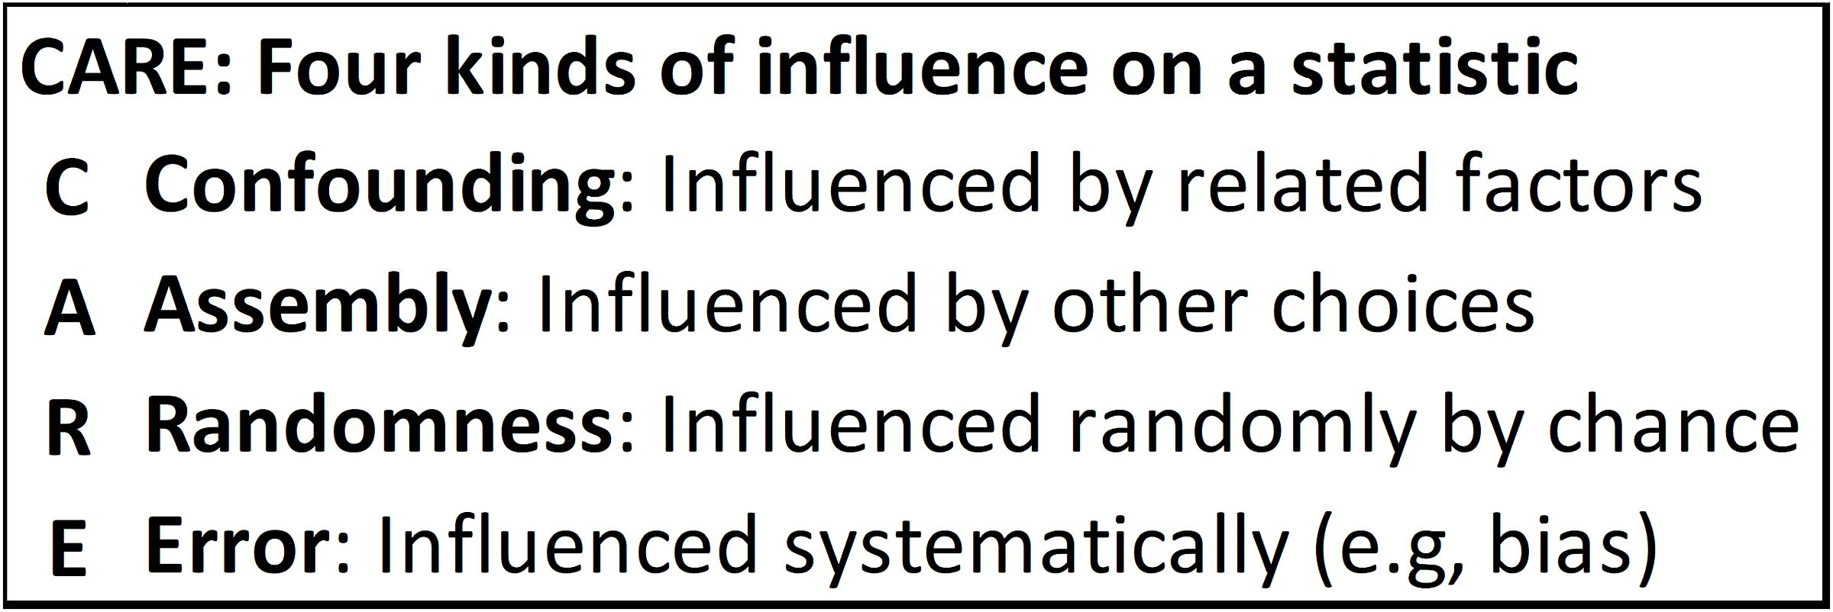
Statistics: Socially Constructed; Are Influenced
Lots of influences on a given statistic.
Need to group these influences into three to five categories
Take CARE: Good advice in life and in statistics!
Notes:
StatLit for Managers
2013
2013Schield-MBAA
20
Analyzing Numbers in the News
15 May 2008
2008SchieldNNN6up.pdf
20
20

Slide 21
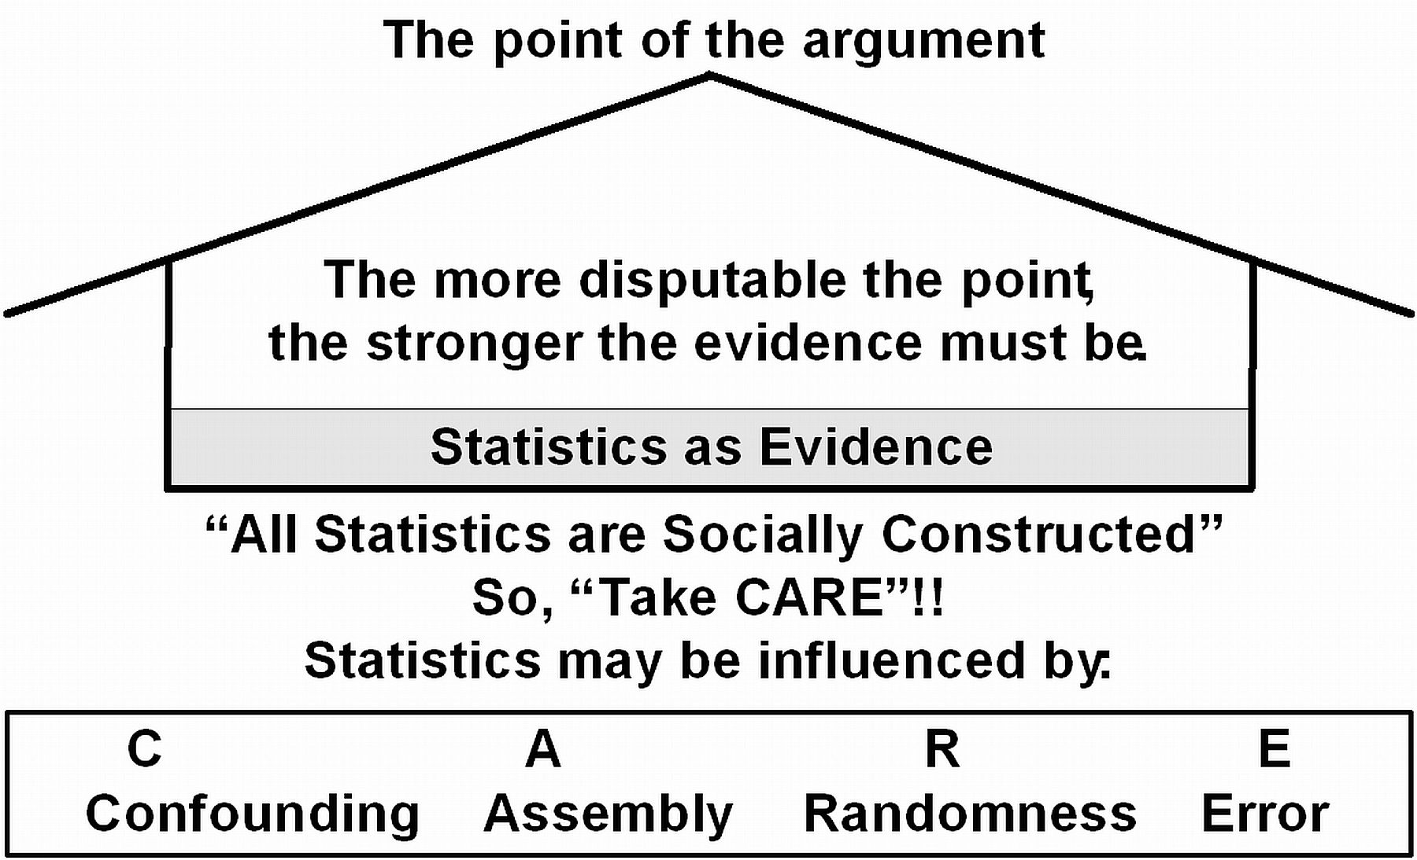
Statistics Can Be Influenced
.
Notes:
StatLit for Managers
2013
2013Schield-MBAA
21
Analyzing Numbers in the News
15 May 2008
2008SchieldNNN6up.pdf
21
21

Slide 22
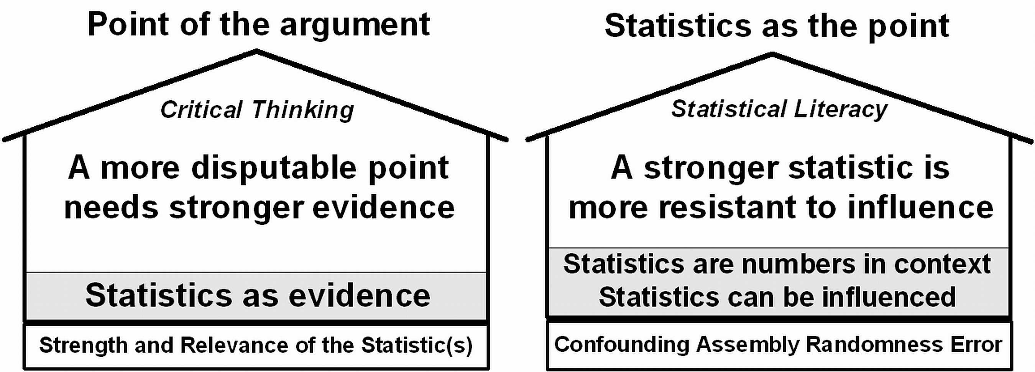
Separate Critical Thinking from Statistical Litearcy
Statisticians may use arguments involving causation (critical thinking) to illustrate statistical literacy.
Statisticians may argue for a causal explanation personally – but not as a statistician.
Notes:
StatLit for Managers
2013
2013Schield-MBAA
22
Analyzing Numbers in the News
15 May 2008
2008SchieldNNN6up.pdf
22
22

Slide 23
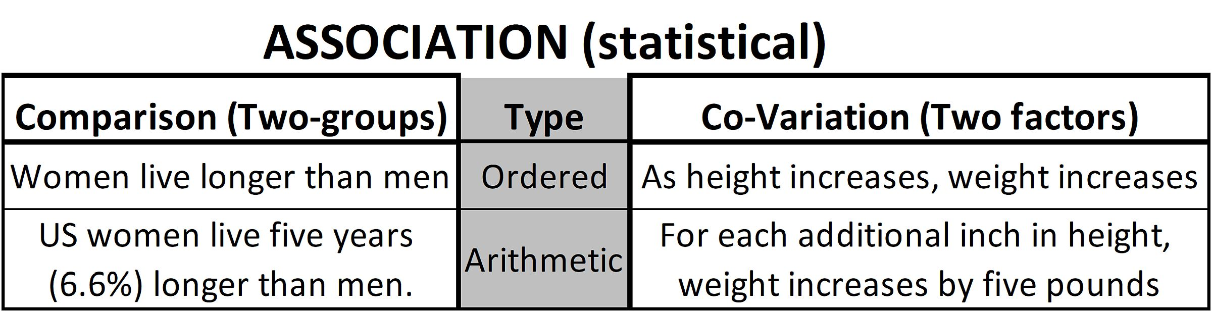
Introduce Association;
Study Grammar!
Students have difficulty with statistical association.
Technical definition: quantitatively-based connection
Two group comparison versus two factor co-variation.
Notes:
StatLit for Managers
2013
2013Schield-MBAA
23
Analyzing Numbers in the News
15 May 2008
2008SchieldNNN6up.pdf
23
23

Slide 24
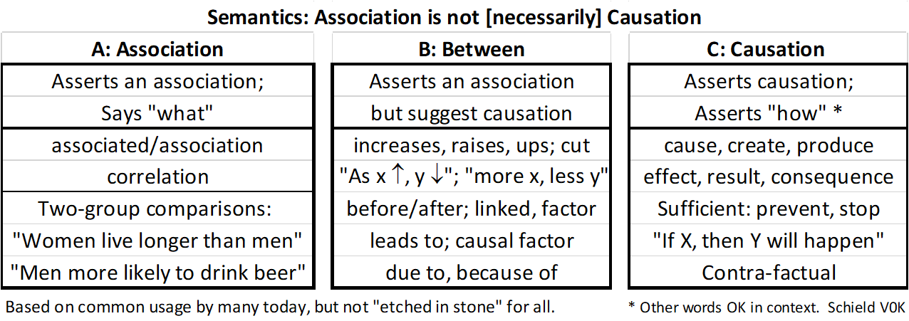
Association is Not Causation:
Study Grammar
.
Notes:
StatLit for Managers
2013
2013Schield-MBAA
24
Analyzing Numbers in the News
15 May 2008
2008SchieldNNN6up.pdf
24
24

Slide 25
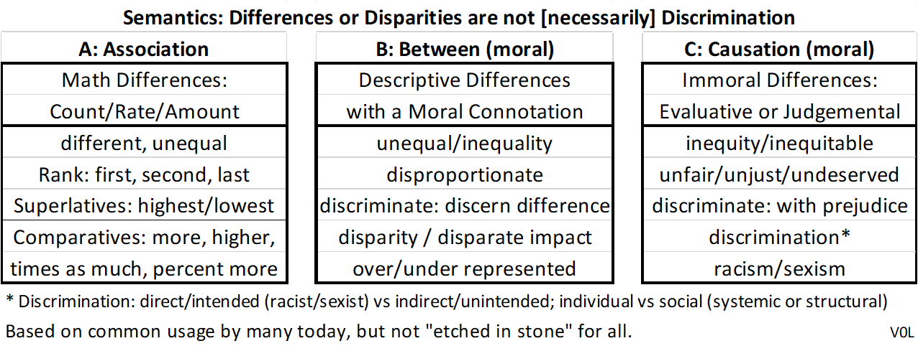
Disparity is not Discrimination:
Study the Grammar
Simple application of “Association is not Causation”.
Notes:
StatLit for Managers
2013
2013Schield-MBAA
25
Analyzing Numbers in the News
15 May 2008
2008SchieldNNN6up.pdf
25
25

Slide 26
Care:
Influence of Confounding
Confounded/confounding: Confused, confusing
Confounder: Found with, that which confuses
Confounder: A 3rd factor that is related to an association, that causes the outcome and is not caused by the predictor.
Controlling for the influence of a confounder can:
Reverse an association
Nullify an association
Decrease – but not nullify or reverse – an association
Increase an association
Notes:
StatLit for Managers
2013
2013Schield-MBAA
26
Analyzing Numbers in the News
15 May 2008
2008SchieldNNN6up.pdf
26
26

Slide 27
Care:
Confounding
Not listed in McKenzie's 2004 survey of 30
“possible core concepts” in statistics education.
Not listed in index of most intro statistics textbooks
Featured in Fisher-Cornfield debate on association between smoking and lung cancer. Cornfield (1958)
“Confounding and variations are two major obstacles in learning from data”. Tintle, Cobb, etc. (2013)
Can be visually demonstrated. Wainer (2003).
Notes:
StatLit for Managers
2013
2013Schield-MBAA
27
Analyzing Numbers in the News
15 May 2008
2008SchieldNNN6up.pdf
27
27

Slide 28
cAre:
Influence of Assembly
  How they were collected, defined, grouped, summarized, compared and presented.
  The context in which things are counted or measured
  Small change in syntax; big change in semantics!
Popes have above-average lifespan
90% of shoppers* say Costco is a good place to shop!
* 1,024 shoppers interviewed outside Costco
Notes:
StatLit for Managers
2013
2013Schield-MBAA
28
Analyzing Numbers in the News
15 May 2008
2008SchieldNNN6up.pdf
28
28
10 shoppers; 1 disagreed?

Slide 29
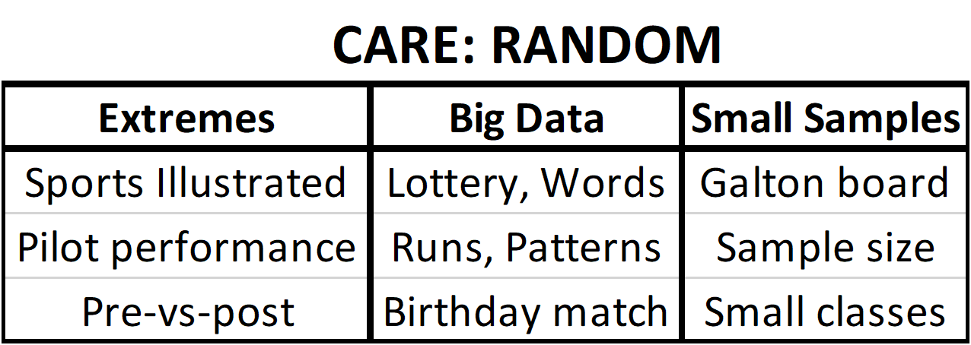

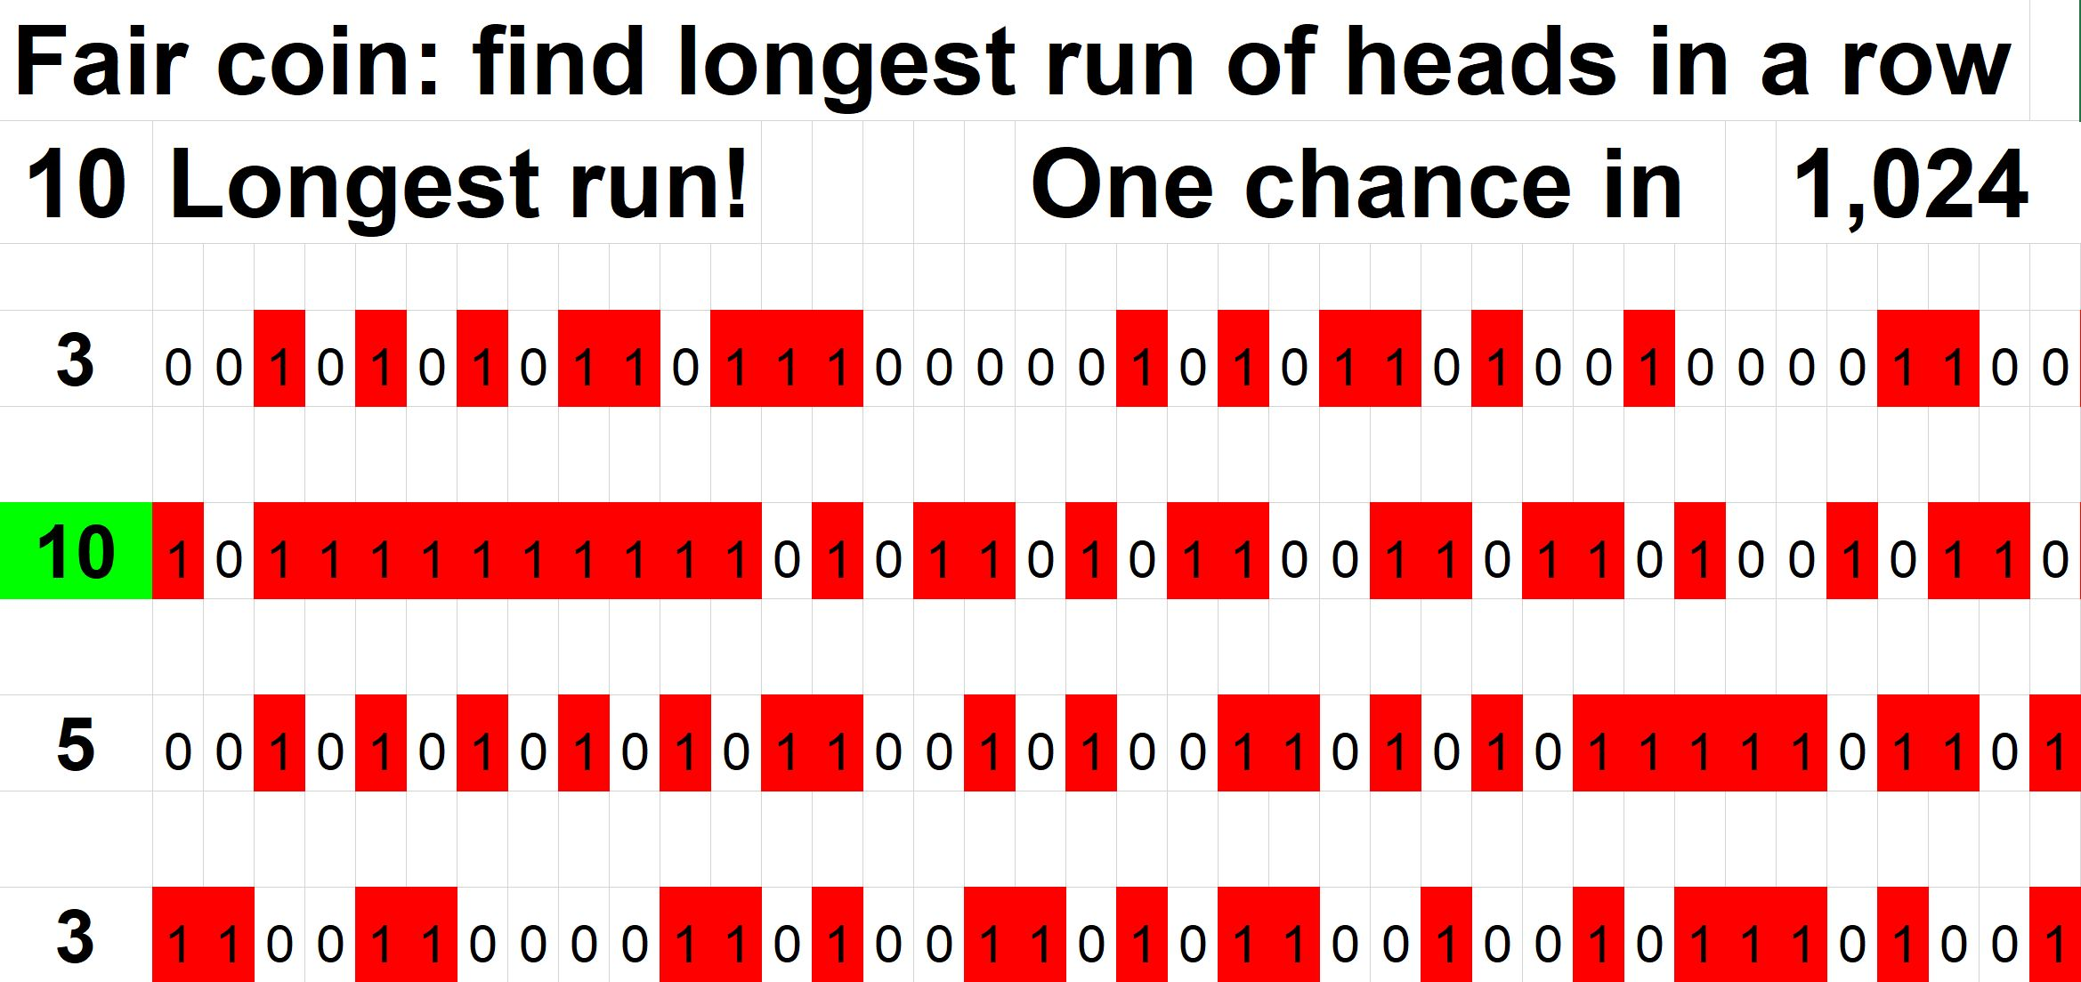
caRe:
Influence of Randomness
Notes:
StatLit for Managers
2013
2013Schield-MBAA
29
Analyzing Numbers in the News
15 May 2008
2008SchieldNNN6up.pdf
29
29

Slide 30
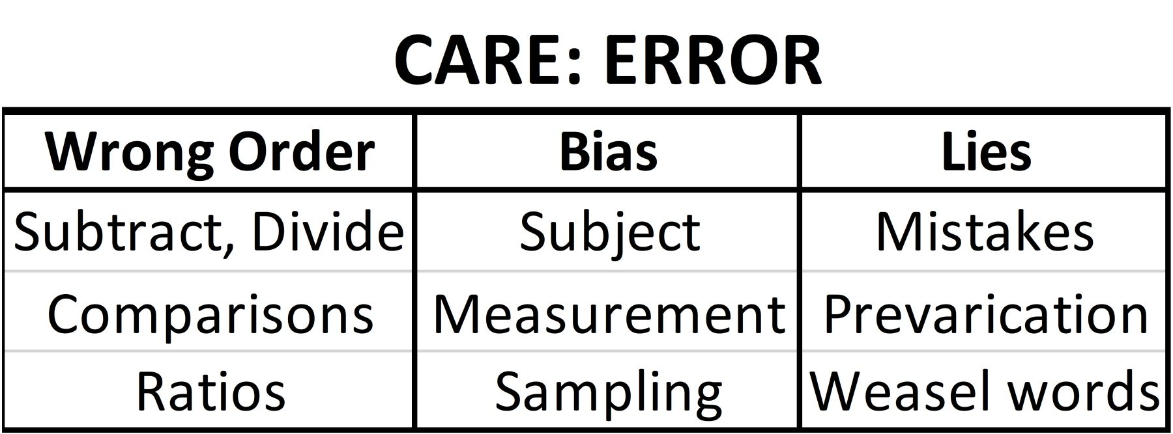
carE:
Influence of Error (Bias)
Includes “confusion of the inverse”
Notes:
StatLit for Managers
2013
2013Schield-MBAA
30
Analyzing Numbers in the News
15 May 2008
2008SchieldNNN6up.pdf
30
30

