Slide 1
UNM Offers New Confounder-Based Statistical Literacy Course
Milo Schield, Univ. New Mexico
Fellow: American Statistical Association
Member: International Statistical Institute
US Rep: International Statistical Literacy Project
President: National Numeracy Network
JSM Online August 11, 2021
Paper: www.StatLit.org/pdf/2021-Schield-ASA.pdf
www.StatLit.org/pdf/2021-Schield-ASA-Slides.pdf
www.StatLit.org/pdf/2021-Schield-ASA-Slides-Speed.pdf
Notes:
StatLit for Managers
2013
2013Schield-MBAA
1
Analyzing Numbers in the News
15 May 2008
2008SchieldNNN6up.pdf
1
1

Slide 2
Presentation has Two Main Parts
What is new about Math 1300?
How does Math 1300 relate to a traditional introductory statistical inference course?
What textbook is being used?
Does it satisfy a math requirement in the UNM core curriculum and in the New Mexico general education curriculum?
How were these goals achieved?

Slide 3
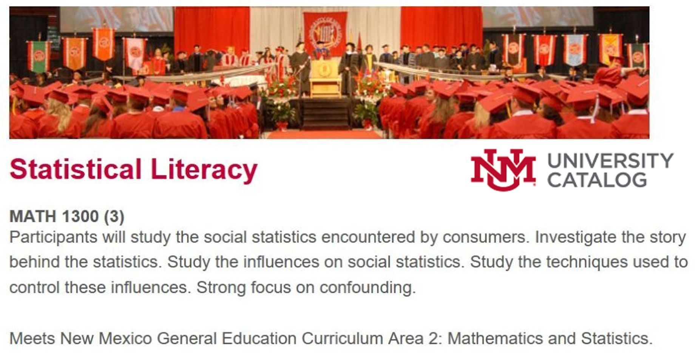
Statistical Literacy: MATH 1300 in the UNM Catalog
Part 1
.
Notes:
If the University of New Mexico can implement a confounder-based statistical literacy course for their students,
why can’t it happen at your college or university?

Slide 4
UNM Math 1300: Quick Summary
Part 1
Less than 30% overlap with traditional statistics
Holistic: Studies all influences on a statistic: confounding, assembly, randomness & error
Statistical: Study design, Cornfield conditions, confounder-influence on statistical significance
GAISE 2016: MV regression: standardization
Ordinary English: conditional probability
Applied/literary: Analyze one or two cases/week

Slide 5
UNM Math 1300: Big Ideas
Part 1
Association is not [always] causation; Disparity is not [always] discrimination
Crude association: An association that does not take anything else into account; a mixed-fruit (apples & oranges) comparison.
To take into account (to control for) a confounder is to adjust (balance) the confounder mixture.

Slide 6
UNM Math 1300: Student Learning Outcomes
Part 1
Distinguish association from causation; form two-group comparisons using ordinary English.
Identify and evaluate kinds of statistical influence: confounding, assembly, randomness and error.
Can identify, evaluate and use techniques to take control of – or control for – these influences.
Can describe and compare rates and percentages using ordinary English
Can analyze and evaluate the statistics in the everyday media, press releases and journal articles.

Slide 7
Confounder-Based Statistical Literacy Textbook
Part 1
.

Slide 8
Getting New Course Approved at UNM
Part 2
New course approval is no small matter
These slides summarize the steps involved in getting statistical literacy approved:
by the Mathematics-Statistics Department
for the UNM core curriculum
by the NM Higher Education Department for the general education curriculum
For entry in the UNM catalog.

Slide 9
Consultant Responsibilities
Part 2
Starting in fall 2018, the consultant’s job was to:
Generate syllabus & description for the course
Generate Student Learning Outcomes (SLOs)
Identify how SLOs would be assessed
Generate sample assessment & budget load
Connect SLOs to UNM curriculum goals
Get approved as a core course at UNM
Get approved for Gen Ed in New Mexico.

Slide 10
New Course Approval: Document Categories
Part 2
This process took 18 months to complete. The 11 documents are presented in four groups:
1a: New Course request (Form B) 1b: Catalog description 1c: Syllabus
2a: Add common course number 2b: Students Learning Outcomes (SLOs)

Slide 11
New Course Approval: Document Categories
Part 2
3a: General Education: Add a course 3b: Assessing Student Learning Outcomes 3c: Goals and Student Learning Outcomes 3d: Sample Assessment
4a: New Course Signoff (Form C) 4b: Budgetary Load Implications

Slide 12
New Course Request Form B: 1a Overview
Part 2
Allow 6 months to complete the approval process.
Attach the following:
Precise complete catalog listing of the new course. This must include the course subject code, and course number, long title, credit hour value and course description.
Course syllabus and bibliography.

Slide 13
New Course Request Form B 1a Justification and Impact
Part 2
Justification: Students in non-STEM majors need a statistics course that studies everyday statistics as evidence in arguments. This course complements the existing Intro Statistics course: MATH 1350.
Impact: If other departments decide to require Statistical Literacy, this could lead to an increase in the number of sections that need to be offered after the first two years.
C. Course Fees & Status: No fees; elective.

Slide 14
New Course MATH 1300: 1c Syllabus (2)
Part 2
Goals To help students think critically about statistics as evidence in arguments: to see the story behind the story. To help students see value in becoming statistically literate.
Required Text: Statistical Literacy 2021 by Schield. Registration in the online forum.
Grading Components Requirements: Chapter Exercises (7@3%) 21%, Forum writing (10-16 cases) 20%; Project and Attendance 9%; Exams (two) 18%; Final Exam 30%; Course Evaluations 2%

Slide 15
New Course MATH 1300: 1c Syllabus Schedule by Week
Part 2
1: Ch 1 Statistics in Arguments. Take CARE 2: Ch 2 Forming comparisons. control influences 3: Evaluate news stories; review homework 4: Ch 3 Understanding Measurements 5: Ch 4 Percent and percentage grammar 6: Ch 5 Reading ratios in tables and graphs 7: Evaluate news stories; review homework 8: Review Ch 1-4. Exam 1

Slide 16
New Course MATH 1300: 1c Syllabus Schedule by Week
Part 2
9: Ch 6 Compare ratios 10 Ch 7 Interpret difficult ratios, Medical tests. 11 Evaluate news stories and Exam #1 12 Review Ch 4-6. Exam 2: Ch 4-6. 13 Ch 8 Samples, significance and confounding 14 Evaluate news stories, Review homework, 15 Evaluate news stories. Review Exam 2 16 Review Ch 1-4, Ch 5-8. 17 Final Exam Ch 1-8. Note: UNM semester is 17 weeks

Slide 17
New Course MATH 1300: 4a Form C: Program Change
Part 2
New Course: Statistical Literacy
Reasons for Request: To serve the changing needs of our diverse student body. To help them read, interpret and evaluate the statistics used in arguments and the everyday news. To offer our students an alternative to our traditional statistical inference course.
Does this change affect in a significant way, any other departmental programs/branch campuses? NO

Slide 18
Statistical Literacy NM HED: 2b Student Learning Outcomes (1)
Part 2
To: New Mexico Higher Education Department.
Here are five student learning outcomes. They encompass most of what is covered in a confounder‐based statistical literacy course. They can be readily assessed.
1. Can distinguish association from causation in reality and in using ordinary English. Can use ordinary English to form arithmetic descriptions and comparisons of statistics.

Slide 19
Statistical Literacy NM HED: 2b Student Learning Outcomes (2)
Part 2
2. Can identify and evaluate known influences (confounding, assembly, randomness and error) on a statistic. Can think hypothetically about influences that are unknown or unmeasured.
3. Can identify, evaluate and use various techniques to take control of – or control for – these influences. These techniques include the physical control of randomness to determine statistical significance and the mental control for the influence of measured confounders on a statistic, a statistical association and statistical significance.

Slide 20
Statistical Literacy NM HED: 2b Student Learning Outcomes (3)
Part 2
4. Can use ordinary English to describe and compare ratios as presented in statements, tables and graphs using percent, percentage, rate and chance grammars.
5. Can evaluate the strength of evidence provided by statistics in the everyday media, in press releases and in journal articles.

Slide 21
Statistical Literacy NM HED: 3a Gen Ed Add Course
Part 2
C. Learning Outcomes
[Same five as the Student Learning Outcomes: SLOs]
Show how the course connects to three of the New Mexico Higher Education general education skills. These three were chosen:
Critical Thinking,
Quantitative Reasoning, and
Communications

Slide 22
Statistical Literacy NM HED: 3a Gen Ed Add Course
Part 2
In this box, provide a narrative that explains how the proposed course addresses the outcomes of this essential skill. 250 – 400 words. [See paper for StatLit response.]
Skill #1: Critical Thinking. Problem Setting; Evidence Acquisition; Evidence Evaluation; and Reasoning/Conclusion

Slide 23
Statistical Literacy NM HED: 3a Gen Ed Add Course
Part 2
Skill #2: Quantitative Reasoning. Communication/Representation of Quantitative Information; Analysis of Quantitative Arguments; and Application of Quantitative Models
Skill #3: Communication. Genre and Medium Awareness, Application and Versatility; Strategies for Understanding and Evaluating Messages; and Evaluation and Production of Arguments.

Slide 24
Statistical Literacy NM HED: 3b: Assessment of SLOs
Part 2
Methods of assessment:
Multiple choice questions in exercises and tests
Writing one-line statements that describe or compare counts, average, rates & percents.
Writing well-reasoned arguments in analyzing news stories tables and graphs (online)

