Slide 1
UNM: New Confounder-Based Statistical Literacy Course
Milo Schield, Univ. New Mexico
Fellow: American Statistical Association
Elected Member: International Statistical Institute
US Rep: International Statistical Literacy Project
President: National Numeracy Network
JSM Online August 11, 2021 Video: www.StatLit.org/pdf/2021-Schield-ASA-Speed-Video.mp4 Paper: www.StatLit.org/pdf/2021-Schield-ASA.pdf Speed: www.StatLit.org/pdf/2021-Schield-ASA-Slides-Speed.pdf Slides: www.StatLit.org/pdf/2021-Schield-ASA-Slides.pdf
Notes:
StatLit for Managers
2013
2013Schield-MBAA
1
Analyzing Numbers in the News
15 May 2008
2008SchieldNNN6up.pdf
1
1

Slide 2
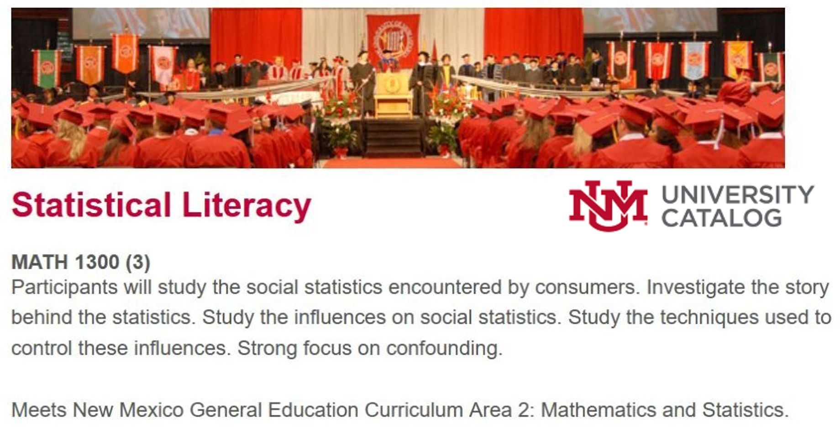
Statistical Literacy: MATH 1300 in the UNM Catalog
.
Notes:
If the University of New Mexico can implement a confounder-based statistical literacy course for their students,
why can’t it happen at your college or university?

Slide 3
UNM Math 1300: Quick Summary
Less than 30% overlap with traditional statistics
Holistic: Studies all influences on a statistic: confounding, assembly, randomness & error
Statistical: Study design, Cornfield conditions, confounder-influence on statistical significance
GAISE 2016: MV regression: standardization
Ordinary English: conditional probability
Applied/literary: Analyze one or two cases/week

Slide 4
UNM Math 1300: Big Ideas
Association is not [always] causation; Disparity is not [always] discrimination
Crude association: An association that does not take anything else into account; a mixed-fruit (apples & oranges) comparison.
To take into account (to control for) a confounder is to adjust (balance) the confounder mixture.

Slide 5
UNM Math 1300: Student Learning Outcomes
Distinguish association from causation; form two-group comparisons using ordinary English.
Identify and evaluate kinds of statistical influence: confounding, assembly, randomness and error.
Can identify, evaluate and use techniques to take control of – or control for – these influences.
Can describe and compare rates and percentages using ordinary English
Can analyze and evaluate the statistics in the everyday media, press releases and journal articles.

Slide 6
Confounder-Based Statistical Literacy Textbook
.

Slide 7
Study Confounder-Based Statistical Literacy
Statistical Literacy: The Diabolical Denominator www.StatLit.org/pdf/2021-Schield-MathFest.pdf
Statistical Literacy: Teaching Confounding
www.StatLit.org/pdf/2021-Schield-USCOTS.pdf
Confounding and Cornfield: Back to the Future www.StatLit.org/2018-Schield-ICOTS.pdf
University of New Mexico Offers Math 1300 www.StatLit.org/pdf/2021-Schield-ASA.pdf
For all of Schield’s papers by topic, www.StatLit.org/Schield-Pubs.htm
Notes:
StatLit for Managers
2013
2013Schield-MBAA
7
Analyzing Numbers in the News
15 May 2008
2008SchieldNNN6up.pdf
7
7

