Slide 1
Increasing Disparity:
The Scanlan Effect
Milo Schield
Augsburg University
Editor of www.StatLit.org
Fellow, American Statistical Association
US Rep: International Statistical Literacy Project
2018
Twin Cities Critical Thinking Clubwww.StatLit.org/pdf/2018-Schield-CTC2-Slides.pdf
Notes:
Analyzing Numbers in the News
15 May 2008
2008SchieldNNN6up.pdf
1
1

Slide 2
Disparate Outcomes:
Call to Action
2
Disparate outcomes are typically relative.
Today, disparate group outcomes are viewed as:
  being bad.
  something to be eliminated.
  something requiring political action.
Disparities can be
Cross-sectional (at the same time)
Longitudinal (before-after time)
Notes:
Analyzing Numbers in the News
15 May 2008
2008SchieldNNN6up.pdf
2
2

Slide 3
Hypothetical Case Study #1
Cross-sectional
3
99% of men would remarry their spouse
90% of women ………………………...
Men are 10% more likely to remarry their spouse.
1% of men would not remarry their spouse
10% of women ……………………………..
Women are 10 times as likely to not remarry their spouse as are men.
Notes:
Analyzing Numbers in the News
15 May 2008
2008SchieldNNN6up.pdf
3
3

Slide 4
Hypothetical Case Study #1
Cross-sectional
4
A ratio of two large percentages always creates
a larger ratio of their small complements.
This is true for complementary ratios taken at the same moment in time (cross-sectional).
Notes:
Analyzing Numbers in the News
15 May 2008
2008SchieldNNN6up.pdf
4
4

Slide 5
Hypothetical Case Study #2
Longitudinal
5
Initially (for success)
Advantaged (90%); Disadvantaged (80%).
Relative to the disadvantaged, the advantaged have:
a 10 point (13%) higher success rate.
Suppose these disparities are seen as a problem!
Management
Institutes training program
Redefines criteria for failure and success.
Monitors progress.
Notes:
Analyzing Numbers in the News
15 May 2008
2008SchieldNNN6up.pdf
5
5

Slide 6
Hypothetical Case Study #2
Success Rates Improved
6
A year later (for success outcome):
Advantaged success 99%; disadvantaged 94%.
Advantaged rate: up 10% (90% to 99%).
Disadvantaged rate: up by 18% (80% to 94%)
Disparity difference cut from 10 points to 5.
Disparity ratio decreased from 1.13 to 1.05.
Looks good. Mission accomplished???
Notes:
Analyzing Numbers in the News
15 May 2008
2008SchieldNNN6up.pdf
6
6

Slide 7
Hypothetical Case Study #2
Failure Disparity Increased
7
A year later:
Advantaged failure rate is 1%.
Disadvantaged failure rate is 6%.
Disparity difference cut by 5 points.
Disparity ratio increases from two to 6.
This three-fold increase is a BIG problem!!
This increase is “journalistically-significant”!
Notes:
Analyzing Numbers in the News
15 May 2008
2008SchieldNNN6up.pdf
7
7

Slide 8
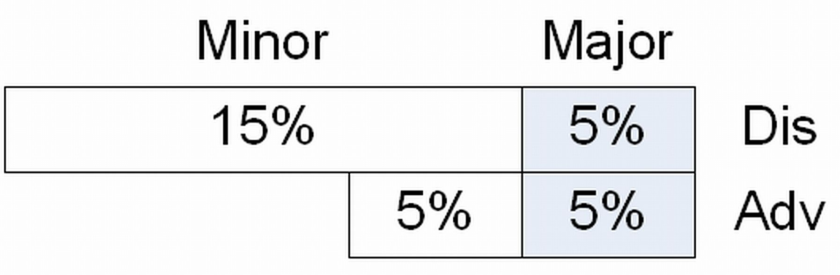
School Suspension Disparity:
Good Intention; Good Result
8
Disparity ratio before: 2 to 1 (20%/10%)
Action: Eliminate suspension for ‘small stuff.’
Result 1: Disparity difference eliminated: Zero
Result 2: Disparity ratio eliminated. One.
Notes:
Analyzing Numbers in the News
15 May 2008
2008SchieldNNN6up.pdf
8
8

Slide 9
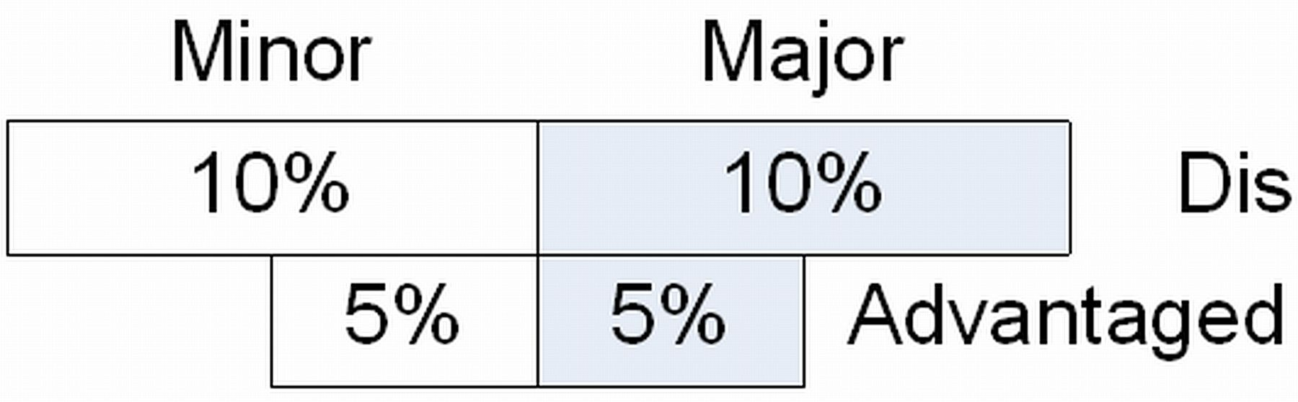
School Suspension Disparity:
Good Intention; Neutral Result
9
Disparity ratio before: 2 to 1 (20%/10%)
Action: Eliminate suspension for ‘small stuff.’
Result 1: Disparity difference halved: 10 pts to 5.
Result 2: Disparity ratio (2 to 1) unchanged.
Notes:
Analyzing Numbers in the News
15 May 2008
2008SchieldNNN6up.pdf
9
9

Slide 10
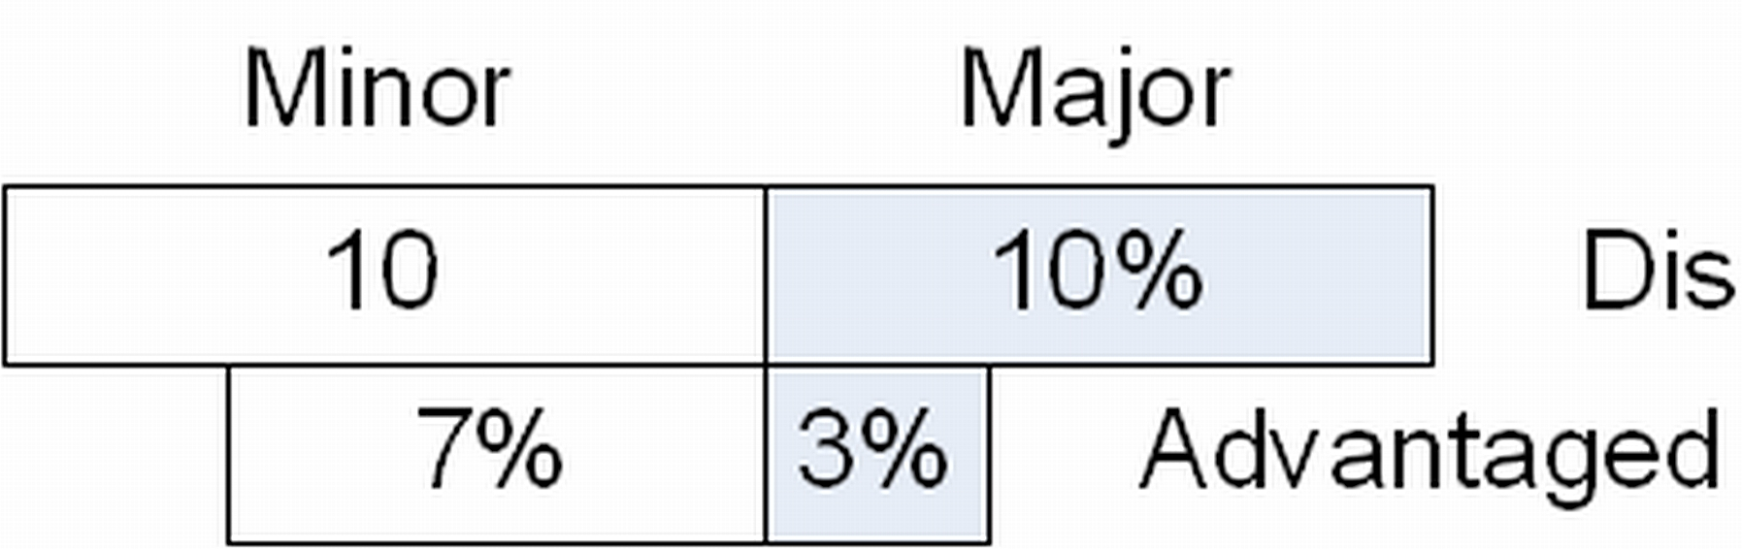
School Suspension Disparity:
Good Intention; Bad Result
10
Disparity ratio before: 2 to 1 (20%/10%)
Action: Eliminate suspension for ‘small stuff.’
Result 1: Disparity difference decreases by 3 pts.
Result 2: Disparity ratio increases from 2 to 3.3.
Notes:
Analyzing Numbers in the News
15 May 2008
2008SchieldNNN6up.pdf
10
10

Slide 11
Summary:
Longitudinal Change
11
Unlikely outcomes: If percentage reductions are identical for advantaged and disadvantaged,
then the disparity ratio remains the same.
Unlikely outcomes; If percentage decrease is bigger for advantaged than for disadvantaged, then disparity ratio will increase.
Bottom line: It all depends on the “mix”!
Notes:
Analyzing Numbers in the News
15 May 2008
2008SchieldNNN6up.pdf
11
11

Slide 12
The Scanlan Rule
12
Scanlan rule: “the rarer an outcome, the greater tends to be the relative difference in experiencing it and the smaller tends to be the relative difference in avoiding it.”
Bauld L, Day P, Judge K. “Off target: A critical review of setting goals for reducing health inequalities in the United Kingdom”. International Journal of Health Services. 2008; 38(3): 439-454.
Access:
http://journals.sagepub.com/doi/10.2190/HS.38.3.d
https://www.scopus.com/record/display.uri
Notes:
Analyzing Numbers in the News
15 May 2008
2008SchieldNNN6up.pdf
12
12

Slide 13

James P. Scanlan, Attorney:
Identified the Scanlan Effect
13
Washington DC. Harvard Law
His website: JPScanlan.com
Specializes in using statistics as evidence in legal matters.
Affirmative action
Education, Housing
Employment, Mortgages.
Calling attention to the Scanlan effect for 31 years.
Notes:
Analyzing Numbers in the News
15 May 2008
2008SchieldNNN6up.pdf
13
13

Slide 14
Scanlan Effect Examples
14
As mortality declines, disparities in survival tend to decrease but relative differences in mortality tend to increase.
As health-care receipt rates increase, disparities in receipt tend to decrease but relative differences in non-receipt tend to increase.
Lowering credit score requirements tends to reduce disparities in acceptance while increasing relative differences in rejection.
As immunization and cancer screening become more common, relative differences in receipt tend to decrease while relative differences in failing to receive them tend to increase.
As hiring and promotion percentages increase, the disparity ratios for those not hired or not promoted tend to increase.
Notes:
Analyzing Numbers in the News
15 May 2008
2008SchieldNNN6up.pdf
14
14

Slide 15
Example: Minnesota School Data:
2013-2018
15
Black students are expelled or suspended eight times as often as white students; American Indians are punished 10 times as often.
Students with disabilities make up 14% of all K-12 students; 43% of suspensions and expulsions.
A third of all school exclusions are for minor incidents: talking back, eye rolling or swearing.
https://www.twincities.com/2018/06/29/st-paul-schools-to-scrutinize-student-suspensions-under-human-rights-agreement/
Notes:
Analyzing Numbers in the News
15 May 2008
2008SchieldNNN6up.pdf
15
15

Slide 16
St. Paul schools scrutinize student suspensions
16
St. Paul staff “took racial equity training, the district narrowed the types of behaviors that were to result in suspension, and principals were instructed to keep kids in class when possible.”
Suspensions dropped significantly, but
racial disparities … actually increased.
https://www.twincities.com/2018/06/29/st-paul-schools-to-scrutinize-student-suspensions-under-human-rights-agreement/
Notes:
Analyzing Numbers in the News
15 May 2008
2008SchieldNNN6up.pdf
16
16

Slide 17
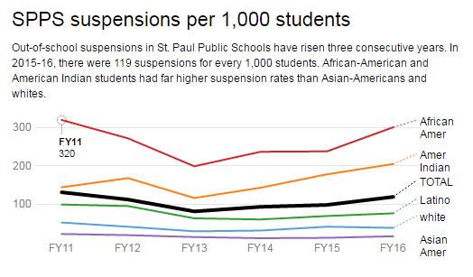
St. Paul Schools:
The Data (Last 5 years)
17
https://www.twincities.com/2018/06/29/st-paul-schools-to-scrutinize-student-suspensions-under-human-rights-agreement/
Suspensions
Down 2011 - 2013
Notes:
Analyzing Numbers in the News
15 May 2008
2008SchieldNNN6up.pdf
17
17

Slide 18
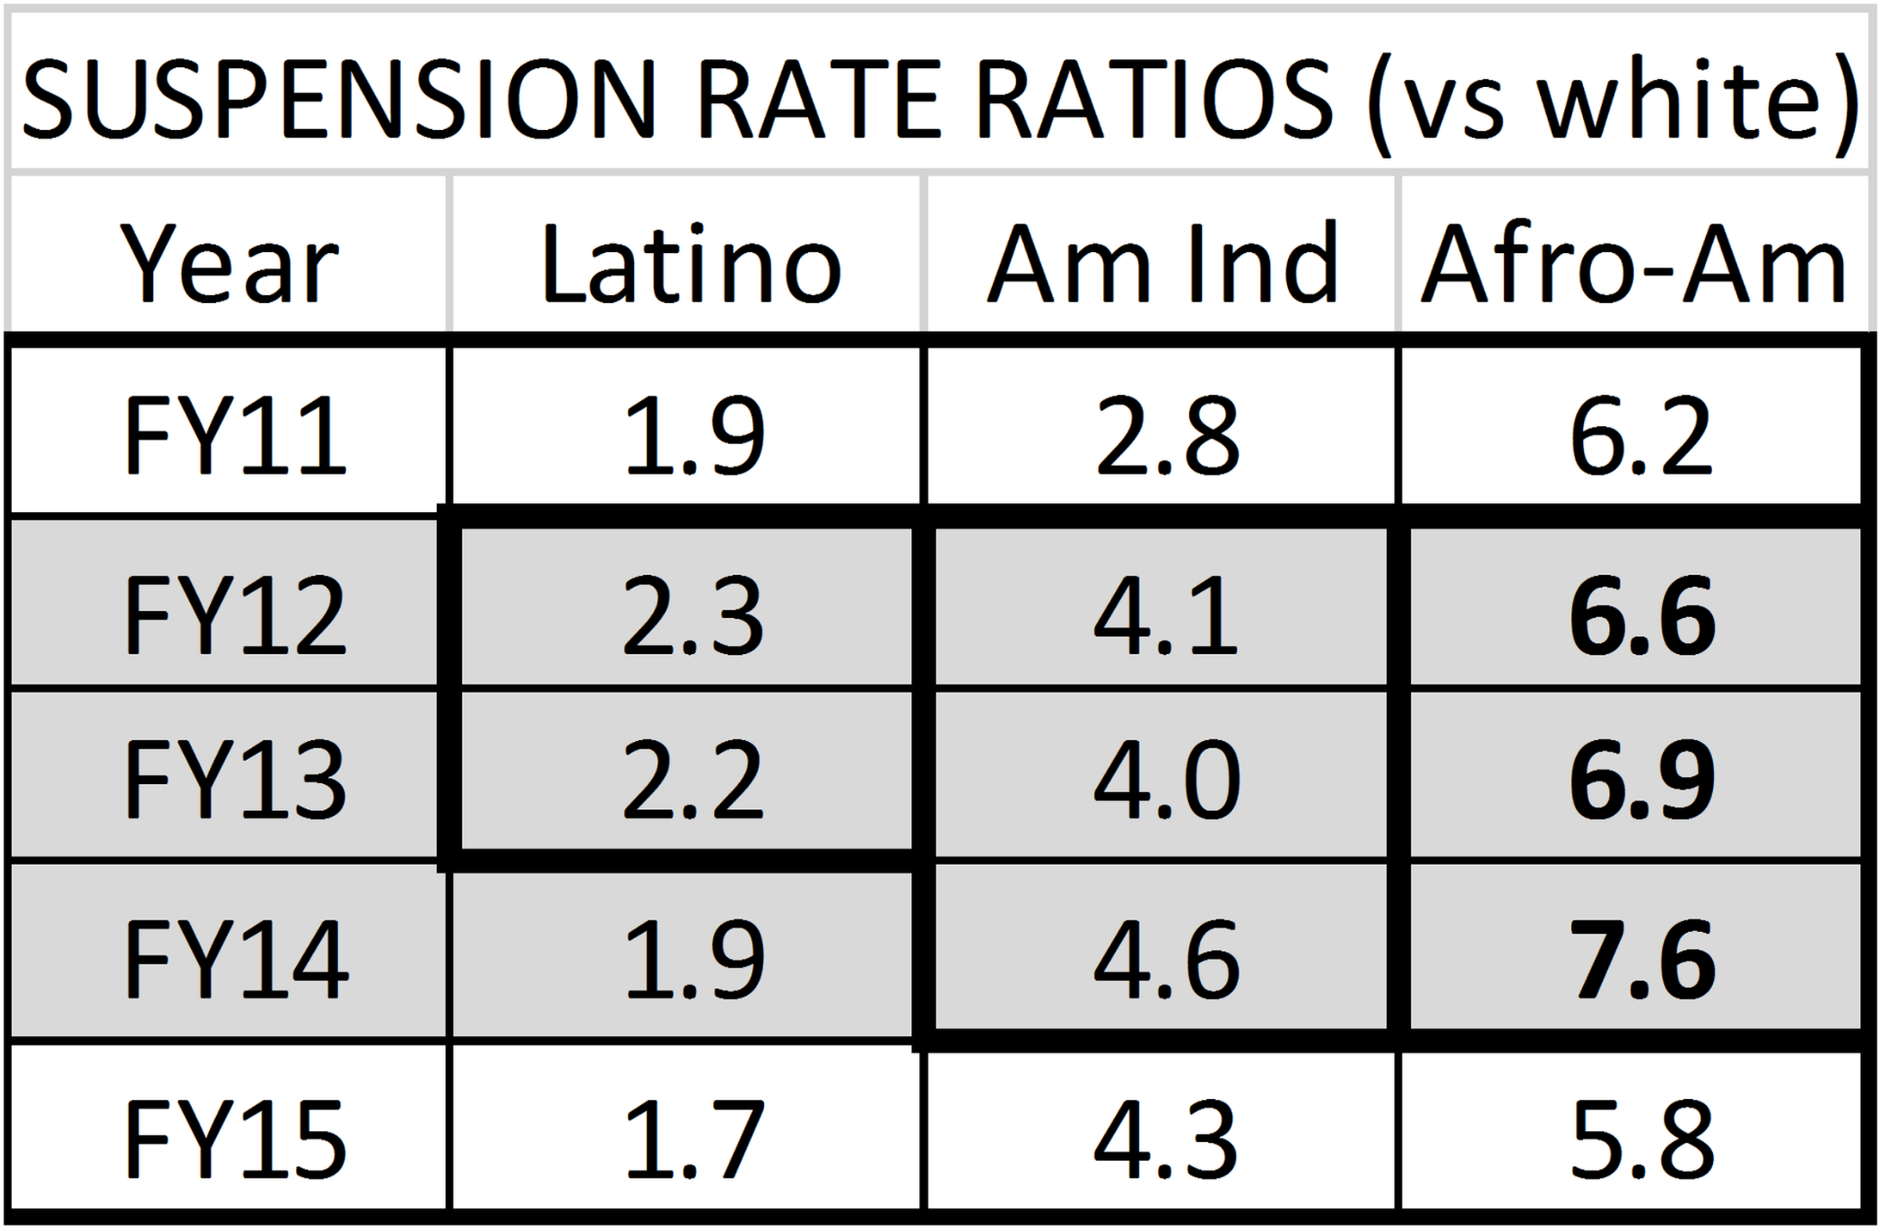
Disparity (Ratios) Up
18
Notes:
Analyzing Numbers in the News
15 May 2008
2008SchieldNNN6up.pdf
18
18

Slide 19
Suspension Disparity Ratio:
Up
19
2012-2014: Suspension rates drop
44% drop for Whites, 37% drop for Afro-Am.
Afro-American vs. white disparity ratio increased
From 6.2 to 7.6 (23% increase)
Why? White rate dropped more than Afro-Amer.
Source: Josh Vergas, St. Paul Pioneer Press.
Notes:
Analyzing Numbers in the News
15 May 2008
2008SchieldNNN6up.pdf
19
19

Slide 20
Four Conclusions
A small ratio of two large percentages always creates a larger ratio of their complements.
If the percentage reduction in the less-likely outcomes is bigger for the advantaged than for the disadvantaged, then the disparity ratio will increase.
Less-Likely outcome: If the percentage reduction in the advantaged rate is greater than that in the disparity difference, then disparity ratio will increase.
As prevalence of rare outcomes decrease, the easier (more likely) it is for the disparity ratio to increase.

Slide 21
The Scanlan Effect
21
Scanlan Effect: “As the chance of an unlikely outcome decreases, the disparity ratios tend to increase.
Why?
Percentage decreases in rate of adverse outcomes tends to be larger for advantaged than for disadvantaged.
Relative decreases in differences tend to be outweighed by larger relative decreases in the smaller prevalence so the disparity ratio increases.
Notes:
Analyzing Numbers in the News
15 May 2008
2008SchieldNNN6up.pdf
21
21

Slide 22
Key Scanlan References:
Statistics-Related (31 years)
22
1987: The “Feminization of Poverty” is Misunderstood (Plain Dealer, Nov. 11, 1987).
http://www.jpscanlan.com/images/Poverty_and_Women.pdf
1994: ‘Divining difference’. CHANCE, 7(4): 38–9, 48.
www.jpscanlan.com/images/Can_We_Actually_Measure_Health_Disparities.pdf
2006: ‘Can We Actually Measure Health Disparities?’ Chance.
www.jpscanlan.com/images/Can_We_Actually_Measure_Health_Disparities.pdf
2012: ‘Misunderstanding Statistics Leads to Misguided Law Enforcement’. Amstat News http://magazine.amstat.org/blog/2012/12/01/misguided-law-enforcement/
2014: ‘Race and Mortality Revisited’. Society
http://jpscanlan.com/images/Race_and_Mortality_Revisited.pdf
2015: ‘Letter to the American Statistical Association.’ http://jpscanlan.com/images/Letter_to_American_Statistical_Association_Oct._8,_2015_.pdf
2016: ‘Mismeasure of Health Disparities’. J. Public Health Mgmt. www.jpscanlan.com/images/The_Mismeasure_of_Health_Disparities_JPHMP_2016_.pdf
Notes:
Analyzing Numbers in the News
15 May 2008
2008SchieldNNN6up.pdf
22
22

Slide 23
Prevalence-Difference Proof:
Prevalences: small adverse outcomes
23
P(Adv,1): Prevalence for advantaged before the change
P(Dis, 2): prevalence for disadvantaged after the change.
D(1) = Initial difference = P(Dis,1)-P(Adv,1) > 0.
R(2) = Final ratio = P(Ddis,2)/P(Adv,2) > 1.
R(k) = P(Dis,k)/P(Adv,k) = 1 + D(k)/P(Adv,k). k = 1, 2.
R(2) – R(1) = D(2)/P(Adv,2) – D(1)/P(Adv,1)
R(2) – R(1) > 0 if D(2)/D(1) > P(Adv,2)/P(Adv,1)
R(2) – R(1) > 0 if P(Adv,1)/P(Adv,2) > D(1)/D(2)
Adverse disparity ratio must increase if relative reduction in prevalence exceeds the relative reduction in difference.
Notes:
Analyzing Numbers in the News
15 May 2008
2008SchieldNNN6up.pdf
23
23

Slide 24
Percentage Reduction Proof
Assume unlikely outcomes
24
P(Adv,1) = Prevalence among Advantaged before.
P(Dis,2) = Prevalence among Disadvantaged after.
1-P(Adv,2)/P(Adv,1): Reduction ratio Adv [Radv]
1-P(Dis,2) / P(Dis,1): Reduction ratio Dis [Rdis]
Rk = Disparity ratio = P(Dis,k)/P(Adv,k) for k =1,2
R2 – R1 = P(Dis,2)/P(Adv,2) - P(Dis,1)/P(Adv,1)
R2-R1 > 0 if P(Dis,2)/P(Adv,2)>P(Dis,1)/P(Adv,1)
R2-R1 > 0 if P(Dis,2)/P(Dis,1)> P(Adv,2)/P(Adv,1)
R2-R1 > 0 if -Rdis > -Radv or Radv > Rdis.
Notes:
Analyzing Numbers in the News
15 May 2008
2008SchieldNNN6up.pdf
24
24

