Slide 1
Teaching Social Statistics:
Handling Objections
Milo Schield, Augsburg College
Member: International Statistical Institute
US Rep: International Statistical Literacy Project
VP. National Numeracy Network
IASE Roundtable in Berlin
July 1, 2016
www.StatLit.org/pdf/2016-Schield-IASE-3Slides.pdf
Notes:
StatLit for Managers
2013
2013Schield-MBAA
1
Analyzing Numbers in the News
15 May 2008
2008SchieldNNN6up.pdf
1
1

Slide 2
Why Teachers Won’t Teach
Social Statistics
Supports using statistical associations as evidence for causal connections
Statisticians got burned on causation
Students have less trust in statistics
Statisticians are not subject-matter experts
Takes time away from statistical inference
Replaces deductive reasoning with inductive

Slide 3
Cornfield Conditions
In replying to Fisher, Cornfield proved a necessary condition for a confounder to nullify (or reverse) an observed association.
“Cornfield's minimum effect size is as important to observational studies as is the use of randomized assignment to experimental studies.”
Schield (1999) Simpson’s Paradox & the Cornfield Conditions
www.statlit.org/pdf/1999SchieldASA.pdf

Slide 4
Stratification
Two-Way Half Tables
Patient Died | “Good” | “Poor” | TOTAL
City Hospital | 1% | 6% | 5.5%
Rural Hospital | 2% | 7% | 3.5%
TOTAL | 1.5% | 6.5%
Patient at City is 2 pts more likely to die that at Rural.
Patient in Poor condition is 5 pts more likely to die than is a Patient in Good condition.
Association with Outcome: Confounder > Predictor
Notes:
StatLit for Managers
2013
2013Schield-MBAA
4
Analyzing Numbers in the News
15 May 2008
2008SchieldNNN6up.pdf
4
4

Slide 5
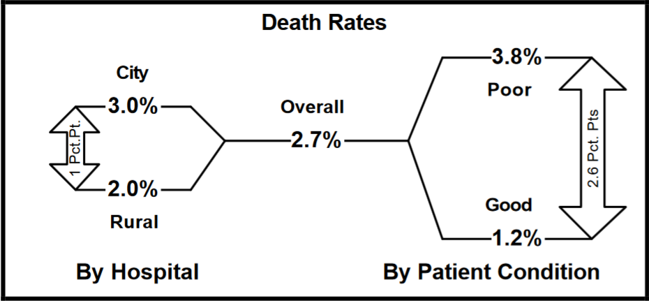
Cornfield Condition for Nullification or Reversal
Schield (1999) based on realistic data

Slide 6
Cornfield Condition for Nullification or Reversal
An association is nullified or reversed only if
confounder (patient condition) has a stronger association with the outcome (death) than does the predictor (hospital).
predictor (hospital) has a stronger association with the confounder (patient condition) than with the outcome (death).

Slide 7
Stratification
Two-Way Half Tables
DIED | YOUNG | OLD | TOTAL
NON SMOKER | 12% | 86% | 31%
SMOKER | 18% | 88% | 24%
TOTAL | 15% | 86% | 28%
Smoker is 10 pts less likely to die that is a non-smoker.
Old is 71 points more likely to die than is Young.
Association: Confounder-outcome > predictor-outcome
Notes:
StatLit for Managers
2013
2013Schield-MBAA
7
Analyzing Numbers in the News
15 May 2008
2008SchieldNNN6up.pdf
7
7

Slide 8
Meaning of Statistically Significant
A sample outcome is statistically significant. Q. What does this mean?
Outcome is unlikely if due to chance
Outcome is unlikely due to chance
Outcome is unlikely to be due to chance
#1 is OK for statisticians. #3 is wrong.
#2 is in-between and ambiguous.

Slide 9
Statistical Tests and
Frequentist Decision Making
Naming an outcome (or those more remote) as being statistically significant is just naming. That choice is arbitrary – within limits.
Recommending that users reject the null and accept the alternate for a statistically-significant outcome is NOT justified by Frequentist theory.
As Frequentists, statistical educators should NEVER allow statistical significance to be used for decision-making in any statistics courses.

Slide 10
Statistical Tests and
Bayesian Decision Making
Shifting from statistical significance to p-values is a way of avoiding the decision-making; we “win the battle but lose the war.”
Instead statisticians should embrace Bayes.
If the alternate (Ha) is more likely to be true than the null (Ho), then a statistically-significant result gives at least a 95% confidence that Ho is False and Ha is true. Schield (1996)

Slide 11
Coincidence in Big Data
.

Slide 12
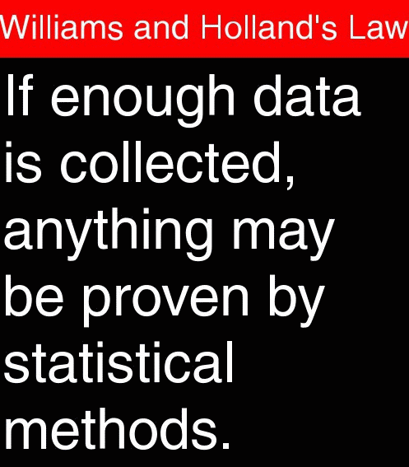
Teaching
Big Data
.

Slide 13
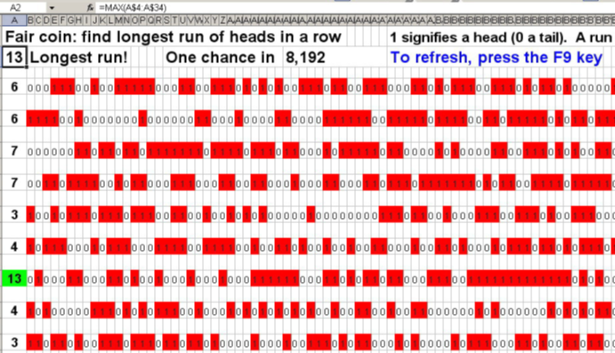
Show: Law Very Large Numbers: www.StatLit.org/Excel/2012Schield-Runs.xls
.

Slide 14
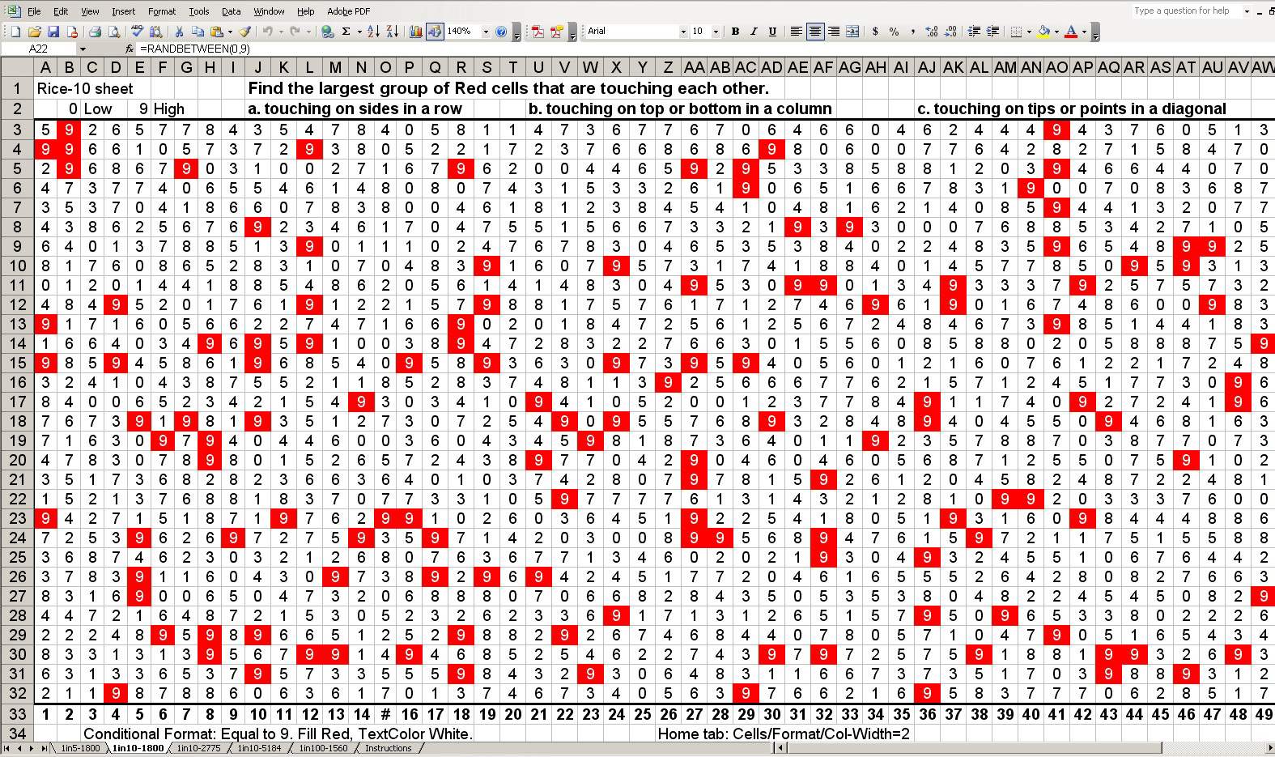
Show: Law Very Large Numbers: www.StatLit.org/Excel/2012Schield-Rice.xls
.

Slide 15
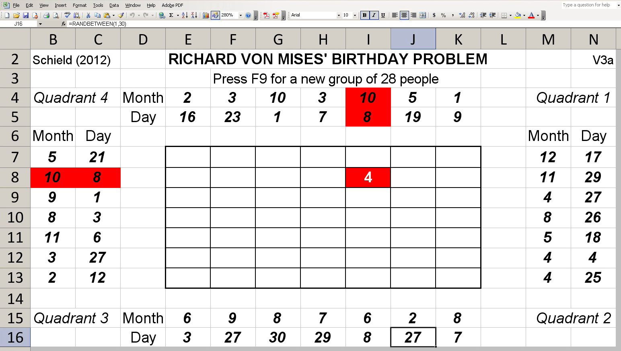
Show: Law Very Large Numbers: www.StatLit.org/Excel/2012Schield-Bday.xls
.

Slide 16
Why We Should Teach
Social Statistics
Most students need it, see value in it.
Separating stats from math has benefits
Inductive reasoning is critical thinking
We are all subject-matter experts on people
Can teach idea of stat. inference in less time
Can show influence of confounding, assembly and bias on statistical significance
Cornfield conditions offset cynicism

Slide 17
Teach Statistical Inference
Differently
Skip derivation of the sampling distribution.
See Utts (2099) and de Veaux (2099).
Use 1-2-3 rule for Confidence levels.
Teach statistical significance – not p-values.
Teach test-sufficiency short-cuts
Teach sufficient conditions for statistical significance. E.g., Lack of overlap of 95% confidence intervals is sufficient for statistical significance

Slide 18
Statistically-Significant Short-Cut:
Chi-Square
Statistically significant if chi-square > 2(DF+1)

Slide 19
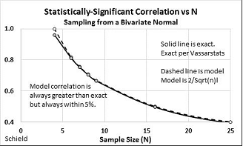
Statistically-Significant Short-Cut:
Bivariate Correlation
Statistically significant if r > 2/Sqrt(n)

Slide 20
Statistically-Significant Short-Cut:
T-Test
Statistically significant if T > Z + 2.5/sqrt(n-2)

Slide 21
Can we show Confounder Influence on Statistical Significance?
Variation – random variation – is at the core of the introductory statistics course.
We know that controlling for a confounder can negate or reverse an observed association.
Can we show this with minimal assumptions?
Yes, using Wainer’s standardization diagram

Slide 22
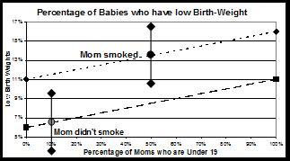
Confounder Influence:
Non-Overlap = Statistical Significance
.

Slide 23
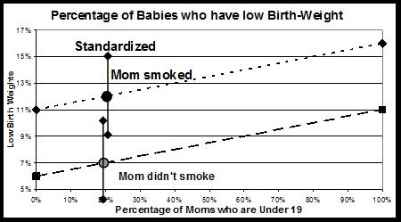
Confounder Influence on Statistical Significance
.

Slide 24
Showing Influence on
Statistical Significance
Variation – random variation – should be at the core of the introductory statistics course.
Wainer’s Standardization technique allow us to show students how controlling for a confounder can influence statistical significance.
Showing confounder influence on statistical significance should be included in every introductory statistic course.
Anything less is professional negligence.

Slide 25
Course Re-Design:
Recommendations
To uphold statistics as mathematics with a context, the intro statistics course must be redesigned.
The intro course needs more focus on big ideas:
Context (control), assembly (definitions) and bias are big ideas for non-statisticians.
Randomness and statistical significance are big ideas for statisticians.
Seeing how confounding, assembly and bias can influence statistical significance should be central for a “statistics-in-context” course.

Slide 26
Thesis
26
Adding context to introductory statistics will
uphold context as the essence of statistics (e.g., statistics are numbers in context),
more clearly separate statistics as a liberal art from mathematical statistics,
improve student retention of key ideas, and
improve student attitudes on the value of statistics.
Notes:
Clinical Trials vs. Causal HeterogeneityStatistical Literacy: Confounding2008 StatLit Skills Survey
29 July, 2012Dec 10, 2010Fall 2008
2012Schield-ASA6up.pdf2010SchieldUST6up.pdf2008SchieldSkillsSurvey6up.pdf
26
Statistical Literacy: Confounding2008 StatLit Skills Survey
Dec 10, 2010Fall 2008
2010SchieldUST6up.pdf2008SchieldSkillsSurvey6up.pdf
26
2008 StatLit Skills Survey
Fall 2008
2008SchieldSkillsSurvey6up.pdf
26
We have the top and bottom of this pyramid.
The Top: We know where we are headed. We are clear on our goal.
Our common goal is to see quantitative literacy grow.
The bottom: We have the foundation.
The need for quantitative literacy has been documented.
The books by Steen and Madison have documented this very clearly.
So, we have the foundation and we know where we are headed.
-------------------------------------
To support an interdisciplinary area, college-wide support is necessary.
To obtain college-wide support, the subject must have wide faculty support.
And in today’s climate, it must be assessable.
Unless QL is a clearly-stated campus-wide goal,
QL programs are likely to be transient.
Interdisciplinary programs cannot survive in a disciplinary world without strong college support
None of this will not happen unless quantitative literacy is “understandable and teachable.”
That brings us back to the problems mentioned in the previous slide.
Quantitative literacy must be “understandable and teachable.”
Whether QL is understandable and teachable depends critically on the content of QL.
> Let’s focus in on some core content of Quantitative Literacy >

Slide 27
Student Evaluations
27
Claim: Statistical literacy should be required for all students for graduation. Students were given 5 choices: strongly disagree, disagree, neutral, agree or strongly agree in an anonymous survey.
Of the 57 students in my classes this past year,
68% chose Agree or "Strongly agree " while
21% chose "Strongly agree."
This is a strong confirmation that a class more-focused on observational studies and using statistical associations as evidence for causal connections is of value to future decision makers.
Notes:
Clinical Trials vs. Causal HeterogeneityStatistical Literacy: Confounding2008 StatLit Skills Survey
29 July, 2012Dec 10, 2010Fall 2008
2012Schield-ASA6up.pdf2010SchieldUST6up.pdf2008SchieldSkillsSurvey6up.pdf
27
Statistical Literacy: Confounding2008 StatLit Skills Survey
Dec 10, 2010Fall 2008
2010SchieldUST6up.pdf2008SchieldSkillsSurvey6up.pdf
27
2008 StatLit Skills Survey
Fall 2008
2008SchieldSkillsSurvey6up.pdf
27
We have the top and bottom of this pyramid.
The Top: We know where we are headed. We are clear on our goal.
Our common goal is to see quantitative literacy grow.
The bottom: We have the foundation.
The need for quantitative literacy has been documented.
The books by Steen and Madison have documented this very clearly.
So, we have the foundation and we know where we are headed.
-------------------------------------
To support an interdisciplinary area, college-wide support is necessary.
To obtain college-wide support, the subject must have wide faculty support.
And in today’s climate, it must be assessable.
Unless QL is a clearly-stated campus-wide goal,
QL programs are likely to be transient.
Interdisciplinary programs cannot survive in a disciplinary world without strong college support
None of this will not happen unless quantitative literacy is “understandable and teachable.”
That brings us back to the problems mentioned in the previous slide.
Quantitative literacy must be “understandable and teachable.”
Whether QL is understandable and teachable depends critically on the content of QL.
> Let’s focus in on some core content of Quantitative Literacy >

Slide 28
3. Broader Scope for
Statistical Significance
Statistical significance: Less than a 5% chance…
Name & suit of next card. Count of next two die.
Suit of next three cards. Heads/tails of next five coins.
Correlation > 2/Sqrt(N). N = # pairs. For N > 10
Rel-Risk > 1 + 2/Sqrt(k). K = n*p1 for p1 < p2
Chi-square > 2N. N = DF + 1 = # Groups
F > 2.1 + 11/(n-k) + 2/(k-1). N = sample size; k = groups
Source: www.statlit.org/pdf/2015-Schield-StatChat-Slides.pdf
Notes:
StatLit for Managers
2013
2013Schield-MBAA
28
Analyzing Numbers in the News
15 May 2008
2008SchieldNNN6up.pdf
28
28

Slide 29
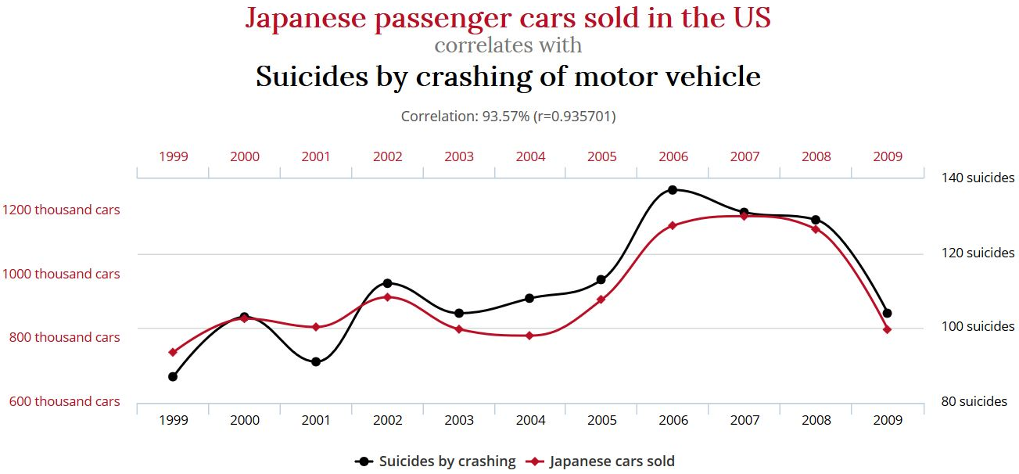
3. Correlation = 93.6%.
Isn’t this statistically significant?
www.tylervigen.com
Normal Statistical Significance Cutoffs
Don’t Apply to Time-Based Correlations
Notes:
StatLit for Managers
2013
2013Schield-MBAA
29
Analyzing Numbers in the News
15 May 2008
2008SchieldNNN6up.pdf
29
29

Slide 30
References
ASA (2012). GAISE Report.
Ehrenberg, A. S. C. (1976). We must preach what is practised: a radical review of statistical teaching. Journal of the Royal Statistical Society, Series D, 25(3),195–208.
Pearl, D., Garfield, J., delMas, R., Groth, R., Kaplan, J. McGowan, H., and Lee, H.S. (2012). Connecting Research to Practice in a Culture of Assessment for Introductory College-level Statistics.
www.causeweb.org/research/guidelines/ResearchReport_Dec_2012.pdf
Schield, M. (2006). Presenting Confounding and Standardization Graphically. STATS Magazine, American Statistical Association. Fall 2006. pp. 14-18. Copy at www.StatLit.org/pdf/2006SchieldSTATS.pdf.

