Slide 1
Teaching Confounding and Multivariate Thinking
Milo Schield, Augsburg College
Member: International Statistical Institute
US Rep: International Statistical Literacy Project
VP. National Numeracy Network
IASE Roundtable in Berlin
July 1, 2016
www.StatLit.org/pdf/2016-Schield-IASE-2Slides.pdf
Notes:
StatLit for Managers
2013
2013Schield-MBAA
1
Analyzing Numbers in the News
15 May 2008
2008SchieldNNN6up.pdf
1
1
The 2016 update to the ASA GAISE guidelines is arguably the biggest change in the introductory course content since discrete math was dropped in the 1980s.

Slide 2
GAISE 2016: Two New Emphases
Teach statistics as an investigative process of problem-solving and decision making.
Statistics is a problem-solving and decision-making process, not a collection of formulas and methods.
Give students experience in multivariable thinking
The world is a tangle of complex problems with inter-related factors. Lets show students how to explore relationships among many variables
Notes:
StatLit for Managers
2013
2013Schield-MBAA
2
Analyzing Numbers in the News
15 May 2008
2008SchieldNNN6up.pdf
2
2
Two new emphases: A. Statistics is a decision-making process. B. Give students experience in multivariable thinking.

Slide 3
GAISE 2016 Add Multivariable Thinking
give "students experience with multivariable thinking"
understand “the possible impact of ... confounding"
See how "a third variable can change our understanding"
Help students "identify observational studies"
teach multivariate thinking "in stages" and
use "simple approaches (such as stratification)”
This change is HUGE! It may be the biggest content change since dropping combinations in the 1980s.
Notes:
StatLit for Managers
2013
2013Schield-MBAA
3
Analyzing Numbers in the News
15 May 2008
2008SchieldNNN6up.pdf
3
3
Understand the impact of confounding.
Identify observational studies. Teach multivariate thinking “in stages”

Slide 4
GAISE 2016 Appendix B: Observational Data
Multivariable thinking is critical to make sense of the observational data around us. The real world is complex and can’t be described well by one or two variables. [Italics added]
Notes:
StatLit for Managers
2013
2013Schield-MBAA
4
Analyzing Numbers in the News
15 May 2008
2008SchieldNNN6up.pdf
4
4
Appendix B is a must read for every statistical educator. Notice the phrase “observational data”. Observational data, confounding and multivariable thinking: these three represent a massive change in focus!

Slide 5
GAISE 2016 Confounding
“The 2014 ASA guidelines for undergraduate programs in statistics recommend that students obtain a clear understanding of principles of statistical design and tools to assess and account for the possible impact of other measured and unmeasured confounding variables (ASA, 2014).“
http://www.amstat.org/education/gaise/collegeupdate/GAISE2016_DRAFT.pdf
Notes:
StatLit for Managers
2013
2013Schield-MBAA
5
Analyzing Numbers in the News
15 May 2008
2008SchieldNNN6up.pdf
5
5
Students need to understand the principles and tool to account for the impact of confounders.

Slide 6
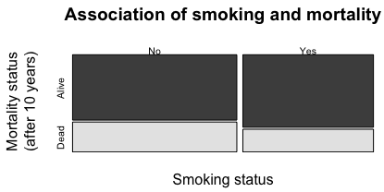
Show Multivariable #1: Ekisogram
Show probabilities as areas:
This mosaic plot doesn’t work well for me.
Notes:
StatLit for Managers
2013
2013Schield-MBAA
6
Analyzing Numbers in the News
15 May 2008
2008SchieldNNN6up.pdf
6
6
First method is Second method starts with a simple two-variable XY-plot. As average teacher salary increases, state average SAT decreases. To increase student SATs, cut teacher salaries.

Slide 7
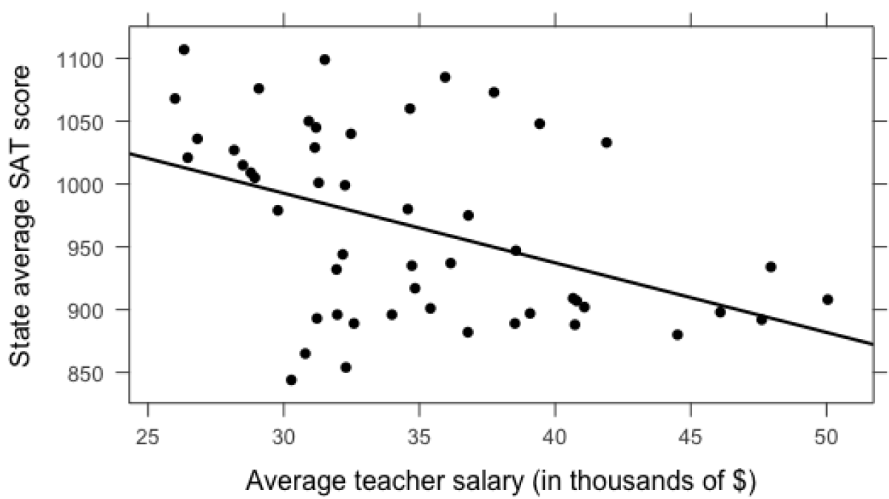
Show Multivariable: #2: XY Plot (2 factors)
.
Notes:
StatLit for Managers
2013
2013Schield-MBAA
7
Analyzing Numbers in the News
15 May 2008
2008SchieldNNN6up.pdf
7
7
First method is Second method starts with a simple two-variable XY-plot. As average teacher salary increases, state average SAT decreases. To increase student SATs, cut teacher salaries.

Slide 8
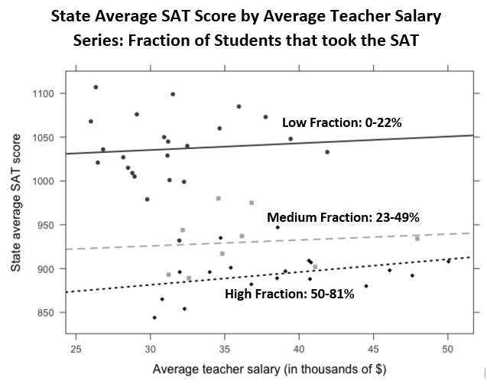
GAISE 2016 Multivariable Thinking
.
Notes:
StatLit for Managers
2013
2013Schield-MBAA
8
Analyzing Numbers in the News
15 May 2008
2008SchieldNNN6up.pdf
8
8
Second method involves modeling separate series in that same XY plot. The confounder is the percentage of students that took the SAT. Consider the top “low-fraction” group. Most students in the Midwest and the South take the ACT – not the SAT. Only the best students take the SAT in applying to colleges on the East or West coast. Being in the Midwest and the South, their teacher salaries are lower. They cluster in the upper-left corner.
Consider the bottom “high fraction” group. Most students on the East and West coast take the SAT. These students include the best, the middle and the below-average. Their average SAT is lower. Being on the coasts, their teacher salaries are higher. They cluster in the lower right corner.
Controlling for the percentage taking the SAT changes the association between teacher salaries and average student scores.

Slide 9
#2 Show Multivariable: Complex Confounder
This method models separate series in that same XY plot. The confounder: percentage of students in the state that took the SAT.
Consider the “low-fraction” states in the upper-left corner. Most students in the Midwest and the South take the ACT – not the SAT. Only the best Midwestern students take the SAT in applying to colleges on the East or West coast. In the Midwest teacher salaries are lower.
Consider the “high fraction” states in the lower-right corner. Most students on the East and West coast take the SAT. These students include all students: best, middle and below-average so their average SAT is lower. On the coasts, teacher salaries are higher.
Controlling for the percentage taking the SAT changes the association between teacher salaries and average student scores.
.
Notes:
StatLit for Managers
2013
2013Schield-MBAA
9
Analyzing Numbers in the News
15 May 2008
2008SchieldNNN6up.pdf
9
9
Second method involves modeling separate series in that same XY plot. The confounder is the percentage of students that took the SAT. Consider the top “low-fraction” group. Most students in the Midwest and the South take the ACT – not the SAT. Only the best students take the SAT in applying to colleges on the East or West coast. Being in the Midwest and the South, their teacher salaries are lower. They cluster in the upper-left corner.
Consider the bottom “high fraction” group. Most students on the East and West coast take the SAT. These students include the best, the middle and the below-average. Their average SAT is lower. Being on the coasts, their teacher salaries are higher. They cluster in the lower right corner.
Controlling for the percentage taking the SAT changes the association between teacher salaries and average student scores.

Slide 10
#3 Show Multivariable Regression X-Y Output
Scottish Hill Races (Time in seconds)
Assume that all modelling assumptions are satisfied Assume that all coefficients are statistically significant. http://www.scottishhillracing.co.uk/
Notes:
StatLit for Managers
2013
2013Schield-MBAA
10
Analyzing Numbers in the News
15 May 2008
2008SchieldNNN6up.pdf
10
10
The third recommended method is to read and interpret computer output. This output shows the relationship between climb distance and total time in Scottish Hill Races. An additional 1.8 seconds for every additional meter of hill climb. This model omits the length of the race – an important factor in predicting race time.

Slide 11
#3 Show Multivariate: Regression X1-X2-Y Output
Scottish Hill Races (Time in seconds)
Controlling for Distance decreases Climb coefficient from 1.755 to 0.852; increases R² from 85% to 97%.
Notes:
StatLit for Managers
2013
2013Schield-MBAA
11
Analyzing Numbers in the News
15 May 2008
2008SchieldNNN6up.pdf
11
11
This model includes both Climb and Distance. Including distance cuts the climb coefficient from 1.8 to 0.8 seconds per meter. Here controlling for a confounder “reduced that observed association.”

Slide 12
2016 GAISE Appendix B: Closing Thoughts (1)
“Multivariable thinking is critical to make sense of the observational data around us. This type of thinking might be introduced in stages”:
Learn to identify observational studies
Why randomized assignment … improves things
Wary: cause-effect conclusions from observational data
Consider – and explain -- confounding factors
Simple approaches (stratification) to show confounding
http://www.amstat.org/education/gaise/collegeupdate/GAISE2016_DRAFT.pdf
Notes:
StatLit for Managers
2013
2013Schield-MBAA
12
Analyzing Numbers in the News
15 May 2008
2008SchieldNNN6up.pdf
12
12
This page alone is incredible. Big three ideas: Observational studies, Confounding and multivariable thinking

Slide 13
2016 GAISE Appendix B Closing Thoughts (2)
“If students do not have exposure to simple tools for disentangling complex relationships, they may dismiss statistics as an old-school discipline only suitable for small sample inference of randomized studies.”
“This report recommends that students be introduced to multivariable thinking, preferably early in the introductory course and not as an afterthought at the end of the course.”
Notes:
StatLit for Managers
2013
2013Schield-MBAA
13
Analyzing Numbers in the News
15 May 2008
2008SchieldNNN6up.pdf
13
13

Slide 14
GAISE 2016 Deletions
.
Notes:
StatLit for Managers
2013
2013Schield-MBAA
14
Analyzing Numbers in the News
15 May 2008
2008SchieldNNN6up.pdf
14
14

Slide 15
Stratification: Half Tables Death Rates by Group
Overall, non-smokers more likely to die than smokers
DIED | YOUNG | OLD | TOTAL
NON SMOKER | 12% | 86% | 31%
SMOKER | 18% | 88% | 24%
TOTAL | 15% | 86% | 28%
Within Young (and within Old) the reverse is true.
Notes:
StatLit for Managers
2013
2013Schield-MBAA
15
Analyzing Numbers in the News
15 May 2008
2008SchieldNNN6up.pdf
15
15

Slide 16
Problem with “Showing” Confounding
Do these visualizations “explain” confounding?
Can students use these to work problems with numerical answers?
Will this be on the final?
If all three answers are “No”, teachers are unlikely to spend much time showing multivariable thinking. Maybe the last class before the final ☺
Notes:
StatLit for Managers
2013
2013Schield-MBAA
16
Analyzing Numbers in the News
15 May 2008
2008SchieldNNN6up.pdf
16
16

Slide 17
Explain Confounding: Alternate Presentations
After Year 1, other disadvantaged student discover this teacher helps them get higher scores, so they switch to this teacher increasing their prevalence from 10% to 50%.
 |  | Year 1 |  | Year 2
 | Number | Score |  | Score | Number
Disadvantaged | 10 | 80% | ­↑ | 81% | 50
Advantaged | 90 | 90% | ­↑ | 91% | 50
TOTAL | 100 | 89% | ↓ | 86% | 100
www.quora.com/What-is-a-simple-explanation-for-why-Simpsons-Paradox-occur
Explain: “It’s the mix”
Notes:
StatLit for Managers
2013
2013Schield-MBAA
17
Analyzing Numbers in the News
15 May 2008
2008SchieldNNN6up.pdf
17
17

Slide 18
Wainer’s Standardization
In 2004, Howard Wainer introduced a graphical technique that controlled for the influence of a binary confounder.
It requires minimal math and is visually intuitive.
Peter Holmes said that reading this graph was the first time he “really understood” confounding.
My music and art majors find this graph easy to read. They can easily work problems with numerical answers.
For details, see Schield (2006). Presenting Confounding Graphically Using Standardization. ASA Stats Magazine.
Notes:
StatLit for Managers
2013
2013Schield-MBAA
18
Analyzing Numbers in the News
15 May 2008
2008SchieldNNN6up.pdf
18
18

Slide 19
Simpson’s Paradox: It’s the Mix More in “Poor” condition
.
Notes:
StatLit for Managers
2013
2013Schield-MBAA
19
Analyzing Numbers in the News
15 May 2008
2008SchieldNNN6up.pdf
19
19

Slide 20
Simpson’s Paradox: It’s the Mix Standardize: Common Mixture
.
Notes:
StatLit for Managers
2013
2013Schield-MBAA
20
Analyzing Numbers in the News
15 May 2008
2008SchieldNNN6up.pdf
20
20

Slide 21
Simpson’s Paradox: It’s the Mix Standardize: Common Mixture
74% of top row are young; 90% of Row 2 are young.
DIED | YOUNG | OLD | TOTAL
NON SMOKER | 12% | 86% | 31%
SMOKER | 18% | 88% | 24%
TOTAL | 15% | 86% | 28%
82% of Row 3 are young; standardize top 2 with 82% young Non-smoker standard death rate: 25% (0.82*12+0.18*86) Smoker standardized death rate: 31% (0.82*18+0.18*88) Standardized death rate for smokers > than for non-smokers
Notes:
StatLit for Managers
2013
2013Schield-MBAA
21
Analyzing Numbers in the News
15 May 2008
2008SchieldNNN6up.pdf
21
21

Slide 22
Back to Beginning
Consider teaching “Association is not causation”
1973 Berkeley sex discrimination case
Ice cream sales and burglaries
Problem: These involve confounding – not chance.
But this is a great introduction for an introductory statistics course that is focused on Social Statistics ☺
Notes:
StatLit for Managers
2013
2013Schield-MBAA
22
Analyzing Numbers in the News
15 May 2008
2008SchieldNNN6up.pdf
22
22

Slide 23
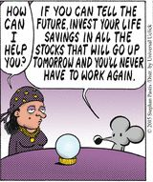
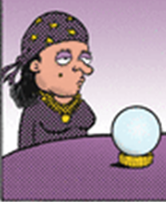
Confounded
.
Notes:
StatLit for Managers
2013
2013Schield-MBAA
23
Analyzing Numbers in the News
15 May 2008
2008SchieldNNN6up.pdf
23
23

