Slide 1
Epidemiological Models
Generate Spotty Statistics
1
MILO SCHIELD,
Augsburg College
US Rep: International Statistical Literacy Project
VP: National Numeracy Network
Webmaster: www. StatLit.org
August 22, 2011
International Statistical Institute Dublin, Ireland
www.StatLit.org/pdf/2011-Schield-ISI-Slides.pdf
Notes:
Social Construction of Rankings
8/4/2010
www.StatLit.org/pdf/2010SchieldASA6up.pdf
1
2008 StatLit Skills Survey
Fall 2008
2008SchieldSkillsSurvey6up.pdf
1

Slide 2
1. Linear-model statistics are found in the media
2
“the rate of [Alzheimer’s] decline unfolded 4 percent more quickly for each additional year of education.” Reuters 10/22/2007.
“For every can or glass of sugar-sweetened beverage a child drank [a day] …, a child’s … chance of becoming obese increased 60%.” The Lancet, 2001; 357:505-508.
“each hour of television watched per day at ages 1-3 increases the risk of attention problems, such as ADHD, by almost 10 percent at age 7.” Science Daily 4/6/2004.
Notes:
Social Construction of Rankings
8/4/2010
www.StatLit.org/pdf/2010SchieldASA6up.pdf
2
2008 StatLit Skills Survey
Fall 2008
2008SchieldSkillsSurvey6up.pdf
2
We have the top and bottom of this pyramid.
The Top: We know where we are headed. We are clear on our goal.
Our common goal is to see quantitative literacy grow.
The bottom: We have the foundation.
The need for quantitative literacy has been documented.
The books by Steen and Madison have documented this very clearly.
So, we have the foundation and we know where we are headed.
-------------------------------------
To support an interdisciplinary area, college-wide support is necessary.
To obtain college-wide support, the subject must have wide faculty support.
And in today’s climate, it must be assessable.
Unless QL is a clearly-stated campus-wide goal,
QL programs are likely to be transient.
Interdisciplinary programs cannot survive in a disciplinary world without strong college support
None of this will not happen unless quantitative literacy is “understandable and teachable.”
That brings us back to the problems mentioned in the previous slide.
Quantitative literacy must be “understandable and teachable.”
Whether QL is understandable and teachable depends critically on the content of QL.
> Let’s focus in on some core content of Quantitative Literacy >

Slide 3

2. Epidemiological-model statistics are also found in the media
3
.
Notes:
Social Construction of Rankings
8/4/2010
www.StatLit.org/pdf/2010SchieldASA6up.pdf
3
2008 StatLit Skills Survey
Fall 2008
2008SchieldSkillsSurvey6up.pdf
3

Slide 4
2. How Epidemiological Models
Generate Statistics
4
Percentage Attributed to Exposure = 100% * (RateExposed – RateControl)/RateExposed
Consider these death rates:
• 10% for a city hospital (4% for a rural hospital).
Based on this, one can say
• “60% of the deaths at city hospital
are attributed to that hospital.”
• Excess / Higher = (10% - 4%)/10% = 60%
Notes:
Social Construction of Rankings
8/4/2010
www.StatLit.org/pdf/2010SchieldASA6up.pdf
4
2008 StatLit Skills Survey
Fall 2008
2008SchieldSkillsSurvey6up.pdf
4

Slide 5
2. How Epidemiological Models
Generate Statistics #2
5
If lung-cancer deaths are 10 times as prevalent for smokers as for non-smokers, then 90% of smoker lung-cancer deaths are attributable to smoking.
Suppose the coroner-certified lung-cancer deaths among smokers number 100,000.
The lung-cancer deaths among smokers attributable to smoking number 90,000: 90% of 100,000.
Notes:
Social Construction of Rankings
8/4/2010
www.StatLit.org/pdf/2010SchieldASA6up.pdf
5
2008 StatLit Skills Survey
Fall 2008
2008SchieldSkillsSurvey6up.pdf
5

Slide 6
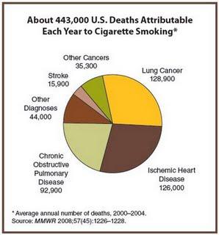
.
6
.
Notes:
Social Construction of Rankings
8/4/2010
www.StatLit.org/pdf/2010SchieldASA6up.pdf
6
2008 StatLit Skills Survey
Fall 2008
2008SchieldSkillsSurvey6up.pdf
6

Slide 7

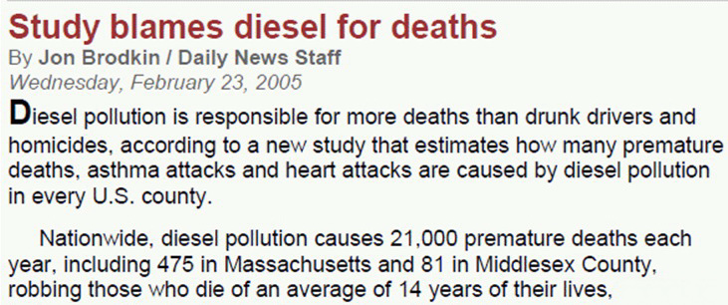
Responsible for …
7
Notes:
Social Construction of Rankings
8/4/2010
www.StatLit.org/pdf/2010SchieldASA6up.pdf
7
2008 StatLit Skills Survey
Fall 2008
2008SchieldSkillsSurvey6up.pdf
7
We have the top and bottom of this pyramid.
The Top: We know where we are headed. We are clear on our goal.
Our common goal is to see quantitative literacy grow.
The bottom: We have the foundation.
The need for quantitative literacy has been documented.
The books by Steen and Madison have documented this very clearly.
So, we have the foundation and we know where we are headed.
-------------------------------------
To support an interdisciplinary area, college-wide support is necessary.
To obtain college-wide support, the subject must have wide faculty support.
And in today’s climate, it must be assessable.
Unless QL is a clearly-stated campus-wide goal,
QL programs are likely to be transient.
Interdisciplinary programs cannot survive in a disciplinary world without strong college support
None of this will not happen unless quantitative literacy is “understandable and teachable.”
That brings us back to the problems mentioned in the previous slide.
Quantitative literacy must be “understandable and teachable.”
Whether QL is understandable and teachable depends critically on the content of QL.
> Let’s focus in on some core content of Quantitative Literacy >

Slide 8
2. Epidemiological statistics are common!
US Annual Deaths Attributable To:
8
Smoking: 467,000 Blood pressure: 395,000
Overweight: 216,000 Inactivity: 191,000
Blood sugar: 190,000 LDL cholesterol: 113,000
Dietary salt: 102,000 Low omega-3 : 84,000
High dietary trans fatty acids: 82,000
Alcohol use: 64,000 (90,000 less 26,000 averted)
Low intake of fruits and vegetables: 58,000
Low poly-unsaturated fatty acids: 15,000
www.emaxhealth.com/2/24/30740/
smoking-high-blood-pressure-obesity-top-preventable-death-causes.html
Notes:
Social Construction of Rankings
8/4/2010
www.StatLit.org/pdf/2010SchieldASA6up.pdf
8
2008 StatLit Skills Survey
Fall 2008
2008SchieldSkillsSurvey6up.pdf
8
We have the top and bottom of this pyramid.
The Top: We know where we are headed. We are clear on our goal.
Our common goal is to see quantitative literacy grow.
The bottom: We have the foundation.
The need for quantitative literacy has been documented.
The books by Steen and Madison have documented this very clearly.
So, we have the foundation and we know where we are headed.
-------------------------------------
To support an interdisciplinary area, college-wide support is necessary.
To obtain college-wide support, the subject must have wide faculty support.
And in today’s climate, it must be assessable.
Unless QL is a clearly-stated campus-wide goal,
QL programs are likely to be transient.
Interdisciplinary programs cannot survive in a disciplinary world without strong college support
None of this will not happen unless quantitative literacy is “understandable and teachable.”
That brings us back to the problems mentioned in the previous slide.
Quantitative literacy must be “understandable and teachable.”
Whether QL is understandable and teachable depends critically on the content of QL.
> Let’s focus in on some core content of Quantitative Literacy >

Slide 9
2. Web Articles Involving Deaths
[Google matches]
9
Google Search (4/2011) Exact Phrase)
### | WEB SEARCH | ### | WEB SEARCH
7 M | deaths associated with | 591 K | deaths attributed
87 K | deaths connected with | 246 K | deaths attributable
6 M | deaths linked to | 65 K | attributable deaths
5 M | deaths because of | 384 K | unnecessary deaths
39 M | deaths due to | 363 K | excess deaths
28 M | deaths caused by | 1.2 M | premature deaths
Notes:
Social Construction of Rankings
8/4/2010
www.StatLit.org/pdf/2010SchieldASA6up.pdf
9
2008 StatLit Skills Survey
Fall 2008
2008SchieldSkillsSurvey6up.pdf
9

Slide 10
2. Epidemiological statistics are easily generated
10
Two rates: complementary wholes and a common part:
Percentage attributable:
Graduation: % attributable to having educated parents
Dropouts: % attributable to having a single-parent
Incarceration: % attributable to having low IQ
Cases attributable:
Premature babies attributable to mom being a smoker
Auto accidents attributable to having DWI conviction
Deaths attributable to living in US vs. Mexico
Notes:
Social Construction of Rankings
8/4/2010
www.StatLit.org/pdf/2010SchieldASA6up.pdf
10
2008 StatLit Skills Survey
Fall 2008
2008SchieldSkillsSurvey6up.pdf
10
We have the top and bottom of this pyramid.
The Top: We know where we are headed. We are clear on our goal.
Our common goal is to see quantitative literacy grow.
The bottom: We have the foundation.
The need for quantitative literacy has been documented.
The books by Steen and Madison have documented this very clearly.
So, we have the foundation and we know where we are headed.
-------------------------------------
To support an interdisciplinary area, college-wide support is necessary.
To obtain college-wide support, the subject must have wide faculty support.
And in today’s climate, it must be assessable.
Unless QL is a clearly-stated campus-wide goal,
QL programs are likely to be transient.
Interdisciplinary programs cannot survive in a disciplinary world without strong college support
None of this will not happen unless quantitative literacy is “understandable and teachable.”
That brings us back to the problems mentioned in the previous slide.
Quantitative literacy must be “understandable and teachable.”
Whether QL is understandable and teachable depends critically on the content of QL.
> Let’s focus in on some core content of Quantitative Literacy >

Slide 11
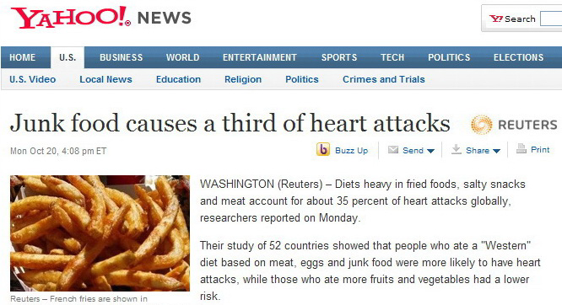
Causes; Account for
11
.
Notes:
Social Construction of Rankings
8/4/2010
www.StatLit.org/pdf/2010SchieldASA6up.pdf
11
2008 StatLit Skills Survey
Fall 2008
2008SchieldSkillsSurvey6up.pdf
11
We have the top and bottom of this pyramid.
The Top: We know where we are headed. We are clear on our goal.
Our common goal is to see quantitative literacy grow.
The bottom: We have the foundation.
The need for quantitative literacy has been documented.
The books by Steen and Madison have documented this very clearly.
So, we have the foundation and we know where we are headed.
-------------------------------------
To support an interdisciplinary area, college-wide support is necessary.
To obtain college-wide support, the subject must have wide faculty support.
And in today’s climate, it must be assessable.
Unless QL is a clearly-stated campus-wide goal,
QL programs are likely to be transient.
Interdisciplinary programs cannot survive in a disciplinary world without strong college support
None of this will not happen unless quantitative literacy is “understandable and teachable.”
That brings us back to the problems mentioned in the previous slide.
Quantitative literacy must be “understandable and teachable.”
Whether QL is understandable and teachable depends critically on the content of QL.
> Let’s focus in on some core content of Quantitative Literacy >

Slide 12
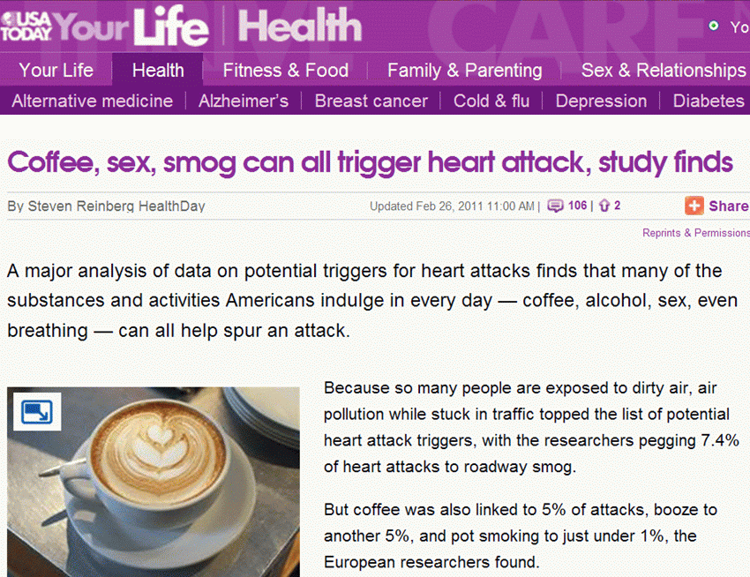
.
12
.
Notes:
Social Construction of Rankings
8/4/2010
www.StatLit.org/pdf/2010SchieldASA6up.pdf
12
2008 StatLit Skills Survey
Fall 2008
2008SchieldSkillsSurvey6up.pdf
12
We have the top and bottom of this pyramid.
The Top: We know where we are headed. We are clear on our goal.
Our common goal is to see quantitative literacy grow.
The bottom: We have the foundation.
The need for quantitative literacy has been documented.
The books by Steen and Madison have documented this very clearly.
So, we have the foundation and we know where we are headed.
-------------------------------------
To support an interdisciplinary area, college-wide support is necessary.
To obtain college-wide support, the subject must have wide faculty support.
And in today’s climate, it must be assessable.
Unless QL is a clearly-stated campus-wide goal,
QL programs are likely to be transient.
Interdisciplinary programs cannot survive in a disciplinary world without strong college support
None of this will not happen unless quantitative literacy is “understandable and teachable.”
That brings us back to the problems mentioned in the previous slide.
Quantitative literacy must be “understandable and teachable.”
Whether QL is understandable and teachable depends critically on the content of QL.
> Let’s focus in on some core content of Quantitative Literacy >

Slide 13
2. Epidemiological statistics encourage seductive grammar
13
Consider these titles of news stories:
45,000 deaths attributable to uninsurance
45,000 deaths associated with lack of insurance
Lack of insurance linked to 45,000 deaths
45,000 die … because of lack of health insurance
Lack of Health Insurance Kills 45,000 a Year
Lack of Health Insurance cause 44789 deaths
Lack of insurance to blame for almost 45,000 deaths
Source: www.StatLit.org/pdf/2010SchieldICOTS.pdf
Notes:
Social Construction of Rankings
8/4/2010
www.StatLit.org/pdf/2010SchieldASA6up.pdf
13
2008 StatLit Skills Survey
Fall 2008
2008SchieldSkillsSurvey6up.pdf
13

Slide 14
3. Epidemiological models generate “spotty” statistics
14
Model-based numbers are sensitive to the assumptions.
Epidemiological models are extremely sensitive to what is – and is not – taken into account.
“Spotty” statistics are statistics generated by epidem-iological models: they conceal more than they reveal.
“Spotty statistics” look like real statistics, but they are model-based. They look like they identify real causes,
but they merely indicate the size of an association.
Notes:
Social Construction of Rankings
8/4/2010
www.StatLit.org/pdf/2010SchieldASA6up.pdf
14
2008 StatLit Skills Survey
Fall 2008
2008SchieldSkillsSurvey6up.pdf
14

Slide 15
3. “Spotty” statistics are very sensitive to assumptions
15
2004: 400,000 deaths attributable to obesity.
“Obesity might soon pass smoking as the country's leading cause of preventable death.”
2005: 27,000 deaths attributable to obesity.
This finding transformed obesity from fearsome killer to pitiable also-ran, ranked in 7th place.
What changed? Perhaps they took something into account that is closely associated with death rates. Something such as age ... ☺
Notes:
Social Construction of Rankings
8/4/2010
www.StatLit.org/pdf/2010SchieldASA6up.pdf
15
2008 StatLit Skills Survey
Fall 2008
2008SchieldSkillsSurvey6up.pdf
15
We have the top and bottom of this pyramid.
The Top: We know where we are headed. We are clear on our goal.
Our common goal is to see quantitative literacy grow.
The bottom: We have the foundation.
The need for quantitative literacy has been documented.
The books by Steen and Madison have documented this very clearly.
So, we have the foundation and we know where we are headed.
-------------------------------------
To support an interdisciplinary area, college-wide support is necessary.
To obtain college-wide support, the subject must have wide faculty support.
And in today’s climate, it must be assessable.
Unless QL is a clearly-stated campus-wide goal,
QL programs are likely to be transient.
Interdisciplinary programs cannot survive in a disciplinary world without strong college support
None of this will not happen unless quantitative literacy is “understandable and teachable.”
That brings us back to the problems mentioned in the previous slide.
Quantitative literacy must be “understandable and teachable.”
Whether QL is understandable and teachable depends critically on the content of QL.
> Let’s focus in on some core content of Quantitative Literacy >

Slide 16
3. “Spotty” statistics are hard to detect
16
Spotty statistics – epidemiologically-based statistics – are common – but hidden – in the news.
• They have no unique grammar or keywords.
• They look plausible -- coroners might count them.
• We treat counts as facts.
• Journalists and politicians don’t question them.
• We don’t question them.
Notes:
Social Construction of Rankings
8/4/2010
www.StatLit.org/pdf/2010SchieldASA6up.pdf
16
2008 StatLit Skills Survey
Fall 2008
2008SchieldSkillsSurvey6up.pdf
16
We have the top and bottom of this pyramid.
The Top: We know where we are headed. We are clear on our goal.
Our common goal is to see quantitative literacy grow.
The bottom: We have the foundation.
The need for quantitative literacy has been documented.
The books by Steen and Madison have documented this very clearly.
So, we have the foundation and we know where we are headed.
-------------------------------------
To support an interdisciplinary area, college-wide support is necessary.
To obtain college-wide support, the subject must have wide faculty support.
And in today’s climate, it must be assessable.
Unless QL is a clearly-stated campus-wide goal,
QL programs are likely to be transient.
Interdisciplinary programs cannot survive in a disciplinary world without strong college support
None of this will not happen unless quantitative literacy is “understandable and teachable.”
That brings us back to the problems mentioned in the previous slide.
Quantitative literacy must be “understandable and teachable.”
Whether QL is understandable and teachable depends critically on the content of QL.
> Let’s focus in on some core content of Quantitative Literacy >

Slide 17
3. Statistical education should focus more on “spotty statistics”
17
By remaining silent on these “spotty” statistics,
the most common type of model-based statistics in the everyday media,
statistical education may be seen as an archaic subject stuck in the 20th century fields
of Fisher’s Rothamsted agricultural station.
Notes:
Social Construction of Rankings
8/4/2010
www.StatLit.org/pdf/2010SchieldASA6up.pdf
17
2008 StatLit Skills Survey
Fall 2008
2008SchieldSkillsSurvey6up.pdf
17
The bottom: We have the foundation.
The need for quantitative literacy has been documented.
The books by Steen and Madison have documented this very clearly.
So, we have the foundation and we know where we are headed.
-------------------------------------
To support an interdisciplinary area, college-wide support is necessary.
To obtain college-wide support, the subject must have wide faculty support.
And in today’s climate, it must be assessable.
Unless QL is a clearly-stated campus-wide goal,
QL programs are likely to be transient.
Interdisciplinary programs cannot survive in a disciplinary world without strong college support
None of this will not happen unless quantitative literacy is “understandable and teachable.”
That brings us back to the problems mentioned in the previous slide.
Quantitative literacy must be “understandable and teachable.”
Whether QL is understandable and teachable depends critically on the content of QL.
> Let’s focus in on some core content of Quantitative Literacy >

Slide 18
4. Statistical Literacy focuses on numbers in the everyday media
18
Statistical literacy is the ability to read and interpret summary statistics in the everyday media: in graphs, tables, statements, surveys
and studies.
Statistical literacy studies the use and misuse of “spotty statistics” in the everyday media.
Notes:
Social Construction of Rankings
8/4/2010
www.StatLit.org/pdf/2010SchieldASA6up.pdf
18
2008 StatLit Skills Survey
Fall 2008
2008SchieldSkillsSurvey6up.pdf
18
The bottom: We have the foundation.
The need for quantitative literacy has been documented.
The books by Steen and Madison have documented this very clearly.
So, we have the foundation and we know where we are headed.
-------------------------------------
To support an interdisciplinary area, college-wide support is necessary.
To obtain college-wide support, the subject must have wide faculty support.
And in today’s climate, it must be assessable.
Unless QL is a clearly-stated campus-wide goal,
QL programs are likely to be transient.
Interdisciplinary programs cannot survive in a disciplinary world without strong college support
None of this will not happen unless quantitative literacy is “understandable and teachable.”
That brings us back to the problems mentioned in the previous slide.
Quantitative literacy must be “understandable and teachable.”
Whether QL is understandable and teachable depends critically on the content of QL.
> Let’s focus in on some core content of Quantitative Literacy >

Slide 19
4. Statistical Educators Should
Promote Statistical Literacy
19
Almost 20% of US four-year colleges offer
a course in statistical literacy.
Statistical educators may say
“This is not our job.”
But if not you, then who?
If not now, then when?
Notes:
Social Construction of Rankings
8/4/2010
www.StatLit.org/pdf/2010SchieldASA6up.pdf
19
2008 StatLit Skills Survey
Fall 2008
2008SchieldSkillsSurvey6up.pdf
19
The bottom: We have the foundation.
The need for quantitative literacy has been documented.
The books by Steen and Madison have documented this very clearly.
So, we have the foundation and we know where we are headed.
-------------------------------------
To support an interdisciplinary area, college-wide support is necessary.
To obtain college-wide support, the subject must have wide faculty support.
And in today’s climate, it must be assessable.
Unless QL is a clearly-stated campus-wide goal,
QL programs are likely to be transient.
Interdisciplinary programs cannot survive in a disciplinary world without strong college support
None of this will not happen unless quantitative literacy is “understandable and teachable.”
That brings us back to the problems mentioned in the previous slide.
Quantitative literacy must be “understandable and teachable.”
Whether QL is understandable and teachable depends critically on the content of QL.
> Let’s focus in on some core content of Quantitative Literacy >

Slide 20
Bibliography
20
Schield, Milo (2009). Confound Those Speculative Statistics. 2009 American Statistical Association Proceedings of the Section on Statistical Education. [CD-ROM] P. 4255-4266. See www.StatLit.org/pdf/2009SchieldASA.pdf
Schield, Milo (2010). Assessing Statistical Literacy: TAKE CARE in Assessment Methods in Statistical Education: An International Perspective. Edited by P. Bidgood, N. Hunt and F. Joliffe. Wiley Publishers, Ch. 11, p. 133-152. Excerpts: www.statlit.org/pdf/2010SchieldExcerptsAssessingStatisticalLiteracy.pdf
Notes:
Social Construction of Rankings
8/4/2010
www.StatLit.org/pdf/2010SchieldASA6up.pdf
20
2008 StatLit Skills Survey
Fall 2008
2008SchieldSkillsSurvey6up.pdf
20
The bottom: We have the foundation.
The need for quantitative literacy has been documented.
The books by Steen and Madison have documented this very clearly.
So, we have the foundation and we know where we are headed.
-------------------------------------
To support an interdisciplinary area, college-wide support is necessary.
To obtain college-wide support, the subject must have wide faculty support.
And in today’s climate, it must be assessable.
Unless QL is a clearly-stated campus-wide goal,
QL programs are likely to be transient.
Interdisciplinary programs cannot survive in a disciplinary world without strong college support
None of this will not happen unless quantitative literacy is “understandable and teachable.”
That brings us back to the problems mentioned in the previous slide.
Quantitative literacy must be “understandable and teachable.”
Whether QL is understandable and teachable depends critically on the content of QL.
> Let’s focus in on some core content of Quantitative Literacy >

