Slide 1
Down Syndrome by
Birth Order & Mom’s Age
by
Milo Schield
Member: International Statistical Institute
US Rep: International Statistical Literacy Project
Director, W. M. Keck Statistical Literacy Project
Slides and Data at: www.StatLit.org/
pdf/2017-Schield-Downs-Syndrome-Slides.pdf
xls/2017-Schield-Downs-Syndrome-Data.xlsx
Notes:
Analyzing Numbers in the News
15 May 2008
2008SchieldNNN6up.pdf
1
1

Slide 2
Down Syndrome
2
Each person has 23 chromosome pairs.
Chromosomes are small “packages” of genes.
Down syndrome is a defect in chromosome 21.
Down syndrome is a genetic defect.
It is not the most common genetic defect.
It is #3 after cystic fibrosis & Huntington’s disease.
About 6,000 US babies/year have Down syndrome.
Notes:
Analyzing Numbers in the News
15 May 2008
2008SchieldNNN6up.pdf
2
2

Slide 3


Down Syndrome Kids
3
.
Notes:
Analyzing Numbers in the News
15 May 2008
2008SchieldNNN6up.pdf
3
3

Slide 4
Down Syndrome:
Common Health Problems
4
Hearing loss (up to 75%)
Obstructive sleep apnea (between 50 -75%)
Ear infections (between 50 -70%)
Eye diseases like cataracts (up to 60%) Heart defects present at birth (50%)
Disease: Symptoms with a definite cause.
Syndrome: Symptoms without a definite cause.
Usage may linger after cause is identified.
Notes:
Analyzing Numbers in the News
15 May 2008
2008SchieldNNN6up.pdf
4
4

Slide 5


Down Syndrome Kids
5
.
Notes:
Analyzing Numbers in the News
15 May 2008
2008SchieldNNN6up.pdf
5
5

Slide 6
Down Syndrome Adults:
Intelligence & Behavior
6
Average IQ of Down syndrome adult:
50: the mental ability of a 9-year-old
Down syndrome kids: slower to speak.
Down-syndrome child-behavior problems:
negativity, impulsivity,
oppositional behavior, inattention,
noncompliance, and disobedience, especially as they get older.
Notes:
Analyzing Numbers in the News
15 May 2008
2008SchieldNNN6up.pdf
6
6

Slide 7


Some Down Syndrome Kids Excel
7
Actors:
Chris Burke played Corky
in Life Goes On
Lauren Potter plays Becky Jackson on Glee
Notes:
Analyzing Numbers in the News
15 May 2008
2008SchieldNNN6up.pdf
7
7

Slide 8
Average Survival Age and Sex Ratio
8
Due to advances in medical technology,
individuals with Down syndrome are living longer.
Before antibiotics, average survival age was nine.
With antibiotics, average survival age was 19.
With antibiotics and corrective heart surgery,
80% of adults with Down syndrome reach age 60.
Among infants with Down syndrome, males are 24% more prevalent than females. Among moms 20-24, the male-female sex ratio is 1.73. The sex-ratio decreases as the age of the mother increases.
Notes:
Analyzing Numbers in the News
15 May 2008
2008SchieldNNN6up.pdf
8
8

Slide 9
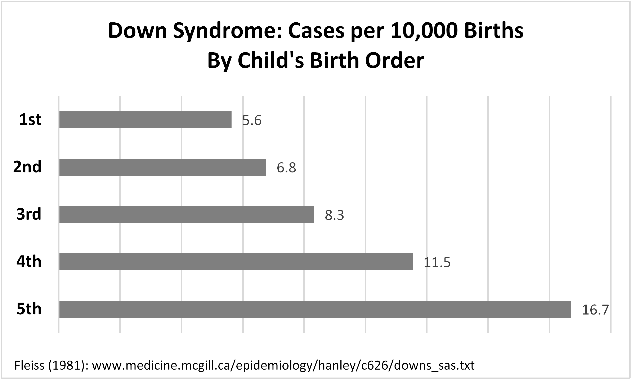
Down Syndrome Rate by Birth Order
.
Notes:
Analyzing Numbers in the News
15 May 2008
2008SchieldNNN6up.pdf
9
9

Slide 10
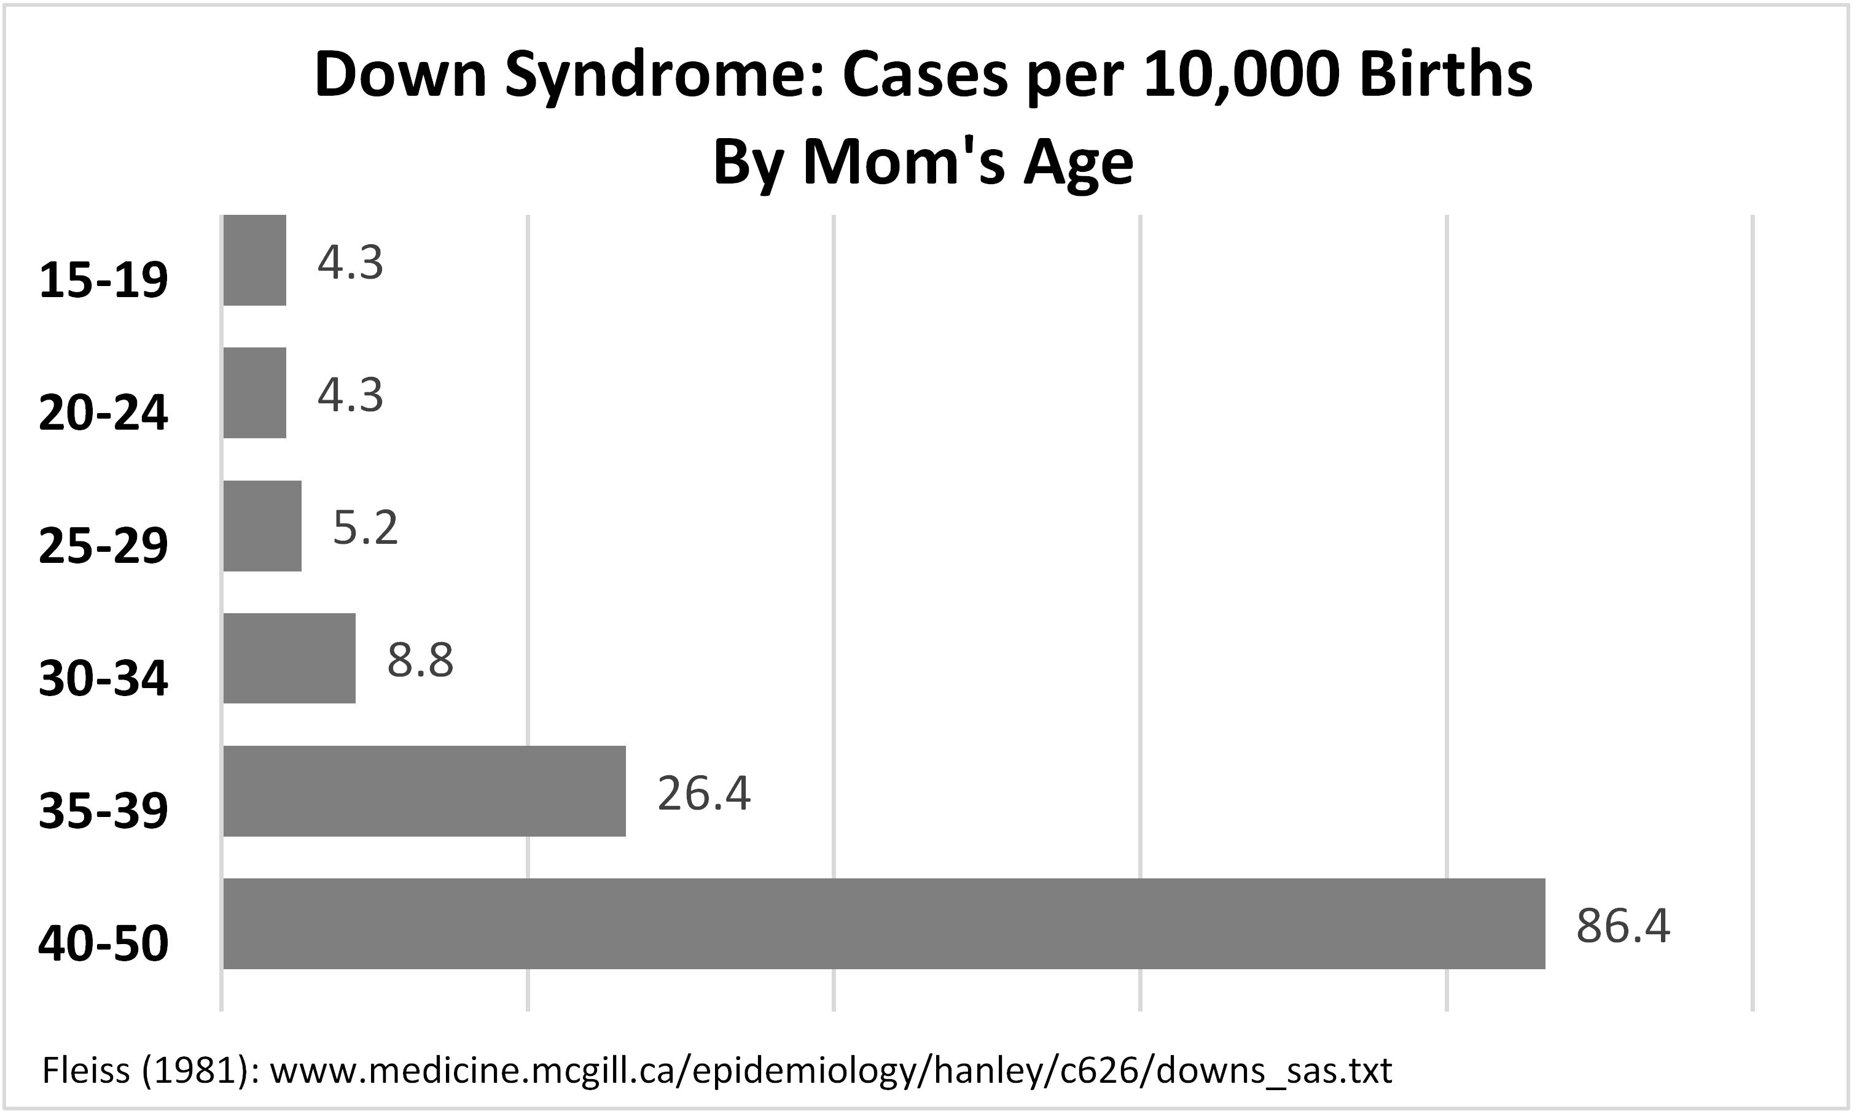
Down Syndrome Rate by Mom’s Age
.
Notes:
Analyzing Numbers in the News
15 May 2008
2008SchieldNNN6up.pdf
10
10

Slide 11
Down Syndrome Rates: Combine into Two Groups
Combine birth orders into two groups.
Combine mom’s ages into two groups.
Conceptually simpler.
Facilitates simple arithmetic comparisons.
Check conditions for Simpson’s paradox
Notes:
Analyzing Numbers in the News
15 May 2008
2008SchieldNNN6up.pdf
11
11

Slide 12
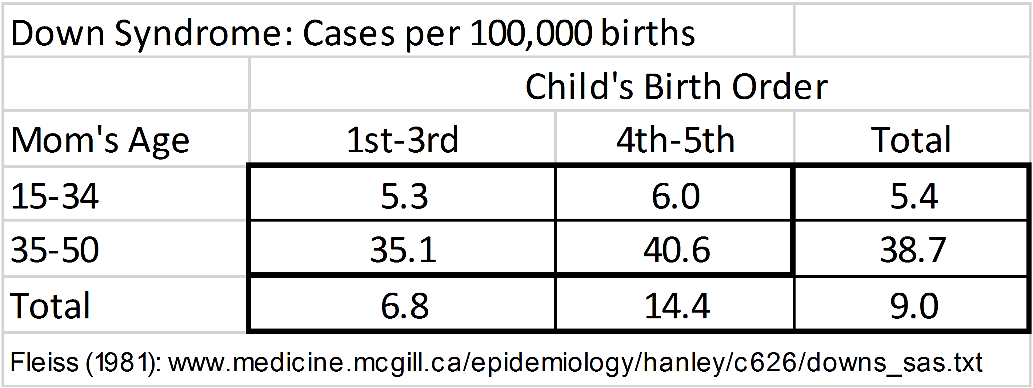
Down Syndrome Rate by Birth Order and Mom’s Age
12
Later children are twice as likely to have
Down syndrome as [are] earlier children.
Older moms are seven times as likely to have
Down syndrome child as [are] younger moms.
Notes:
Analyzing Numbers in the News
15 May 2008
2008SchieldNNN6up.pdf
12
12

Slide 13
Down Syndrome Rate by Birth Order and Mom’s Age
13
Later children are 112% more likely to have
Down syndrome than [are] earlier children.
Among younger moms, later children are 14% more
likely to have Down syndrome than earlier children.
Among older moms, later children are 16% more
likely to have Down Syndrome than earlier children.
Notes:
Analyzing Numbers in the News
15 May 2008
2008SchieldNNN6up.pdf
13
13

Slide 14
Down Syndrome Rate:
Controlling for Moms Age
14
Before controlling for Mom’s age, “Later children are 112% more likely to have Down syndrome than earlier children [more than twice as likely as earlier children].
After controlling for mom’s age, “Later children are 14 to 16% more likely to have Down syndrome than earlier children.
Notes:
Analyzing Numbers in the News
15 May 2008
2008SchieldNNN6up.pdf
14
14

Slide 15
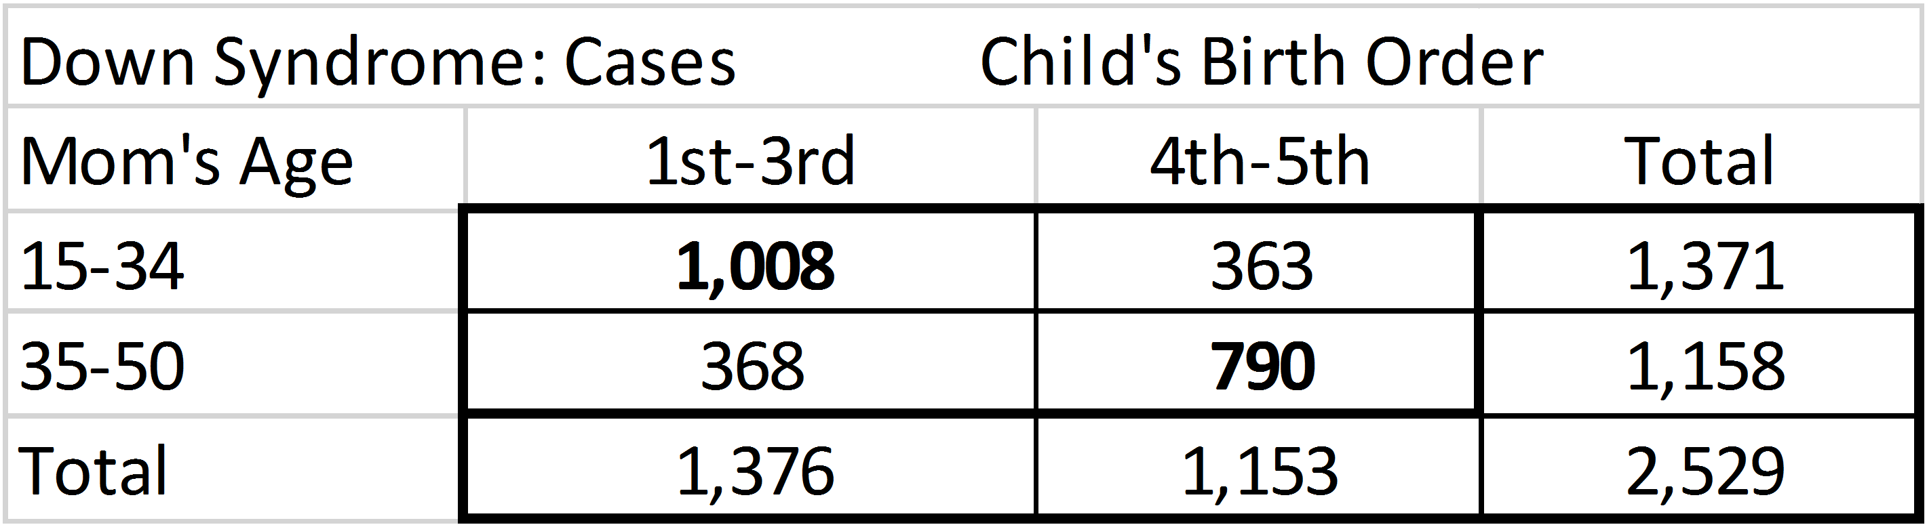
Down Syndrome Cases:
15
Association between birth order and mom’s age.
Earlier children: more likely to have younger moms.
Later children: more likely to have older moms.
Mom’s age confounds influence of birth order on chance of a child having Down syndrome.
Notes:
Analyzing Numbers in the News
15 May 2008
2008SchieldNNN6up.pdf
15
15

Slide 16
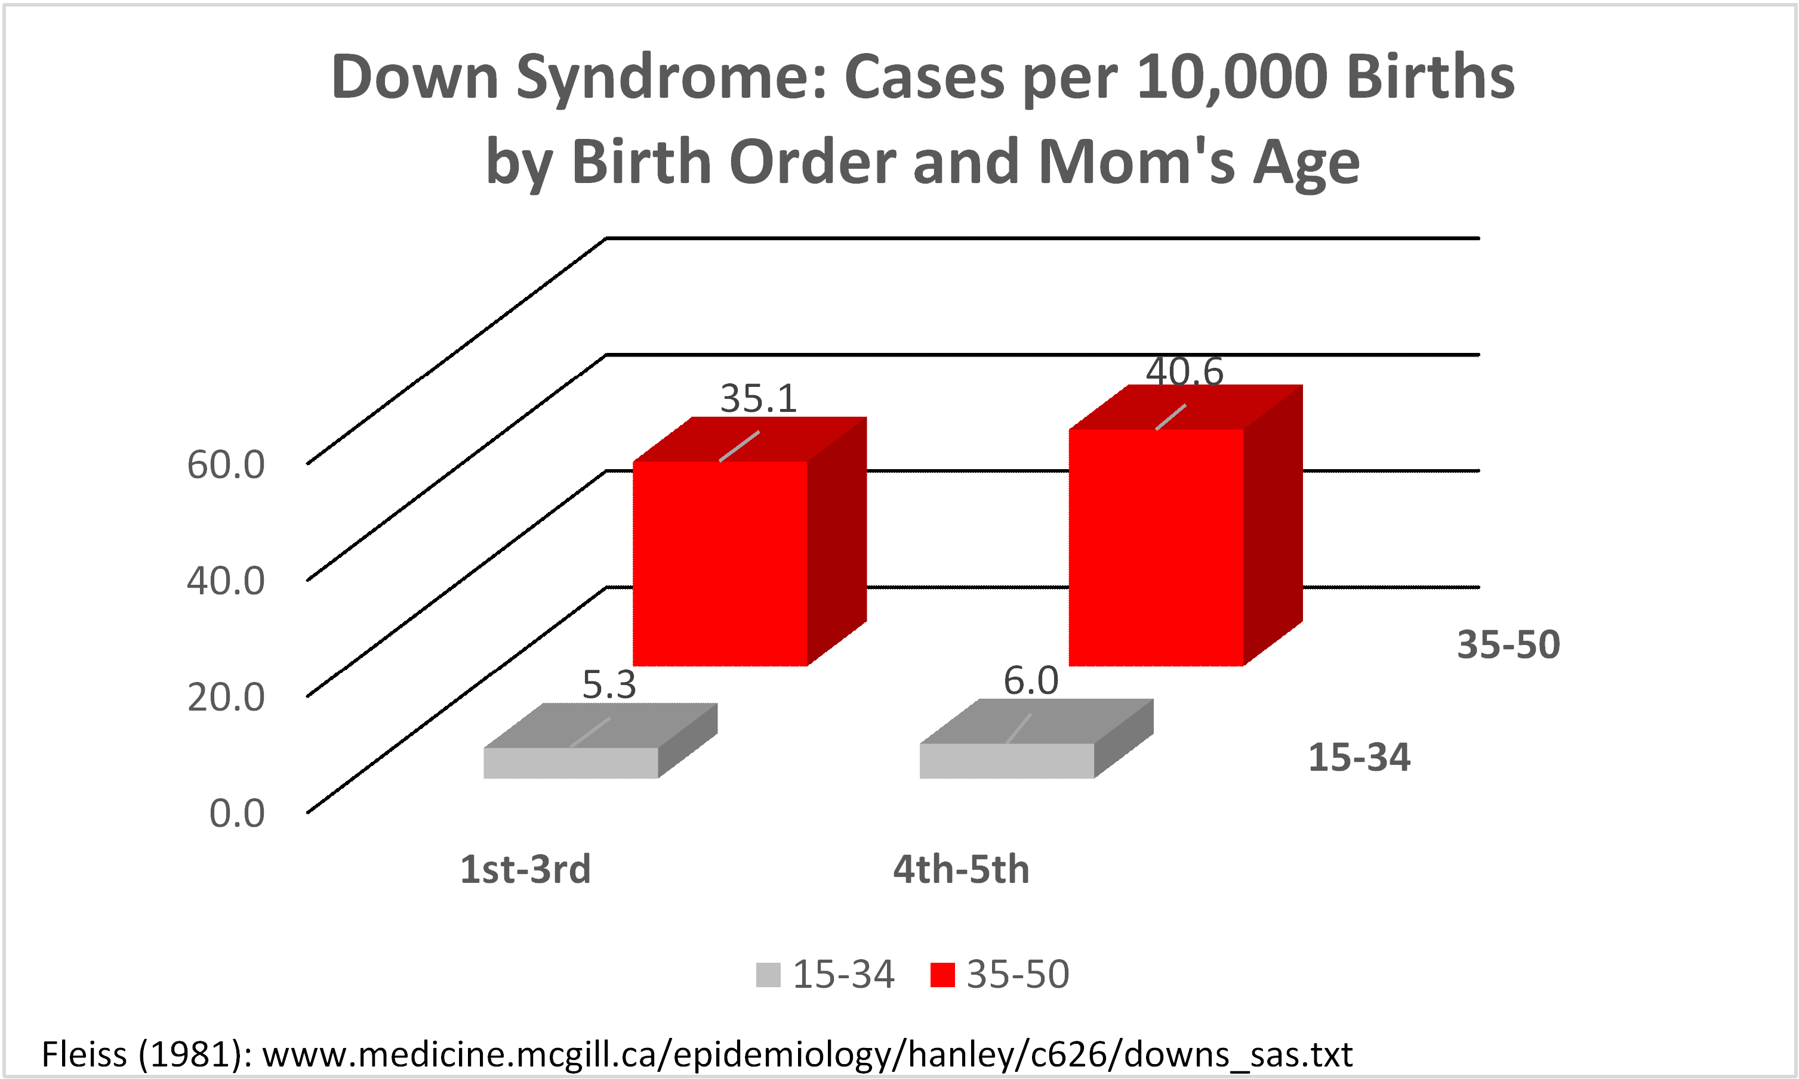
Down Syndrome Rate by Birth Order and Mom’s Age
16
.
Notes:
Analyzing Numbers in the News
15 May 2008
2008SchieldNNN6up.pdf
16
16

Slide 17
Down Syndrome:
Most Common vs. Most Likely
54% of children with Down syndrome are born to women under 35 years of age.
Children with Down syndrome are most common for Moms under 35 years old.
Children with Down syndrome are most likely for Moms over 35 years old.
Notes:
Analyzing Numbers in the News
15 May 2008
2008SchieldNNN6up.pdf
17
17

Slide 18
Conclusion
18
Being a statistician involves searching for the strongest –
the most fundamental – factors that influence an association.
Ignoring stronger factors can lead to Simpson’s paradox or simply misunderstanding the relevant statistical associations that might better serve as a basis for identifying causal connections.
Notes:
Analyzing Numbers in the News
15 May 2008
2008SchieldNNN6up.pdf
18
18

