Slide 1
All Statistics are Socially Constructed
1
MILO SCHIELD,
Augsburg College
US Rep: International Statistical Literacy Project
VP National Numeracy Network
Webmaster www. StatLit.org
18 August 2011
IASE Malahide, Ireland
www.StatLit.org/pdf/2011-Schield-IASE-Slides.pdf
Notes:
Social Construction of Rankings
8/4/2010
www.StatLit.org/pdf/2010SchieldASA6up.pdf
1
2008 StatLit Skills Survey
Fall 2008
2008SchieldSkillsSurvey6up.pdf
1
Good evening.

Slide 2
Statistical Literacy courses:
The Next Big Thing?
2
2009: Survey of all US four-year colleges found that 19% of respondents offered a statistical literacy course.
2010: Wired Magazine said, "Statistical literacy: A course you should have taken in college."
2011: US Supreme Court finds statistical significance is not necessary for causation.
2011: Eight college faculty completed the Augsburg College statistical-literacy teacher-training course online. These teachers analyzed 14 news stories.
Notes:
Social Construction of Rankings
8/4/2010
www.StatLit.org/pdf/2010SchieldASA6up.pdf
2
2008 StatLit Skills Survey
Fall 2008
2008SchieldSkillsSurvey6up.pdf
2

Slide 3
#1 All Statistics are
Socially Constructed
3
“All statistics, from the best to the worst, are socially constructed.
All statistics are products of choices and compromises that inevitably shape, limit, and distort the outcome.”
Joel Best (2002)
Notes:
Social Construction of Rankings
8/4/2010
www.StatLit.org/pdf/2010SchieldASA6up.pdf
3
2008 StatLit Skills Survey
Fall 2008
2008SchieldSkillsSurvey6up.pdf
3

Slide 4
#2 Four Kinds of Influence on Statistics
Take CARE
4
Context: Influence of factors that were – and were
not – taken into account (multivariate analysis)
Assembly: Influence of choices in defining, measuring,
comparing and presenting statistics
Randomness: Influence of chance based on choices
in type and size of sample
Error (Bias): Influence of factors generating systematic
differences between observed and reality.
Notes:
Social Construction of Rankings
8/4/2010
www.StatLit.org/pdf/2010SchieldASA6up.pdf
4
2008 StatLit Skills Survey
Fall 2008
2008SchieldSkillsSurvey6up.pdf
4

Slide 5
Statistical-Inference Courses
Cover Randomness and Error
5
Statistical educators generally teach that statistics can be influenced by human choices:
Randomness: size and type of sample (random vs. convenience), sampling distribution, etc.
Error/bias: Choices that produce subject-response bias, measurement bias and sampling bias. E.g., the target population, the sampled population, the sampling method, the handling of non-responses
Notes:
Social Construction of Rankings
8/4/2010
www.StatLit.org/pdf/2010SchieldASA6up.pdf
5
2008 StatLit Skills Survey
Fall 2008
2008SchieldSkillsSurvey6up.pdf
5

Slide 6
#3. Statistics Are
Influenced by “Context”
6
Statistical educators agree that statistics are numbers in context, but they don’t generally teach that statistics can be influenced by human choices involving “context”: choices in
what to take into account using tables, series, ratios, comparisons and comparisons of ratios
how to model data
what factors not taken into account (potential confounders)
Notes:
Social Construction of Rankings
8/4/2010
www.StatLit.org/pdf/2010SchieldASA6up.pdf
6
2008 StatLit Skills Survey
Fall 2008
2008SchieldSkillsSurvey6up.pdf
6

Slide 7


Hyatt: Close to the US Capital
7
.
Notes:
Social Construction of Rankings
8/4/2010
www.StatLit.org/pdf/2010SchieldASA6up.pdf
7
2008 StatLit Skills Survey
Fall 2008
2008SchieldSkillsSurvey6up.pdf
7

Slide 8




Loudest Animal on Earth
8
.
Notes:
Social Construction of Rankings
8/4/2010
www.StatLit.org/pdf/2010SchieldASA6up.pdf
8
2008 StatLit Skills Survey
Fall 2008
2008SchieldSkillsSurvey6up.pdf
8

Slide 9
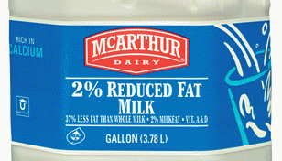
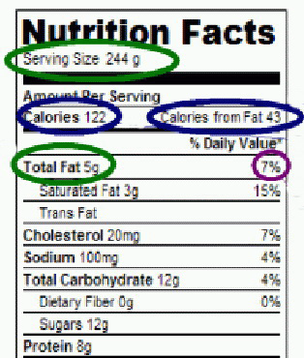
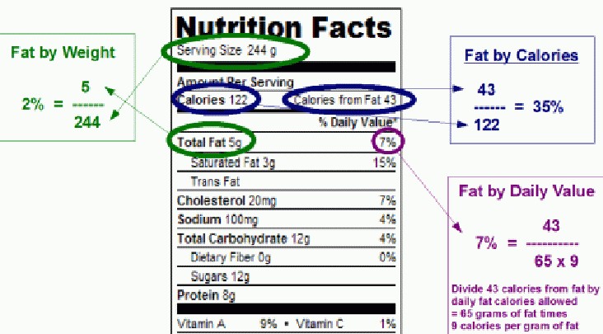
Two Per Cent Milk
9
.
Notes:
Social Construction of Rankings
8/4/2010
www.StatLit.org/pdf/2010SchieldASA6up.pdf
9
2008 StatLit Skills Survey
Fall 2008
2008SchieldSkillsSurvey6up.pdf
9

Slide 10
#4 Statistics are
Influenced by “Assembly”
10
Statistical educators don’t generally teach that statistics can be influenced by human choices in “Assembly”: choices in
definitions of groups/measures*
comparisons (# more vs. % more)
presentation (pie chart vs. bar graph)
* aside from mean vs. median...
Notes:
Social Construction of Rankings
8/4/2010
www.StatLit.org/pdf/2010SchieldASA6up.pdf
10
2008 StatLit Skills Survey
Fall 2008
2008SchieldSkillsSurvey6up.pdf
10

Slide 11
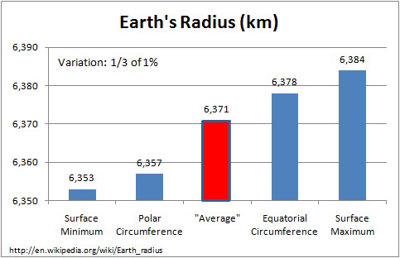
Radius of the Earth (km)
11
.
Notes:
Social Construction of Rankings
8/4/2010
www.StatLit.org/pdf/2010SchieldASA6up.pdf
11
2008 StatLit Skills Survey
Fall 2008
2008SchieldSkillsSurvey6up.pdf
11

Slide 12
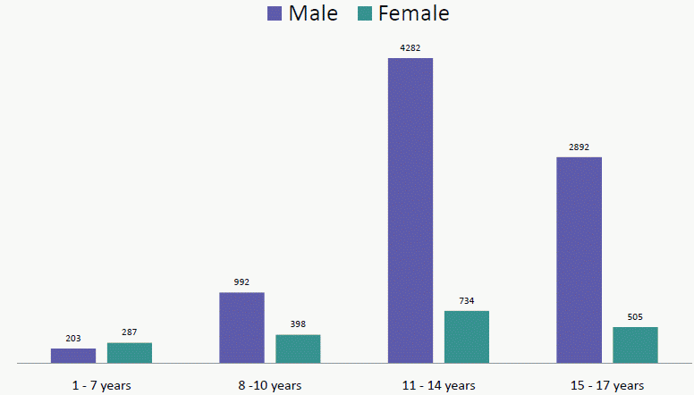
Children sexually-abused by priests:
Less than 20% involved pedophilia
12
.
Pedophile: adult who sexually abuses pre-pubescent children
(< 11)
Under age 11:
< 20% of cases
Notes:
Social Construction of Rankings
8/4/2010
www.StatLit.org/pdf/2010SchieldASA6up.pdf
12
2008 StatLit Skills Survey
Fall 2008
2008SchieldSkillsSurvey6up.pdf
12

Slide 13
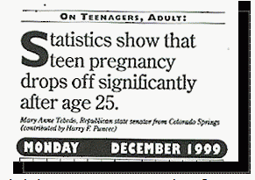
Pure Assembly!!
13
.
Notes:
Social Construction of Rankings
8/4/2010
www.StatLit.org/pdf/2010SchieldASA6up.pdf
13
2008 StatLit Skills Survey
Fall 2008
2008SchieldSkillsSurvey6up.pdf
13

Slide 14
How to Teach Context and Assembly?
14
Must involve problems that can be assessed.
Augsburg’s Statistical Literacy course has created:
over 300 involving Context
over 100 exercises involving Assembly
Consider ways to teach assembly using definitions
Notes:
Social Construction of Rankings
8/4/2010
www.StatLit.org/pdf/2010SchieldASA6up.pdf
14
2008 StatLit Skills Survey
Fall 2008
2008SchieldSkillsSurvey6up.pdf
14

Slide 15
Definitions of statistics
Can be Classified on a Spectrum
15
Two Extremes for Comparisons:
Formal: Need no knowledge of ideas
  Fewer tall smokers than smokers…
Material: Need detailed knowledge of ideas
  More autistic boys than autistic girls…
In between: Need some knowledge of ideas
  Men are taller than women on average.
  Women live longer than men on average.
Notes:
Social Construction of Rankings
8/4/2010
www.StatLit.org/pdf/2010SchieldASA6up.pdf
15
2008 StatLit Skills Survey
Fall 2008
2008SchieldSkillsSurvey6up.pdf
15

Slide 16
Statistical educators should teach definitions as part of study design
16
Should teach formal comparisons of operational definitions. Little knowledge of ideas is needed. Like logic/math.
Might delay teaching material comparisons of operational definitions. Requires a detailed knowledge of specialized ideas. Leave this to SMEs.
Could selectively teach in-between comparisons of operational definitions. At least show sensitivity of some statistics to small changes in definition.
Notes:
Social Construction of Rankings
8/4/2010
www.StatLit.org/pdf/2010SchieldASA6up.pdf
16
2008 StatLit Skills Survey
Fall 2008
2008SchieldSkillsSurvey6up.pdf
16

Slide 17
Formal Compare: Operational Definitions
Counts: Criteria-based
17
Examples: Which count/total is larger?
US population; US male population?
Not employed; Not employed and looking for work?
Use of physical force ; Use or threat of physical force?
Principles involving counts or totals:
And phrases and modifiers restrict options – smaller total
Or phrases increase options – larger total
Notes:
Social Construction of Rankings
8/4/2010
www.StatLit.org/pdf/2010SchieldASA6up.pdf
17
2008 StatLit Skills Survey
Fall 2008
2008SchieldSkillsSurvey6up.pdf
17

Slide 18
Formal Compare: Operational Definitions
Counts: Frequency-based
18
Examples: Which count is bigger?
1a. Smoker: smokes more than five cigarettes a day
1b. Smoker: smokes more than two cigarettes a day
2a. Sober: consume less than 3 drinks in past week
2b. Sober: consume less than 1 drink in past week
Principles involving ranges:
More than X. Larger X gives smaller count.
Less than X. Larger X gives bigger count.
Notes:
Social Construction of Rankings
8/4/2010
www.StatLit.org/pdf/2010SchieldASA6up.pdf
18
2008 StatLit Skills Survey
Fall 2008
2008SchieldSkillsSurvey6up.pdf
18

Slide 19
Formal Compare: Operational Definitions
Counts: Duration-based
19
Examples: Which count is bigger?
1a. Smoker: smoked in the past 2 weeks
1b. Smoker: smoked in the past 4 weeks
2a. Sober: No alcohol in past 2 weeks
2b. Sober: No alcohol in past 4 weeks
Principles involving time periods:
Event in past X periods: Bigger X, bigger number.
Event-free in past X periods: Bigger X, smaller #.
Notes:
Social Construction of Rankings
8/4/2010
www.StatLit.org/pdf/2010SchieldASA6up.pdf
19
2008 StatLit Skills Survey
Fall 2008
2008SchieldSkillsSurvey6up.pdf
19

Slide 20
Formal Compare: Operational Definitions
Ratios: Compare Numerators
20
Which ratio is larger in each group?
Percentage of US citizens who are adults;
who are adult males; who are adults or are males?
2. The US death rate due to suicide; the US death rate;
the US death or emigration rate
Principles: Changes in the Numerator:
And phrases and modifiers restrict – smaller ratios
Or phrases increase options – larger ratios
Notes:
Social Construction of Rankings
8/4/2010
www.StatLit.org/pdf/2010SchieldASA6up.pdf
20
2008 StatLit Skills Survey
Fall 2008
2008SchieldSkillsSurvey6up.pdf
20

Slide 21
Between Compare: Operational Definitions
Part-Whole Ratios
21
General: Minimal knowledge of ideas is needed
Examples: Which ratio is bigger?
US birth rate: per 1,000 adults or per 1,000 women?
2a. Percentage of US males who are in the military
2b. Percentage of the US military who are male
3a. Percentage of US oil imports that are from OPEC
3b. Percentage of US oil usage that is from OPEC
Notes:
Social Construction of Rankings
8/4/2010
www.StatLit.org/pdf/2010SchieldASA6up.pdf
21
2008 StatLit Skills Survey
Fall 2008
2008SchieldSkillsSurvey6up.pdf
21

Slide 22
Study Between Operational Definitions:
Part-Whole Ratios
22
General: Minimal knowledge of ideas is needed
Examples: Which ratio is bigger?
1a. Percentage of auto accidents that involve a death
1b. Percentage of auto death that involve an accident
2a. Accidental death rate per 1,000 US males
2b. Male-death rate per 1,000 US accidents
3a. Percentage of US adult prisoners who have low IQ
3b. Percentage of US low-IQ adults who are in prison
Notes:
Social Construction of Rankings
8/4/2010
www.StatLit.org/pdf/2010SchieldASA6up.pdf
22
2008 StatLit Skills Survey
Fall 2008
2008SchieldSkillsSurvey6up.pdf
22

Slide 23
Recommendation
23
Statistical educators must go beyond chance and bias in analyzing the influences on a statistic.
We should encourage critical thinking about the choices that could have been made in creating statistics and how sensitive the statistics are to those choices.
We should start with the simple question: “Where do statistics come from?” Once people realize that all statistics are constructs, socially-constructed tools, then we can teach statistical literacy as a liberal art (an inductive activity) rather than as a mathematical skill.
Notes:
Social Construction of Rankings
8/4/2010
www.StatLit.org/pdf/2010SchieldASA6up.pdf
23
2008 StatLit Skills Survey
Fall 2008
2008SchieldSkillsSurvey6up.pdf
23

Slide 24
References
24
Joel Best Articles Page: www.StatLit.org/Best.htm
Schield, Milo (2007). Teaching the Social Construction of Statistics, 2007 Midwest Sociological Society, Chicago. See www.StatLit.org/pdf/2007SchieldMSS.pdf
Schield, Milo (2010). Assessing Statistical Literacy: TAKE CARE in Assessment Methods in Statistical Education: An International Perspective. Edited by P. Bidgood, N. Hunt and F. Joliffe. Wiley Publishers, Ch. 11, p. 133-152.
Notes:
Social Construction of Rankings
8/4/2010
www.StatLit.org/pdf/2010SchieldASA6up.pdf
24
2008 StatLit Skills Survey
Fall 2008
2008SchieldSkillsSurvey6up.pdf
24

